Slide 1
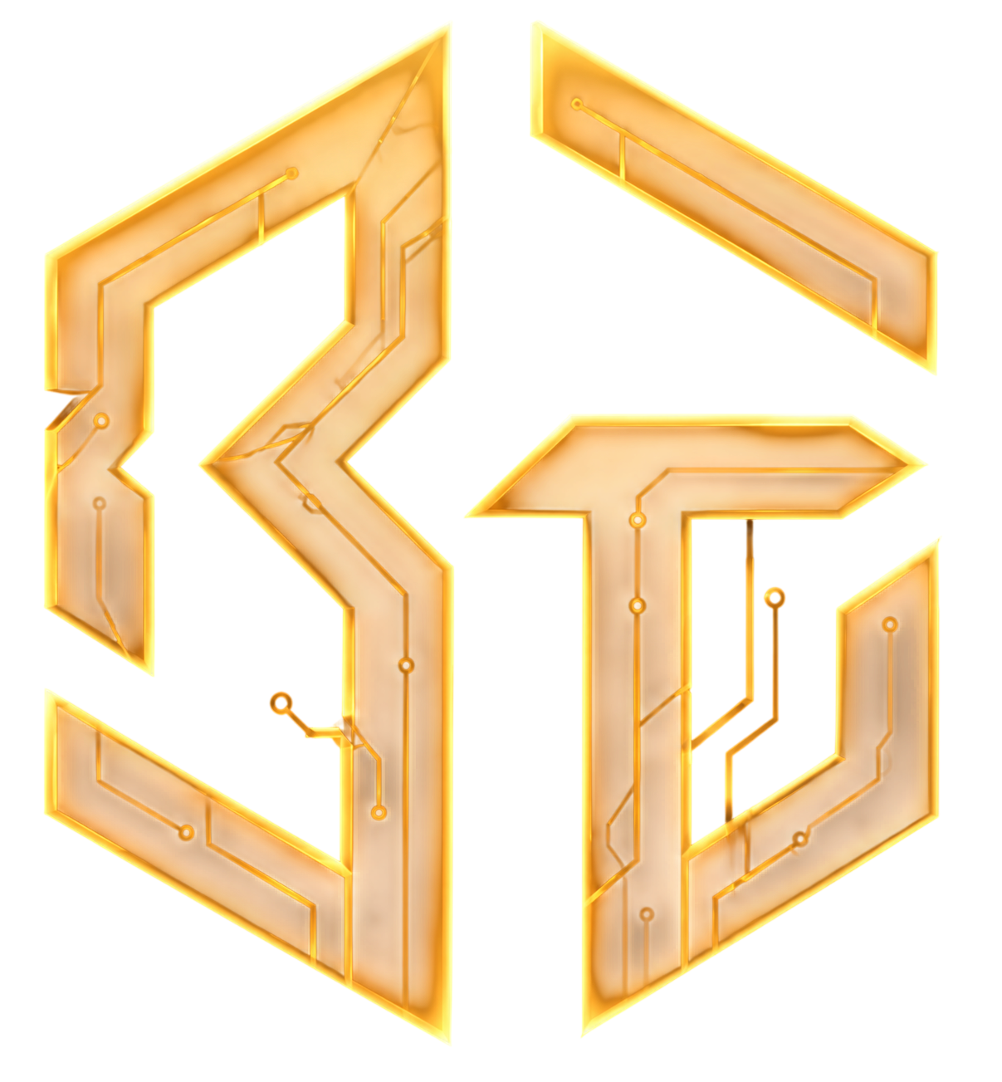
COMPANY PROFILE · 2026
Bolter
Technologies
We build software that works, and we stand behind it.
ESTABLISHED
HEADQUARTERS
WEBSITE
CONTACT
2024
Islamabad, Pakistan
boltertech.com
contact@boltertech.com

Slide 2
01 COMPANY OVERVIEW
Company Overview
Bolter Technologies is a Pakistan-based software and technology company headquartered in Islamabad, serving businesses and enterprise clients. Our work spans AI, automation, software development, data analytics, and cybersecurity, with a focus on technology that supports real business and operational needs.
Bolter is a relatively young company, but our senior team brings experience from established businesses and long-running projects. We are a sister company of Sigma Engineering, in business since 2008, giving us a broad business and technical foundation.
Our company is built around a simple idea: technology should make life easier for everyone. We work across numerous fields of technology, helping businesses turn ideas, inefficient processes, and complex data into practical systems that actually work.
LEGAL NAME
Bolter Technologies Private Limited
GROUP OF COMPANIES
Sigma Engineering
INDUSTRY
IT Services and IT Consulting
CORE FIELDS
AI · Automation · Software · Data · Cyber Security
CLIENT FOCUS
B2B & Enterprise
HEADQUARTERS
Islamabad, Pakistan
BOLTER TECHNOLOGIES PRIVATE LIMITED · COMPANY PROFILE
02 / 30

Slide 3
02 COMPANY OVERVIEW
Company Overview
Bolter Technologies Private Limited is a Pakistan-based software and technology company headquartered in Islamabad, serving businesses and enterprise clients. Our work spans artificial intelligence, automation, software development, data analytics, and cybersecurity, with a focus on technology that supports real business and operational needs.
Bolter is a relatively young company, but our senior team brings experience from established businesses and long-running projects. We are a sister company of Sigma Engineering, in business since 2008, and Sigma Technologies, giving us a broader business and technical foundation than our own age suggests.
Today, Bolter operates across a broad range of technology requirements, working with organisations that need software, data, AI, automation, or security as part of their business. Our clients are primarily B2B and enterprise organisations, and our work ranges from individual technology projects to larger systems built around specific business requirements.
WE RUN THE TECHNOLOGY FOR
Sigma Engineering
SISTER COMPANY, ESTABLISHED 2008
Berkeley Technology
LONG-TERM CLIENT
Logmate Engineering and Services
LONG-TERM CLIENT
BOLTER TECHNOLOGIES PRIVATE LIMITED · COMPANY PROFILE
03 / 33

Slide 4
03 VISION & DIRECTION
Vision & Direction
VISION
Technology that makes work simpler for every business we serve.
MISSION
Build systems that fit how clients operate and keep working long after launch.
DIRECTION
Grow from Islamabad into a technology partner for businesses across the globe.
“
We start with what the customer needs and work backwards.
“
Jeff Bezos
FOUNDER, AMAZON
BOLTER TECHNOLOGIES PRIVATE LIMITED · COMPANY PROFILE
03 / 30

Slide 5
04 PEOPLE
Leadership
TM
CEO
MH
COO
MS
CTO
Tariq Mehmood
Muhammad Hamza Javaid
Muhammad Sadiq Raza
27 years in business and operations
Delivery and client engagements
Software architecture and engineering
Tariq leads Bolter’s vision, strategy, partnerships, and growth.
Hamza runs Bolter’s day-to-day delivery: scoping client engagements and keeping every project on schedule.
Sadiq leads software architecture, development, integrations, and technical delivery.
ceo@boltertech.com
coo@boltertech.com
linkedin.com/in/HamzaJBandesha
cto@boltertech.com
linkedin.com/in/blackstarin
BOLTER TECHNOLOGIES PRIVATE LIMITED · COMPANY PROFILE
04 / 30

Slide 6
04 PEOPLE
Senior team
Bolter is a young company staffed by people who are not. Our senior engineers and directors come out of telecom, enterprise software and Sigma Engineering, where most of them have spent their careers.
Muhammad Naeem
Bilal Ahmed
Hina Rauf
DIRECTOR · TELECOM
LEAD ENGINEER · SOFTWARE DELIVERY
DATA LEAD · DATA AND ANALYTICS
25 years
12 years
10 years
Naaim has spent twenty-five years in the telecom industry. He advises on the network and carrier side of our work and opens the doors that come with that long in one industry.
Bilal has built enterprise software for twelve years. He leads the build on client projects and reviews what the team ships before a client sees it.
Hina has worked on data systems for ten years, most of it in reporting and analytics for large operations. She owns the data side of our projects, from the pipelines to the dashboards people actually open.
BOLTER TECHNOLOGIES PRIVATE LIMITED · COMPANY PROFILE
06 / 33

Slide 7
05 CAPABILITIES
Capabilities
Our Clients brought us a problem they couldn't solve in-house.
Each case study that follows sets out what was wrong, what we built and what changed.
Find the one that looks like yours.
01
AI and business automation
04
LEAD PRACTICE
CASE STUDIES
03
Software development
03
CASE STUDIES
04
Data analytics
04
CASE STUDIES
05
Cyber security
04
CASE STUDIES
BOLTER TECHNOLOGIES PRIVATE LIMITED · COMPANY PROFILE
05 / 30

Slide 8
05 CAPABILITIES · 01 / 04
AI and business automation
LEAD PRACTICE
HOW WE HELP
Most offices have a job someone does by hand every day: copying numbers between two systems, chasing an approval, sending the same report every Monday. We find those jobs, build software that does them, and leave people in charge of the decisions that need judgement.
01
Automate repetitive work that takes up your team's time
02
Replace manual handoffs between people, spreadsheets, and systems
03
Connect the software your business already relies on
CASE STUDIES THAT FOLLOW
04
Create custom applications around your team's actual workflows
Current by Logmate
Cortex Strike
EchoHunt
RetinaScan AI
05
Use AI where it can handle work that previously required a person
06
Keep the system running, maintained, and supported after it goes live
BOLTER TECHNOLOGIES PRIVATE LIMITED · COMPANY PROFILE
06 / 30

Slide 9
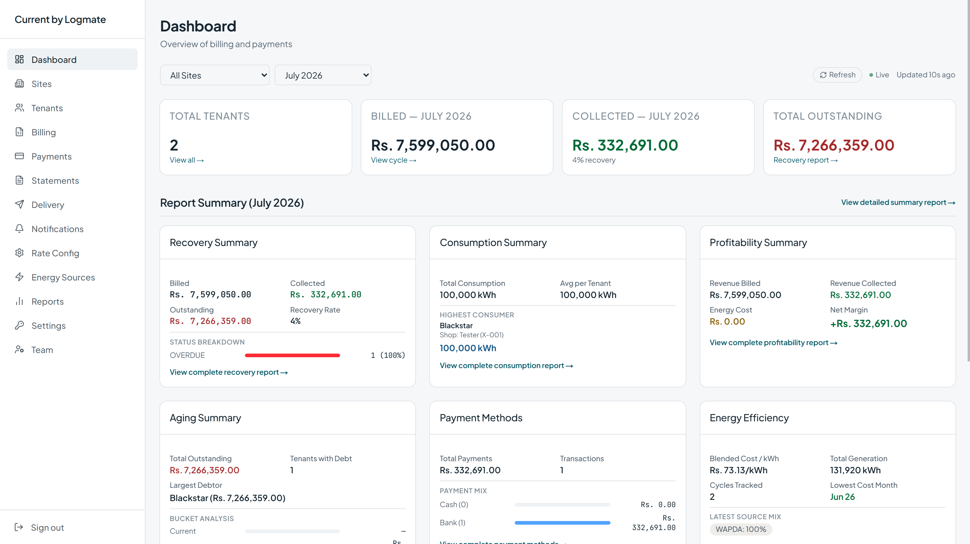
05 AI AND BUSINESS AUTOMATION · CASE STUDY 01 / 04
Current by Logmate
Billing and recovery platform
LOGMATE ENGINEERING AND SERVICES · 2026 · 13 WEEKS · ONGOING
THE PROBLEM
Billing electricity accurately for a commercial mall with over 250 tenants across multiple sites is a moving target every single month. Every unit sits on a different consumption tier, every bill has to reach the right tenant through the right channel, and every incoming payment has to be tracked down and matched to the right account before anyone can say who has paid and who has not. On top of that, ownership needs clean recovery and profitability numbers every month.
250+
100%
WHAT CHANGED
tenant accounts billed automatically every month
of bills calculated, generated and delivered without manual entry
The mall runs its entire monthly billing and collections cycle end to end, across every site it operates. Tenants receive accurate, on-time bills through the channels they actually check, overdue accounts are caught and escalated without anyone chasing them, and the business gets ready-to-use recovery and profitability reporting each month instead of assembling it by hand.
~70%
24/7
less manual effort spent on billing and reconciliation
automated bank payment reconciliation
BOLTER TECHNOLOGIES PRIVATE LIMITED · COMPANY PROFILE
07 / 30

Slide 10
05 CAPABILITIES · 02 / 05
AI solutions
AI is worth paying for when it takes real work off people. We start with the job you want done, pick the model that does it, and build the checks that keep the answers honest. If AI is the wrong tool for a job, we say so.
HOW WE HELP
01
Read and sort documents: invoices, forms, contracts, reports
02
Answer questions from your own files and data, with the source shown
CASE STUDIES THAT FOLLOW
Cortex Strike
EchoHunt
RetinaScan AI
03
Assistants that do one specific job inside software your team already uses
04
Test the output against real examples before it goes live, then keep watching it
05
Run it on your own servers when the data cannot leave the building
06
Agents that carry out multi-step work and keep a record of every step
BOLTER TECHNOLOGIES PRIVATE LIMITED · COMPANY PROFILE
10 / 33

Slide 11
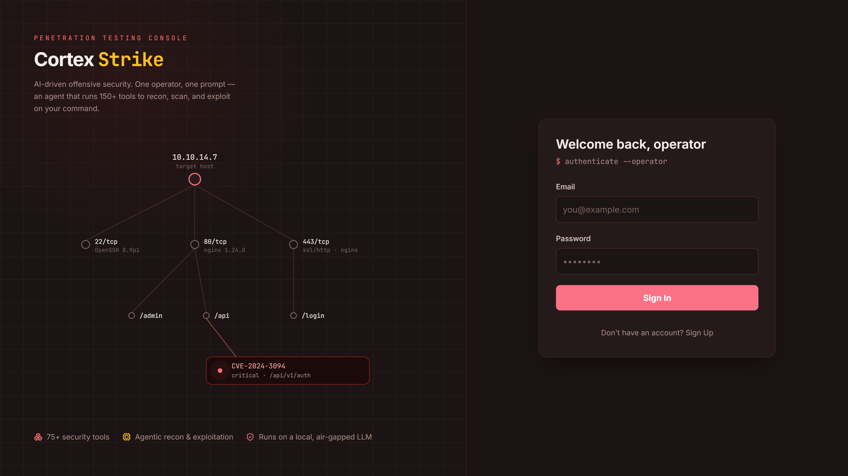
05 AI SOLUTIONS · CASE STUDY 02 / 04
Cortex Strike
Autonomous penetration testing agent
GOVERNMENT AND CRITICAL INFRASTRUCTURE — NAME WITHHELD · 2026 · 1 YEAR · DELIVERED
THE PROBLEM
Running a real penetration test means operating dozens of separate command-line tools by hand — a network scanner here, a web fuzzer there, a credential tester somewhere else — then manually correlating everything each one turns up before a single finding can be written down.
WHAT CHANGED
90+
24+ hrs
Operators run full, multi-tool security assessments through a single guided conversation, with the agent actively helping interpret findings, connect signals and steer the assessment as it unfolds. Instead of juggling tools and outputs, the platform turns raw security data into actionable insight while capturing findings, tool output and reports on its own.
security tools an operator can run through one AI-guided conversation
longest autonomous assessment run without operator intervention
20%
better results than the same tools driven by hand
BOLTER TECHNOLOGIES PRIVATE LIMITED · COMPANY PROFILE
08 / 30

Slide 12
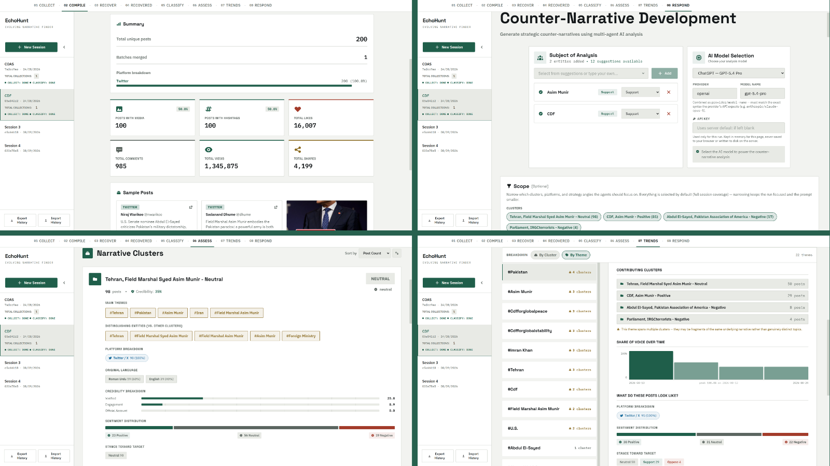
05 AI SOLUTIONS · CASE STUDY 03 / 04
EchoHunt
Digital discourse monitoring
GOVERNMENT AND PUBLIC SECTOR COMMUNICATIONS — NAME WITHHELD · 2025 · 10 MONTHS · DELIVERED
THE PROBLEM
Narratives move fast across social media, and by the time a harmful or misleading story is obvious to a communications team, it has often already spread across multiple platforms and languages. Manually tracking thousands of posts across Twitter, Instagram, YouTube and Facebook — in multiple languages, including text baked into images and spoken in videos — is not something a human team can do at scale or in real time.
180,000+
4
WHAT CHANGED
posts collected, enriched and analysed
platforms monitored at once — Twitter, Instagram, YouTube, Facebook
Communications and analyst teams get one workflow in place of hours of manual, multi-platform monitoring: scrape, enrich, detect, review, respond. Instead of discovering a narrative after it has already spread and then starting a response cold, they see narratives ranked by real credibility and influence signals and receive a drafted, platform-specific strategy they can act on immediately.
100%
of the core pipeline runs on local infrastructure, no cloud required
BOLTER TECHNOLOGIES PRIVATE LIMITED · COMPANY PROFILE
09 / 30

Slide 13
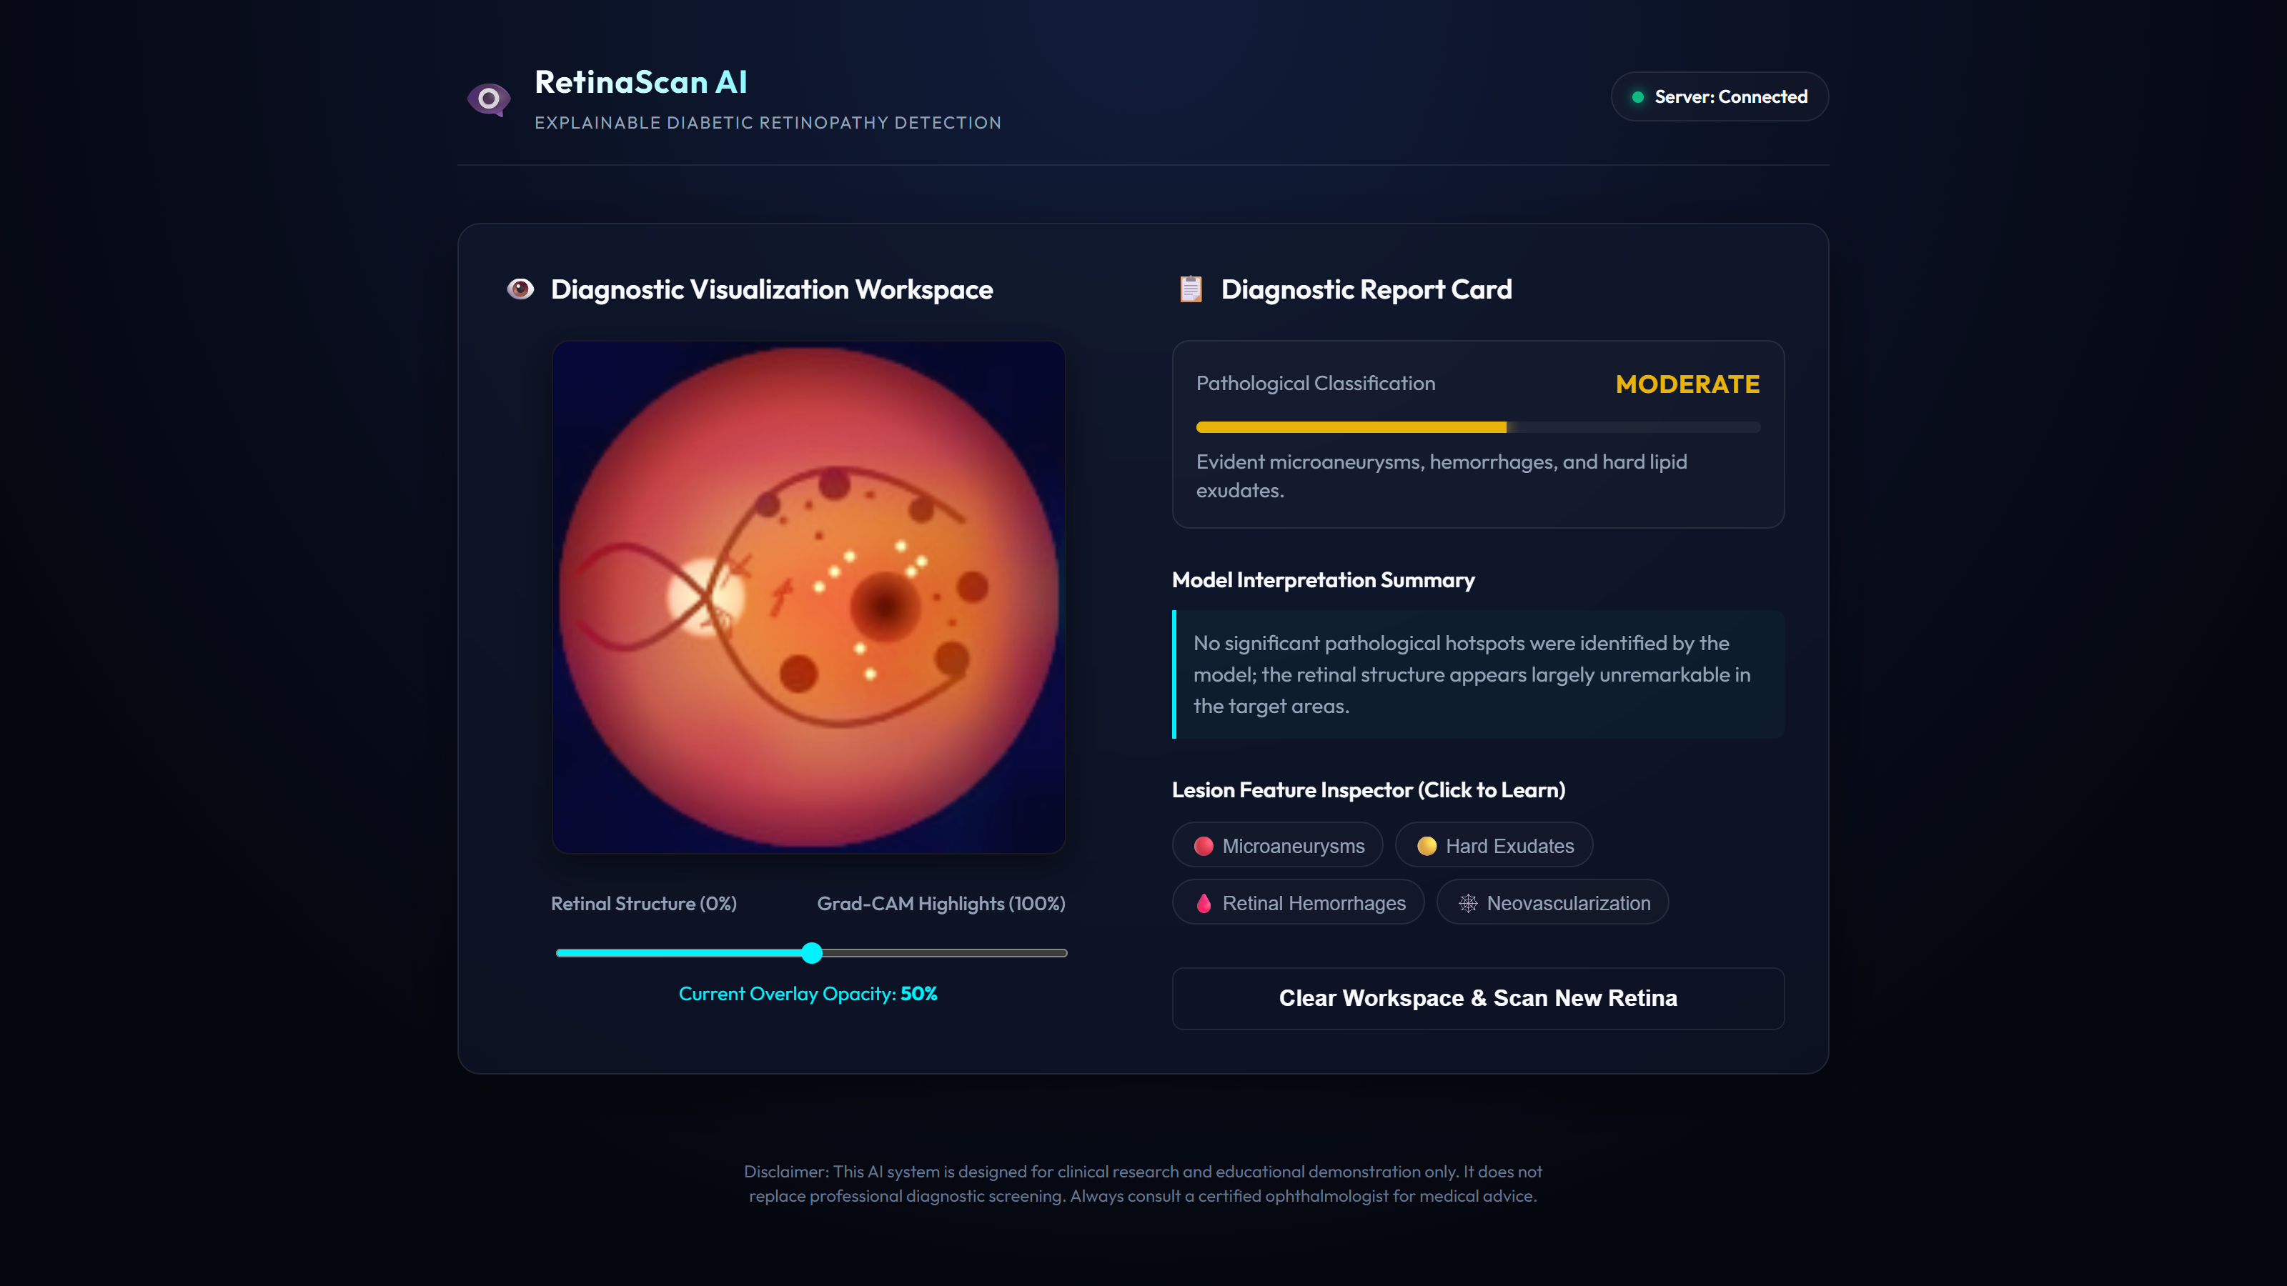
05 AI SOLUTIONS · CASE STUDY 04 / 04
RetinaScan AI
Explainable diabetic retinopathy screening
IN-HOUSE PRODUCT · 2026 · 5 MONTHS · DELIVERED
THE PROBLEM
Diabetic retinopathy is one of the leading causes of preventable blindness in working-age adults, and it is entirely manageable when caught early. The problem is catching it. Screening depends on a specialist reading a retinal photo and judging where it falls across five stages of severity, from no disease to sight-threatening proliferative disease.
5
4
WHAT CHANGED
An inspectable alternative to black-box DR screening: one photo in, a severity read and a visual, plain-language explanation out. Rather than trusting a single number, a viewer can see which part of the retina drove the classification and what clinical feature it corresponds to — which is the gap between "the model said so" and "here is the evidence."
DR severity stages classified per scan, healthy to proliferative
clinical findings flagged and explained per scan
30,657
<5s
labelled fundus images used to train the diagnostic model
from image upload to full diagnostic report
BOLTER TECHNOLOGIES PRIVATE LIMITED · COMPANY PROFILE
10 / 30

Slide 14
05 CAPABILITIES · 02 / 04
Software development
The software a business actually runs on: the product its customers use, the internal systems its teams rely on every day, and the spreadsheet that has somehow been holding an entire department together for the last six years. We build the tools that make that work easier, more reliable, and less dependent on someone remembering exactly how everything works.
HOW WE HELP
01
Web applications, customer portals and internal systems
02
Replace spreadsheets and manual trackers with something built for the job
03
Connect to what you already use: accounting, CRM, payments, email, WhatsApp
CASE STUDIES THAT FOLLOW
LTE Trove
PSX Portfolio Tracker
Zenith
04
Extend and repair software you already own instead of starting again
05
Logins, permissions, payments, notifications and the workflow behind them
06
Put it live, watch it, and hand over documentation your team can work from
BOLTER TECHNOLOGIES PRIVATE LIMITED · COMPANY PROFILE
11 / 30

Slide 15
05 SOFTWARE DEVELOPMENT · CASE STUDY 01 / 03
98 → 5
-95%
LAB SETUP & 3GPP REGRESSION TEST DURATION (HOURS)
LTE Trove
Virtual 4G network lab
TELECOMMUNICATIONS — NAME WITHHELD · 2026 · 6 MONTHS · DELIVERED
THE PROBLEM
Testing and validating cellular network protocols traditionally requires dedicated RF testbenches, physical eNodeB base stations, software-defined radios, RF shielding enclosures and programmable USIM cards — tens of thousands of dollars per bench. Physical test rigs create constant contention across engineering teams, introduce hardware misconfigurations that are difficult to isolate, and demand hours of manual wiring and flashing just to test a single core configuration or handover scenario.
100%
< 3 min
software-defined RF simulation, no physical hardware dependency
to provision and orchestrate a full multi-node virtual EPC and RAN
WHAT CHANGED
The dependency on specialised lab hardware is gone: complete, isolated 4G LTE networks now spin up on standard compute workstations and in CI. Protocol engineers configure multi-eNodeB topologies, simulate subscriber authentication, execute X2 handovers and verify end-to-end data session flows through automated suites in minutes rather than days.
7
automated 3GPP milestone verification suites, M1 to M7
BOLTER TECHNOLOGIES PRIVATE LIMITED · COMPANY PROFILE
12 / 30

Slide 16
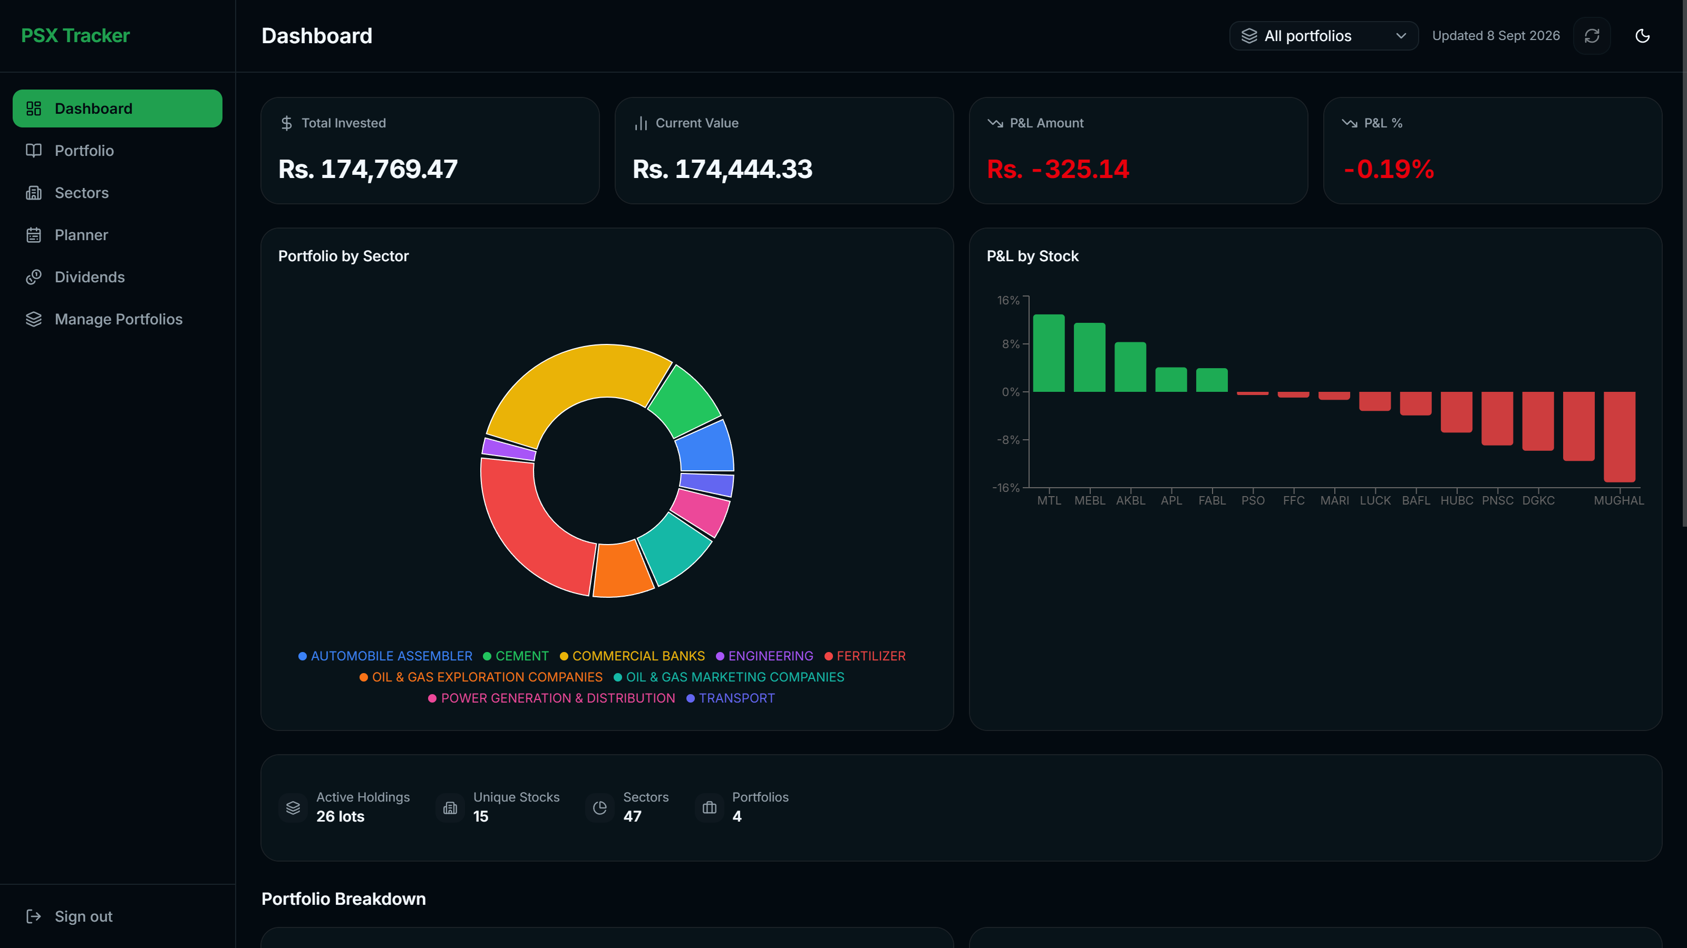
05 SOFTWARE DEVELOPMENT · CASE STUDY 02 / 03
PSX Portfolio Tracker
Live tracking for the Pakistan Stock Exchange
IN-HOUSE PRODUCT · 2026 · 10 WEEKS · LIVE
THE PROBLEM
Tracking a portfolio of Pakistan Stock Exchange holdings usually means working around whatever the broker gives you. Broker platforms are built for placing trades, not for understanding a portfolio afterwards: the record of what was bought, when, and at what price is often thin or hard to find, dividend history is rarely tracked at all, and there is no view of how money is split across sectors or how a stop-loss level compares to where a stock is trading right now.
700+
15-min
WHAT CHANGED
PSX-listed stocks tracked with live pricing
price refresh cycle for near real-time market data
Everything that used to mean toggling between a broker app and a stack of old emails now lives in one live dashboard: current holdings and P&L, a real buy and sell history, dividend income, sector allocation against target, and a clear monthly plan for new investment. Stop-loss levels are calculated for every holding without manual math, and drilling into a single stock's full trading history takes one click instead of an inbox search.
-75%
10x
less manual effort tracking prices, dividends and performance by hand
faster portfolio check-ins than digging through broker records and email
BOLTER TECHNOLOGIES PRIVATE LIMITED · COMPANY PROFILE
13 / 30

Slide 17
05 SOFTWARE DEVELOPMENT · CASE STUDY 03 / 03
95 → 9
-91%
TIME SPENT NAVIGATING CLUTTER & LOADING CHAPTERS (RELATIVE INDEX)
Zenith
A reading platform for serialised web fiction
IN-HOUSE PRODUCT · 2025 · 4 MONTHS · DELIVERED
THE PROBLEM
Readers who follow serialised web fiction end up managing sprawling libraries — hundreds of ongoing titles and tens of thousands of chapters, all on a single ad-heavy site with inconsistent formatting and no way to organise anything. Tracking what has been read, picking back up where you left off, and grouping a library by genre or priority are simply not options there. Nothing treats a personal reading library as a library rather than a stream of individual novels.
200+
10,000+
WHAT CHANGED
novels imported and organised from a single library export
chapters scraped, formatted and made available offline
An entire library in one place: imported in a single step, kept organised with categories and tags, and readable offline in a clean, consistent format with none of the original site's clutter. Library and reading progress carry across the web app and the Android build, with text-to-speech built in for hands-free reading.
-80%
3
less time spent on ads and page loads before reaching a chapter
ways to organize your library for easier storage
BOLTER TECHNOLOGIES PRIVATE LIMITED · COMPANY PROFILE
14 / 30

Slide 18
05 CAPABILITIES · 03 / 04
Data analytics
Most companies already have the data they need. They are spread across systems that do not talk to each other, so answering a simple question means deriving it from the ground up. We ensure that you are in complete control of your company.
HOW WE HELP
01
Get data out of the systems it is stuck in, and clean it up
02
One dashboard for the numbers you check daily, built around your questions
03
Reports that build themselves instead of someone assembling them every Monday
CASE STUDIES THAT FOLLOW
DCAS
PKNVD
Enterprise Omnichannel Media & Social Analytics Platform
Enterprise Real-Time Website Analysis Dashboard
04
Match records across systems that spell the same customer four different ways
05
Forecasting and early warnings where the data actually supports them
06
Checks that flag a wrong number before anyone makes a decision on it
BOLTER TECHNOLOGIES PRIVATE LIMITED · COMPANY PROFILE
15 / 30

Slide 19
05 DATA ANALYTICS · CASE STUDY 01 / 04
95 → 8
-92%
CROSS-DATABASE RECORD LINKAGE PROCESSING TIME (HOURS)
DCAS
Data correlation and entity resolution
DATA INTELLIGENCE AND ANALYTICS — NAME WITHHELD · 2026 · 6 WEEKS · DELIVERED
THE PROBLEM
Analysts and intelligence teams routinely work against fragmented data silos: internal databases, customer registries, transaction logs, external communication records. Each dataset follows different schema conventions, lacks standardised formatting — inconsistent phone numbers, partial names, typos, alias variations — and runs to millions of rows.
WHAT CHANGED
99.8%
10x
Days of manual spreadsheet lookups and brittle one-off scripts collapsed into an automated correlation workflow with visible progress. Analysts can watch a run resolve linkages across massive datasets in real time, then export verified match clusters and audit-ready reports directly to stakeholders.
entity resolution precision across dirty and unstructured records
faster cross-database correlation than manual spreadsheet lookups
0 sec
UI freeze during multi-million record runs, via streamed progress
BOLTER TECHNOLOGIES PRIVATE LIMITED · COMPANY PROFILE
16 / 30

Slide 20
05 DATA ANALYTICS · CASE STUDY 02 / 04
88 → 8
-91%
VULNERABILITY ADVISORY TRIAGE TIME (MINUTES)
PKNVD
National vulnerability database
PUBLIC SECTOR CYBERSECURITY — NAME WITHHELD · 2026 · 9 WEEKS · DELIVERED
THE PROBLEM
Security teams and national CERTs face thousands of new CVEs every month. Relying on base CVSS severity alone leaves analysts in the dark: a theoretical CVSS 9.8 flaw with no known exploit monopolises an emergency patching cycle while an actively weaponised CVSS 7.5 vulnerability goes unnoticed.
WHAT CHANGED
200,000+
< 50ms
Security teams can isolate the vulnerabilities that have working public exploit code in a single click, rather than reconstructing that picture across several browser tabs. Contextual severity scoring — exploited in the wild, not merely theoretically severe — is what changes patch prioritisation, and it is now the default view rather than a manual research task.
CVE records indexed and cross-referenced with exploit registries
multi-facet query response across the full vulnerability catalogue
100%
automated weaponisation tracking across CISA KEV and public exploit sources
BOLTER TECHNOLOGIES PRIVATE LIMITED · COMPANY PROFILE
17 / 30

Slide 21
05 DATA ANALYTICS · CASE STUDY 03 / 04
94 → 10
-89%
WEEKLY MANUAL REPORTING & CONSOLIDATION EFFORT (HOURS)
Enterprise Omnichannel Media & Social Analytics Platform
DIGITAL MEDIA, PUBLISHING & BROADCAST TELECOMMUNICATIONS — NAME WITHHELD · 2025 · 9 WEEKS · DELIVERED
THE PROBLEM
High-volume digital publishing networks and regional broadcasting outlets distribute hundreds of news stories daily across a sprawling network of digital channels, including X (Twitter), Facebook, YouTube, Instagram, TikTok, Threads, WhatsApp Channels, and web portals.
WHAT CHANGED
90%
<300ms
Editorial and marketing teams eliminated manual spreadsheet consolidation, collapsing a recurring multi-hour reporting chore into a live view they can open on demand. The unified eight-channel dashboard gives newsroom directors instant visibility into audience engagement dynamics, enabling immediate editorial pivots, content amplification, and clear cross-network performance benchmarking.
reduction in weekly manual reporting and CSV consolidation overhead
query execution time for multi-year aggregated cross-platform analytics
8 Channels
2 Languages
unified into a single real-time executive dashboard
native bilingual support (English & Urdu) across editorial workflows
BOLTER TECHNOLOGIES PRIVATE LIMITED · COMPANY PROFILE
18 / 30

Slide 22
05 DATA ANALYTICS · CASE STUDY 04 / 04
90 → 8
-91%
DOMAIN AUDIT & OSINT COMPILATION TURNAROUND (MINUTES)
Enterprise Real-Time Website Analysis Dashboard
OPEN-SOURCE INTELLIGENCE (OSINT) & CYBERSECURITY ANALYTICS — NAME WITHHELD · 2024 · 6 WEEKS · DELIVERED
THE PROBLEM
Cybersecurity analysts, OSINT researchers, and digital intelligence teams routinely audit target domains to evaluate infrastructure footprints, traffic patterns, hosting jurisdictions, and visual website configurations. Historically, investigators were forced to switch between 4–5 disconnected utilities to compile WHOIS ownership records, monthly visitor volumes, bounce rates, server geolocation, and responsive layouts.
85%
<100ms
WHAT CHANGED
reduction in domain audit and OSINT triage turnaround time
UI state transition and dashboard render latency
Analysts consolidated multi-step manual lookup routines into a single three-second query workflow, eliminating tool sprawl and accelerating domain risk evaluations. The unified dashboard provides complete multi-device layout visibility without local browser exposure, while sub-second page transitions and concurrent rendering provide the responsiveness required for fast-paced digital intelligence operations.
100%
5 to 1
multi-device viewport inspection coverage without local endpoint risk
tool consolidation into a single unified intelligence console
BOLTER TECHNOLOGIES PRIVATE LIMITED · COMPANY PROFILE
19 / 30

Slide 23
05 CAPABILITIES · 04 / 04
Cyber security
Security is not something you add after the software is built. We build systems that keep sensitive information under control from the start. That includes secure messaging and collaboration platforms, endpoint protection, EDR and SIEM systems, threat intelligence, and offensive and defensive security testing. We help businesses control who can access data, detect when something goes wrong, investigate what happened, and test their defences before someone else does.
HOW WE HELP
01
Penetration testing of applications and infrastructure, with a report your team can act on
02
Find what you have exposed to the internet and forgotten about
03
Protect sensitive data with access controls, encryption, and secure communication systems
04
Secure employee endpoints and control what data can leave the organisation
CASE STUDIES THAT FOLLOW
Bolter SIEM
Enterprise Cyber Complaint & Content Governance Dashboard
Threat Intelligence and Adversary Tracking Platform
Secure End-to-End Encrypted Company Chatbot
05
Compliance and complaint systems with a full audit trail behind them
06
Review code and design for security problems before something ships
BOLTER TECHNOLOGIES PRIVATE LIMITED · COMPANY PROFILE
20 / 30

Slide 24
05 CYBER SECURITY · CASE STUDY 01 / 04
88 → 19
-78%
MEAN TIME TO INVESTIGATE INCIDENT (MINUTES)
Bolter SIEM
SOC monitoring and UEBA analytics
IN-HOUSE PRODUCT · 2025 · 8 MONTHS · DELIVERED
THE PROBLEM
Modern security operations centres are buried under millions of event logs from firewalls, Windows event logs, Linux syslogs and endpoint agents. Traditional SIEM interfaces lag under that volume, suffer severe alert fatigue, and lack coherent entity resolution — often conflating service accounts and high-traffic file servers with rogue human behaviour in UEBA leaderboards.
1,000,000+
~65%
WHAT CHANGED
Analysts investigate roughly three times faster, working from zero-navigation forensic drawers and unified asset timelines rather than reassembling a device's history by hand across duplicate records. The segregated UEBA engine cut behavioural noise by about 40%, so responders spend their attention on genuine threats instead of benign automated workloads.
security events indexed and queryable per second
reduction in mean time to detect via live detection streams
100%
device identity unification across multi-agent telemetry sources
BOLTER TECHNOLOGIES PRIVATE LIMITED · COMPANY PROFILE
21 / 30

Slide 25
05 CYBER SECURITY · CASE STUDY 02 / 04
92 → 9
-90%
COMPLAINT TURNAROUND TIME (HOURS)
Enterprise Cyber Complaint & Content Governance Dashboard
TELECOMMUNICATIONS & CYBER REGULATORY GOVERNANCE — NAME WITHHELD · 2024 · 8 WEEKS · DELIVERED
THE PROBLEM
Regulatory compliance teams and cyber governance bodies handle high volumes of reported URLs, impersonation claims, hate speech, and unlawful digital content across major social media networks, including X/Twitter, Facebook, YouTube, TikTok, and Instagram. Previously, compliance teams relied on fragmented spreadsheets, manual status logging, and ad-hoc evidence retention.
90%
100%
WHAT CHANGED
Regulatory analysts replaced disparate spreadsheets and manual handoffs with a unified, real-time command dashboard. Executive leadership gained instant transparency into platform compliance distributions, monthly enforcement velocity, and removed-reach metrics. The platform established an unbroken, tamper-proof evidentiary audit trail while providing fast analytical reporting and zero-downtime reliability for mission-critical regulatory monitoring.
reduction in complaint processing and administrative turnaround time
audit readiness and tamper-proof evidence archiving on Azure
1,095+
<1s
violating content items and accounts tracked and resolved
real-time alert latency across analyst consoles
BOLTER TECHNOLOGIES PRIVATE LIMITED · COMPANY PROFILE
22 / 30

Slide 26
05 CYBER SECURITY · CASE STUDY 03 / 04
90 → 11
-88%
INDICATOR TRIAGE & CORRELATION LATENCY (MINUTES)
Threat intelligence and adversary tracking platform
CYBERSECURITY AND DEFENCE — NAME WITHHELD · 2025 · 8 MONTHS · DELIVERED
THE PROBLEM
Enterprise security operations centres and threat hunting teams are inundated with disconnected feeds of IP addresses, domain names, file hashes and malware signatures. Manually pulling from dozens of open-source and proprietary threat lists leaves analysts drowning in false positives and stale data, with no automated way to connect an isolated malicious IP to an active threat actor campaign, a known malware family, or the MITRE ATT&CK techniques being leveraged.
80+
50,000+
WHAT CHANGED
OSINT, STIX/TAXII and commercial feeds ingested automatically
indicators of compromise normalised and scored every day
Raw, noisy threat feeds became an organised, actionable intelligence hub. Analysts replaced hours of manual indicator cross-referencing with automated risk scoring and instant campaign context, cutting triage time sharply. Security teams gain immediate visibility into global adversary activity, high-risk emerging indicators and relevant countermeasures from a single high-density command centre rather than a dozen browser tabs.
3D
geospatial command centre for real-time adversary tracking
BOLTER TECHNOLOGIES PRIVATE LIMITED · COMPANY PROFILE
23 / 30

Slide 27
05 CYBER SECURITY · CASE STUDY 04 / 04
42 → 2
-95%
TIME TO FIND AN INTERNAL ANSWER (MINUTES)
Secure End-to-End Encrypted Company Chatbot
PROFESSIONAL SERVICES — LOGMATE / DEVTROVE / SIGMA · 2026 · 3 MONTHS · DELIVERED
THE PROBLEM
Company knowledge was spread across shared drives, email threads, wikis, chat history and file servers, in every format from scanned PDFs to recorded training videos. Staff lost hours searching or asking colleagues, and new hires took months to learn where things lived. Public AI assistants were ruled out: sending confidential files to an outside model broke data policy, and none of them could respect who is allowed to see what.
400K+
5
WHAT CHANGED
documents, images, videos and PDFs indexed and searchable
access tiers checked on every question before an answer is drawn
Every document, image, video and PDF now sits in one encrypted company brain that staff question in plain language. Conversations are encrypted end to end, and role-based access is checked before any answer is written, so an analyst and a director asking the same question each get an answer drawn only from what they are cleared to see. Every answer cites its source files, and every query is logged for audit.
E2E
encryption from the employee's device to the knowledge store
BOLTER TECHNOLOGIES PRIVATE LIMITED · COMPANY PROFILE
24 / 30

Slide 28
06 CLIENTS
In our clients' words
CURRENT BY LOGMATE
ENTERPRISE CYBER COMPLAINT & CONTENT GOVERNANCE DASHBOARD
“This product has effectively reduced our workload by three quarters.”
“Boltertech delivered an enterprise platform that transformed our compliance monitoring capabilities. The combination of real-time data visualizations, cloud evidence storage, and automated reporting has given our team unprecedented control and clarity over digital content governance.”
Hamid Mehmood
Hasib Ahmad
DIRECTOR, LOGMATE
TEAM LEAD, DEVTROVE
ENTERPRISE OMNICHANNEL MEDIA & SOCIAL ANALYTICS PLATFORM
ENTERPRISE REAL-TIME WEBSITE ANALYSIS DASHBOARD
“Bolter Tech delivered a tailored solution that completely transformed how our newsroom and marketing teams track audience engagement. Having our 8 major channels reporting real-time metrics in a single, high-speed dashboard has significantly improved our decision-making speed.”
“BolterTech transformed our website evaluation workflow into a seamless, single-pane-of-glass dashboard. Their expertise in modern React architectures and intuitive SOC design made this project an outstanding success.”
Fayyaz Siddiqui
Asif Usman
MEDIA NETWORK DIRECTOR, CSCCC
LEAD SECURITY & OSINT ANALYST, TENBYTES
BOLTER TECHNOLOGIES PRIVATE LIMITED · COMPANY PROFILE
25 / 30

Slide 29
07 METHOD
PROJECT COST ESTIMATOR
How we work
Know what you're building before you build it.
Explore the features you need and get an early view of scope, timeline and cost. Indicative, not a quote.
OPEN ESTIMATOR →
01
02
03
04
Discovery
Plan & Scope
Build & Deliver
Handover & Support
We start by understanding what you need the software to do and how the work happens today. We define the features, scope, requirements, and technical approach before we start. Use our website’s cost estimator to work through your requirements and get a clearer picture of what you need.
We turn the requirements into a clear plan with defined deliverables, timelines, and pricing. For phased projects, each phase has an agreed scope and cost, with assumptions and uncertainties made clear from the start.
We build the solution in practical stages and show you working progress along the way. You stay involved throughout the process, so feedback can be addressed early rather than waiting until everything is finished.
Once the project is delivered, we provide the necessary documentation, access, and handover so your team can use and manage the solution confidently. If you need ongoing maintenance, improvements, automation, analytics, or technical support, we can continue through an ongoing support arrangement.
BOLTER TECHNOLOGIES PRIVATE LIMITED · COMPANY PROFILE
26 / 30

Slide 30
07 ENGAGEMENT MODELS
How you can engage us
START YOUR JOURNEY HERE
MOST COMMON
AFTER LAUNCH
Discovery & Planning
Build & Deliver
Ongoing Support
From a small task that simply needs to get done to a complete software, AI automation, or data analytics solution, we build what your business needs and take it through to delivery. We work in clear phases with defined deliverables, keeping you involved throughout development while handling the technical work from start to finish. This is the right fit when you have a project that needs to be built, improved, automated, or brought to life.
Some solutions need more than a one-time delivery. We stay involved to maintain, improve, monitor, automate, and support your digital systems over time, whether that means ongoing software development, AI automation, data analytics, digital marketing, or operational support. This is ideal for businesses that need a reliable technology partner without building a full in-house team.
Not sure where to start, or have an idea that needs to be shaped into a practical solution? We work with you to understand the problem, define what needs to be built, identify the right technology and approach, and create a clear plan for execution. This is ideal for larger or more complex projects where getting the direction right before development can save time and cost.
TERMS
TERMS
TERMS
Typically 1–2 weeks, priced according to project requirements.
Priced per project, with larger engagements structured into clear delivery phases.
Monthly retainer, with scope and support level agreed based on ongoing requirements.
BOLTER TECHNOLOGIES PRIVATE LIMITED · COMPANY PROFILE
27 / 30

Slide 31
07 WHAT YOU GET
What we commit to in writing
01
02
03
04
A dedicated point of contact
Clear pricing by phase
You own what we build
Support beyond delivery
You will have a clear point of contact throughout the project who understands your requirements, decisions, and progress. You will always know who to speak to when you have a question, need an update, or want to make a decision.
Before each phase begins, you will know what we are delivering, what it will cost, and what assumptions the price is based on. If a change affects the scope, timeline, or cost, we will discuss and agree it with you before carrying out the additional work.
The software, designs, documentation, and project deliverables created specifically for you belong to you, subject to the terms agreed in your contract. We will provide the access and documentation you need to operate, maintain, and continue developing your solution.
Our involvement does not have to end when the project goes live. We provide a proper handover and can continue supporting, maintaining, improving, and expanding your solution through an ongoing support arrangement when your business needs it, with 3 months of guaranteed support.
BOLTER TECHNOLOGIES PRIVATE LIMITED · COMPANY PROFILE
28 / 30

Slide 32
07 WORKING TOGETHER
Questions we get asked
Who owns the code and the intellectual property?
What timezone overlap do we actually get?
You do, on final payment, in full. That includes the source, the infrastructure definitions, and the documentation. We keep no licence over your systems and we do not reuse client code in other engagements.
We operate in UTC+5. That is a full working morning overlapping Europe and an afternoon overlapping the US East Coast. We commit to a fixed daily overlap window in writing before a project starts rather than leaving it to chance.
How do you scope and price a project?
Do you use AI to write our code, and will you tell us?
We start with a conversation to understand what you need, how the work is done today, and what the project needs to achieve. We then turn that into a written scope with clear deliverables, timelines, assumptions, and pricing, with larger projects broken into defined phases. If something changes along the way, we discuss the impact on scope, timeline, and cost before doing the additional work, so there are no unexpected charges.
Yes, we use AI tools where they can improve speed, research, testing, documentation, and development efficiency. AI-generated work is reviewed, tested, and validated by our engineers before it becomes part of your solution, and we remain responsible for the quality, security, and functionality of what we deliver. If AI is used in a material part of your project, we will be transparent about how it is being used and what human review is applied.
Can you work with our existing systems, or do we need to start from scratch?
What if our needs change during the project?
We plan in phases and communicate regularly, so changes can be discussed and incorporated as we go. If something new is needed, we will clarify the impact on scope, timeline, and cost before proceeding.
We can work with what you already have. Whether you need to improve an existing application, connect different systems, automate a manual process, add AI capabilities, or build something completely new, we first assess your current setup and recommend the most practical approach. We do not rebuild something from scratch simply because it is easier for us.
BOLTER TECHNOLOGIES PRIVATE LIMITED · COMPANY PROFILE
29 / 30

Slide 33
08 CONTACT
Start a project
Tell us what is slowing your team down, and let’s get started
EMAIL
PHONE
contact@boltertech.com
+92 334 707 0209
WEBSITE
OFFICE
boltertech.com
303, 3rd Floor, Mehran Business Square, Plaza 3-H, Kunwar Block, Topcity-1, Islamabad, Pakistan
BOLTER TECHNOLOGIES PRIVATE LIMITED · COMPANY PROFILE
30 / 30

