Slide 1
IMPLEMENTING A BLOCCHAIN BASED ANTI-COUNTERFEIT SYSTEM
By
VCTOR MBUGUA
EMANUEL KIBET
PENINAH KALAITE
ECLECTICS /JKUAT HACKATHON RESEARCH PROPOSAL
AUGUST 2022

Slide 2
motivation
In Kenya currently, there is no such system to detect counterfeit products. So, the solution involves a simple QR code-based identification that can help the end-user or customers to scan and identify the genuineness of the product by using a smartphone while helping companies ensure that products provided in the market are authentic.

Slide 3
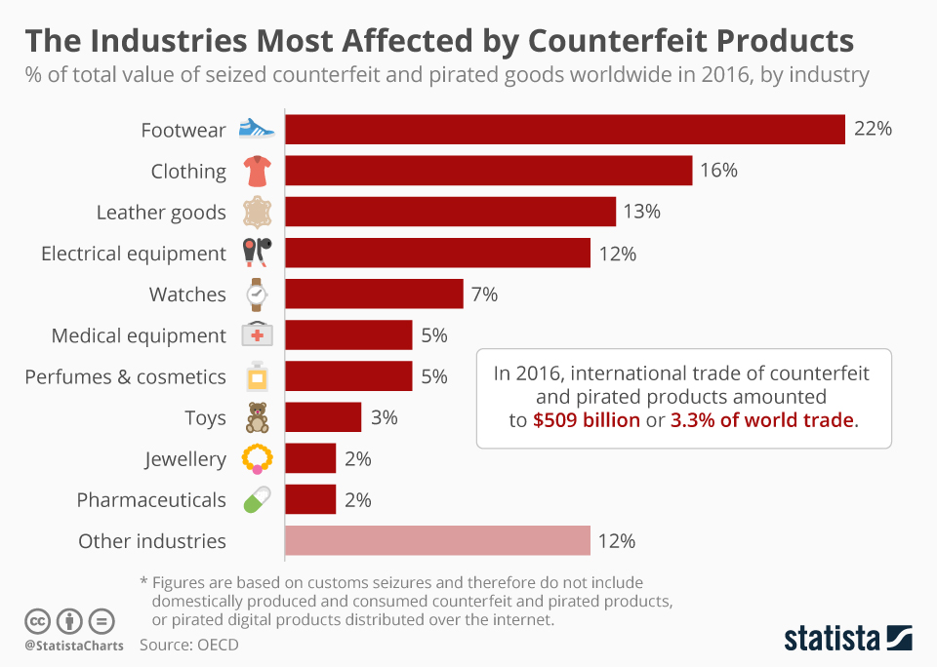
Problem Definition

Slide 4
Problem Definition
The International Chamber of Commerce of Geneva claimed that the total global annual sale of counterfeit products is USD 650 billion.
Poor visibility, lack of transparency, incorrect recording and inefficient tracking are some of the challenges faced within the supply-chain ecosystem, which means that it has made it harder to understand where the problem arises.

Slide 5
Problem Definition
In addition, most of the existing anti-counterfeiting supply chains are centralized and depend on a central authority to authenticate products. Despite their potential to detect counterfeit products, their centralization dependency introduces many problems.

Slide 6
proposed solution
We have come up with an idea that utilizes both blockchain technology and QRcode with a new form of algorithm that may enable one to validate products as they go through the production and distribution processes within the supply chain in order to weed out any counterfeit goods. Blockchain technology helps to solve the problem of counterfeiting a product.
Product information is permanently recorded by a blockchain, and cannot be altered, erased, or manipulated. A blockchain is a public decentralized ledger, so historical product information can be freely observed and verified by a user within the supply chain cycle.

Slide 7
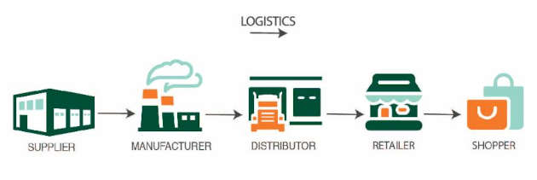
targeted client or market

Slide 8
targeted client or market
Among those most impacted by counterfeiting are companies in the fashion industry,particularly high end fashion brands such as Louis Vuitton, Gucci, and Prada (Mavlanova &Benbunan-Fich, 2010). Due to the relative ease of manufacturing imitated clothing, bags, shoes, and accessories, combined with the prestige and exclusivity achieved through expensive brand marketing campaigns, the fashion industry has become a viable target for counterfeiters all over the world (Mavlanova & Benbunan-Fich, 2010)

Slide 9
existing systems
Cryptographic Approaches
Cryptographic approaches use public or private key cryptography to authenticate products. propose an online approach that uses NFC tags and is based on public key cryptography. This approach allows customers to check the authenticity of products using their smartphones and does not require access to a database.

Slide 10
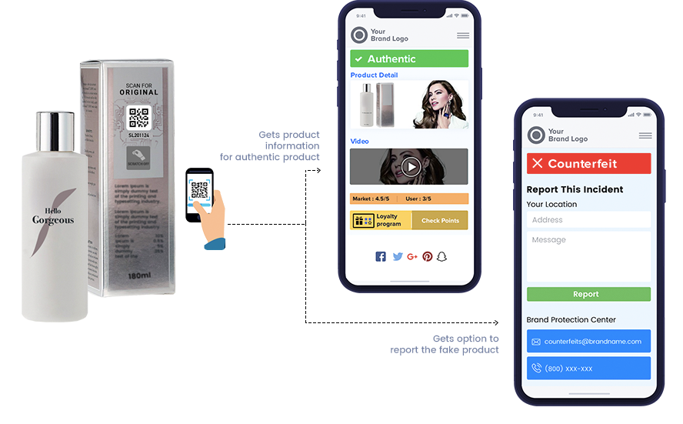
Monitoring and blocking of suspicious resources
The approach is that the manufacturer monitors Internet resources for infringing goods and their subsequent blocking. Monitoring such resources in automatic or semi-automatic modes requires developing specialized software, respectively, and resources for this development.

Slide 11
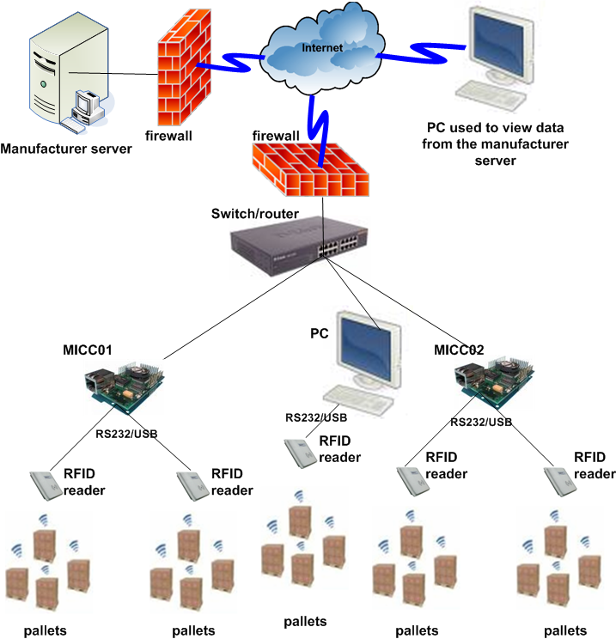
Track-and-Trace Approaches
This kind of approach uses Radio-Frequency Identification (RFID) tags to track the physical locations of a product, which are then stored in a centralized database. proposed one of the first track-and trace approaches, which uses Electronic Product Codes (EPC) to uniquely identify and track products in the supply chains.

Slide 12
proposed system
We proposed a fake product detection system using blockchain technology as an android application for the detection of counterfeit products. The proposed system ensures that the detection of fake products in day-to-day life. The proposed system consists of three main parts, customer or user android application, Manufacturer’s or company’s web application, and Database.

Slide 13
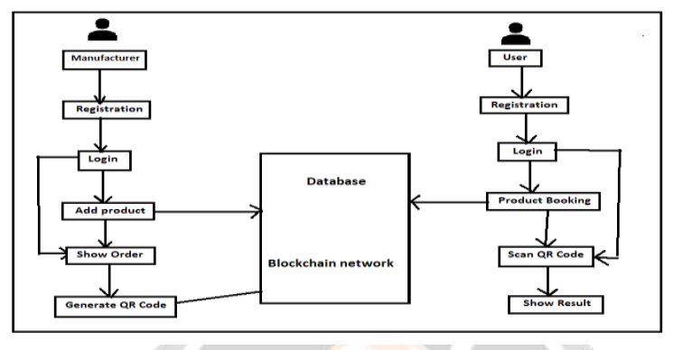
proposed system:UI

Slide 14
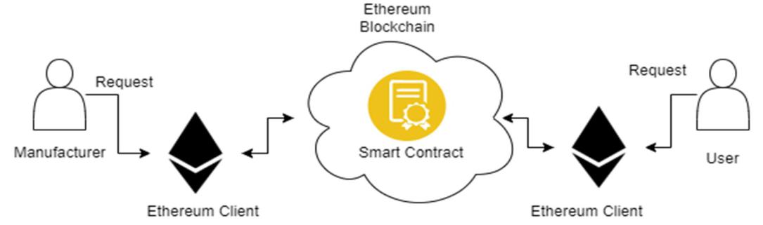
Within the blockchain network

Slide 15
Within the blockchain network
The Block-Supply authenticates every product and detects counterfeit products without the need for a centralized authentication server.There are three types of nodes in our protocol:
  1. Proposing (proposer): This is the node which currently has the product. It creates, proposes, and broadcasts the new block to the network.
  2. Validator: This node is responsible for validating the newly proposed block. Moreover, validators communicate their votes on the block to reach consensus.
  3. Idle: This node does nothing except wait for the decision to be reached by validators on whether to accept or reject the proposed block.

Slide 16
Within the blockchain network
Initialization Phase
This first phase is responsible for initializing the details of each product, securing them and storing them on the product’s QRCode tag.
Verification Phase
This phase is executed by the supply chain nodes using blockchain. As a product flows throughout the supply chain, its blockchain grows and gets updated every time it leaves a node and moves to the next by adding new blocks to it.

Slide 17
benefits
Blockchain offers better transparency, security, global peer-to-peer interaction, and decentralization.
. The use of blockchain would provide better access to customers by sharing information about products effectively.

Slide 18
Dependencies:BUDGET
No | Item Description | Available | Estimated cost(Kshs)
1 | Personal computer | 
2 | Flash memory | 
3 | Smartphone | 
4 | Documentation printing and binding |  | 3,000
4 | Documentation, apis and cloud services |  | 15,000
5 | Stationeries | 
6 | PyCharm(Community) | 
7 | XAMPP Server | 
8 | Android Studio | 
 | Browser(Chrome 2020) | 
9 | Research Expenses |  | 10,000
9 | QR printer |  | 30,000
Grand Total |  |  | 58,000

Slide 19
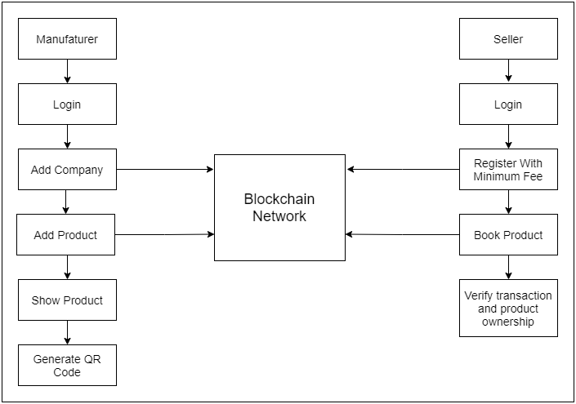

Slide 20
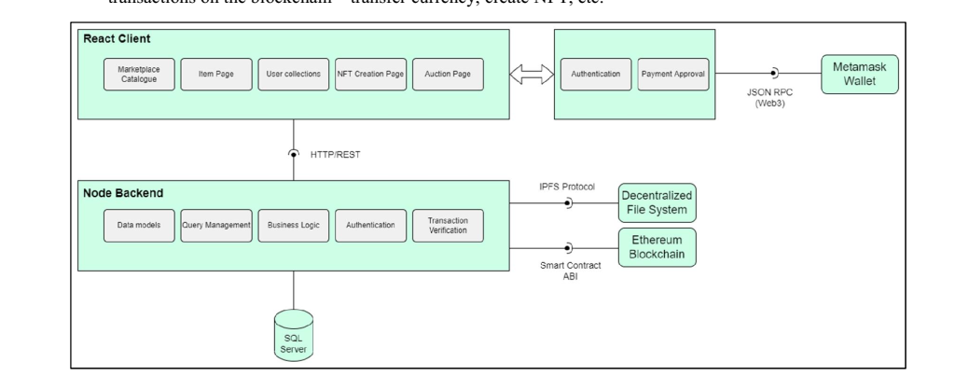

Slide 21
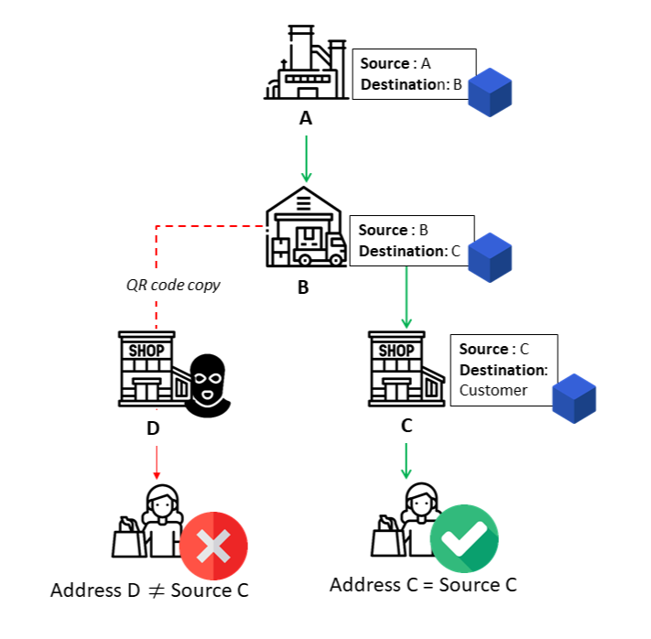

Slide 22
achievement
Several technologies that exist to solve the product-counterfeiting problem, such as
radio-frequency identification, barcode scanning, and mobile technology. However, these
technologies are mainly centralized and rely on trusted servers, which are vulnerable to
cyberattacks, for example, replay and man-in-the-middle attacks. Blockchain technology has
emerged as the best candidate to overcome these attacks. It can build a transparent,
trustworthy, and secure supply chain that prevents the counterfeiting of products.

Slide 23
future/work recommendations
In cooperation of AI or Machine Learning, to the data collected, hence may be used to developan automated system that checks on e-commerce platforms for any form of counterfeit

