Slide 1
101pong
B-MAT-100

Slide 2
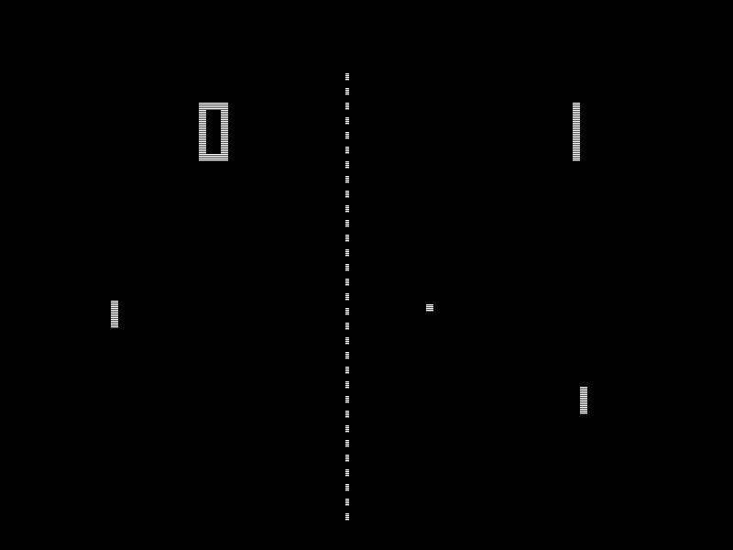

Slide 3
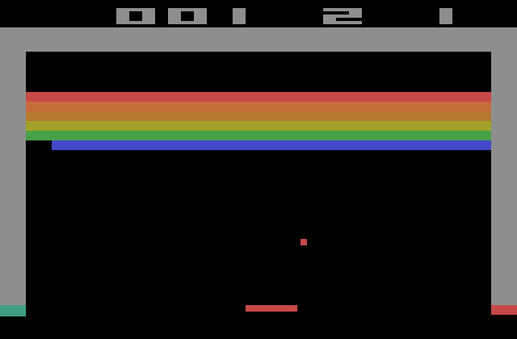

Slide 4
Project Goal
Compute velocity of the ball
Move the ball
Check if the ball hits the bat
Compute angle at which the ball hits the bat

Slide 5
Coordinate system
Z
B.z
B(x, y, z)
B
O
B.y
Y
B.x
X

Slide 6
Coordinate system
Z
B₀(x₀, y₀, z₀)
B₁(x₁, y₁, z₁)
O
Y
X

Slide 7
Vectors
A(x_{A}, y_{A}, z_{A})
B
B(x_{B}, y_{B}, z_{B})
V
V = B - A
A
V = (x_{B} - x_{A}, y_{B} - y_{A}, z_{B} - z_{A})

Slide 8
Vectors
Z
V₂
V₃
B
V₁
B = V₁ = V₂ = V₃ = V₄
O
Y
V₄
X

Slide 9
Operations on vectors
V = (x, y, z)
V
-V
-V = (-x, -y, -z)

Slide 10
Operations on vectors
V = (x, y, z)
V
2V = (2x, 2y, 2z)
2V

Slide 11
Operations on vectors
U = (x_{U}, y_{U}, z_{U})
V
V = (x_{V}, y_{V}, z_{V})
U
U + V
U + V = (x_{U} + x_{V}, y_{U} + y_{V}, z_{U} + z_{V})

Slide 12
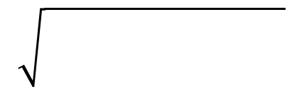
Operations on vectors
V = (x, y, z)
V
‖V‖
‖V‖ = x² + y² + z²

Slide 13
Velocity
Speed = Distance / Time
Velocity is speed and direction
Velocity is a vector!
T = 1s
V
Speed = ‖V‖
T = 0s

Slide 14
Angles: degrees vs radians
Angle | Degrees | Radians
Zero angle | 0° | 0
Right angle | 90° | π / 2
Straight angle | 180° | π
Full angle | 360° | 2π
r = (π / 180) d
d = (180 / π) r
π = 3.14159265358979323846264338327950…

Slide 15
Trigonometry
sin(θ) = a / c
cos(θ) = b / c
c
a
θ = arcsin(a / c)
θ
b
θ = arccos(b / c)

Slide 16
Trigonometry
z
θ = arcsin(z / ‖V‖)
V
θ

Slide 17
101pong
Inputs:
x0, y0, z0: ball coordinates at time t - 1
x1, y1, z1: ball coordinates at time t
n: time shift (>= 0)
Outputs:
Velocity vector of the ball
Coordinates of the ball at time t + n
Angle at which the ball will hit the ball (if there is a hit)

Slide 18
Points of attention
The bat is in the (Oxy) plan (z = 0) and is an infinitely large wall
Don’t forget error handling!
Types and number
Division by 0
Languages: C, C++, python3, ruby, perl, php, bash
Provide a Makefile if necessary

Slide 19
Suggested bonuses
Ball acceleration
Graphical interface
Complete game (2D, 3D, Pong, Breakout)
Spherical bat

