Slide 1
106bombyx
B-MAT-200

Slide 2
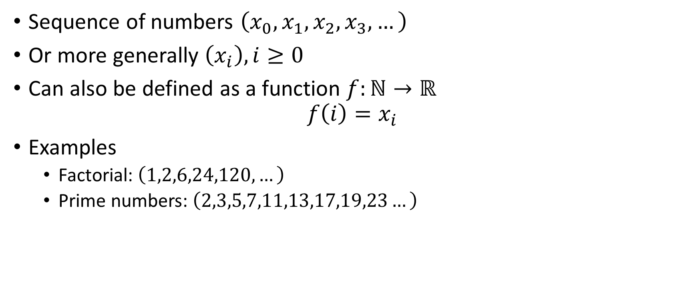
Sequences
Sequence of numbers $\left(x_{0},x_{1},x_{2},x_{3},…\right)$
Or more generally $\left(x_{i}\right), i≥0$
Can also be defined as a function $f:ℕ→ℝ$
$$f\left(i\right)=x_{i}$$
Examples
Factorial: $\left(1,2,6,24,120,…\right)$
Prime numbers: $\left(2,3,5,7,11,13,17,19,23…\right)$

Slide 3
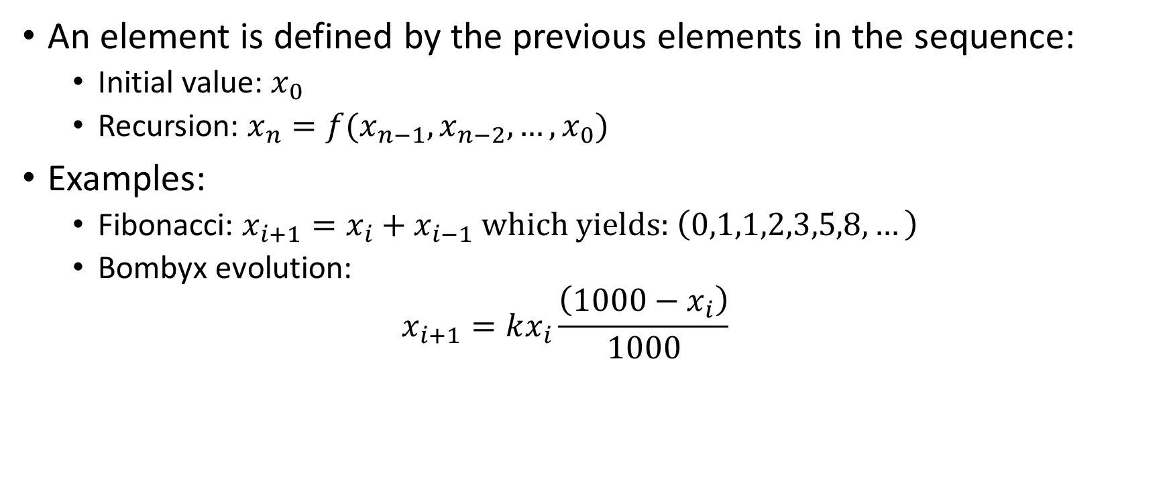
Definition by recursion
An element is defined by the previous elements in the sequence:
Initial value: $x_{0}$
Recursion: $x_{n}=f(x_{n−1}, x_{n−2},…,x_{0})$
Examples:
Fibonacci: $x_{i+1}=x_{i}+x_{i−1}$ which yields:$\left(0,1,1,2,3,5,8,…\right)$
Bombyx evolution:
$$x_{i+1}=kx_{i}\frac{\left(1000−x_{i}\right)}{1000}$$

Slide 4
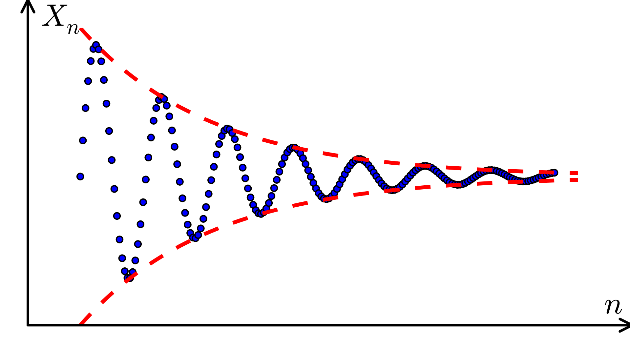
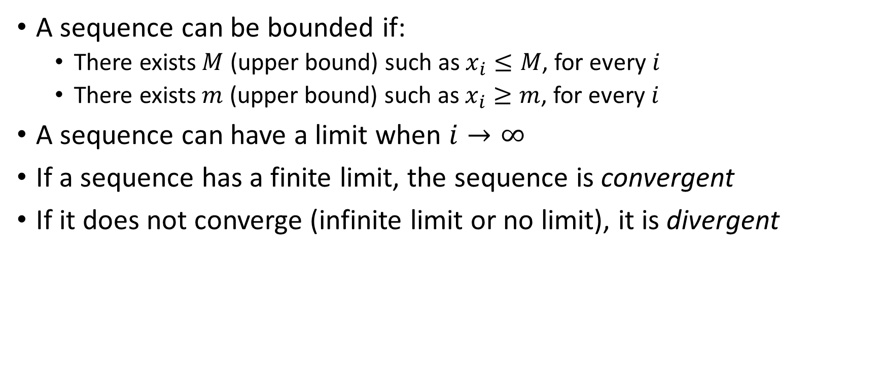
Sequence properties
A sequence can be bounded if:
There exists $M$ (upper bound) such as $x_{i}≤M$, for every $i$
There exists $m$ (upper bound) such as $x_{i}≥m$, for every $i$
A sequence can have a limit when $i→∞$
If a sequence has a finite limit, the sequence is convergent
If it does not converge (infinite limit or no limit), it is divergent

Slide 5
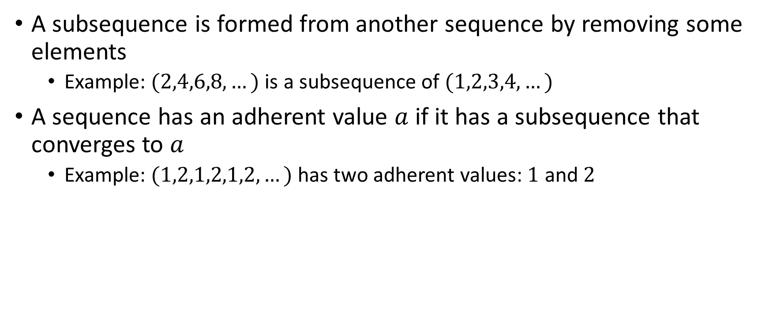
Subsequences and adherent values
A subsequence is formed from another sequence by removing some elements
Example: $(2,4,6,8,…)$ is a subsequence of $(1,2,3,4,…)$
A sequence has an adherent value $a$ if it has a subsequence that converges to $a$
Example: $(1,2,1,2,1,2,…)$ has two adherent values: $1$ and $2$

Slide 6
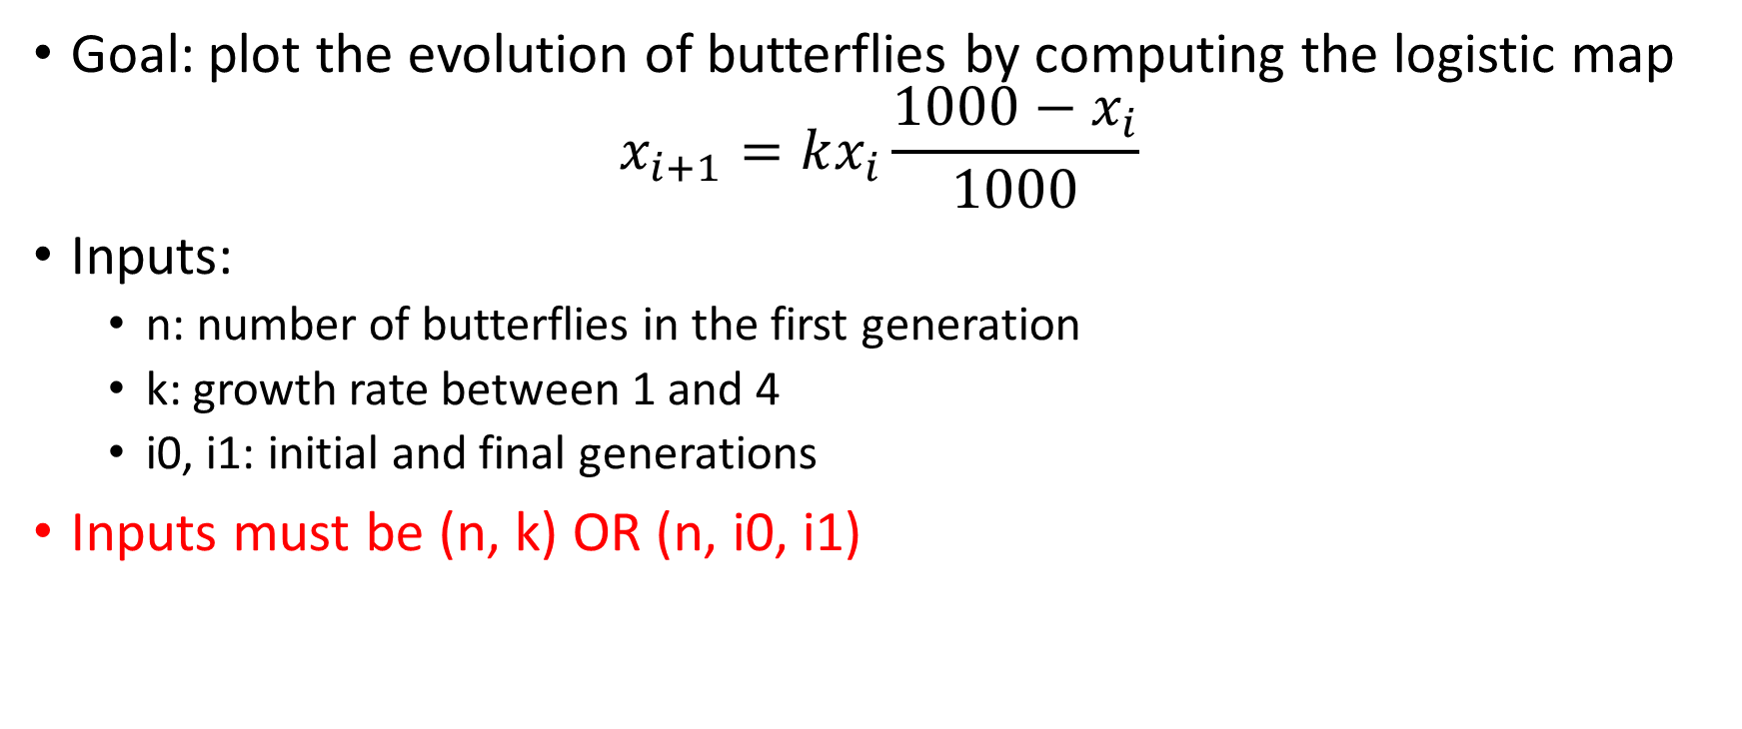
106bombyx
Goal: plot the evolution of butterflies by computing the logistic map
$$x_{i+1}=kx_{i}\frac{1000−x_{i}}{1000}$$
Inputs:
n: number of butterflies in the first generation
k: growth rate between 1 and 4
i0, i1: initial and final generations
Inputs must be (n, k) OR (n, i0, i1)

Slide 7
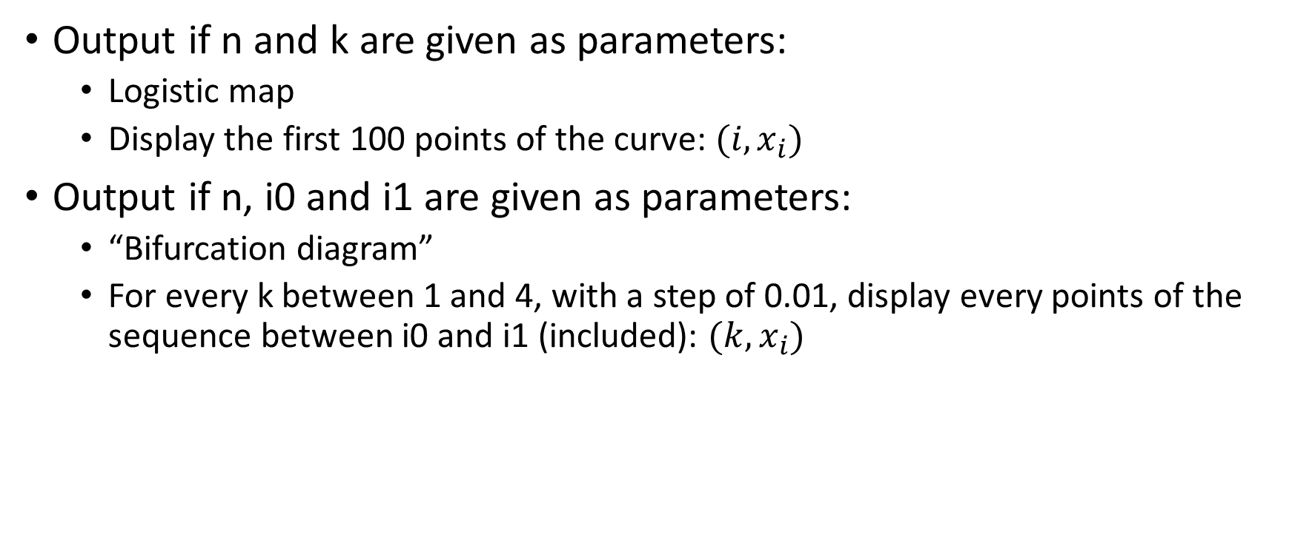
106bombyx
Output if n and k are given as parameters:
Logistic map
Display the first 100 points of the curve: $(i, x_{i})$
Output if n, i0 and i1 are given as parameters:
“Bifurcation diagram”
For every k between 1 and 4, with a step of 0.01, display every points of the sequence between i0 and i1 (included): $(k, x_{i})$

Slide 8
Suggested bonus
Plot the curves with gnuplot
Learn about fractals and plot:
Julia set
Mandelbrot set

Slide 9
