Slide 1
108trigo
B-MAT-200

Slide 2
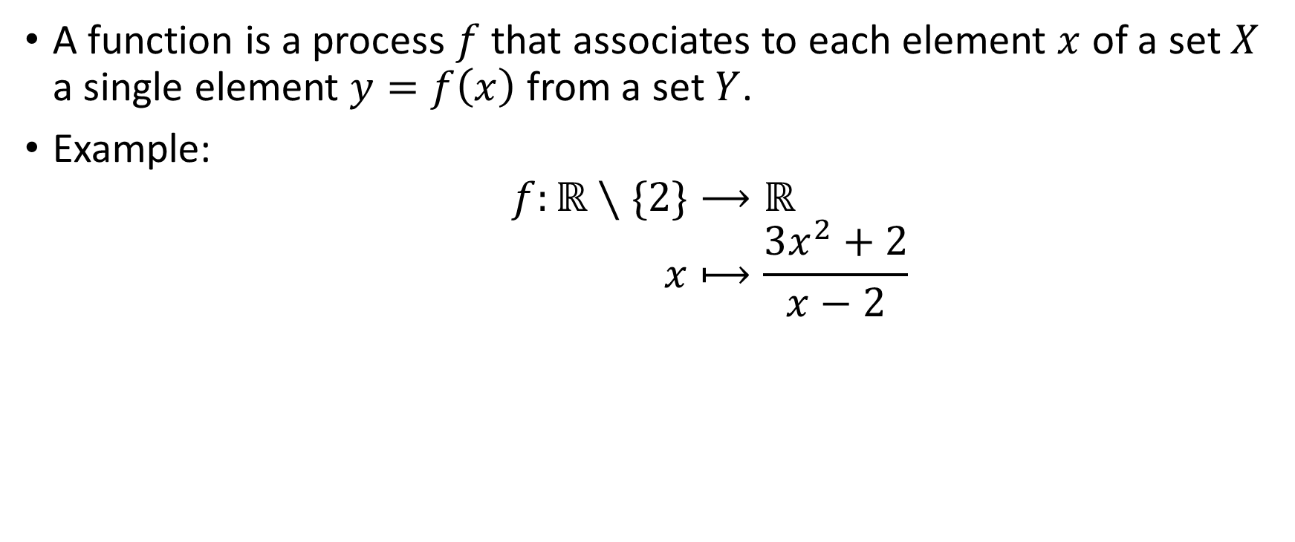
Previously: Functions
A function is a process $f$ that associates to each element $x$ of a set $X$ a single element $y=f\left(x\right)$ from a set $Y$.
Example:
$$f:ℝ∖\{2\}⟶ℝ \\ x⟼\frac{3x^{2}+2}{x−2}$$

Slide 3
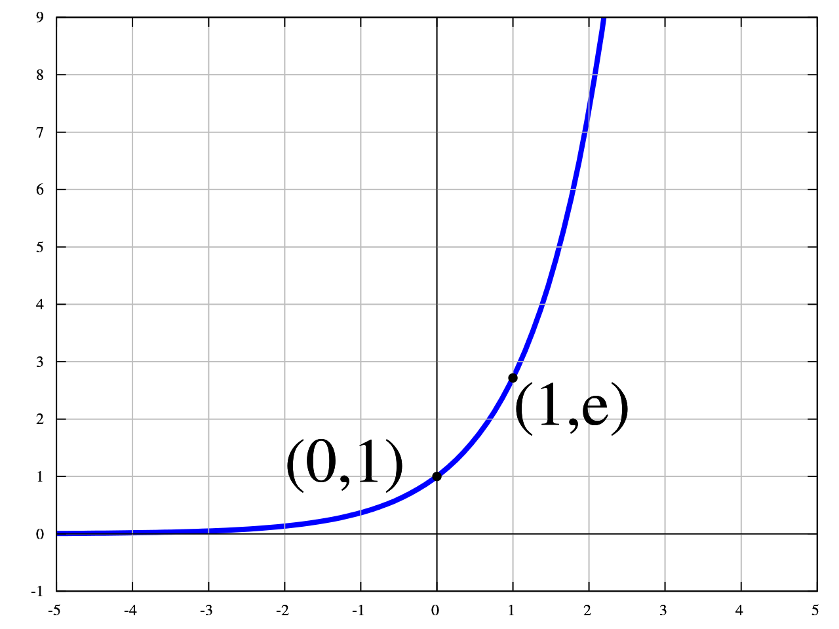

Exponential function
$\exp{(x)}=e^{x}$
$e≈2.71828$
$e^{x}>0$
Inverse: $log$
$y=e^{x}$
$x=log⁡(y)$
$\log\left(e\right)=1$

Slide 4
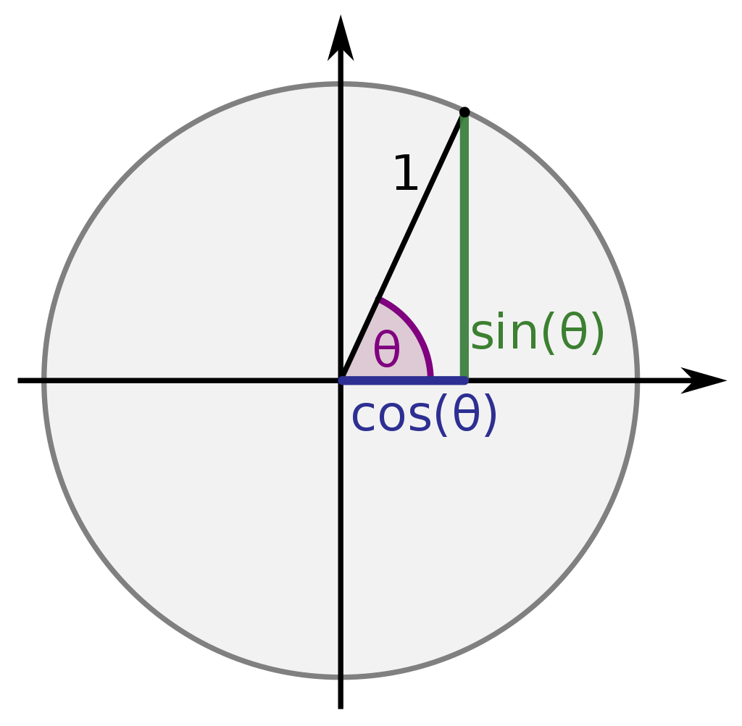
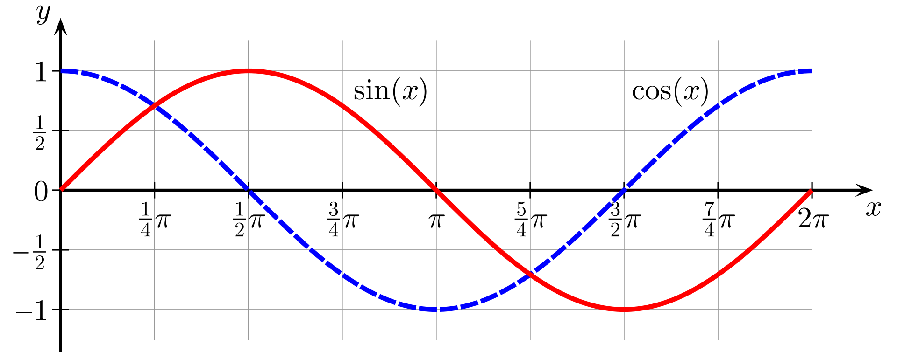

Trigonometric functions
$\sin\left(x\right)$
$cos⁡(x)$

Slide 5
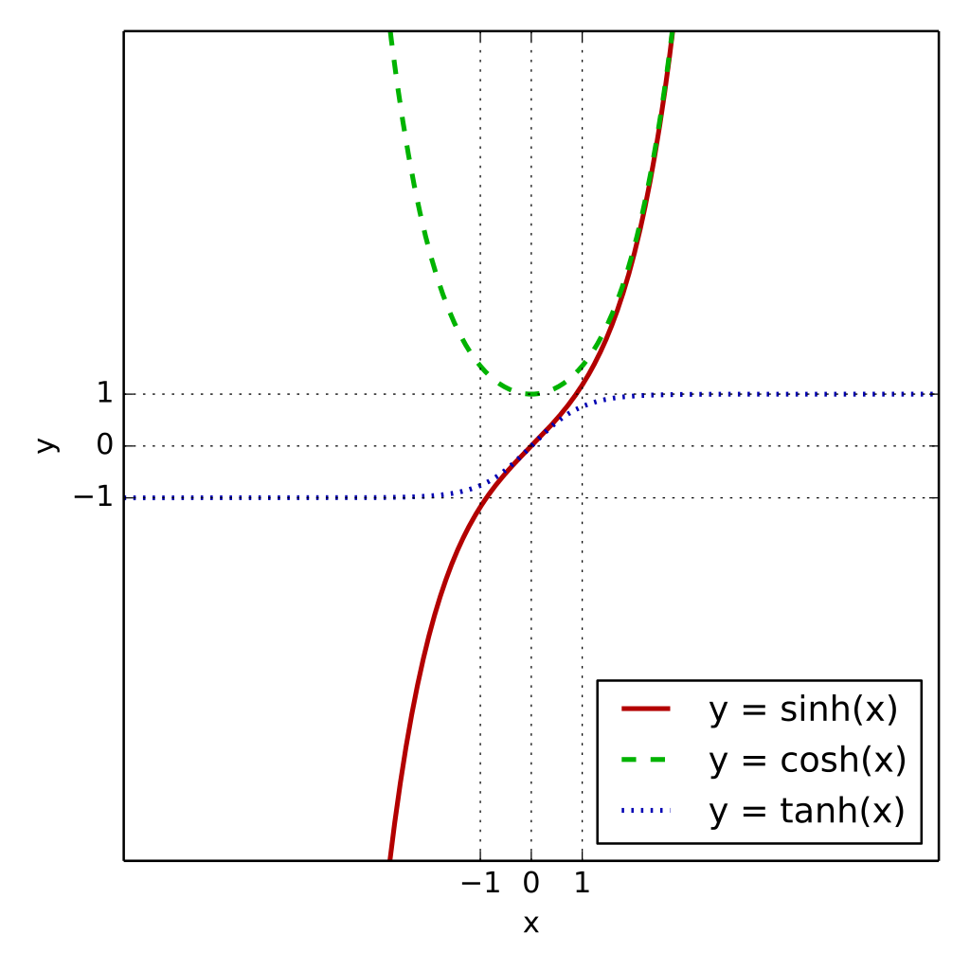
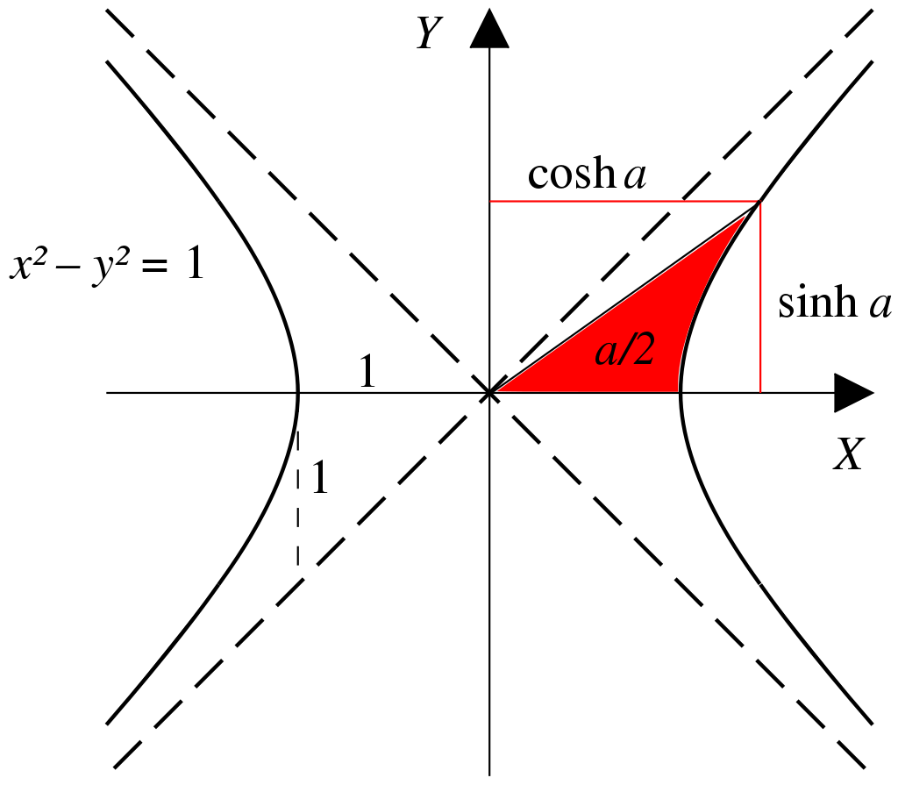

Hyperbolic functions
$\sinh\left(x\right)=\frac{e^{x}−e^{−x}}{2}$
$\cosh\left(x\right)=\frac{e^{x}+e^{−x}}{2}$

Slide 6
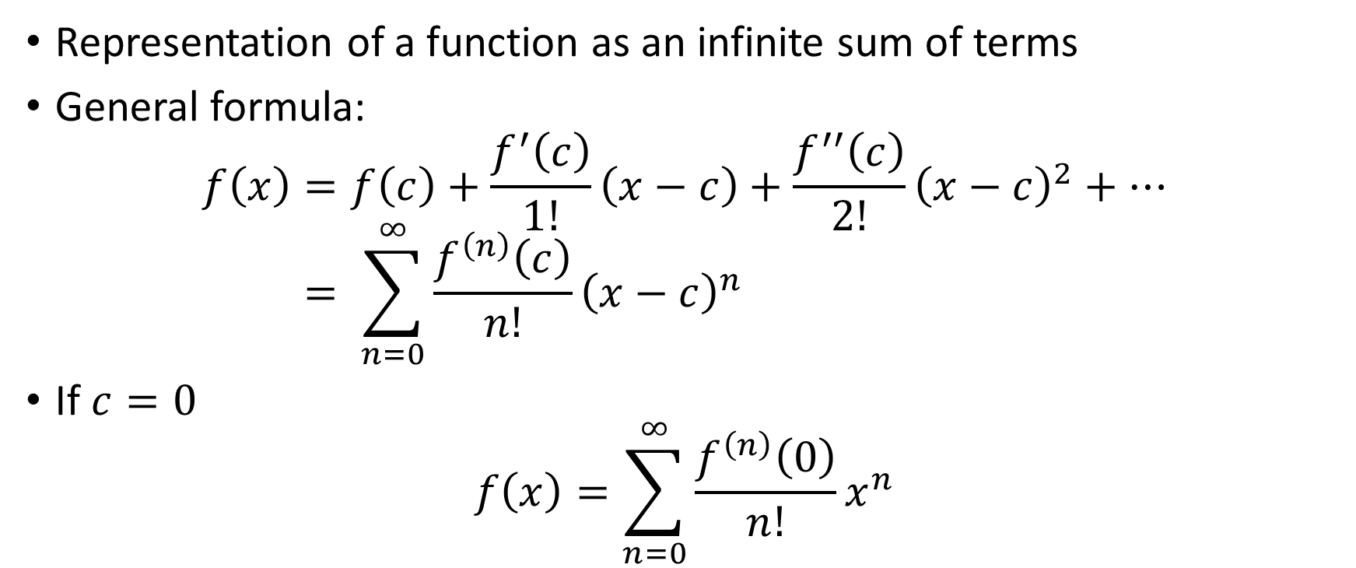
Taylor series
Representation of a function as an infinite sum of terms
General formula:
$$f\left(x\right)=f\left(c\right)+\frac{f^{′}\left(c\right)}{1!}\left(x−c\right)+\frac{f^{′′}\left(c\right)}{2!}{\left(x−c\right)}^{2}+… \\ = \sum_{n=0}^{∞}{\frac{f^{\left(n\right)}\left(c\right)}{n!}}{\left(x−c\right)}^{n}$$
If $c=0$
$$f\left(x\right)=\sum_{n=0}^{∞}{\frac{f^{\left(n\right)}\left(0\right)}{n!}}x^{n}$$

Slide 7
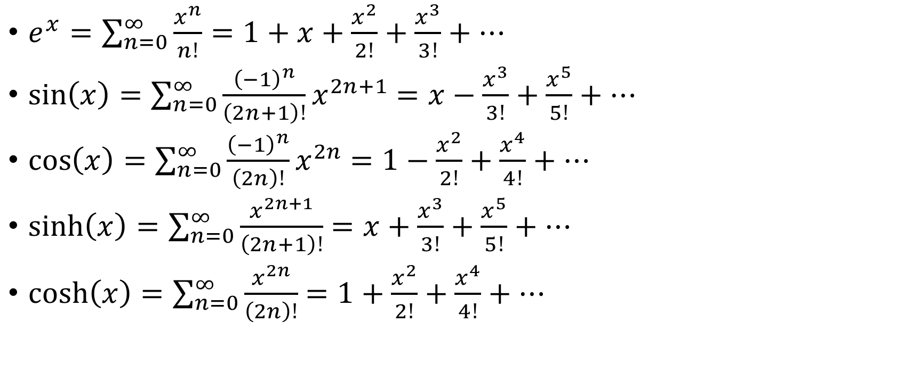
Taylor expansions
$e^{x}=\sum_{n=0}^{∞}{\frac{x^{n}}{n!}}=1+x+\frac{x^{2}}{2!}+\frac{x^{3}}{3!}+…$
$\sin\left(x\right)=\sum_{n=0}^{∞}{\frac{{\left(−1\right)}^{n}}{\left(2n+1\right)!}x^{2n+1}}$ $=x−\frac{x^{3}}{3!}+\frac{x^{5}}{5!}+…$
$\cos\left(x\right)=\sum_{n=0}^{∞}{\frac{{\left(−1\right)}^{n}}{\left(2n\right)!}x^{2n}}$ $=1−\frac{x^{2}}{2!}+\frac{x^{4}}{4!}+…$
$\sinh\left(x\right)=\sum_{n=0}^{∞}{\frac{x^{2n+1}}{\left(2n+1\right)!}}$ $=x+\frac{x^{3}}{3!}+\frac{x^{5}}{5!}+…$
$\cosh\left(x\right)=\sum_{n=0}^{∞}{\frac{x^{2n}}{\left(2n\right)!}}$ $=1+\frac{x^{2}}{2!}+\frac{x^{4}}{4!}+…$

Slide 8
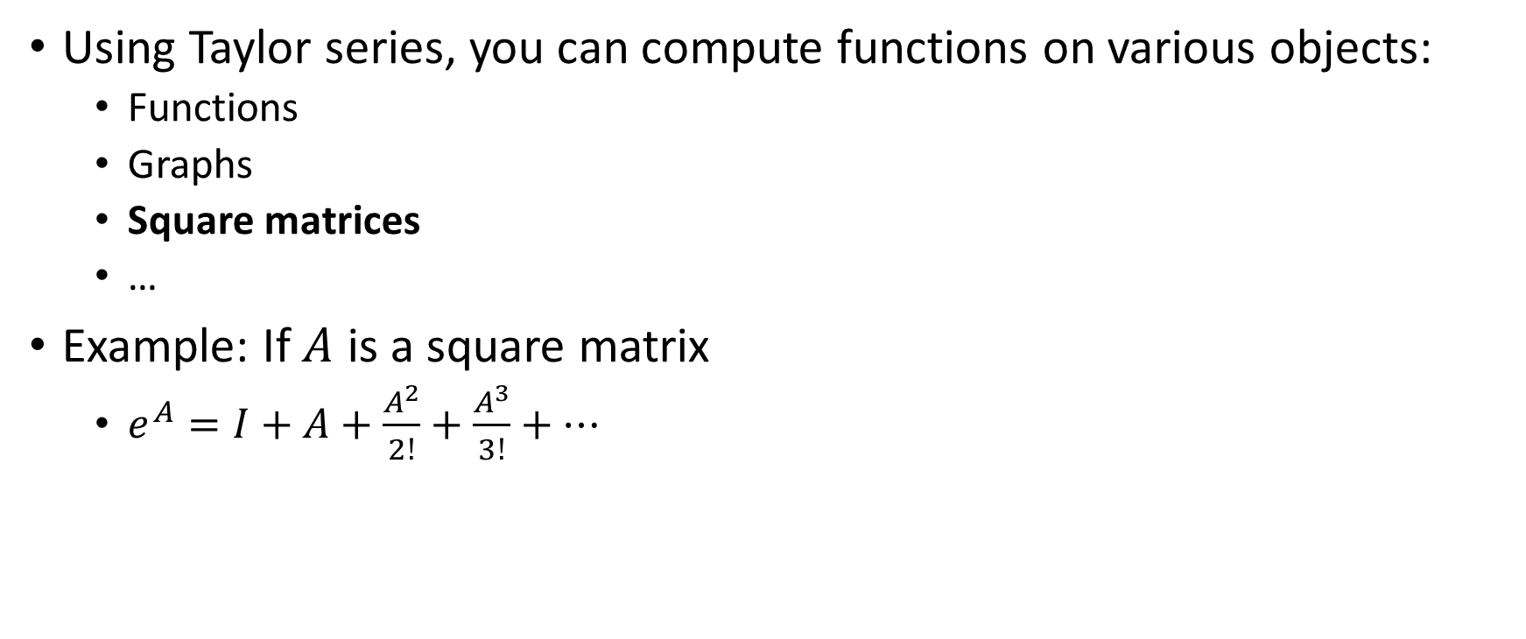
Functions on mathematical objects
Using Taylor series, you can compute functions on various objects:
Functions
Graphs
Square matrices
…
Example: If $A$ is a square matrix
$e^{A}=I+A+\frac{A^{2}}{2!}+\frac{A^{3}}{3!}+…$

Slide 9
108trigo
Goal: Evaluate functions on square matrices using Taylor series
Inputs:
A string representing a function: “EXP”, “SIN”, “COS”, “SINH”, “COSH”…
The coefficients of the matrix (line by line)
Output: Result matrix
You can add additional functions as a bonus
Logarithm
Tangent, arcsin…
…

Slide 10
Points of attention
You must decide how many terms of the series you need to compute
Think about efficient ways to compute:
Powers of matrices
Factorials

