Slide 1
110borwein
B-MAT-200

Slide 2
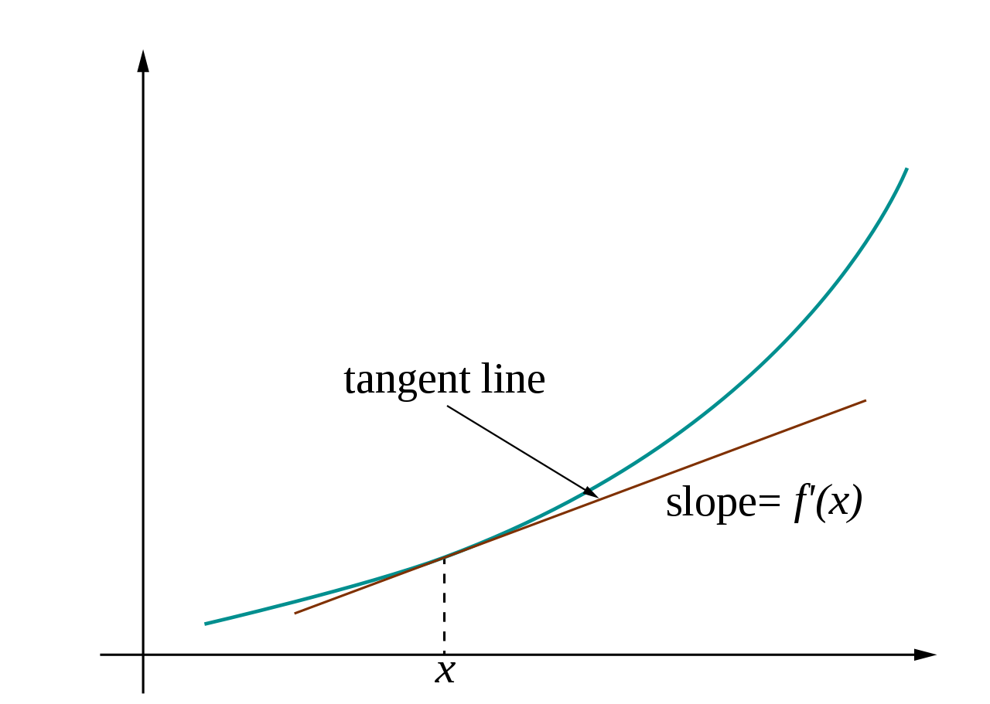
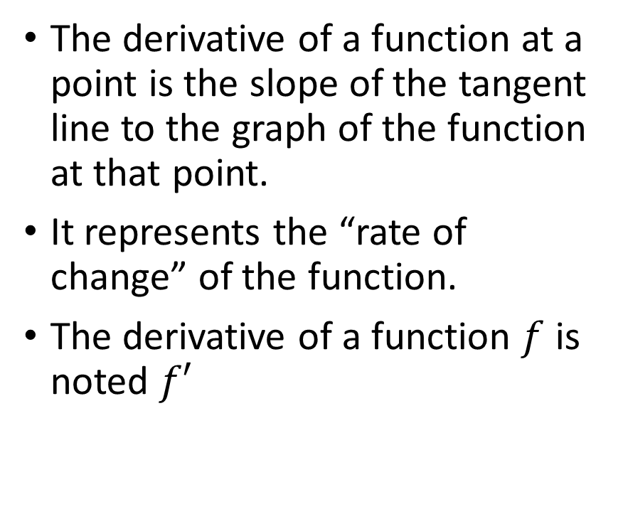
Previously: Derivative
The derivative of a function at a point is the slope of the tangent line to the graph of the function at that point.
It represents the “rate of change” of the function.
The derivative of a function $f$ is noted $f′$

Slide 3
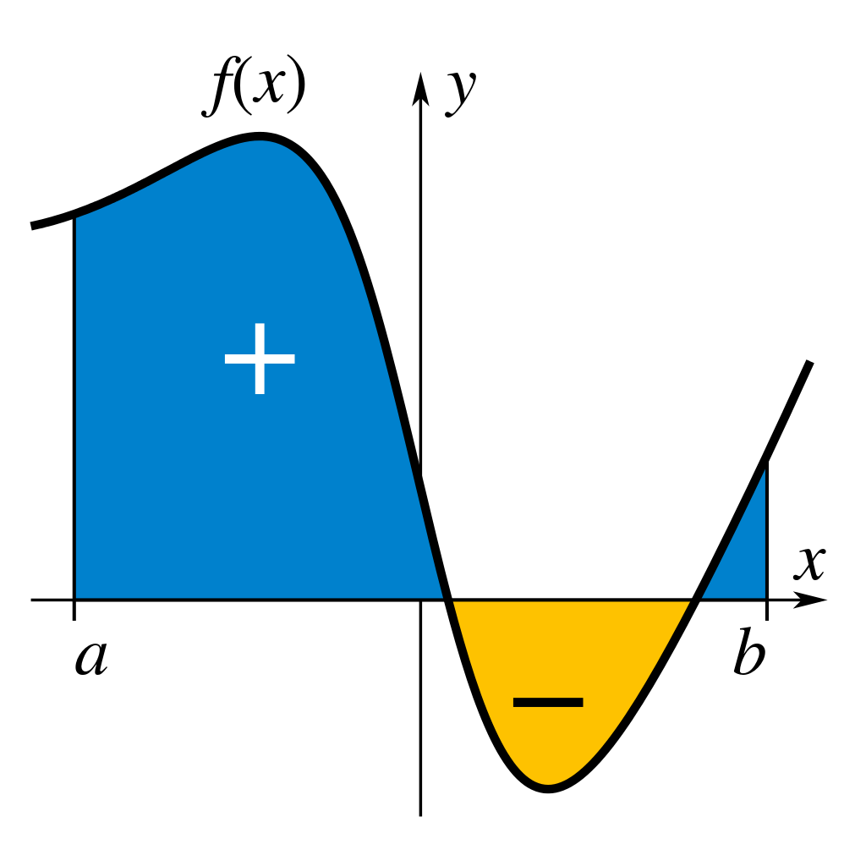
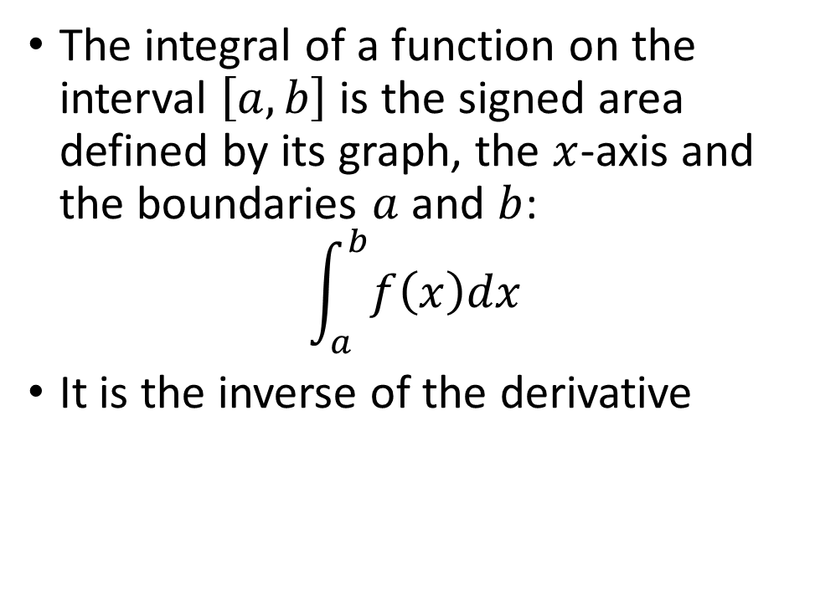
Integral
The integral of a function on the interval $\left[a,b\right]$ is the signed area defined by its graph, the $x$-axis and the boundaries $a$ and $b$:
$$\int_{a}^{b}{f\left(x\right)dx}$$
It is the inverse of the derivative

Slide 4
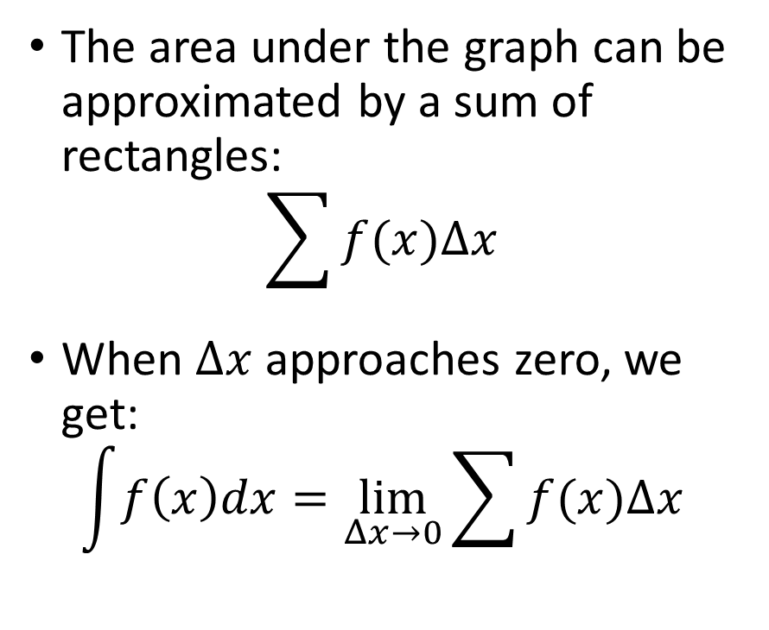

What are $∫$and $dx$?
The area under the graph can be approximated by a sum of rectangles:
$$\sum{f(x)Δx}$$
When $Δx$ approaches zero, we get:
$$\int{f\left(x\right)dx}=\lim_{Δx→0}{\sum{f(x)Δx}}$$

Slide 5
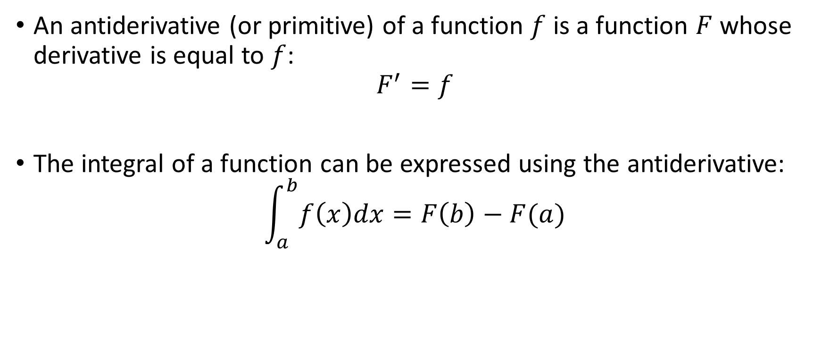
Antiderivative
An antiderivative (or primitive) of a function $f$ is a function $F$ whose derivative is equal to $f$:
$$F^{′}=f$$
The integral of a function can be expressed using the antiderivative:
$$\int_{a}^{b}{f\left(x\right)dx}=F\left(b\right)−F(a)$$

Slide 6
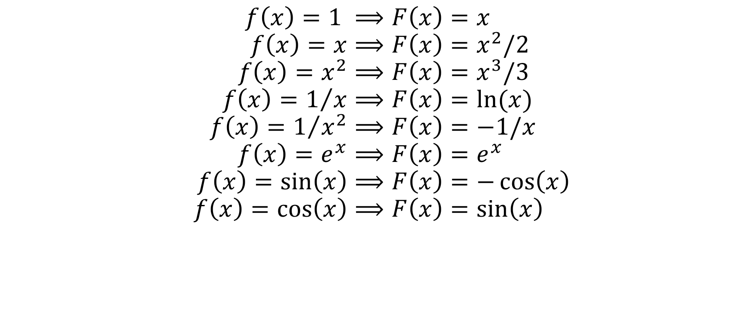
Examples
$$f\left(x\right)=1 ⟹F\left(x\right)=x \\ f\left(x\right)=x⟹F\left(x\right)=x^{2}/2 \\ f\left(x\right)=x^{2}⟹F\left(x\right)=x^{3}/3 \\ f\left(x\right)=1/x⟹F\left(x\right)=ln⁡(x) \\ f\left(x\right)=1/{x^{2}}⟹F\left(x\right)=−1/x \\ f\left(x\right)=e^{x}⟹F\left(x\right)=e^{x} \\ f\left(x\right)=\sin\left(x\right)⟹F\left(x\right)=−\cos\left(x\right) \\ f\left(x\right)=\cos\left(x\right)⟹F\left(x\right)=\sin\left(x\right)$$

Slide 7
Numerical integration
Numerical integration is a way to approximate an integral
This is generally done in three steps:
Subdividing the integration interval into smaller subintervals
For each subinterval, evaluating the function on a finite set of points and using a weighted sum to approximate the integral.
Adding up the approximations for each subinterval.
We will describe three methods:
The midpoint rule
The trapezoidal rule
The Simpson’s rule

Slide 8
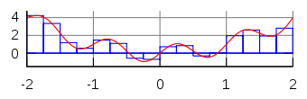
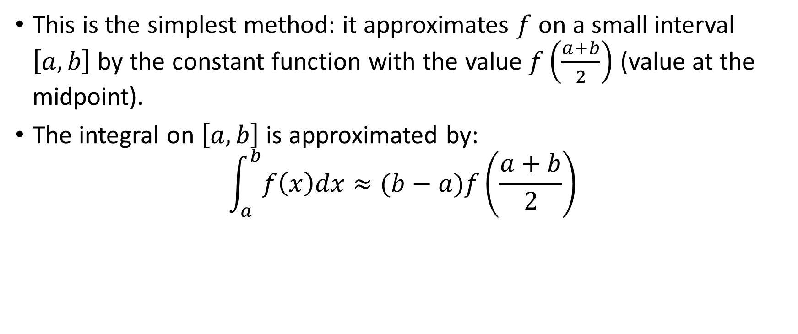
Midpoint rule
This is the simplest method: it approximates $f$ on a small interval $\left[a,b\right]$ by the constant function with the value $f\left(\frac{a+b}{2}\right)$ (value at the midpoint).
The integral on $\left[a,b\right]$ is approximated by:
$$\int_{a}^{b}{f\left(x\right)dx}≈(b−a)f\left(\frac{a+b}{2}\right)$$

Slide 9
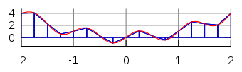
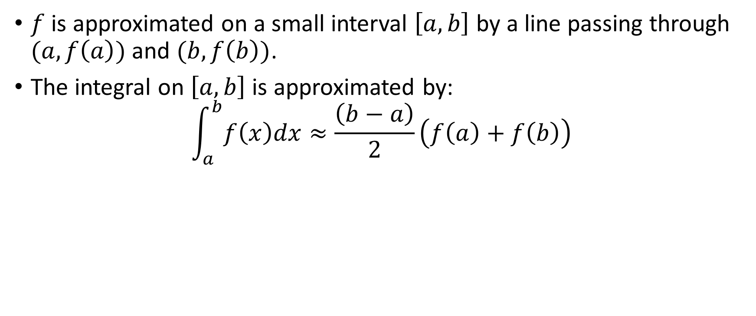
Trapezoidal rule
$f$ is approximated on a small interval $\left[a,b\right]$ by a line passing through $(a,f\left(a\right))$ and $(b,f\left(b\right))$.
The integral on $\left[a,b\right]$ is approximated by:
$$\int_{a}^{b}{f\left(x\right)dx}≈\frac{\left(b−a\right)}{2}\left(f\left(a\right)+f\left(b\right)\right)$$

Slide 10
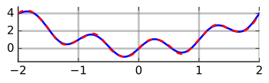
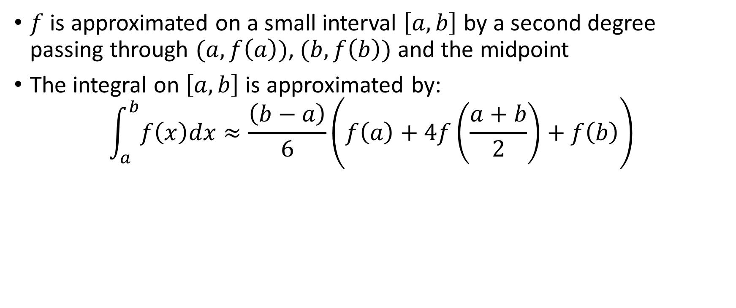
Simpson’s rule
$f$ is approximated on a small interval $\left[a,b\right]$ by a second degree passing through $(a,f\left(a\right))$, $(b,f\left(b\right))$ and the midpoint
The integral on $\left[a,b\right]$ is approximated by:
$$\int_{a}^{b}{f\left(x\right)dx}≈\frac{\left(b−a\right)}{6}\left(f\left(a\right)+4f\left(\frac{a+b}{2}\right)+f\left(b\right)\right)$$

Slide 11
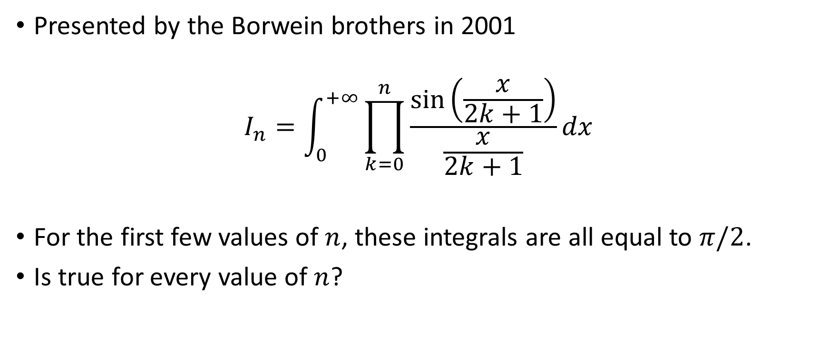
Borwein integrals
Presented by the Borwein brothers in 2001
$$I_{n}=\int_{0}^{+∞}{\prod_{k=0}^{n}{\frac{\sin\left(\frac{x}{2k+1}\right)}{\frac{x}{2k+1}}}}dx$$
For the first few values of $n$, these integrals are all equal to $π/2$.
Is true for every value of $n$?

Slide 12
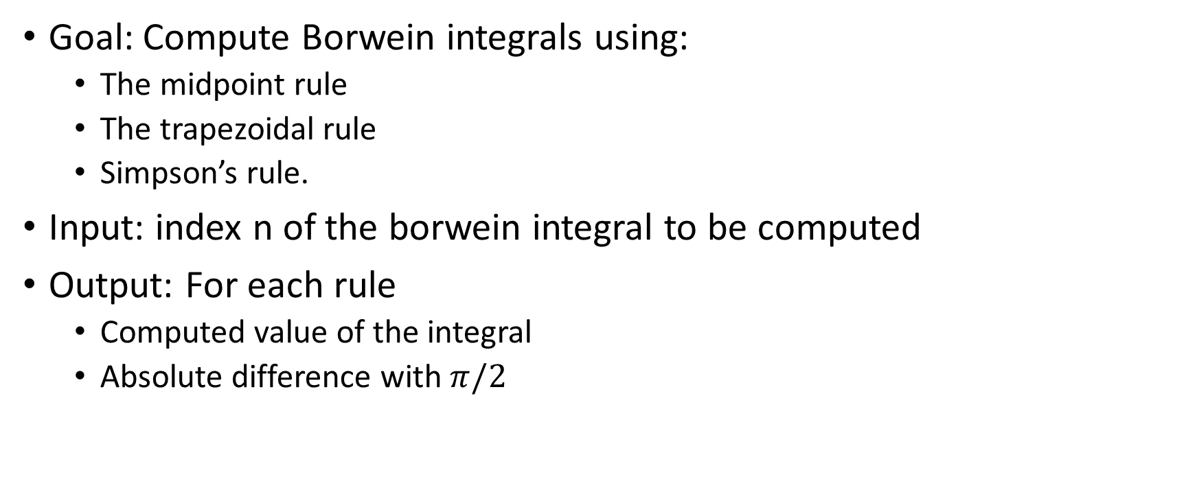
110borwein
Goal: Compute Borwein integrals using:
The midpoint rule
The trapezoidal rule
Simpson’s rule.
Input: index n of the borwein integral to be computed
Output: For each rule
Computed value of the integral
Absolute difference with $π/2$

Slide 13

Points of attention
The $\left[0,+∞\right]$ interval will be approximated by $\left[0,5000\right]$
For each rule, this interval will be subdivided into 10000 subintervals

