Slide 1
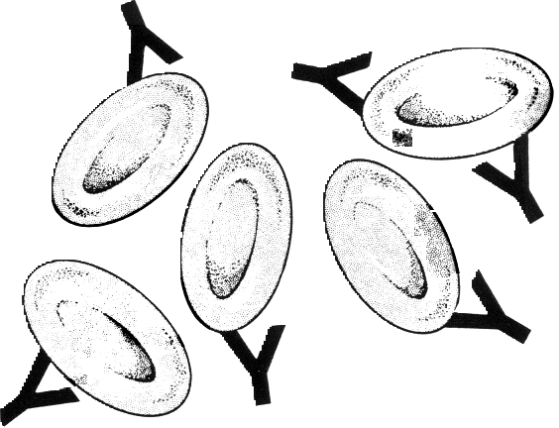
Synthesis of Blood antigens A and B
For the development of an universal plasma device

Slide 2
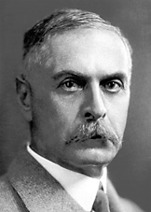
Discovery – Karl Landsteiner
Discovered ABO blood types in 1900 while trying to understand how blood transfusions often resulted in death
Awarded Nobel Prize in 1930 for this work
Importance
Allowed for advancement in blood transfusion procedures
Gained understanding on how blood type is passed through genetics

Slide 3
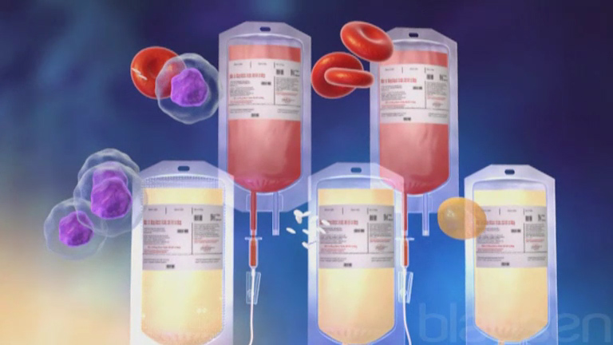
Lack of Universal plasma
Traumatic injury leading to blood hemorrhage is a major cause of mortality in both hospital and military environments.
Blood and plasma transfusions play vital role in preventing these deaths.
Only around 4% of the population (US) is a universal plasma donor (Type AB).
M. R. D'Angelo and R. P. Dutton; AANA Journal, vol. 78, no. 1, pp. 35-40, 2010.
M. Yazer, A. F. Eder and K. J. Land, Transfusion, vol. 53, pp. 1627-1633, 2013.

Slide 4
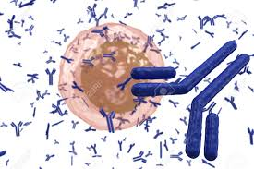
Blood plasma
Rejection of plasma in a patient is an immune response triggered by antibodies present in the serum.
Two types of antibodies are present in human blood plasma, these are A and B-antibodies. These antibodies selectively bind to A and B-antigens, respectively.
https://www.123rf.com/photo_40257234_white-blood-cell-b-lymphocyte-plasma-cell-producing-antibodies-isolated-on-white-background.html

Slide 5
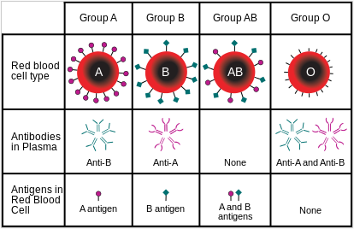
Blood antigens
Blood antigens are O-linked Glycans attached to either membrane glycoproteins or cell surface glycolipids.

Slide 6

Structural motif of A/B/O antigens
KEY
α(1→2)
α(1→2)
(Fucose)
α(1→2)
α(1→3)
α(1→3)
(Galactose)
(N-Acetyl Galactosamine)
O Antigen
A Antigen
B Antigen

Slide 7
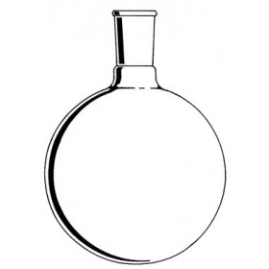
Previous syntheses of a, b and O(h) blood group antigens

Slide 8
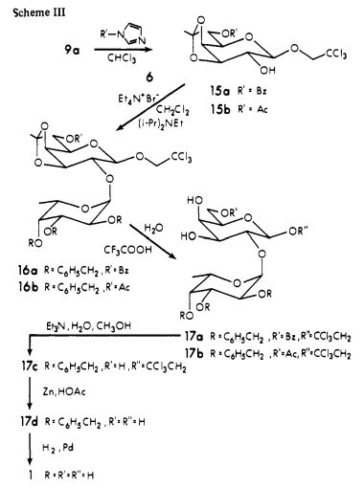

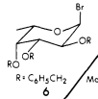
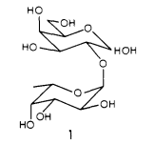
Lemieux - first synthesis in 1975
Key glycosylations performed using
bromide ion catalyzed conditions
82%, α-selectivity
(O-antigenic determinant)
J. Am. Chem. Soc., 1975, 97 (14), pp 4069–4075
Notes:
Benzoylation of 9a using the C-6 selective imidazole base

Slide 9
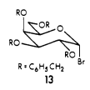
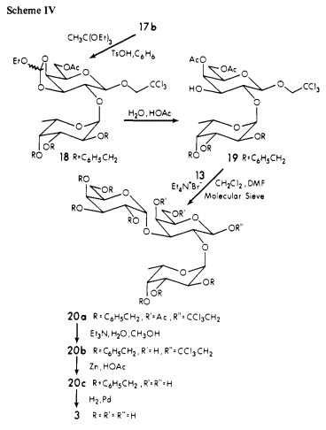
In the same paper from 1975, Lemieux goes on to finish the first synthesis of the B-antigenic determinant, shown below.
28%
Lemieux’s glycosyl halides required long reaction
times (~4 days) as well as armed donors for
to proceed. He obtained 14 mg of the pure
B-antigen with relatively low yield.
J. Am. Chem. Soc., 1975, 97 (14), pp 4069–4075

Slide 10
Paulsen and Kolar (1978)
Paulsen and Kolar were the next group to synthesize the B-antigenic determinant and also synthesized the A-antigenic determinant.
In addition to the functionally significant trisaccharide core, Paulsen and Kolar extended their synthesis to include a fourth sugar residue on the C1 position of the central galactose residue (Type I).
Alpha selectivity was achieved through their method.
Key glycosylation steps had higher yield than Lemieux’s previous synthesis, but there are a few reasons this scheme would be difficult to scale.
B-antigen (types I-VI)
Angew. Chem. Int. Ed. Engl. 17 (1978) No. 10
Notes:
They synthesize the Type-I A and B antigen tetrasaccharide

Slide 11
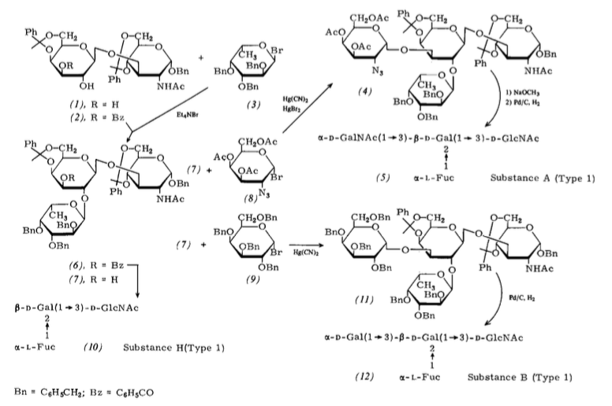
63%
82%
73%
The use of Mercury(II) Cyanide in any synthesis is not ideal. This reagent can absorb
very readily through the skin due to its high solubility in water or by inhalation to
cause death.
Angew. Chem. Int. Ed. Engl. 17 (1978) No. 10

Slide 12
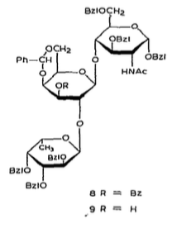
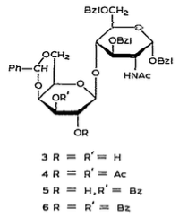
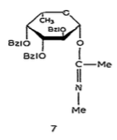
Sinay & Milat (1981)
Using an imidate glycosylation strategy, Sinay and Milat synthesized the type-II B-antigenic determinant tetrasaccharide in their 1981 paper.
+
89%
Although this glycosylation has high yield, It suffers from a long reaction time (3 days)
Carbohydrate Research, 92 (1981) 183-189

Slide 13
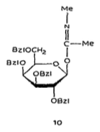
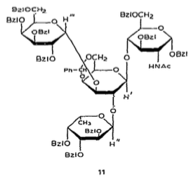
+
90%
The yields are again high, but reaction time is still quite long (2 days)
Carbohydrate Research, 92 (1981) 183-189

Slide 14
Fraser-Reid (1992)
Fraser-Reid used an n-pentenyl glycoside (nPG) strategy in his synthesis of a blood group substance B trisaccharide.
This method proved to give good yields and allows for more freedom in planning the synthesis since nPG’s can act as anomeric protecting groups until activated, therefore can be installed early on.
One major drawback is ensuring that you will obtain complete stereocontrol, as can be seen in the late-stage galactosylation and fucosylation reactions. It may be difficult to separate an anomeric mixture so complete control is ideal.
Tetrahedron Vol. 48, No. 23, pp. 4713-4724, 1992

Slide 15
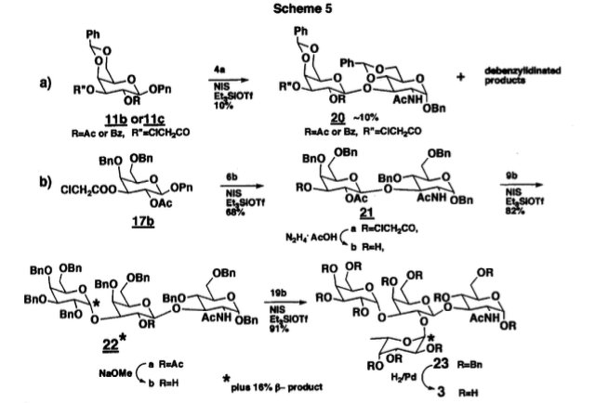
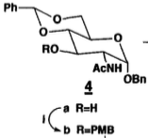
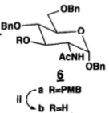
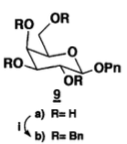
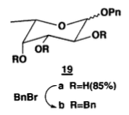
Tetrahedron Vol. 48, No. 23, pp. 4713-4724, 1992

Slide 16
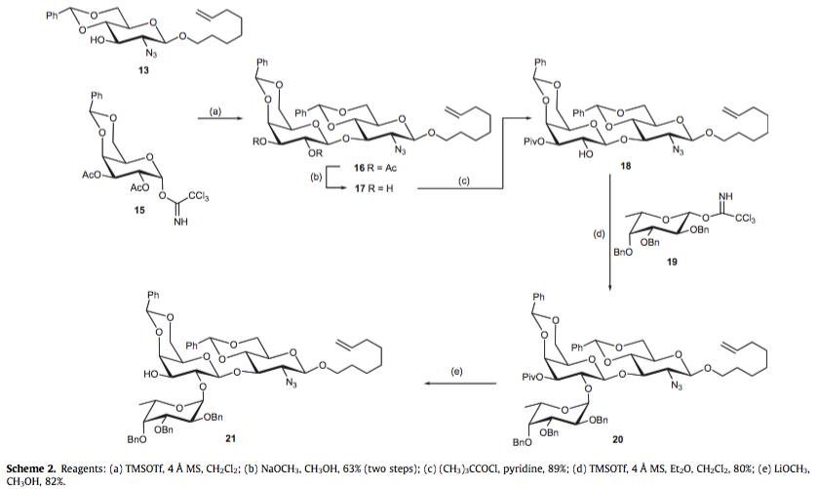
Lowary group (2010)
Carbohydr. Res. 2010, 345, 2305–2322.
The Lowary group synthesized a variety of ABO blood group antigens using a trichloroacetimidate donors.

Slide 17
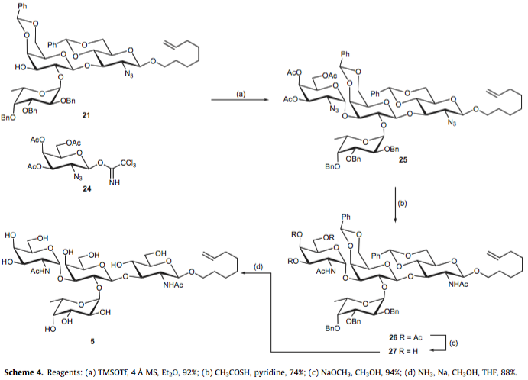
Carbohydr. Res. 2010, 345, 2305–2322.

Slide 18
Universal plasma device
Modern blood transfusion relies on separating blood components (ie. The RBCs and blood plasma) from donors and replacing them in patients.
Compatibility between donor and acceptor is a common issue in medical environments and blood banks are often in short supply.
Solution?

Slide 19
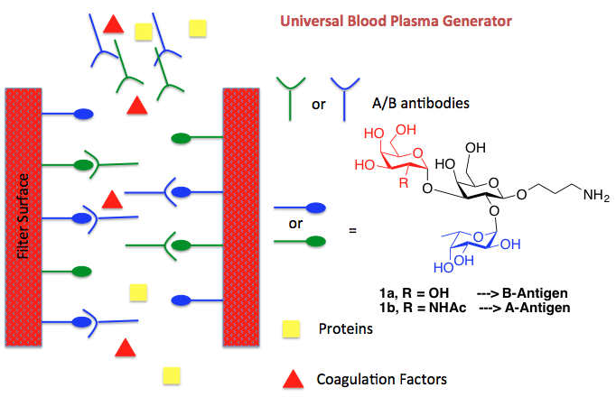
concept
In order to obtain an universal plasma, all antibodies present in the serum must be removed.

Slide 20
Materials Required for antibody affinity column
Solid support capable of allowing antibody infused plasma to flow through.
Solid support capable of accommodating both A and B antigens on its surface.
Conjugatable A and B antigen compounds capable of binding anti-A and anti-B antibodies.

Slide 21
Materials Required for antibody affinity column
Solid support capable of allowing antibody infused plasma to flow through.
Solid support capable of accommodating both A and B antigens on its surface.
Conjugatable A and B antigen compounds capable of binding anti-A and anti-B antibodies.

Slide 22
Solid support/antigen immobilization
Monomer Synthesis
Polymerization and immobilization of B-antigen

Slide 23
Materials Required for antibody affinity column
Solid support capable of allowing antibody infused plasma to flow through.
Solid support capable of accommodating both A and B antigens on its surface.
Conjugatable A and B antigen compounds capable of binding anti-A and anti-B antibodies.

Slide 24
Targets
Terminal amine in both antigens will be the latch point for the solid support.

Slide 25
B-antigen (1st generation) retrosynthesis
The first generation B-antigen was prepared using a 2,3,4,6-O-tetra-benzyl
galactose thioglycoside donor (show in red) for the final glycosylation step. However
this did not give complete α-selectivity and another galactose donor was designed.

Slide 26
B-antigen (2nd generation) retrosynthesis
Using a 4,6-O-benzylidene protection on the second generation galactose donor gave
Excellent stereocontrol upon glycosylation. Producing the α-selective linkage desired.

Slide 27
B-antigen (2nd generation) building block synthesis

Slide 28
Target:

Slide 29
Target:

Slide 30
Target:

Slide 31
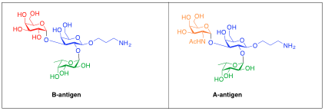
Common disaccharide core

Slide 32
B-antigen (2nd generation)
52%
α-selective
~99%

Slide 33
Work towards a-antigen
Several approaches currently under investigation.
Relevant building blocks:

Slide 35
Having trouble getting acceptable yields from this glycosylation.

Slide 36
Deprotection/acetylation strategy
A-antigen

Slide 38
80%
α-selectivity with good yield

Slide 39
Deprotection/acetylation strategies
Azide reduction MUST be regioselective
A-antigen
Knouzi, N.; Vaultier, M.; Carrie ́, R. Bull. Soc. Chim. Fr. 1985, 5, 815- 819.

Slide 40
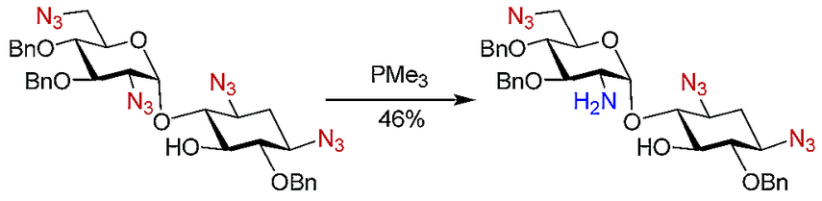
Alternative
Also regioselective
Wong, C.; Nyffeler, P.; Liang, C.; Koeller, K. J. AM. CHEM. SOC. 2002, 124, 10773-10778

Slide 41
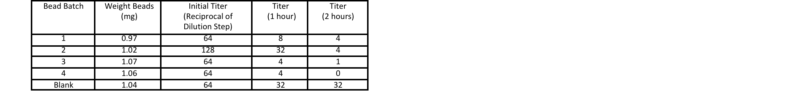
Initial results using b-antigen plasma column

