Slide 1


Behavioral finance tools for farmers’ input price risk management
Riccardo Spada¹, Emilia Mattsson², Simone Cerroni³, Laura Moritz³, Jens Rommel², Miranda Meuwissen¹, Tobias Dalhaus¹
26/08/2025 – EAAE Conference Bonn, Germany
¹ Wageningen University and Research, Wageningen, The Netherlands
² Swedish University of Agricultural Sciences, Uppsala, Sweden
³ University of Trento, Trento, Italy
This work has received funding from the Swiss State Secretariat for Education, Research and Innovation (SERI)

Slide 2
Introduction
Fertilizer prices have experienced substantial volatility in the past few decades
Price risk management tools can reduce the financial exposure to price volatility (Hardaker et al., 2015)
Adoption is below what EUT suggest
Behavioural economic theories might better explain adoption decisions (Spada et al., n.d.; Mattos et al., 2008).
Notes: Monthly indices based on nominal US dollars, 2010=100; Weights used in the World Bank Fertilizer Price Index (in Percent): 16.9 natural phosphate rock, 21.7 phosphate, 20.1 potassium, 41.3 nitrogenous.
Source: World Bank monthly commodity prices data "Pink Sheet" March 2024

Slide 3
Objectives
Adjust contract specifics of fertilizer contracts to better fit farmers' behavioural preferences
Show how contract adjustments potentially affect farmers utility under different decision theories and different framing

Slide 4
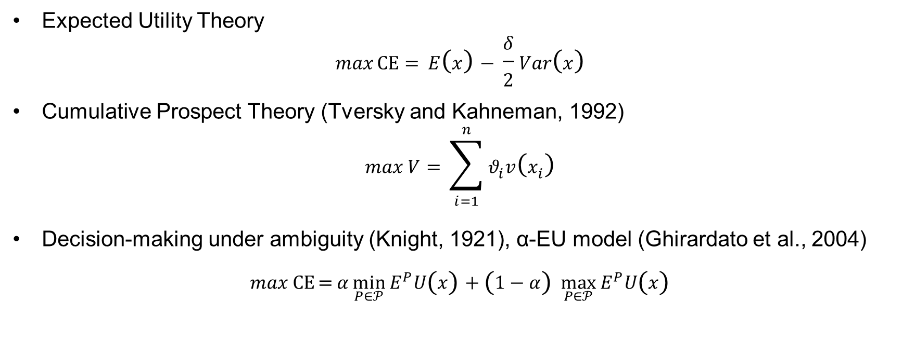
Decision Theories
Expected Utility Theory
$$\begin{aligned}maxCE={ E\left(x\right)− \frac{δ}{2}Var\left(x\right)}\#\end{aligned}$$
Cumulative Prospect Theory (Tversky and Kahneman, 1992)
$$\max{V= }\sum_{i=1}^{n}{θ_{i}v\left(x_{i}\right)}$$
Decision-making under ambiguity (Knight, 1921), α-EU model (Ghirardato et al., 2004)
$$max CE={α\min_{P∈𝒫}{E^{P}U\left(x\right)}+\left(1−α\right) \max_{P∈𝒫}{E^{P}U\left(x\right)}}$$

Slide 5
Decision framing
Decision-makers can evaluate risky decisions using different mental framing (Tversky & Kahneman, 1981)
Broad framing
risky choices are considered in conjunction with other risks, utility is defined over total wealth or profits
input contracting as a tool for risk management
Narrow framing (Barberis et al., 2006)
risky choices considered separately from other risks, utility is narrowly defined
input contracting as a stand-alone investment

Slide 6
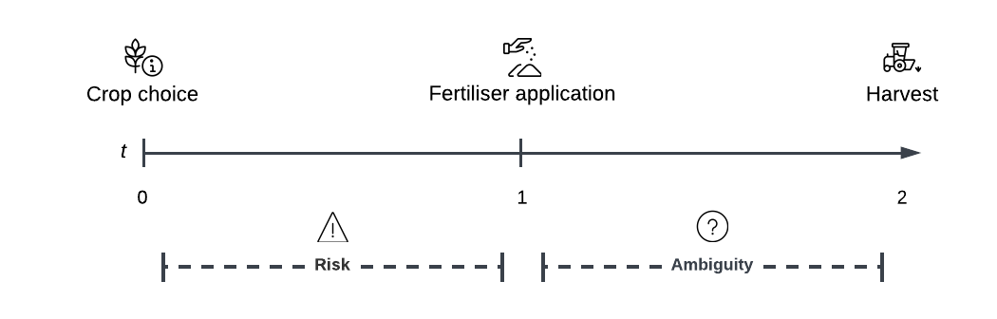
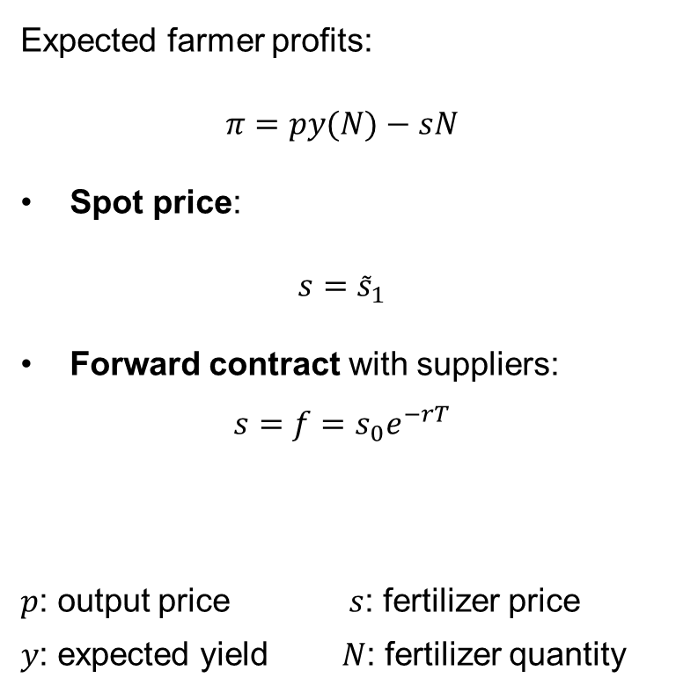
Economic model
Expected farmer profits:
$π=py(N)−sN$
Spot price:
$s={\tilde{s}}_{1}$
Forward contract with suppliers:
$$s=f=s_{0}e^{−rT}$$
$p$: output price $s$: fertilizer price
𝑦: expected yield $N$: fertilizer quantity

Slide 7
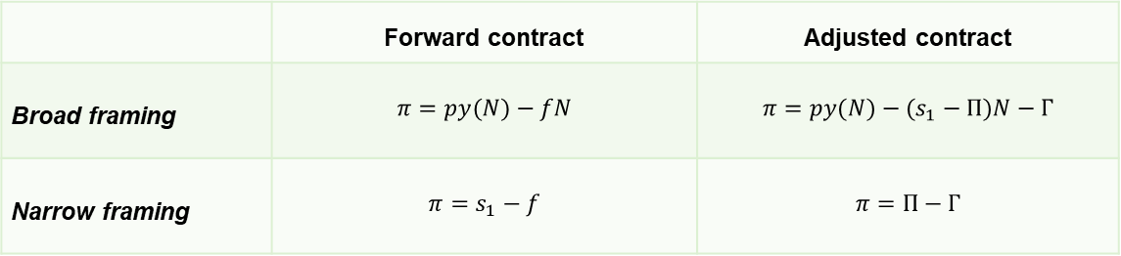
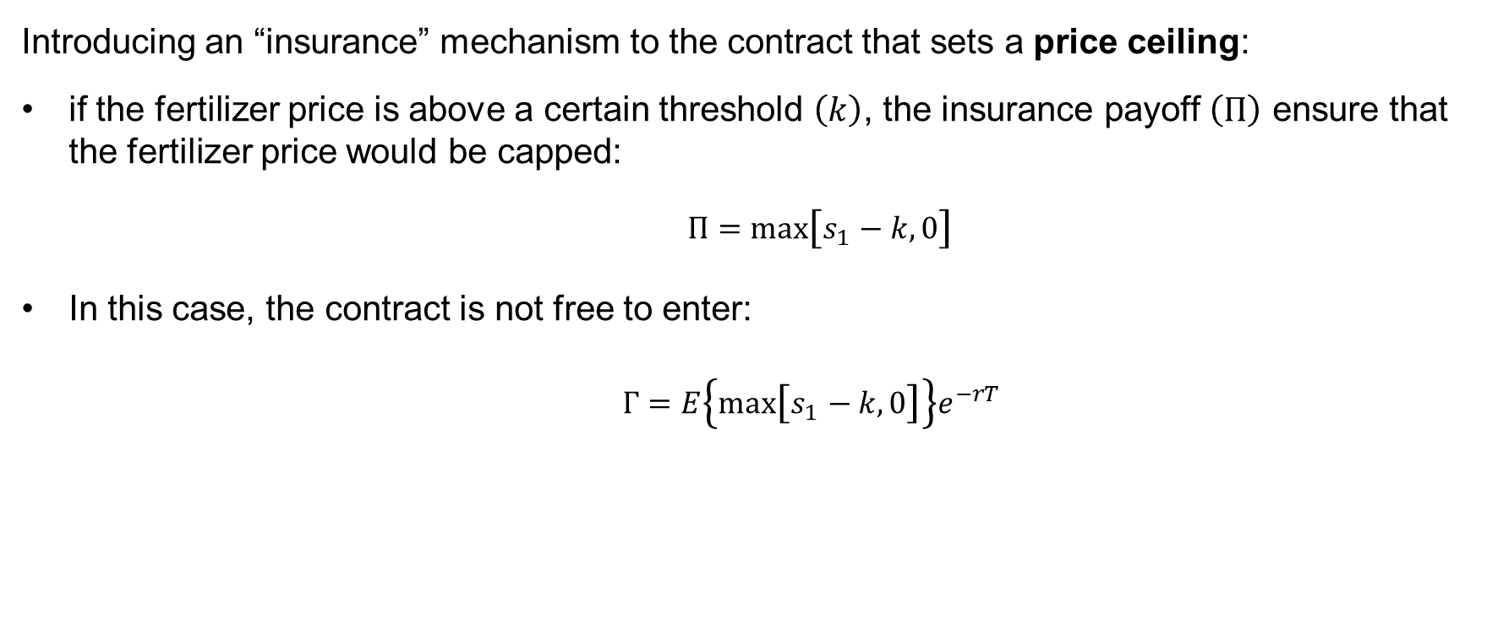
Adjusted contract design
Introducing an “insurance” mechanism to the contract that sets a price ceiling:
if the fertilizer price is above a certain threshold $\left.\left(k\right.\right)$, the insurance payoff $\left(Π\right)$ ensure that the fertilizer price would be capped:
$Π=\max\left[s_{1}−k,0\right]$
In this case, the contract is not free to enter:
$Γ=E\left\{\max\left[s_{1}−k,0\right]\right\}e^{−rT}$
 | Forward contract | Adjusted contract
Broad framing | $$π=py(N)−fN$$ | $$π=py(N)−(s_{1}−Π)N−Γ$$
Narrow framing | $$π=s_{1}−f$$ | $$π=Π−Γ$$

Slide 8
Methodology and Data
Nitrogen-yield relationship
Crop simulation model
Just & Pope (1978, 1979) production function
Nitrogen prices – Yield prices relationship
Quantile Vector Autoregression
Contract pricing
Heston model (extension to Black-Scholes with stochastic volatility)
Fertilizer prices
World Bank Commodity prices (urea), monthly data
Montecarlo simulation of farmers utility under different preferences and framing

Slide 9

Thank you
Riccardo Spada
riccardo.spada@wur.nl

Slide 10
References
Barberis, N., Huang, M., & Thaler, R. H. (2006). Individual Preferences, Monetary Gambles, and Stock Market Participation: A Case for Narrow Framing. American Economic Review, 96(4), 1069–1090. https://doi.org/10.1257/aer.96.4.1069
Ghirardato, P., Maccheroni, F., & Marinacci, M. (2004). Differentiating ambiguity and ambiguity attitude. Journal of Economic Theory, 118(2), 133–173. https://doi.org/10.1016/j.jet.2003.12.004
Hardaker, J. B., Huirne, R. B. M., Anderson, J. R., & Lien, G. (2015). Coping With Risk in Agriculture (3rd ed.). CABI Publishing. https://www.cabidigitallibrary.org/doi/book/10.1079/9781780645742.0000
Just, R. E., & Pope, R. D. (1978). Stochastic specification of production functions and economic implications. Journal of Econometrics, 7(1), 67–86. https://doi.org/10.1016/0304-4076(78)90006-4
Just, R. E., & Pope, R. D. (1979). Production Function Estimation and Related Risk Considerations. American Journal of Agricultural Economics, 61(2), 276–284. https://doi.org/10.2307/1239732
Knight, F. H. (1921). Risk, uncertainty and profit (Vol. 31). Houghton Mifflin.
Mattos, F., Garcia, P., & Pennings, J. M. E. (2008). Probability weighting and loss aversion in futures hedging. Journal of Financial Markets, 11(4), 433–452. https://doi.org/10.1016/j.finmar.2008.04.002
Spada, R., Moritz, L., Rommel, J., Cerroni, S., Meuwissen, M. P. M., & Dalhaus, T. (2025). Behavioral Preferences Affecting the Adoption of Financial Price Risk Management Tools in Agriculture: A Systematic Literature Review. https://doi.org/10.22004/ag.econ.356632
Tversky, A., & Kahneman, D. (1981). The Framing of Decisions and the Psychology of Choice. Science, 211(4481), 453–458. https://doi.org/10.1126/science.7455683
Tversky, A., & Kahneman, D. (1992). Advances in prospect theory: Cumulative representation of uncertainty. Journal of Risk and Uncertainty, 5(4), 297–323. https://doi.org/10.1007/BF00122574

