Slide 1


Farmers input price risk management
Literature Insights and Research Agenda on Input Contract Adjustment
Riccardo Spada
Business Economics Group
Wageningen University & Research
MATS Summer School on Agricultural Finance
Aussois, France
June 30 - July 4, 2025

Slide 2
Literature review
Behavioral Preferences and Price Risk Management: A Systematic Literature Review
Riccardo Spada¹, Laura Moritz², Jens Rommel³, Simone Cerroni², Miranda Meuwissen¹, Tobias Dalhaus¹
¹ Wageningen University and Research
² University of Trento
³ Swedish University of Agricultural Science

Slide 3
Literature review
Recent geopolitical crises have caused substantial volatility on agricultural markets (Vigani et al., 2024)
Risk management tools can be used for price risk (Hardaker et al., 2004)
Previous research argues that farmers’ decisions are in general influenced by behavioral factors (Dessart et al., 2019; Palm-Forster et al., 2019; Wuepper et al., 2023)
Conduct a systematic literature review to identify behavioral factors that influence the adoption of financial tools for price risk management in agriculture

Slide 4
Literature review
Conceptual framework
Behavioral preferences
Psychological factors
formally recognized in economic models
describe farmer preferences but are not mathematically implemented into a theoretical economic model
(e.g. risk, uncertainty, time preferences and hyperbolic discounting, loss aversion, or probability weighting)
(e.g. social interaction, culture, and personality traits)

Slide 5
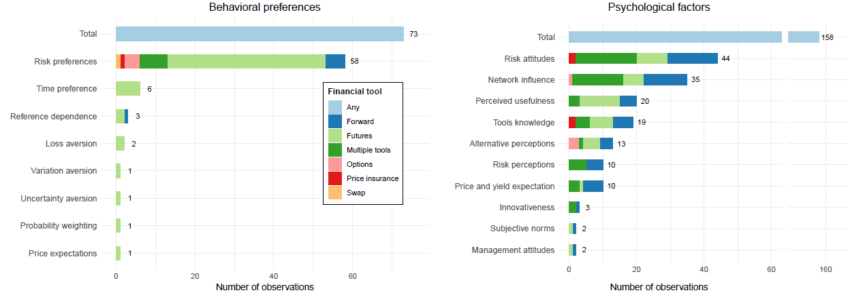
Literature review
Results
Figure 1. Overview of behavioural preferences and psychological factors

Slide 6
Literature review
Conclusions
Behavioral preferences
Psychological factors
Risk aversion still the main paradigm
Directional effect is mixed
Only a handful of studies relate price risk management and reference dependence, loss aversion, and uncertainty preferences
Network influences and tools knowledge were found as an important factor in adoption decision
Extension services, financial tools providers, and policy makers can have a role in providing training and education to improve farmers’ decision-making ability regarding price risk
Notes:
We currently have a very limited understanding of farmers’ price risk management adoption and related decision-making processes

Slide 7
Research agenda Paper 2
Behavioural finance tools for farmers’ input price risk management
Riccardo Spada¹, Miranda Meuwissen¹, Tobias Dalhaus¹
¹ Wageningen University and Research

Slide 8
Introduction
(Nitrogen) fertilizers stand out as one of the most relevant agricultural inputs
  Increase productivity
  High share of input costs (crop farms)
  Environmental concern
Fertilizer support to agricultural producers in the EU during the 2020-2022 period almost doubled compared to the 2015-2019 average, reaching USD 27.1 billion in OECD countries (Jones & Deuss, 2024)

Slide 9
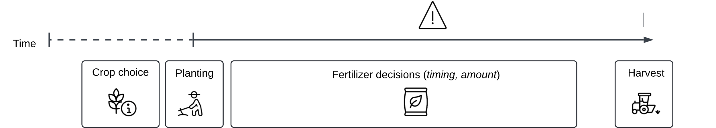
Introduction
Farmers buy fertilizers at spot price or forward contract with suppliers
Figure 2. Simple production timeline

Slide 10
Objectives
Adjust contract specifics of suppliers contracts for farmers’ input price risk management to better fit farmers' behavioural preferences
Show how contract adjustments potentially affect farmers utility under different decision theories and different framing

Slide 11
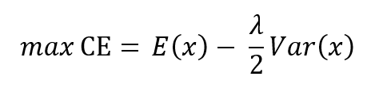


Decision-making theories
Expected Utility Theory
Cumulative Prospect Theory (Tversky and Kahneman, 1992)
Decision-making under uncertainty (Knight, 1921)
Notes:
We know farmers behave heterogeneously: some behave as EUT max, some as CPT max and some under uncertainty.

Slide 12




Economic model and contract design
When farmers buy fertilisers they pay the market price
When forward contracting, the input costs become fixed, with the forward price calculated as:
introducing an “insurance” mechanism to the contract:

Slide 13

Framing
Traditional (broad) framing → risky choices are considered broadly in conjunction with other risks, by defining the utility of total wealth or profits.
Narrow framing → farmers consider contracts decisions as a stand-alone investment:
for a forward contract:
for the adjusted contract:

Slide 14
Data and Empirical strategy
Fertilizer prices
World Bank Commodity prices (urea), monthly data
Farm input prices (?)
Relationship fertilizer-yield
Moment-based approach (Antle, 1983)
Contract pricing
Black-Scholes

Slide 15
Next steps
Decision model:
  Winter wheat case
  Other costs
Extend to multi-year contracts
Experimental investigation on farmer acceptance of adjusted contracts

Slide 16


Thank you
Riccardo Spada
riccardo.spada@wur.nl
AgEnRes project
https://agenres.eu/

Slide 17
Appendix

Slide 18
Behavioral Preferences and Price Risk Management: A Systematic Literature Review
Riccardo Spada¹, Laura Moritz², Jens Rommel³, Simone Cerroni², Miranda Meuwissen¹, Tobias Dalhaus¹
¹ Wageningen University and Research
² University of Trento
³ Swedish University of Agricultural Science

Slide 19
Conceptual framework
Behavioral economists developed extensions of Expected Utility Theory and relax some of its assumption by incorporating new behavioral preferences
Social-psychological factors not yet considered formally in economic models, play an increasing role in applied agricultural economics research

Slide 20
Conceptual framework
Behavioral preferences
Psychological factors
formally recognized in economic models
describe farmer preferences but are not mathematically implemented into a theoretical economic model
(e.g. risk, uncertainty, time preferences and hyperbolic discounting, loss aversion, or probability weighting)
(e.g. social interaction, culture, and personality traits).

Slide 21
Conceptual framework
Behavioral preferences
Decision-making theories:
Expected Utility Theory
Cumulative Prospect Theory (Tversky & Kahneman, 1992)
Theories under uncertainty and ambiguity (Savage, 1954; Klibanoff et al., 2005)
risk preferences
loss aversion
probability weighting
time preferences
uncertainty aversion
subjective probabilities

Slide 22
Conceptual framework
Psychological factors
Following the approach proposed by Dessart et al. (2019):
Dispositional factors
  rather stable internal factors of a given individual
Social factors
  relate to the network and social environment
Cognitive factors
  related to learning and reasoning and are more closely dependent on the specific decision-making process

Slide 23
Methods
Systematic Literature Review
Pre-registration plan (Spada et al., 2024)
PRISMA guidelines (Page et al., 2021)
1
Research question
2
Search strategy
3
Eligibility criteria
4
Screening and selection
5
Data extraction
6
Data analysis
Databases: Scopus; Web Of Science
Search string:
Farmers
Financial tools
Behavioral factors
  Behavioral preferences
  Psychological factors

Slide 24
Methods
 | Inclusion criteria
Subject | Farmers
Decision making | Adoption of financial price risk management tools: Forward contracts Futures contracts Options contracts Price insurances Other price tools Impact of behavioral preferences and psychological factors on adoption
Geography | Agricultural systems in countries classified as "advanced economies"¹
Type of report | Peer-reviewed literature
Year of publication | No limit
Language | English
Eligibility
¹ Following the International Monetary Fund “advanced economies” classification.

Slide 25
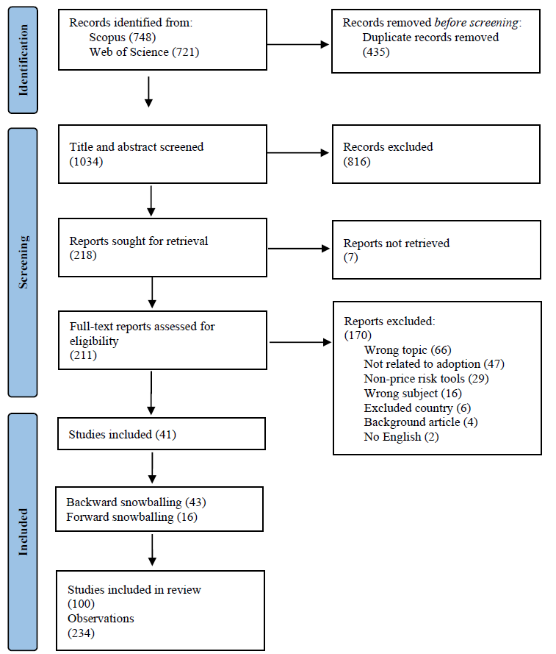
Methods
Screening
1469 entries obtained through the search process
To ensure literature saturation, a snowballing method was implemented

Slide 26
Results
Categorization
Behavioral preferences | Psychological factors
Risk preferences Time preferences Uncertainty and Variation aversion Probability weighting Loss aversion Reference dependence Price expectations | Dispositional factors Risk attitudes Innovativeness Management attitudes Social factors Network influence Social norms Cognitive factors Tool knowledge and perceived ease of use Alternative perceptions Perceived usefulness Risk perceptions Price and yield expectations

Slide 27
Results
Methodological categorization
Behavioral preferences | Number of papers | Psychological factors | Number of papers
Theoretical models | 15 | Experiments | 40
Optimizations | 42 | Econometric methods | 3
Stochastic dominance | 2
Total | 57 | Total | 43

Slide 28
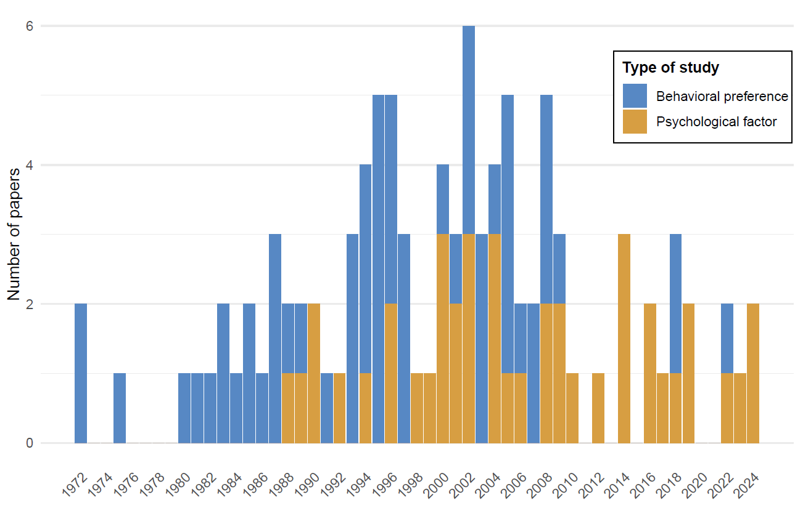
Results
Distribution of publication over time

Slide 29
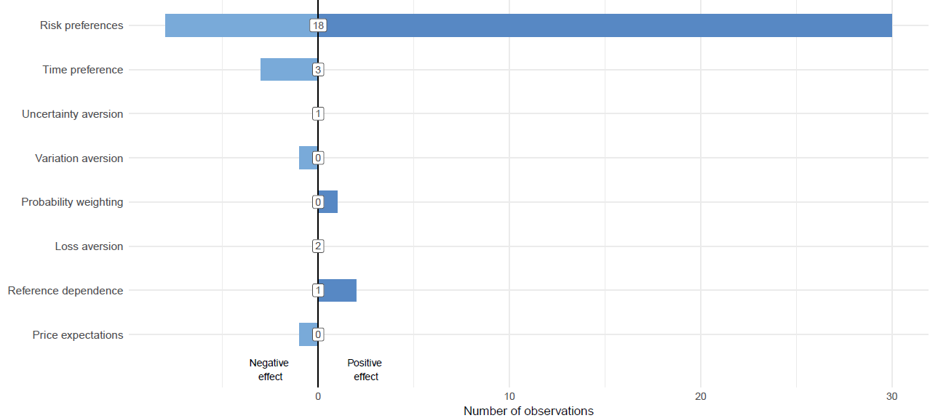
Behavioral preferences
Notes: Numbers inside the boxes indicate the number of statistically insignificant observations.

Slide 30
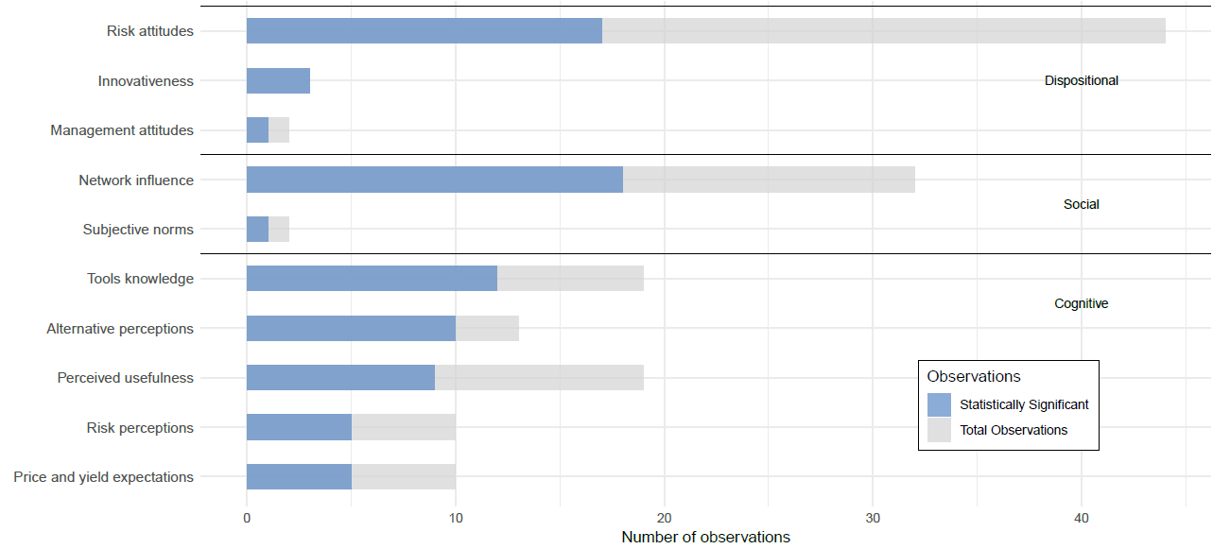
Psychological factors
Statistically significant results relative to total observations

Slide 31
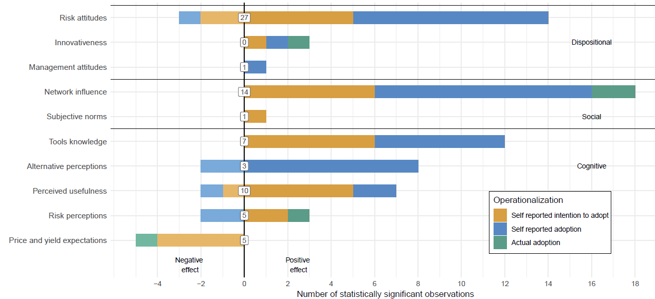
Psychological factors
Effect and direction of statistically significant results
Notes: Numbers inside the boxes indicate the number of statistically insignificant observations.

Slide 32
References
Dessart, F. J., Barreiro-Hurlé, J., & van Bavel, R. (2019). Behavioural factors affecting the adoption of sustainable farming practices: a policy-oriented review. European Review of Agricultural Economics, 46(3), 417–471. https://doi.org/10.1093/erae/jbz019
Hardaker, J., Lien, G., Anderson, J., & Huirne, R. B. M. (2004). Coping with risk in agriculture (J. B. Hardaker, R. B. M. Huirne, J. R. Anderson, & G. Lien, Eds.; 3rd ed.). CABI. https://doi.org/10.1079/9780851998312.0000
Jones, D. and A. Deuss (2024), “Understanding the resilience of fertiliser markets to shocks: An overview of fertiliser policies”, OECD Food, Agriculture and Fisheries Papers, No. 208, OECD Publishing, Paris, https://doi-org.ezproxy.library.wur.nl/10.1787/43664170-en.
Klibanoff, P., Marinacci, M., & Mukerji, S. (2005). A Smooth Model of Decision Making under Ambiguity. Econometrica, 73(6), 1849–1892. https://doi.org/10.1111/j.1468-0262.2005.00640.x
Page, M. J., McKenzie, J. E., Bossuyt, P. M., Boutron, I., Hoffmann, T. C., Mulrow, C. D., Shamseer, L., Tetzlaff, J. M., Akl, E. A., Brennan, S. E., Chou, R., Glanville, J., Grimshaw, J. M., Hróbjartsson, A., Lalu, M. M., Li, T., Loder, E. W., Mayo-Wilson, E., McDonald, S., … Moher, D. (2021). The PRISMA 2020 statement: an updated guideline for reporting systematic reviews. BMJ, 372, n71. https://doi.org/10.1136/bmj.n71
Palm-Forster, L. H., Ferraro, P. J., Janusch, N., Vossler, C. A., & Messer, K. D. (2019). Behavioral and Experimental Agri-Environmental Research: Methodological Challenges, Literature Gaps, and Recommendations. Environmental and Resource Economics, 73(3), 719–742. https://doi.org/10.1007/S10640-019-00342-X/TABLES/2
Savage, L. J. (1954). The foundations of statistics. In Naval Research Logistics Quarterly (Vol. 1, Issue 3). John Wiley & Sons, Ltd. https://doi.org/10.1002/nav.3800010316

Slide 33
References
Shapiro, B. I., & Brorsen, B. W. (1988). Factors Affecting Farmers’ Hedging Decisions. North Central Journal of Agricultural Economics, 10(2), 145. https://doi.org/10.2307/1349215
Spada, R., Moritz, L., Rommel, J., Cerroni, S., Meuwissen, M., & Dalhaus, T. (2024). Pre-registration plan for “Understanding Farmers Behavior in the Adoption of Financial Price Risk Management Tools: A Systematic Literature Review.” https://doi.org/10.17605/OSF.IO/9XYK7
Tversky, A., & Kahneman, D. (1992). Advances in prospect theory: Cumulative representation of uncertainty. Journal of Risk and Uncertainty, 5(4), 297–323. https://doi.org/10.1007/BF00122574
Vigani, M., Fellmann, T., Porcella Capkovicova, A., & Ferrari, E. (2024). Harvesting resilience: adapting the EU agricultural system to global challenges. Npj Sustainable Agriculture 2024 2:1, 2(1), 1–7. https://doi.org/10.1038/s44264-024-00028-y
Wuepper, D., Bukchin‐Peles, S., Just, D., & Zilberman, D. (2023). Behavioral agricultural economics. Applied Economic Perspectives and Policy, 45(4), 2094–2105. https://doi.org/10.1002/aepp.13343

