Slide 1
Thulseram Naidu kb
Final Project
04/04/2024 Annual Review

Slide 2
IllustrationGAN: Generating Anime Faces with GANs
Create a Generative Adversarial Network (GAN) that can produce images of Aime Faces
04/04/2024 Annual Review

Slide 3


AGENDA
Problem Statement
Project Overview
End Users
Solution and Value Proposition
Unique Aspects of the Solution
Modelling
Results
04/04/2024 Annual Review

Slide 4

PROBLEM STATEMENT
Utilizing Generative Adversarial Networks (GANs), our project endeavors to generate anime faces resembling those found in popular Japanese animation. Drawing from a diverse dataset of anime character images, we aim to produce new and compelling faces with intricate details and expressive features. This initiative serves as a valuable resource for artists, game developers, and enthusiasts within the anime community, fostering creativity and innovation in character design.
04/04/2024 Annual Review

Slide 5

PROJECT OVERVIEW
Our project revolves around the implementation of Generative Adversarial Networks (GANs) to generate anime faces. Leveraging a comprehensive dataset of anime character images, we seek to employ GANs to synthesize new and diverse anime faces with intricate details and expressive features. This initiative not only aims to produce high-quality anime faces but also serves as a platform for exploring the intersection of machine learning and artistic expression in the context of Japanese animation.
04/04/2024 Annual Review

Slide 6

WHO ARE THE END USERS?
The end users of our project are enthusiasts and creators within the anime community, including artists, designers, and fans of Japanese animation. Additionally, researchers and developers in the fields of artificial intelligence and computer graphics may also benefit from our work, utilizing the generated anime faces for various applications such as character generation, animation, and content creation.
04/04/2024 Annual Review

Slide 7

SOLUTION AND ITS VALUE PROPOSITION
Our solution leverages Generative Adversarial Networks (GANs) to generate high-quality anime faces. By utilizing GANs, we can produce novel and realistic anime-style images that closely resemble those created by human artists. This provides a valuable tool for artists and designers looking to create diverse and unique anime characters for various projects, including illustrations, animations, games, and more. Additionally, our solution offers researchers and developers a platform to explore and advance the capabilities of GANs in generating complex and artistic content.
04/04/2024 Annual Review

Slide 8

THE WOW IN SOLUTION
Our solution leverages Generative Adversarial Networks (GANs) to generate high-quality anime faces with unparalleled realism. By harnessing the power of GANs, we empower artists and enthusiasts to create captivating anime-style characters with ease and precision. With our innovative approach, users can unlock limitless creative possibilities, inspiring a new wave of artistic expression and imagination in the anime community.
04/04/2024 Annual Review
8

Slide 9
MODELLING
Utilizing advanced deep learning techniques, our model learns the intricate features and patterns of anime faces from a diverse dataset. Through an iterative process, the generator network generates images that progressively resemble authentic anime characters, while the discriminator network ensures the fidelity and realism of the generated faces. This intricate interplay between the generator and discriminator culminates in the production of high-fidelity anime faces that exhibit remarkable visual appeal and authenticity.
04/04/2024 Annual Review
9

Slide 10
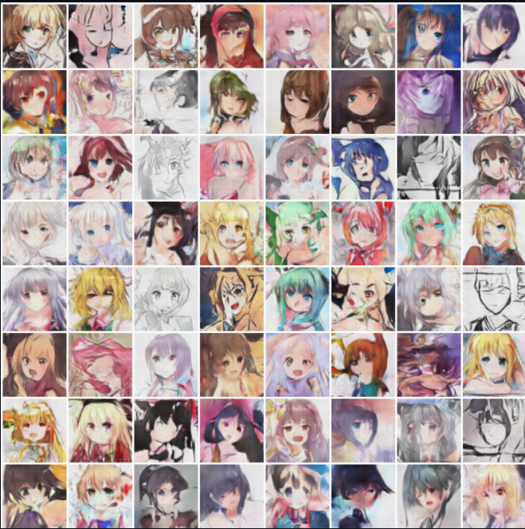
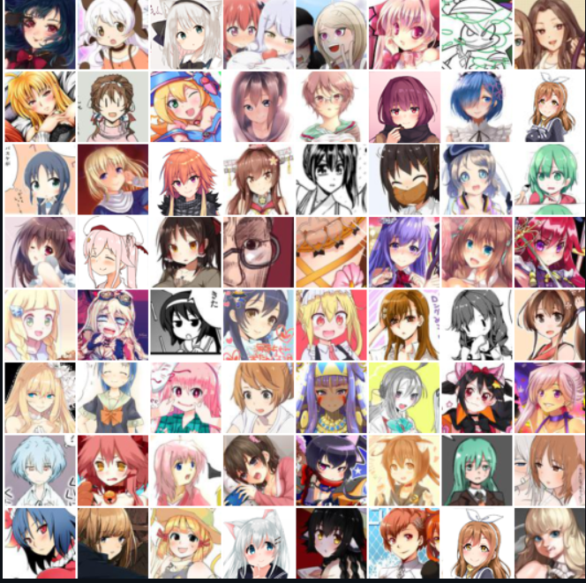
RESULTS
Generated
Original
Demo Link
04/04/2024 Annual Review
10

Slide 11
CONCLUSION
In conclusion, our GAN architecture excels in generating lifelike anime faces, offering a novel tool for artists and animators. With its ability to produce diverse and realistic anime characters, our model represents a significant advancement in computer-generated imagery, enabling new possibilities for creativity and innovation in anime artistry.
04/04/2024 Annual Review
11

Slide 12
REFERENCES
https://www.tensorflow.org/
https://keras.io/
https://numpy.org/
https://matplotlib.org/
scikit-learn: machine learning in Python — scikit-learn 1.4.1 documentation
MNIST handwritten digit database, Yann LeCun, Corinna Cortes and Chris Burges
https://www.techtarget.com/searchenterpriseai/definition/generative-adversarial-network-GAN
01/04/2024 Annual Review
12

