Slide 1
Comparative Analysis of Classification Algorithms
SVC, Perceptron, MLP, Decision Tree, Naive Bayes, KNN, AdaBoost & Random Forest
Mustafa
December 17, 2025

Slide 2
Outline
Definitions of major classifiers
Key differences & characteristics
Typical use cases & applications
Illustrative examples
Experimental comparison & trade‑offs
Recommendations & conclusions

Slide 3
Classifier Definitions
Algorithm | Definition
SVC | C-Support Vector Classification maximises the margin between classes using kernel functions; training complexity grows quadratically with the number of samples.
Perceptron | A linear classifier trained using the perceptron loss; a special case of stochastic gradient descent with a constant learning rate.
MLPClassifier | A multi-layer perceptron that minimises log-loss using L-BFGS, SGD, or Adam; hidden layers and activation functions enable modelling of non-linear relationships.
Decision Tree | A flowchart-based model of feature tests and outcomes; a non-parametric white-box classifier that is easy to interpret and typically fast to train.
Gaussian NB | A Naive Bayes classifier assuming Gaussian feature distributions and conditional independence between features; supports online updates via partial fitting.
KNN | k-Nearest Neighbours classifies instances by majority vote of the k closest samples using a chosen distance metric; weights may be uniform or distance-based.
AdaBoost | An ensemble method that sequentially reweights misclassified samples so subsequent weak learners focus on harder cases.
Random Forest | An ensemble of decision trees trained on bootstrapped subsets with feature randomness; predictions are aggregated to improve accuracy and reduce overfitting.
[1] [2] [3] [4] [5] [6] [7] [8] [9]

Slide 4
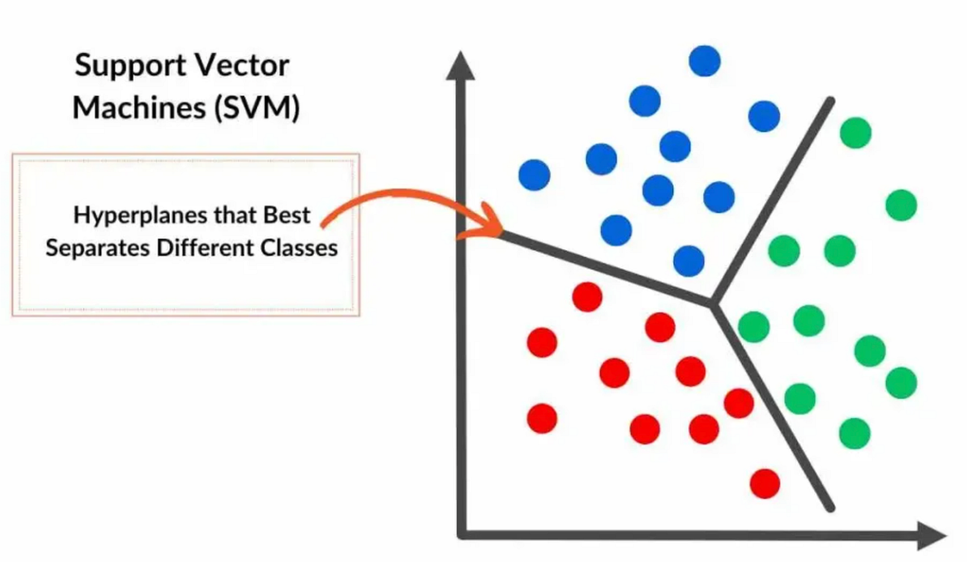
SVC: Support Vector Classifier (Support Vector Machine for classification)
Key idea: maximise the margin between classes
Where We Use It:
Binary and multi-class classification problems
High-dimensional data (e.g. text classification, bioinformatics)
Non-linear classification using kernel functions (RBF, polynomial)
Advantages:
Effective in high-dimensional feature spaces
Maximizes margin → good generalization
Kernel trick enables non-linear decision boundaries
Disadvantages:
Computationally expensive for large datasets
Sensitive to kernel choice and hyperparameters
Less interpretable than tree-based models
Conclusion: SVC performs well on complex and high-dimensional datasets by maximising class separation, but its practical use is constrained by computational cost and the need for careful parameter tuning.

Slide 5
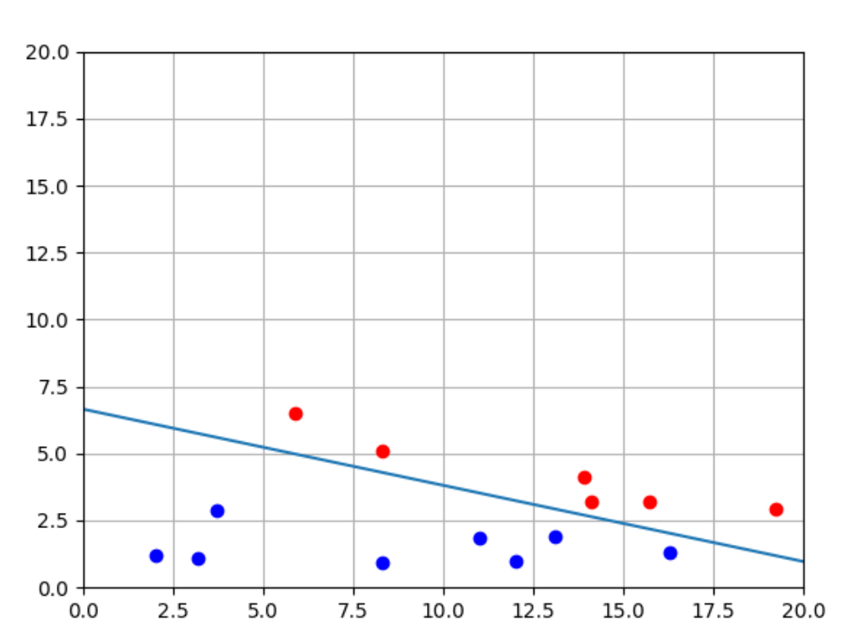
Perceptron (Single-Layer Perceptron Classifier)
Key idea: learn a linear decision boundary using misclassification updates
Where We Use It:
Binary classification with linearly separable data
Baseline models and educational demonstrations
Large datasets requiring very fast training
Advantages:
Simple and computationally efficient
Fast convergence on linearly separable data
Easy to implement and understand
Disadvantages:
Works only for linearly separable problems
Cannot model non-linear decision boundaries
Sensitive to noisy and non-separable data
Conclusion: The Perceptron is a simple and efficient linear classifier that serves as a strong baseline and learning tool, but its applicability is limited to linearly separable data and it cannot capture complex patterns.

Slide 6
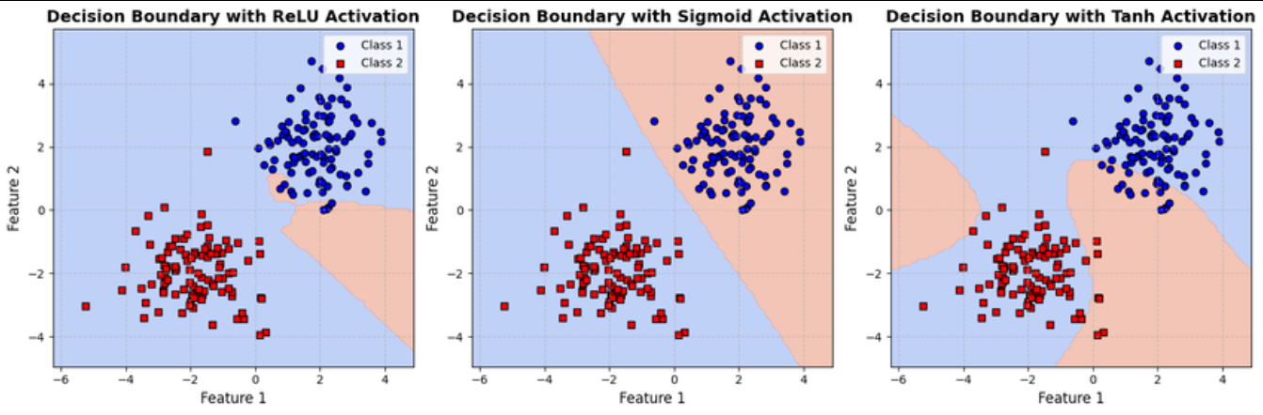
MLPClassifier (Multi-Layer Perceptron Classifier)
Key idea: learn complex non-linear decision boundaries using multiple neural network layers
Where We Use It:
Non-linear classification problems
Medium-sized datasets with complex feature interactions
Pattern recognition tasks (e.g. image, speech, tabular data)
Advantages:
Capable of modelling complex non-linear relationships
Flexible architecture (hidden layers, neurons, activations)
Strong performance when properly tuned
Disadvantages:
Computationally expensive to train
Sensitive to hyperparameter selection and initialisation
Less interpretable than linear and tree-based models
Conclusion: MLPClassifier is a powerful non-linear model that can capture complex patterns in data, but it requires careful tuning, sufficient training data, and higher computational resources compared to simpler classifiers.

Slide 7
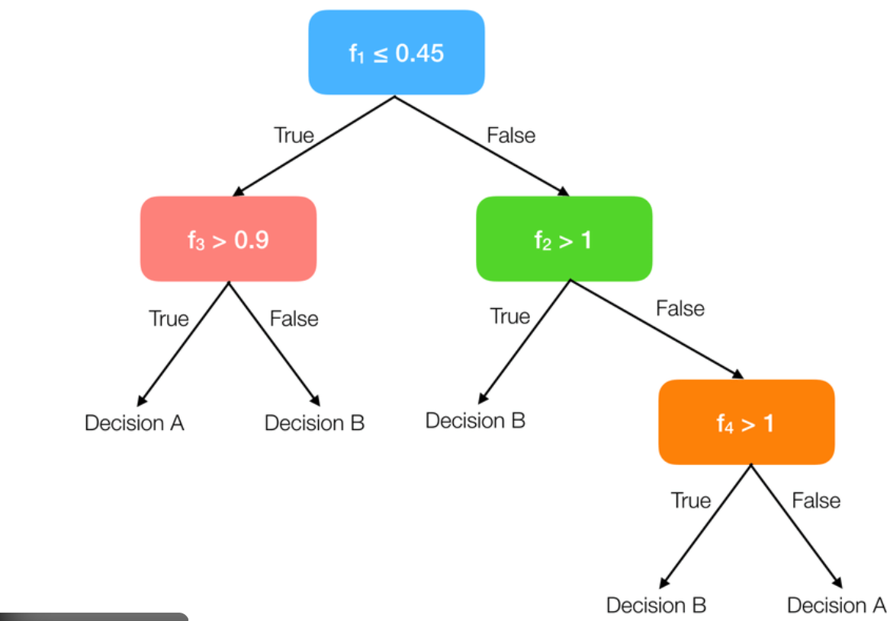
Decision Tree Classifier
Key idea: make decisions by recursively splitting data based on feature tests
Where We Use It:
Classification tasks requiring model interpretability
Tabular datasets with mixed feature types
Problems where decision rules need to be explained
Advantages:
Easy to interpret and visualise
Handles non-linear relationships naturally
Requires little data pre-processing.
Disadvantages:
Prone to overfitting, especially with deep trees
Sensitive to small changes in the training data
Often less accurate than ensemble methods
Conclusion: Decision Trees provide transparent and intuitive decision-making models, making them ideal for interpretability-focused tasks, but their tendency to overfit often necessitates pruning or ensemble-based extensions.

Slide 8
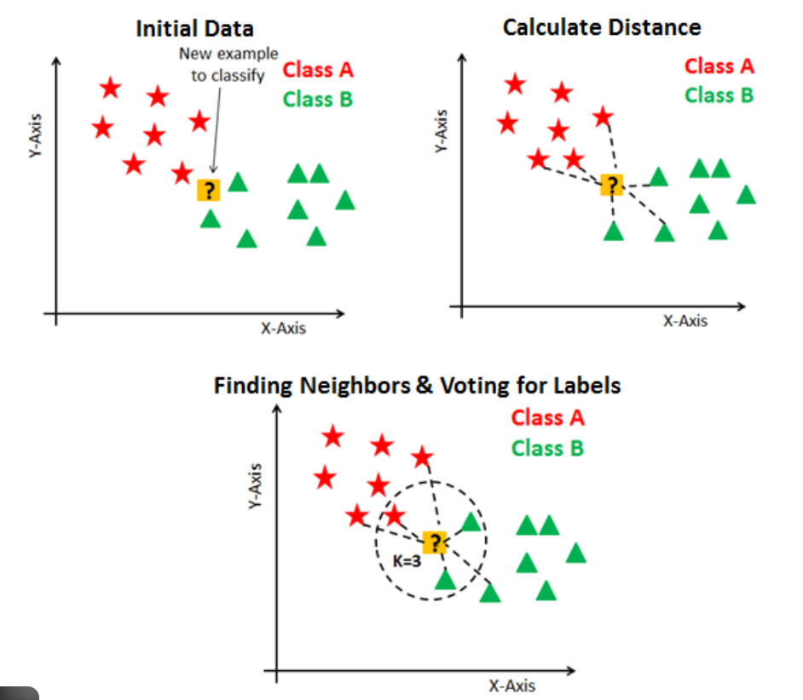
KNN (k-Nearest Neighbours Classifier)
Key idea: classify a sample based on the majority label of its nearest neighbours
Where We Use It:
Small to medium-sized datasets
Problems with irregular or complex decision boundaries
Baseline comparison and instance-based learning tasks
Advantages:
Simple and intuitive to understand
No explicit training phase
Naturally handles non-linear decision boundaries
Disadvantages:
Computationally expensive at prediction time
Sensitive to choice of k and distance metric
Performance degrades in high-dimensional spaces
Conclusion: KNN is an intuitive and flexible classifier that adapts well to complex data distributions, but its high prediction cost and sensitivity to parameter choices limit its scalability and robustness.

Slide 9
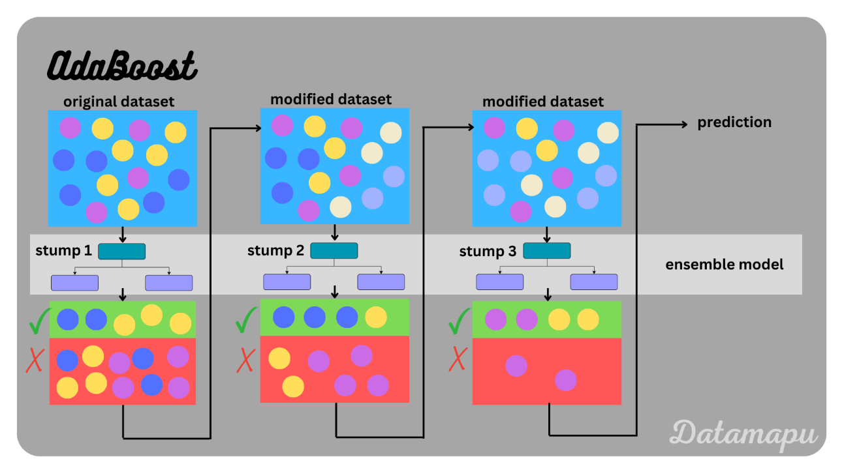
AdaBoost (Adaptive Boosting Classifier)
Key idea: combine multiple weak learners by focusing sequentially on misclassified samples
Where We Use It:
Classification problems where simple models underperform
Structured and tabular datasets
Situations requiring improved accuracy over single classifiers
Advantages:
Improves performance of weak learners
Reduces bias through sequential learning
Often achieves high accuracy with simple base models
Disadvantages:
Sensitive to noisy data and outliers
Can overfit if too many estimators are used
Training is slower than single models
Conclusion: AdaBoost is a powerful ensemble method that enhances weak classifiers by focusing on hard-to-classify samples, but its sensitivity to noise requires careful control of model complexity.

Slide 10
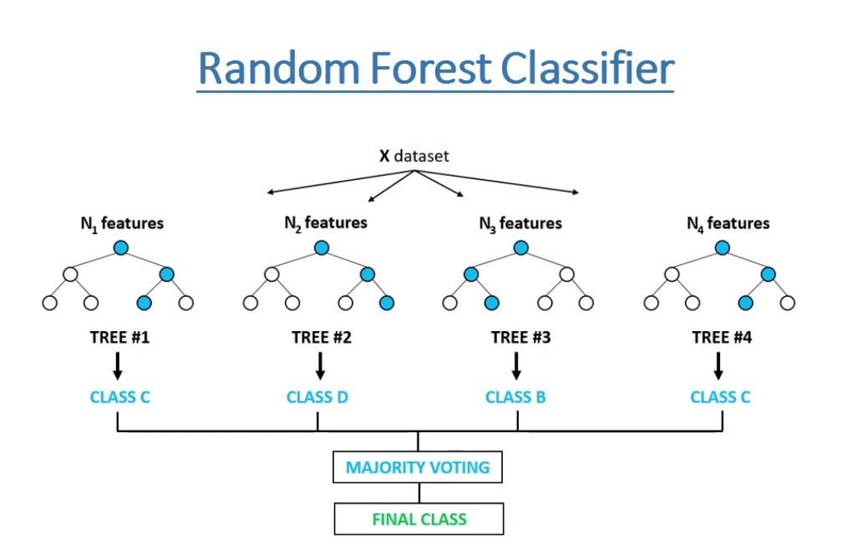
Random Forest Classifier
Key idea: combine many decision trees trained on random subsets to improve robustness and accuracy
Where We Use It:
  General-purpose classification problems
  Large tabular datasets with mixed feature types
  Applications requiring strong performance with minimal tuning
Advantages:
  High accuracy and strong generalisation
  Reduces overfitting compared to single decision trees
  Handles non-linear relationships and feature interactions well
Disadvantages:
  Less interpretable than a single decision tree
  Larger memory and computational requirements
  Slower prediction compared to simple models
Conclusion: Random Forest is a robust and reliable ensemble classifier that delivers strong performance across a wide range of problems, but this comes at the cost of reduced interpretability and increased computational complexity.

Slide 11
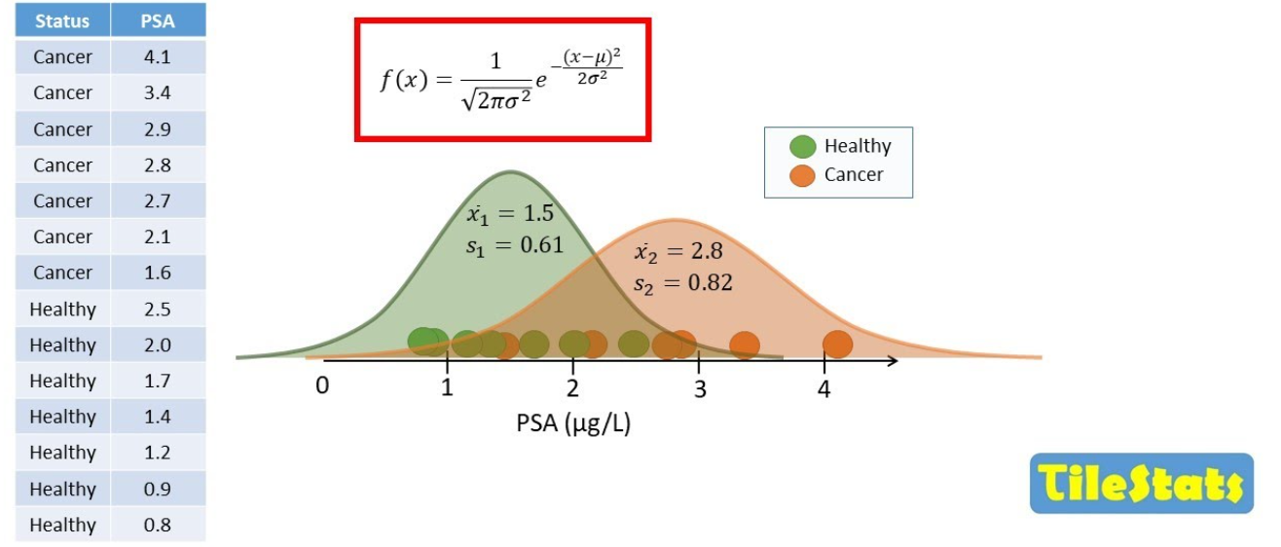
Gaussian Naive Bayes (Gaussian NB)
Key idea: apply Bayes’ theorem assuming feature independence and Gaussian distributions
Where We Use It:
Classification with continuous features
High-dimensional datasets (e.g. text and document classification)
Real-time or streaming applications due to fast training
Advantages:
Very fast training and prediction
Works well with small datasets
Performs well in high-dimensional spaces
Disadvantages:
  Strong independence assumption rarely holds in practice
  Assumes Gaussian distribution of features
  Limited ability to model complex feature interactions
Conclusion: Gaussian Naive Bayes is a simple and efficient probabilistic classifier that performs well on high-dimensional data, but its strong assumptions limit its accuracy on complex real-world problems.

Slide 12
Key Differences & Characteristics
Algorithm | Type / Nonlinearity | Interpretability | Scalability & Speed
SVC | Kernel‑based, non‑linear | Low – support vectors are not directly interpretable | Poor scalability; training complexity O(n²)
Perceptron | Linear classifier | Low – weight vector interpretable but limited | Excellent scalability; very fast training
MLP | Deep neural network, non‑linear | Low – black box model | Slow training; computationally expensive
Decision Tree | Tree‑based, non‑linear | High – explicit rules and splits | Good training speed; sensitive to noise
Gaussian NB | Probabilistic, generative | Moderate – interpretable probabilities | Extremely fast; scales well to large data
KNN | Instance‑based, non‑linear | None – lazy learner | Trivial training but slow inference on large data
AdaBoost | Ensemble of weak learners | Moderate – can inspect base learners | Moderate training speed; sequential weighting
Random Forest | Ensemble of trees | Medium – aggregated decisions | Good scalability; parallelisable but memory heavy
[1] [2] [3] [4] [5] [6] [7] [8] [9] [10] [11] [12] [13] [14]

Slide 13

When to Use Which Model?
Scenario | Recommended Models
Linearly separable or streaming tasks | Perceptron, Gaussian NB
High‑dimensional & non‑linear patterns | SVC, MLP, Random Forest
Require explainable decisions | Decision Tree, Random Forest
Limited computational resources | Gaussian NB, Perceptron, KNN
[4] [5] [6] [7] [8] [9] [10] [11] [12] [13] [14]

