Slide 1
Claudio Sartori
Department of Computer Science and Engineering claudio.sartori@unibo.it https://www.unibo.it/sitoweb/claudio.sartori/
Informatics
The basics of
Networking

Slide 2
Learning Objectives
Tell whether a communication technology (Internet, radio, LAN, etc.) is synchronous or asynchronous; broadcast or point-to-point
Explain the roles of Internet addresses, domain names, and DNS servers in networking
Distinguish between types of protocols (TCP/IP and Ethernet)
Describe how computers are interconnected by an ISP and by a LAN
Distinguish between the Internet and the World Wide Web
Explain file structure, and how to navigate up and down the hierarchy

Slide 3
Comparing Communication Types
To understand the Internet we need to cover some basic communication vocabulary:
  Synchronous Communication
  Asynchronous Communication
  Broadcast
  Communication
  Multicast
  Point-to-point communication

Slide 4
General Communication
Synchronous communication:
  Both the sender and the receiver are active at the same time (think of talking on a telephone)
Asynchronous communication:
  The sending and receiving occur at different times (think of email and answering machines)

Slide 5
General Communication
Another property of communication concerns the number of receivers
Broadcast communication: single sender and many receivers(radio and TV)
Multicast: is many receivers, but usually a specific group (specialized topics)
Point-to-point communication: one specific sender and one specific receiver (telephone call)
Notes:
Broadcast and multicast are both methods of transmitting data across a network, but they are used in different ways.
Broadcasting involves sending a message to all devices on a network simultaneously. The message is sent to a broadcast address, which is a special address that is reserved for this purpose. All devices on the network will receive the message, regardless of whether they are the intended recipient or not. Broadcasting can be useful for tasks such as network discovery or sending messages to all devices on the network.
Multicasting, on the other hand, involves sending a message to a specific group of devices on a network. The message is sent to a multicast address, which is a special address that represents a group of devices. Only devices that have joined the multicast group will receive the message. Multicasting can be useful for tasks such as streaming multimedia content or sending updates to a group of devices.
The main difference between broadcast and multicast is that broadcast sends a message to all devices on the network, while multicast sends a message to a specific group of devices. As a result, broadcast can generate more network traffic, while multicast is more efficient and targeted.

Slide 6
Example of broadcast in internet
Address Resolution Protocol (ARP) request. When a device wants to communicate with another device on the same local network (e.g., LAN), it needs to know the MAC address of the destination device. The device sends an ARP request to the broadcast address (FF:FF:FF:FF:FF:FF) asking "Who has the IP address x.x.x.x?".
All devices on the same local network receive the broadcast message, but only the device that has the requested IP address will respond with its MAC address. The requesting device will then use this MAC address to communicate with the destination device.
Another example of broadcasting on the internet is when a router sends routing updates to all devices on its directly connected networks. This allows all devices to learn about the network topology and update their routing tables accordingly.

Slide 7
Example of multicast in internet
Internet Group Management Protocol (IGMP). IGMP is used by devices on a local network to join or leave multicast groups, and by routers to learn which devices are interested in receiving multicast traffic.
Multicasting is widely used for multimedia streaming applications such as video conferencing, online gaming, and live video broadcasting. For example, a video streamer may send a live video stream to a multicast group address. Users who want to watch the video can join the multicast group by sending an IGMP join message to the local router. The router will then forward the video stream to all devices that have joined the multicast group.
Another example of multicasting on the internet is the Domain Name System (DNS). DNS queries are typically sent to a unicast IP address, but DNS servers can also respond to queries with a multicast response. This allows multiple devices on the same local network to receive the DNS response simultaneously, reducing network traffic and improving performance.

Slide 8
Example of unicast in internet
When you visit a website, your web browser sends a unicast request to the web server asking for the web page. The web server then sends a unicast response back to your computer with the requested web page.
When you send an email, your email client sends a unicast message to the email server containing the recipient's email address and the message content. The email server then sends a unicast message to the recipient's email server, which in turn sends a unicast message to the recipient's email client.
When you make a VoIP (Voice over IP) call, your device sends a unicast stream of voice data to the recipient's device, and the recipient's device sends a unicast stream of voice data back to your device.
In all of these examples, the data is sent from one sender to one receiver using a unicast communication method.

Slide 9
Internet’s Communication Properties
The Internet supports point-to-point asynchronous communication
The Internet provides a general communication “fabric” linking all computers connected to it
Computers and the network become a single medium

Slide 10
Internet’s Communication Properties
The Internet is fast enough to mimic synchronous communication (like using a phone)
Multicasting is also possible, allowing groups to communicate in chat rooms
You can post video that can be accessed by anyone, as a form of broadcasting (compares with radio or television)

Slide 11
Internet’s Communication Properties
The Internet is a universal communication medium
The Internet also becomes more effective with each additional computer added
  If x computers are already attached to the Internet, adding one more results in x potential new connections!

Slide 12
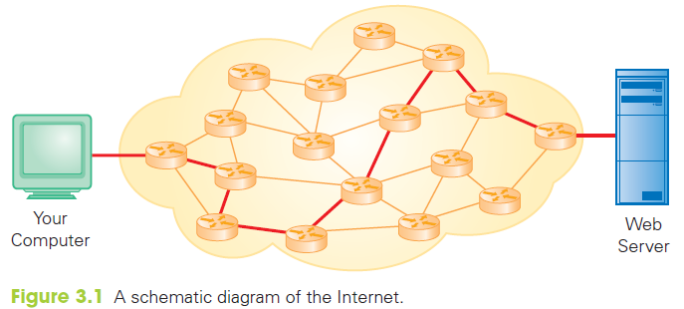
Internet Schematic Diagram

Slide 13
Client/Server Structure
Most interactions over the Internet use the client/server interaction protocol:
  When you click a Web link, your computer gets the page for you...beginning the client/server interaction
    Your computer is the client computer and the computer with the Web page is the server (Web server)
    The client, gets services from the server
  When the page is returned, the operation is completed and the client/server relationship ends

Slide 14
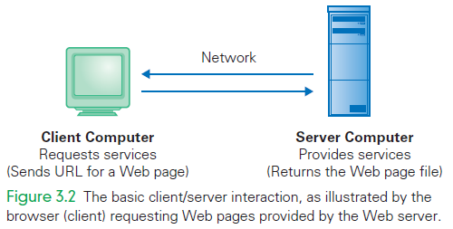
Basic Client/Server Interaction

Slide 15
Client/Server Structure
The client/server structure is fundamental to Internet interactions
A key aspect is that only a single service request and response are involved
The relationship is very brief relationship, lasting from the moment the request is sent to the moment the service is received

Slide 16
Many Brief Relationships
This approach means that the server can handle many clients at a time
For example, between two consecutive client requests from your browser (getting a page and asking for another) that server could have serviced hundreds of other clients
The server is busy only for as long as it takes to perform your request

Slide 17
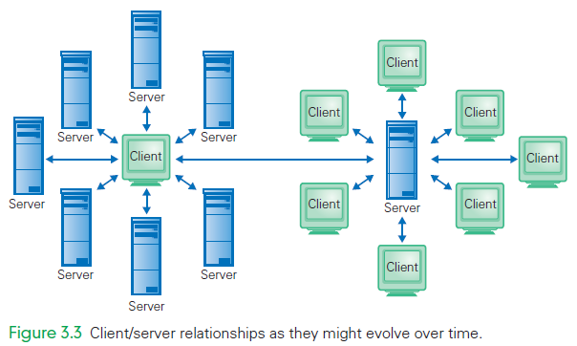
Client/Server Relationships

Slide 18
Getting More Connected
The Internet is primarily a point-to-point asynchronous communication system
Software has been built to implement the many forms of communication
A video chat client seems to have a constant connection, but actually “slices up” the computer’s sound and video signals into into chunks, and sends each chunk separately

Slide 19
Getting More Connected
Content is transferred to the other party, whose client reassembles the sound and image for display
This process relies on fast and reliable transmission to simulate a direct connection
The Internet Protocol is generally fast and reliable enough to work

Slide 20
Appearing to Stay Connected
Even though users interact with a web site through multiple brief exchanges, many sites must give the appearance that these are part of a longer-lived connection
When using a bank web site, your login interaction must be associated with your transactions
When buying on-line, your purchases must be related to your shopping cart

Slide 21
Appearing to Stay Connected
Cookies
  Server stores a small file on the client, that is returned with each request
  Contains enough information to associate the interactions.
URL Parameters
  Information is added to the URL
  You can see this in the URL created by a Google search

Slide 22
Computer Addresses
IP Addresses
  Each computer connected to the Internet is given a unique address called its IP address
  An IP address is a series of four numbers (one byte each) separated by dots
  The range of each of these numbers (0–255) allows for billions of IP addresses
  New IP addresses are in short supply

Slide 23
Computer Addresses
Each message on the Internet is called an IP packet.
Each packet is sent to a particular IP address.
Each packet may take a different route to reach that address.
A tool called Traceroute can display this route

Slide 24
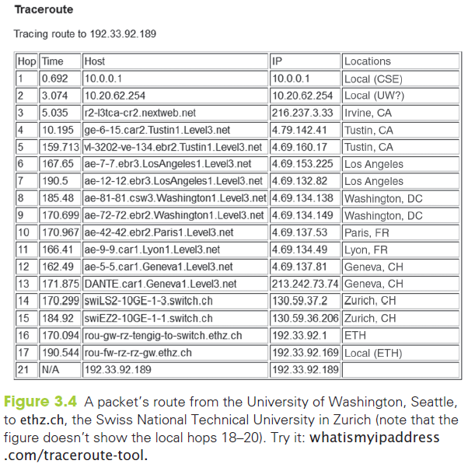
Traceroute

Slide 25
TCP/IP
TCP/IP Postcard Analogy
  The Internet is like sending a novel to your publisher using postcards
  The novel is broken into small units that fit on a postcard
  The “postcards” are numbered to indicate where each belongs in the novel
  As each postcard is completed, it is mailed

Slide 26
TCP/IP
TCP/IP Postcard Analogy
  Sooner or later, your publisher receives the postcards, but not necessarily in sequential order
  Nor do they take the same route
  The cards are finally arranged in order
  These “postcards” are the IP packets
    They hold
      one unit of information (the payload)
      the header, containing all the informations necessary for the transimssion

Slide 27
IP Packet – what's in the header
All the information necessary to:
identify the payload
forward it from the sender to the receiver,
allow the receiver to collect the payloads of different packets and rebuild the original file
inform the sender of the success/failure of the transmission

Slide 28
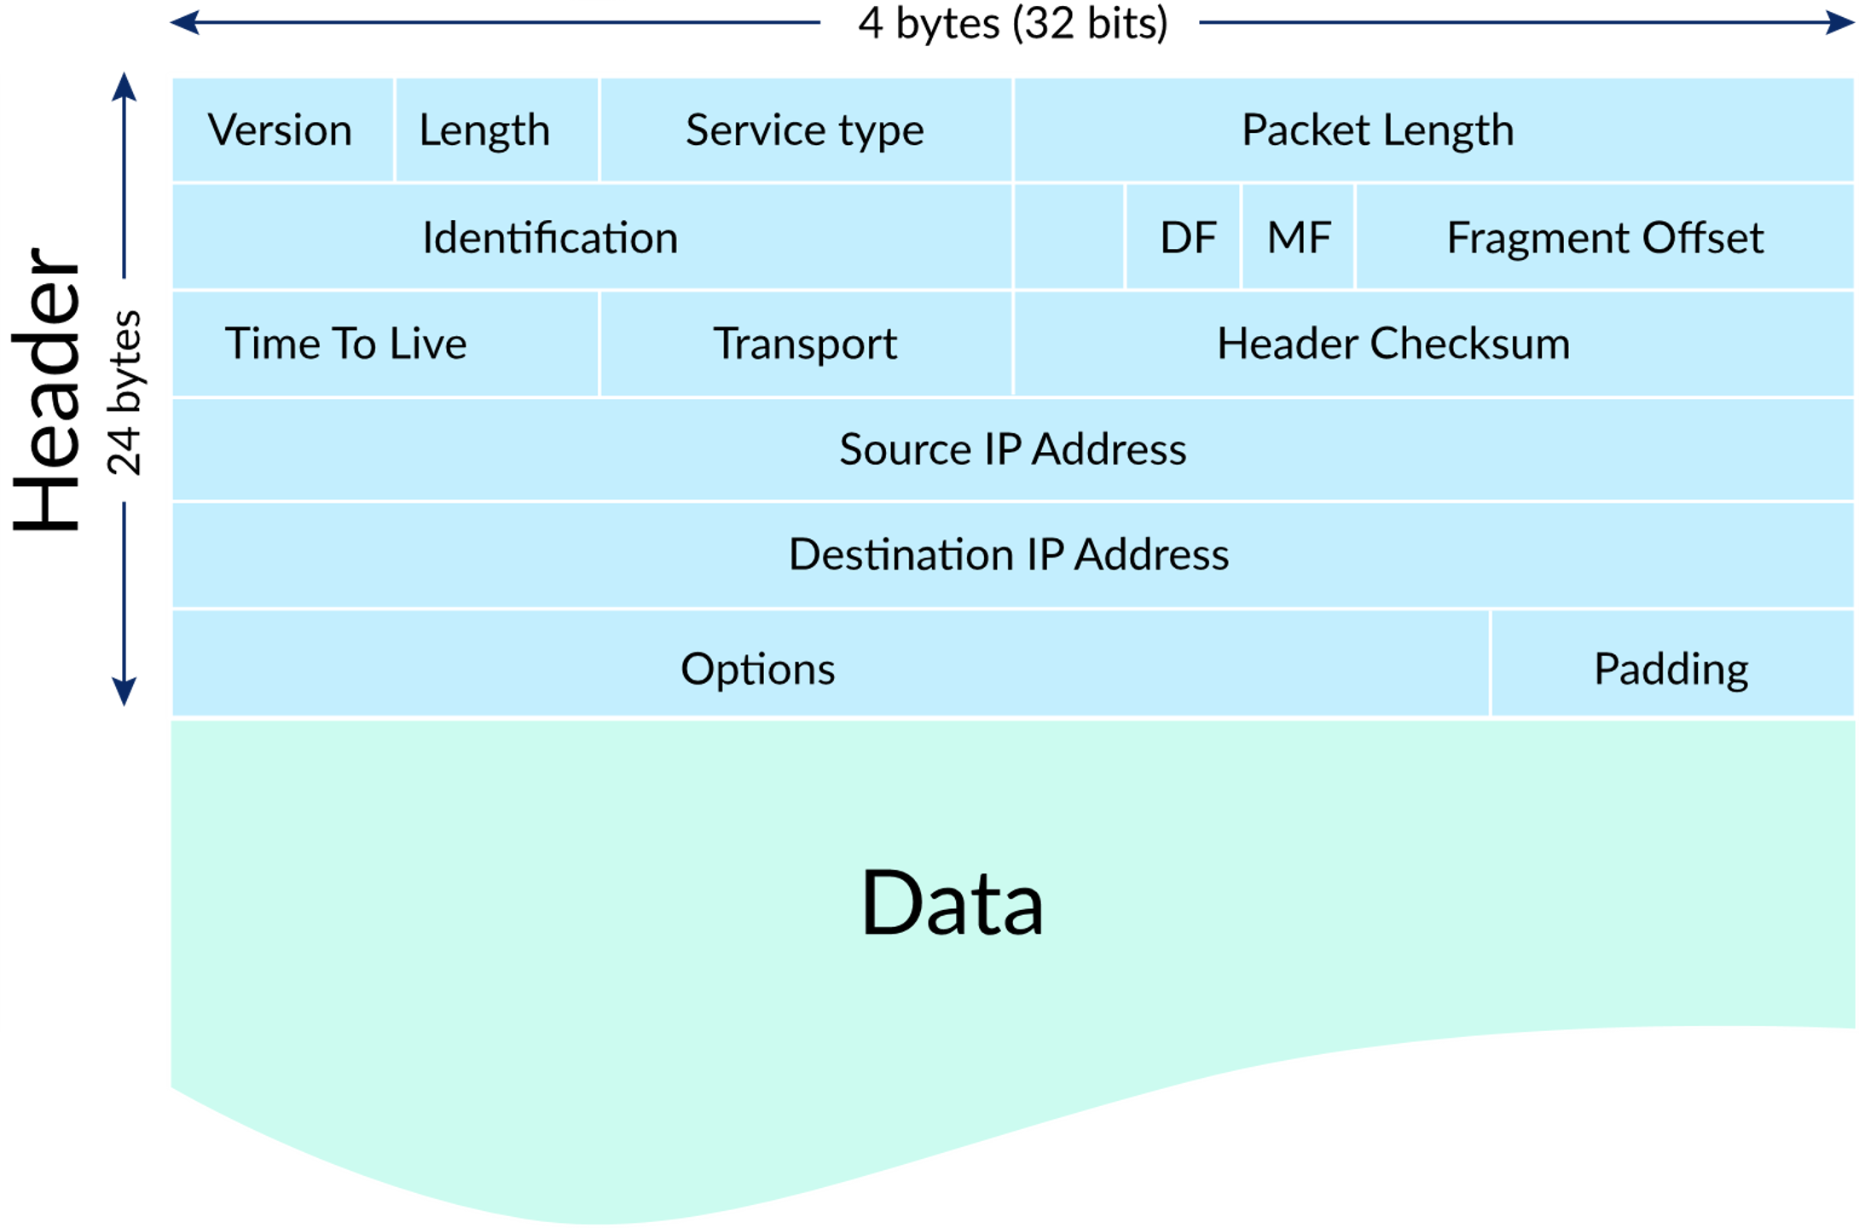
IP Packet – what's in the header
Courtesy of https://www.khanacademy.org
Notes:
https://www.khanacademy.org/computing/computers-and-internet/xcae6f4a7ff015e7d:the-internet/xcae6f4a7ff015e7d:routing-with-redundancy/a/internet-routing

Slide 29
Packets Are Independent
Because each packet can take a different route, congestion and service interruptions do not delay transmissions
  Each TCP/IP packet is independent
The TCP/IP protocol works under adverse conditions
  If traffic is heavy and the packet progress is slow, the protocol allows the packet to be thrown away

Slide 30
Packets Are Independent
If a packet is killed for whatever reason, the recipient will request a resend
Packets can arrive out of order because they take different routes

Slide 31
Far and Near: WAN and LAN
The Internet is a collection of wide area networks (WAN)
  These are networks that are not geographically close
The Internet is a collection of point-to-point channels
  Meaning packets must visit a sequence of computers before they reach their destination

Slide 32
Far and Near: WAN and LAN
A local area network (LAN) connects computers that are geographically close
  Usually they can be linked by a single cable or pair of wires
Ethernet is the main technology for local area networks
  Used for connecting all the computers in a lab or building

Slide 33
Ethernet
The physical setup for an Ethernet network is a wire, wire pair, or optical fiber, called the channel
Engineers “tap” into the channel to connect a computer:
  This allows it to send a signal or an electronic pulse or light flash onto the channel
  All computers, including the sender, can detect the signal

Slide 34
Ethernet Party Analogy
To understand how an Ethernet network works, consider this:
  A group of friends is standing around at a party telling stories.
  While someone is telling a story, everyone is listening.
  When the story is over, there may be a pause before the next one speaks
  Then, someone typically just begins talking and the cycle starts again

Slide 35
Ethernet Party Analogy
Now, insert computer instead of friend:
  A group of friends is standing around at a party telling stories.
  While someone is telling a story, every computer is listening
  When the story is over, there may be a pause before the next one speaks
  Then, someone typically just begins talking and the cycle starts again
computers
a computer
computer
computer
a computer

Slide 36
Ethernet Party Analogy
We assumed that all “friends” were equal
  No had a more important status
  Everyone spoke with the same voice
There are differences, however:
  Only one computer typically keeps the transmitted information
  This broadcast medium is being used for point-to-point communication

Slide 37
Ethernet Party Analogy
A computer wants to transmit a message:
  It starts sending signals and also starts listening to see if the message it gets is the one it sent
  If it is, the computer knows it’s the only computer sending, and it completes the transmission
  If it isn’t, (we call this situation “collision”) the computer stops transmitting immediately

Slide 38
Ethernet Party Analogy
If the the transmission had to stop (because some other computer was sending at the same time):
  The senders wait a random amount of time and try to send again
  Probably they will wait different amounts of time, so one will go first, and the others will wait
  If there is another collision, the process is repeated

Slide 39
Connecting to the Internet
Today there are two basic methods:
  Connection via an Internet service provider (ISP)
  Connection provided by a campus or enterprise network
Most of us use, in different moments, both kinds of connections

Slide 40
1. Connections by ISP
Most home users connect to the Internet by ISPs
  These are companies that sell connections to the Internet
The company places a modem at your house
  Modems convert the bits a computer outputs into a form that is compatible with the carrier

Slide 41
1. Connections by ISP
  The signals are sent to the carrier’s business
  They are converted (via modem) into a form for the server that connects to the Internet via the Internet Gateway
Digital subscriber line (DSL or ADSL) and cable (TV) are two common providers
Your smart phone also has a modem for connecting to network

Slide 42
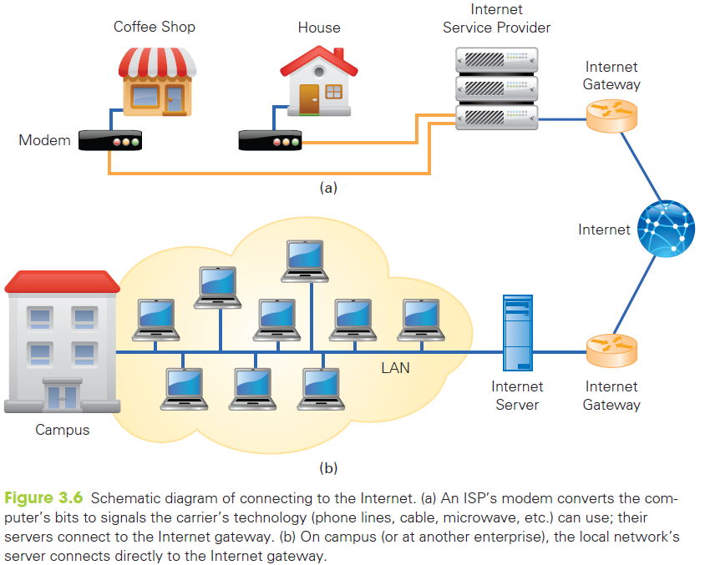

Slide 43
2. Enterprise Network Connections
The other way to connect is as a user of a larger networked organization (school, business, or governmental unit)
A LAN connects computers within the organization
The LAN is connected to the Internet by a gateway

Slide 44
Wireless Networks
Variation of a LAN connection
Referred to by its protocol name 802.11
The router is:
  Physically connected to an ISP’s modem
  Connected to the Internet
  Capable of broadcasting and receiving signals, usually radio frequency (rf ) signals

Slide 45
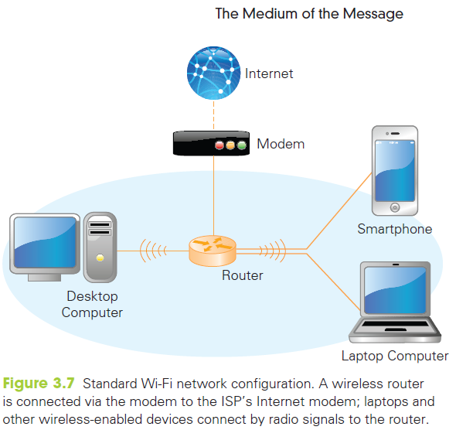

Slide 46
Computer Addresses
Domain Names
  It is hard to remember the numeric IP address of all the computers we communicate with
  The Internet uses human-readable symbolic names for computers that are based on a hierarchy of domains
  A domain is a related group of networked computers

Slide 47
Computer Addresses
Domain Names
  Example: spiff.cs.washington.edu
  The name of the computer is spiff
  it is part of the Computer Science and Engineering Department domain (cs)
  it is part of the University of Washington domain (washington)
  it is part of the educational domain
  (edu)

Slide 48
Computer Addresses
The example shows a hierarchy of domains
Each is a member of the next larger domain
edu is a peer of other top-level domains such as com
These names are symbolic and meaningful, making them easier to read than numbers (and easier to remember)

Slide 49
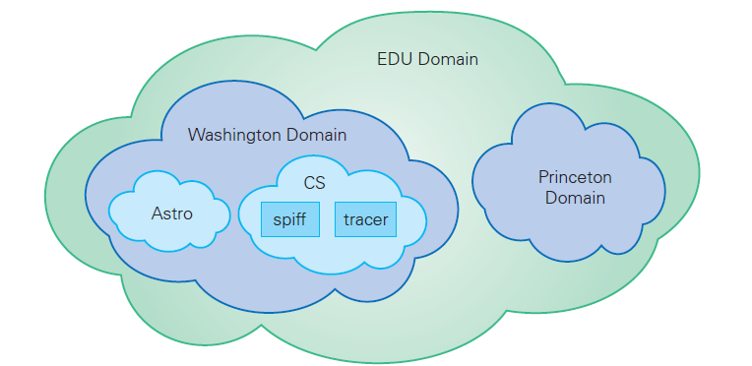
The .edu Domain

Slide 50
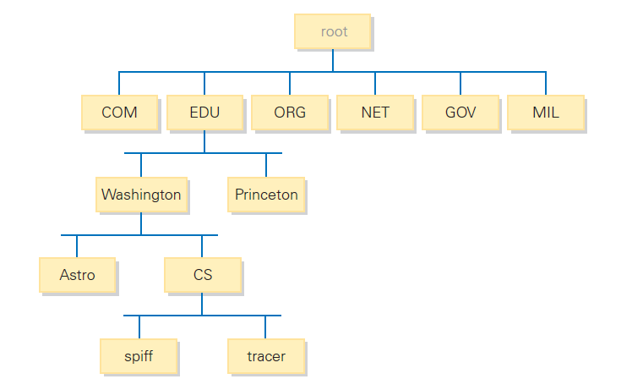
The .edu Domain

Slide 51
DNS Servers
The Domain Name System (DNS) translates the hierarchical, human-readable names into the four-number IP address
Every Internet host knows the IP address of its nearest DNS name server
Whenever the hierarchical symbolic name is used to send information to a destination, your computer asks the DNS server to look up the corresponding IP address

Slide 52
DNS Servers
The server you ask may not know the answer. No DNS server knows all the hostnames on the Internet
Each domain has an authoritative name server, that knows the computers its domain
There are root name servers that know the authoritative server for each top-level domain
To search for a name, work through the domains down from the top

Slide 53
DNS Lookup
Your computer asks the nearest DNS server to translate a name, say www.airandspace.si.edu
That local server asks a root name server for the IP address of the edu authoritative name server
Next it asks that edu server for the si authoritative name server
Then it asks the si server for the airandspace server, that asks for the IP address of www
The administrator of each DNS server makes sure it has a list of root servers to get started

Slide 54
DNS Lookup
Caching
  The local name server remembers the result of a lookup for a while
  Skips the lookup if it already knows the answer
Redundancy
  There are 13 root name servers
  share load
  one might crash

Slide 55
Top-Level Domains
Top-level domain names (TLDs):
  .edu for educational groups
  .com for commercial enterprises
  .org for organizations
  .net for networks
  .mil for the military
  .gov for government agencies

Slide 56
Top-Level Domains
The top-level domains were expanded to include biz, info, name, travel, and others
The full list can be found at www.icann.org
(ICANN is Internet Corporation for Assigned Names and Numbers)
The original top-level domains listed all apply to organizations in the United States.

Slide 57
Top-Level Domains
There is also a set of two-letter country designators (ca (Canada), uk (United Kingdom), fr (France), de (Germany, as in Deutschland), etc.)
These allow domain names to be grouped by their country of origin.

Slide 58
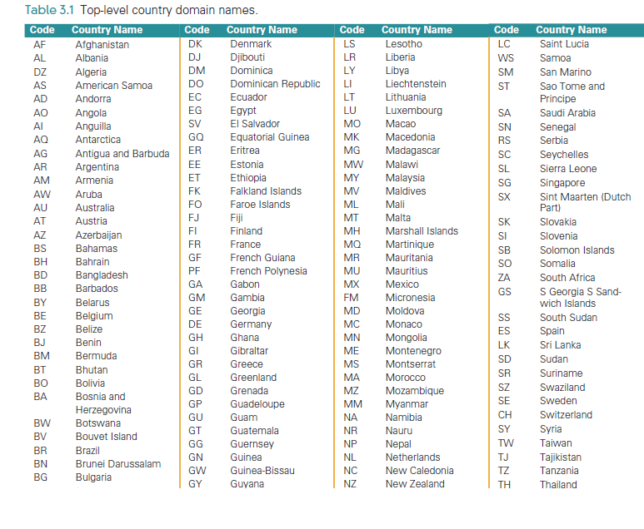

Slide 59
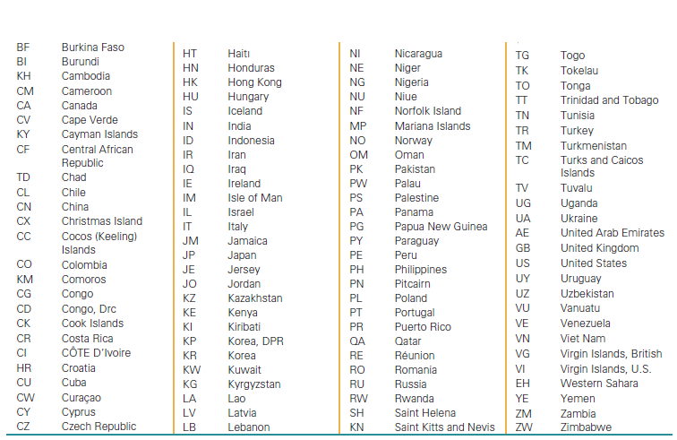

Slide 60
The World Wide Web
Some computers connected to the Internet are Web servers
  Computers programmed to send files to browsers running on other computers connected to the Internet.
These Web servers and their files comprise the World Wide Web (WWW)

Slide 61
The World Wide Web
Those files may be Web pages
Web servers store and send other kinds of files, too
The files are often used to:
  Enhance the Web page (images or animations)
  Help with other Web services (play audio or video)

Slide 62
Requesting a Web Page
Web requests use client/server interaction
Requesting a Web page means your browser is a client asking for a file from a Web server
The file can be found in looking at the URL (Universal Resource Locator)
Web browsers and Web servers both “speak” the HTTP protocol

Slide 63
Requesting a Web Page
http://www.cs.washington.edu/homes/snyder/index.html
The URL has three main parts:
  Protocol: tells the computers how to fetch the file
  Server computer’s name: or the server name in the domain hierarchy
  Page’s pathname: tells the server what file (page) is requested and where to find it

Slide 64
Get It Right
An incorrect host name will cause DNS to find the wrong server, or return an error
An error in the path will cause the web server to get the wrong page or return an error
Administrators may arrange that a wrong URL redirects to a corrected one

Slide 65
Describing a Web Page
Servers do not store Web pages in the form seen on our screens
The pages are stored as a description of how they should appear on the screen.
The browser receives the description/source file and creates the Web page image that is described

Slide 66
Describing a Web Page
There are two advantages to storing and sending the source rather than the image itself:
  A description file usually requires less information
  The browser can adapt the source image to your computer more easily

Slide 67
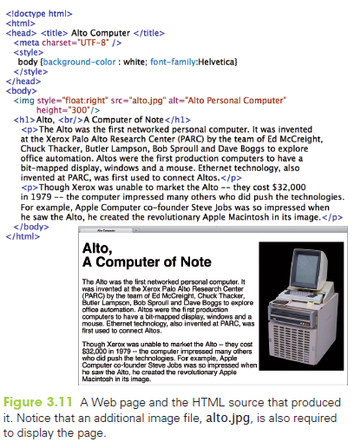

Slide 68
The Internet and the Web
Some Web servers have www as part of their domain name, some don’t
Some Web servers seem to add the www if you leave it out
Some Web servers work either way (both www.moma.org and moma.org display the same Web site)
When is the www required and when is it optional?

Slide 69
File Structure
Folders
  named collection of files or other folders (or both)
  also called a directory

Slide 70
File Structure
Directory Hierarchy
  called the file structure of the computer and forms the directory hierarchy
Think of any hierarchy as a tree
  folders are the branch points
  files are the leaves

Slide 71
File Structure
Directory Hierarchy
  All hierarchies have branch points and leaves
  Hierarchy trees are often drawn sideways or upside down
  Two terms are standard, however:
    Down in the hierarchy means into subfolders (towards the leaves)
    Up in the hierarchy means into folders (toward the root)

Slide 72
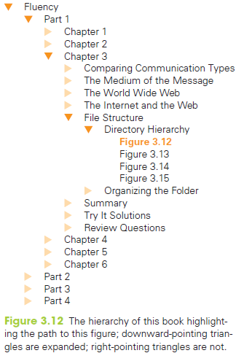

Slide 73
File Structure
Part of the directory hierarchy is shown in the pathnames of this URL: http://www.nps.gov/yell/photosmultimedia/webcams.htm
The page is specified by the pathname that tells the computer how to navigate through the directory hierarchy to the file
Each time there is a slash (/), we move into a subfolder or to the file
We go down in the hierarchy

Slide 74
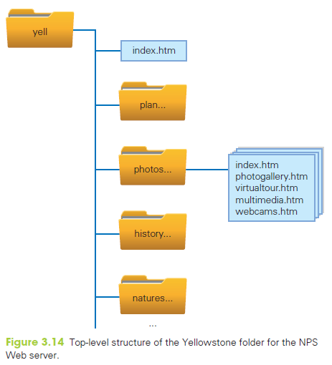

Slide 75
Organizing the Folder
Normally, the last item in the sequence is a file name
This is not always necessary or true
When a URL ends in a slash, the last item is a folder name, and the server delivers a particular file from it, usually index.htm or index.html
  The index.html file exists only if it was built

Slide 76
Organizing the Folder
Why have a hierarchy?
  Most people build hierarchies to organize their own thinking and work
  Directories cost nothing
  There is no reason not to use them
  It is highly recommended

Slide 77
Summary
In this chapter we discussed the basics of networking, including the following:
  Basic types of communication: point-to-point, multicast, broadcast, synchronous, and asynchronous
  Networking, including IP addresses, domains, IP packets, IP protocol, WANS and LANS, Ethernet protocol, ISPs, enterprise networks, and wireless networks

Slide 78
Summary
In this chapter we discussed the basics of networking, including the following:
  The difference between the Internet and the World Wide Web
  File hierarchies

