Slide 1
Claudio Sartori
Department of Computer Science and Engineering claudio.sartori@unibo.it https://www.unibo.it/sitoweb/claudio.sartori/
Informatics
Digital Representation

Slide 2
Learning Objectives
Explain the link between patterns, symbols, and information
Determine possible binary encodings using a physical phenomenon
Encode and decode ASCII
Represent numbers in binary form
Compare two different encoding methods
Explain how structure tags (metadata) encode the Oxford English Dictionary

Slide 3
Digitizing Discrete Information
The dictionary definition of digitize is to represent information with digits
Digit means the ten Arabic numerals
0 through 9

Slide 4
Limitation of Digits
A limitation of the dictionary definition of digitize is that it calls for the use of the ten digits, that produces a whole number
  Digitizing in computing can use almost any symbol
Having a bigger telephone number does not make you a better person

Slide 5
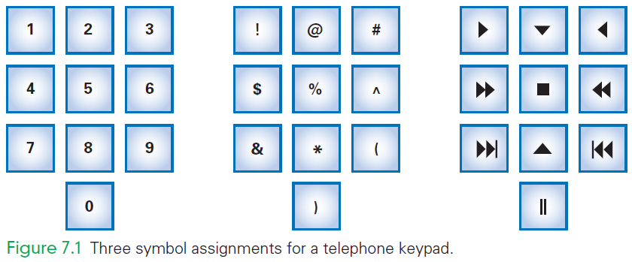
Alternative Representations
Digitizing can use almost any symbols

Slide 6
Symbols, Briefly
One practical advantage of digits is that digits have short names (one, two, etc)
Imagine speaking your phone number the multiple syllable names:
  “asterisk, exclamation, closing parenthesis”
IT uses these symbols, but have given them shorter names:
  exclamation point . . . is bang
  asterisk . . . is star

Slide 7
Ordering Symbols
Another advantage of digits is that the items can be listed in numerical order
Sometimes ordering items is useful
collating sequence: placing information in order by using non-digit symbols
  need to agree on an ordering for the basic symbols
Today, digitizing means representing information by symbols

Slide 8
Fundamental Information Representation
A computer represents information by the presence or absence of some physical phenomenon
This gives two symbols: a binary system
We name the two states 1 and 0
We can then build larger symbols using these two basic ones
The phenomenon can be charge, current, magnetization, or many other things

Slide 9
The Binary Representation
Only two states are available
Such a formulation is said to be discrete
Discrete means “distinct” or “separable”
  It is not possible to transform one value into another by tiny gradations
  There are no “shades of gray”

Slide 10
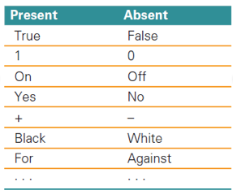
A Binary System
The binary encoding has two patterns: present and absent
Two patterns make it a binary system
There is no law that says:
  on means “present” off means “absent”
the assignment is arbitrary

Slide 11
Bits Form Symbols
In the binary representation, the unit is a specific place (in space and time), where the presence or absence of the phenomenon can be set and detected.
The binary unit is known as a bit
Bit is a contraction for “binary digit”
Bit sequences can be interpreted as binary numbers
Groups of bits form symbols

Slide 12
Bits in Computer Memory
Memory is arranged inside a computer in a very long sequence of bits
  the physical phenomenon can be encoded, the information can be set and detected to present or absent

Slide 13
Alternative binary Encodings
There is no limit to the ways to encode two physical states
  stones on all squares, but with white (absent) and black (present) stones for the two states
  multiple stones of two colors per square, more white stones than black means 1 and more black stones than white means 0
  And so forth

Slide 14
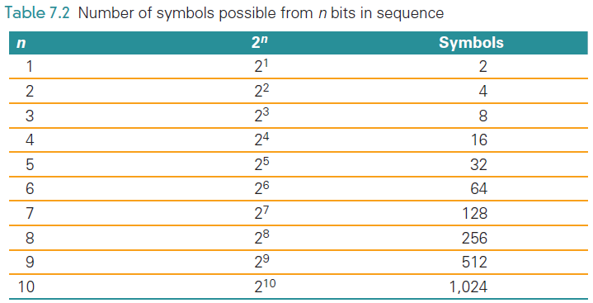
Combining Bit Patterns
The two-bit patterns gives limited resources for digitizing information
Only two values can
be represented
The two patterns must
be combined into
sequences to create
enough symbols to encode the intended information

Slide 15
Binary Explained
Computers use base-2 to represent numbers using the binary number system
When counting in binary you are limited to only use 0 and 1
  0, 1, 10, 11, 100, 101, 110, 111, 1000, …

Slide 16
Hex Explained
Hex digits, short for hexadecimal digits, are base-16 numbers
Uses decimal numbers, and then the first six Latin letters
  0, 1, 2, 3, 4, 5, 6, 7, 8, 9, A, B, C, D, E, F
There needed to be a better way to write bit sequences…hexadecimal digits

Slide 17
Changing Hex to Binary
The 32 bits below represent a computer instruction
    1000 1110 1101 1000 1010 0011 1010 0000
Writing so many 0’s and 1’s is tedious and error prone
We can convert each each four-bit group to hex, giving the shorter version:
8E D8 A3 A0

Slide 18
Hexadecimal Digits
Each hex digit codes a four-bit group:
0000 0 0100 4 1000 8 1100 C
0001 1 0101 5 1001 9 1101 D
0010 2 0110 6 1010 A 1110 E
0011 3 0111 7 1011 B 1111 F

Slide 19
Digitizing Numbers in Binary
The two earliest uses of binary digits were to:
  Encode numbers
  Encode keyboard characters
Representations for sound, images, video, and other types of information are also important

Slide 20
Place Value in a Decimal Number
Recall that To find the quantity expressed by a decimal number:
  The digit in a place is multiplied by the place value and the results are added
Example, 1,010 (base 10) is:
  Digit in the 1’s place is multiplied by its place
  Digit in the 10’s place is multiplied by its place
  and so on:
  (0 × 1) + (1 × 10) + (0 × 100) + (1 × 1000)

Slide 21
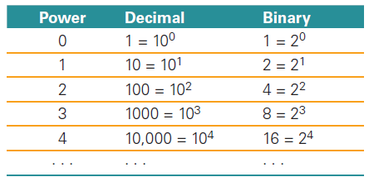
Place Value in a Binary Number
Binary works the same way
The base is 2 instead of 10
Instead of the decimal place values:
1, 10, 100, 1000, . . . ,
the binary place values are:
1, 2, 4, 8, 16, . . . ,

Slide 22
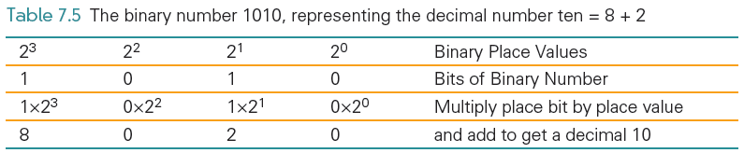
Place Value in a Binary Number
1010 in binary:
  (1 × 8) + (0 × 4) + (1 × 2) + (0 × 1)

Slide 23
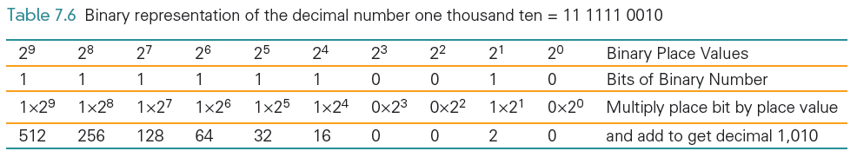

Slide 24
Digitizing Text
The number of bits determines the number of symbols available for representing values:
  n bits in sequence yield 2^{n} symbols
The more characters you want encoded, the more symbols you need

Slide 25
Digitizing Text
Roman letters, Arabic numerals, and about a dozen punctuation characters are the minimum needed to digitize English text
What about:
  Basic arithmetic symbols like +, −, *, /, =?
  Characters not required for English ö, é, ñ, ø?
  Punctuation? « », ¿, π, ∀)? What about business symbols: ¢, £, ¥, ©, and ®?

Slide 26
Assigning Symbols
We need to represent:
  26 uppercase,
  26 lowercase letters,
  10 numerals,
  20 punctuation characters,
  10 useful arithmetic characters,
  3 other characters (new line, tab, and backspace)
  95 symbols…enough for English

Slide 27
Assigning Symbols
To represent 95 distinct symbols, we need 7 bits
  6 bits gives only 2⁶ = 64 symbols
  7 bits give 2⁷ = 128 symbols
128 symbols is ample for the 95 different characters needed for English characters
Some additional characters must also be represented

Slide 28
Assigning Symbols
ASCII stands for American Standard Code for Information Interchange
ASCII is a widely used 7-bit (2⁷) code
Advantages of a “standard”:
  Computer parts built by different manufacturers can be connected
  Programs can create data and store it so that other programs can process it later, and so forth

Slide 29
Extended ASCII: An 8-Bit Code
7-bit ASCII is not enough, it cannot represent text from other languages
IBM decided to use the next larger set of symbols, the 8-bit symbols (2⁸)
Eight bits produce 2⁸ = 256 symbols
  The 7-bit ASCII is the 8-bit ASCII representation with the leftmost bit set to 0
  Handles many languages that derived from the Latin alphabet

Slide 30
Extended ASCII: An 8-Bit Code
IBM gave 8-bit sequences a special name, byte
It is a standard unit for computer memory

Slide 31
Unicode
The 256 extended ASCII codes cover most Western languages
Unicode represents many more characters by using up to 32 bits to code characters
UTF-8 records Unicode by writing long characters as groups of bytes

Slide 32
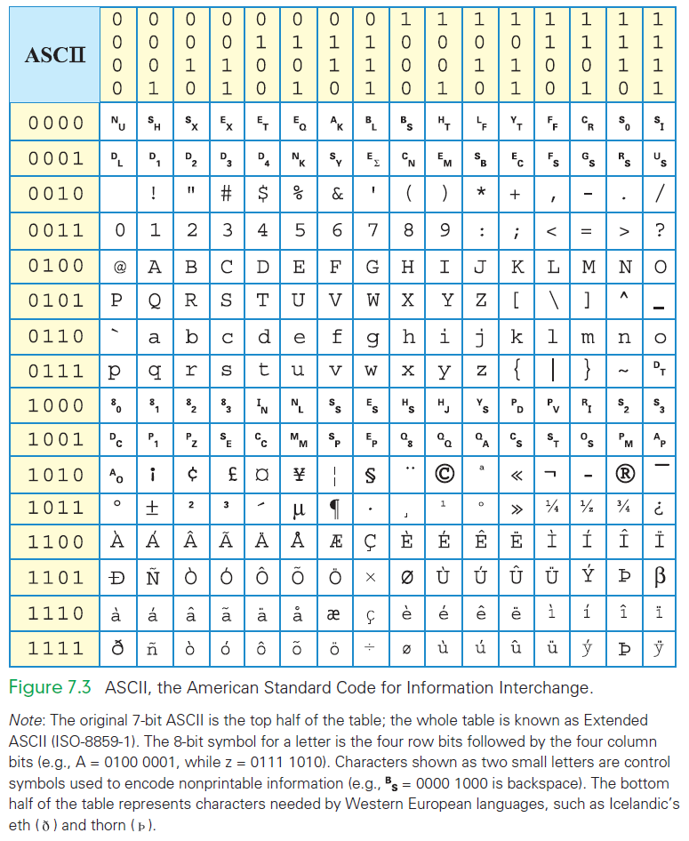

Slide 33
Advantages of Long Encodings
With computing, we usually try to be efficient by using the shortest symbol sequence to minimize the amount of memory
Examples of the opposite:
  NATO Broadcast Alphabet
  Bar Codes

Slide 34
NATO Broadcast Alphabet
The code for the letters used in radio communication is purposely inefficient
The code is distinctive when spoken amid noise
The alphabet encodes letters as words
  Words are the symbols
  “Mike” and “November” replace “em” and “en”
The longer encoding improves the chance that letters will be recognized
Digits keep their usual names, except nine, that is known as niner

Slide 35
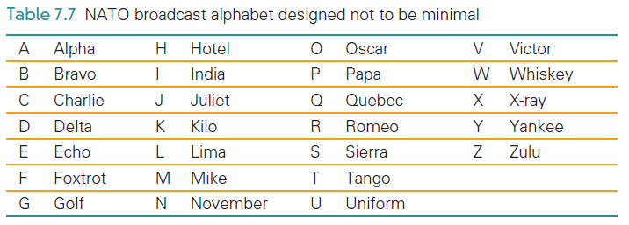
NATO Broadcast Alphabet

Slide 36
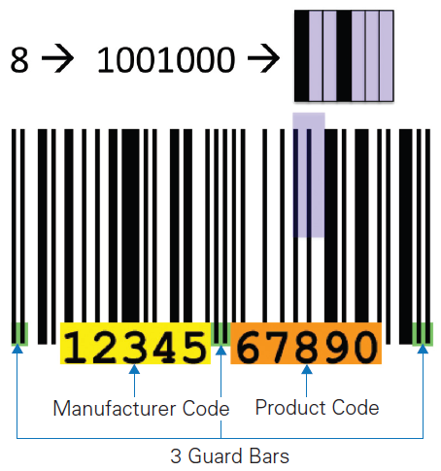
Bar Codes
Universal Product Codes (UPC) also use more than the minimum number of bits to encode information
In the UPC-A encoding, 7 bits are used to encode the digits 0 – 9

Slide 37
Bar Codes
UPC encodes the manufacturer (left side) and the product (right side)
Different bit combinations are used for each side
One side is the complement of the other side
The bit patterns were chosen to appear as different as possible from each other

Slide 38
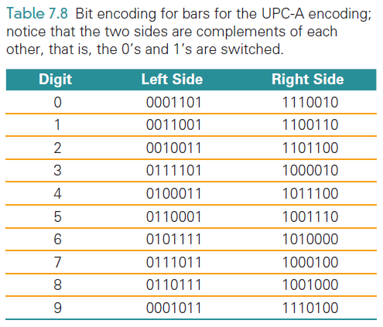
Bar Codes
Different encodings for each side make it possible to recognize whether the code is right side up or upside down

Slide 39
Parity
Computer memory is subject to errors
An extra bit is added to the memory to help detect errors
  A ninth bit per byte can detect errors using parity
Parity refers to whether a number is even or odd
  If the number of 1’s is even, set the ninth bit to 0; otherwise set it to 1

Slide 40
Parity
All 9-bit groups have even parity:
  Any single bit error in a group causes its parity to become odd
  This allows hardware to detect that an error has occurred
  It cannot detect what bit is wrong, however

Slide 41
Why “Byte”?
IBM was building a supercomputer, called Stretch
They needed a word for a quantity of memory between a bit and a word
  A word of computer memory is typically the amount required to represent computer instructions (currently a word is 32 bits)

Slide 42
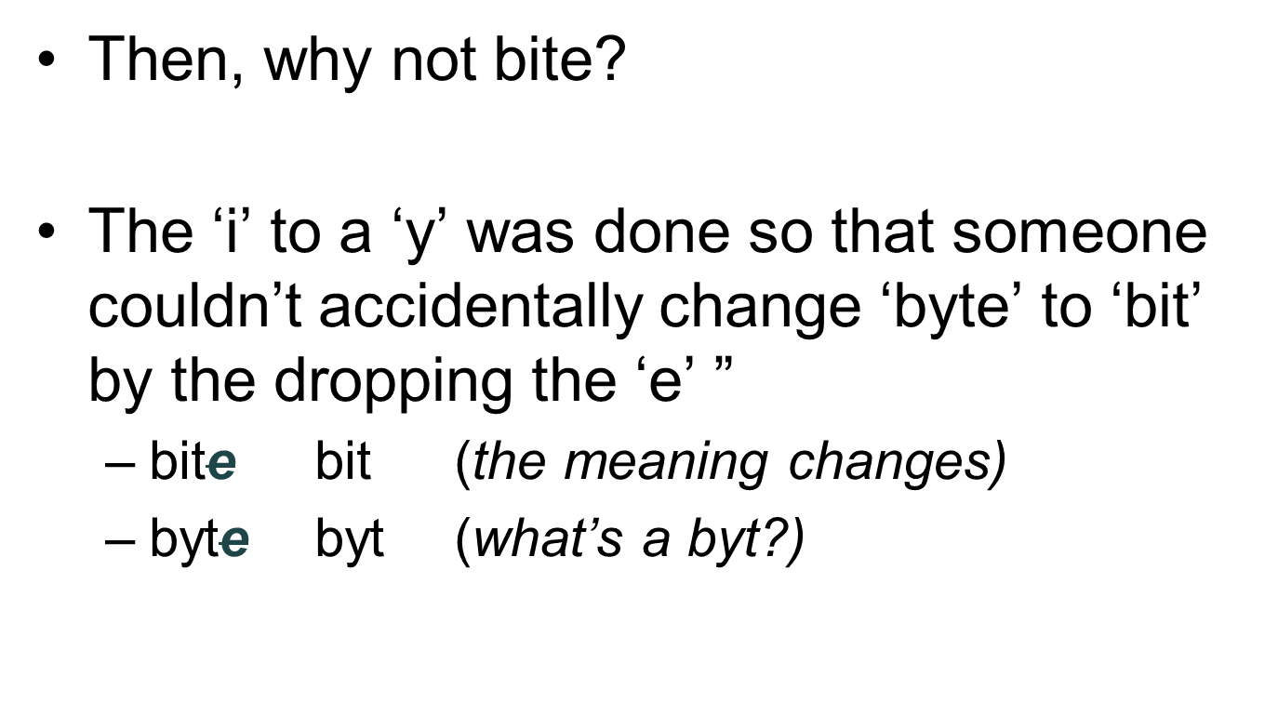
Why “Byte”?

Slide 43
Metadata and the
Oxford English Dictionary (OED)
Converting the content into binary is half of the problem of representing information
The other half of the problem? Describing the information’s properties
Characteristics of the content also needs to be encoded:
  How is the content structured?
  What other content is it related to?
  Where was it collected?
  What units is it given in?
  How should it be displayed?
  When was it created or captured?
  And so on…

Slide 44
Metadata and the OED
Metadata: information describing information
Metadata is the third basic form of data
It does not require its own binary encoding
The most common way to give metadata is with tags (think back to Chapter 4 when we wrote HTML)

Slide 45
Properties of Data
Metadata is separate from the information that it describes
For example:
  The ASCII representation of letters has been discussed
  How do those letters look in Comic Sans font?
  How they are displayed is metadata

Slide 46
Properties of Data
Rather than fill a file with the Times New Roman font, the file is filled with the letters and tags that describe how it should be displayed
This avoids locking-in the form of display, that can be changed by changing the metadata
Metadata can be presented at several levels

Slide 47
Using Tags for Metadata
The Oxford English Dictionary (OED) is the definitive reference for every English word’s meaning, etymology, and usage
The printed version of the OED is truly monumental
  20 volumes
  150 pounds
  4 feet of shelf space

Slide 48
Using Tags for Metadata
In 1984, the conversion of the OED to digital form began
Imagine, with what you know about searching on the computer, finding the definition for the verb set:
  “set” is part of many words
  You would find closet, horsetail, settle, and more
Software can help sort out the words

Slide 49
Structure Tags
Special tags can be developed to handle structure:
  <hw> is the OED’s tag for a headword (word being defined)
  <pr> handles pronunciation
  <ph> does the phonetic notations
  <ps> parts of speech
  <hm> homonym numbers
  <e> surrounds the entire entry
  <hg> surrounds the head group or all of the information at the start of a definition

Slide 50
Structure Tags
With structure tags, software can use a simple algorithm to find what is needed
Tags do not print
They are included only to specify the structure, so the computer knows what part of the dictionary to use
Structure tags are also useful for formatting…for example, boldface used for headwords
Knowing the structure makes it possible to generate the formatting information

Slide 51
Summary
We began the chapter by learning that digitizing doesn’t require digits—any symbols will do
We explored the following:
  binary encoding, that is based on the presence and absence of a physical phenomenon
  Their patterns are discrete; they form the basic unit of a bit. Their names (most often 1 and 0) can be any pair of opposite terms

Slide 52
Summary
We explored the following:
  A bit’s 0 and 1 states naturally encourage the representation of numbers in base 2, that is, binary
  7-bit ASCII, an early assignment of bit sequences (symbols) to keyboard characters. Extended or 8-bit ASCII is the standard
  The need to use more than the minimum number of bits to encode information

Slide 53
Summary
We explored the following:
  How documents like the Oxford English Dictionary are digitized
    We learned that tags associate metadata with every part of the OED
    Using that data, a computer can easily help us find words and other information.
  The mystery of the y in byte

Slide 54
Representing numbers

Slide 55
decimal vs binary numbers
decimal numbers are based on base 10 positional notation
(or base 10 place-value notation)
  ten digits 0 to 9
  234.56 = 2x10² + 3x10¹ + 4x10⁰ + 5x10⁻¹ + 6x10⁻²
positional notation can be used with any base; useful bases
  hexadecimal 16
  octal 8
  binary 2 – the only one used in computers
for technological reasons number representation in computers uses always a fixed number of bits

Slide 56
Types of numbers
Two major types
integers
non-integers → floating point
  float (32 bits)
  double (64 bits) – the non-integers used in R
  … other representations
  float and double share the same principles, the differences are only quantitative, doubles allow a greater precision

Slide 57
Types of numbers
The internal representations are significantly different
integers use less space and are processed at a higher speed
non-integers require a larger number of bytes and more complex processing
  e.g. the sum of two integers can be computed in a single cpu clock cycle, while the sum of two double precision requires 4 cpu clock cycles

Slide 58
Numbers
Integers
Double Floating point
32 bits
  from –(2³¹-1) to 2³¹-1
internal binary representation
negatives represented in two's complement
64 bits
limits can change in different language implementations
represented as
mantissa* base^{exponent}
internal binary representation
mantissa is
also known as
significant

Slide 59
Two's complement for negative integers
representation of -1
  represent 1
    31 zeros followed by 1
  invert all bits
    31 one followed by zero
  add one
00000000000000000000000000000001
11111111111111111111111111111110
11111111111111111111111111111111

Slide 60
Two's complement for negative integers
representation of –(2³¹-1)
01111111111111111111111111111111
10000000000000000000000000000000
10000000000000000000000000000001

Slide 61
Two's complement: 8 bit example
3 | 0 | 0 | 0 | 0 | 0 | 0 | 1 | 1
inversion | 1 | 1 | 1 | 1 | 1 | 1 | 0 | 0
add 1 this is -3 | 1 | 1 | 1 | 1 | 1 | 1 | 0 | 1
what number is? | 0 | 1 | 1 | 1 | 1 | 1 | 1 | 1
this is 127
what number is? | 1 | 0 | 0 | 0 | 0 | 0 | 0 | 0
inversion | 0 | 1 | 1 | 1 | 1 | 1 | 1 | 1
add 1 this is -128 | 1 | 0 | 0 | 0 | 0 | 0 | 0 | 0
non negative
negative

Slide 62
Overflow: 8 bit example
127 | 0 | 1 | 1 | 1 | 1 | 1 | 1 | 1
1 | 0 | 0 | 0 | 0 | 0 | 0 | 0 | 1
127+1 | 1 | 0 | 0 | 0 | 0 | 0 | 0 | 0
when the sum exceeds the maximum integer that can be represented with the actual number of bits per integer in real cases the bits are 32, but one is reserved to discriminate negative and non-negative

Slide 63
Why is the point floating?
because the exponent is adjusted in such a way that
the mantissa is less than 1
the first digit to the right of the decimal point is different from zero

Slide 64
Normalized floating point
any rational number with a finite number of digits can be represented, in a given base B, with two numbers:
  mantissa (or significand)
  exponent
mantissa is a rational number < 1
  it is normalized, requiring the first digit to the right of the decimal point to be non-zero (normalization)
X = m * B^{e}
example: B=10
X | <mantissa,exponent> | representation
42.576 | <0.42576,2> | 0.42576 * 10²
4257.6 | <0.42576,4> | 0.42576 * 10⁴
0.00042576 | <0.42576,-3> | 0.42576 * 10⁻³

Slide 65
double IEEE 754 standard https://en.wikipedia.org/wiki/Double-precision_floating-point_format
bit | 1 | 11 | 52
content | sign | exponent | mantissa
position | 63 | 62 52 | 51 0
numbers represented | expo-nent | 0:1023
 | man-tissa | any but 0
special numbers |  | mantissa and exponent 0 | 0
 |  | mantissa 0, exponent 1023 | Infinity
Use the reference below to visualize bit contents in the float format, that has the same principles of the double but uses only 32 bits in memory http://www.h-schmidt.net/FloatConverter/IEEE754.html. Try 1.4E-45 and 3.4028235E38

Slide 66
Parameters for numbers representation in R to inspect in R print(.Machine$parameter)
Parameter | Value | Description
double.eps | 2.220446e-16 | the smallest positive floating-point number x such that 1 + x != 1
double.neg.eps | 1.110223e-16 | a small positive floating-point number x such that 1 - x != 1
double.xmin | 2.225074e-308 | the smallest non-zero normalized floating-point number
double.xmax | 1.797693e+308 | the largest normalized floating-point number
double.base | 2 | yes, … they are binary!
double.digits | 53 | the number of base digits in the floating-point significand: normally 53
double.rounding | 5 | the rounding action, one of … 5 floating-point addition rounds in the IEEE style, and there is partial underflow.
double.guard | 0 | truncation in floating point arithmetics
double.ulp.digits | -52 | the largest negative integer i such that 1 + double.base ^ i != 1, except that it is bounded below by -(double.digits + 3)
double.neg.ulp.digits | -53 | the largest negative integer i such that 1 - double.base ^ i != 1, except that it is bounded below by -(double.digits + 3)
double.exponent | 11 | the number of bits reserved for the representation of the exponent (including the bias or sign) of a floating-point number
double.min.exp | -1022 | the largest in magnitude negative integer i such that double.base ^ i is positive and normalized
double.max.exp | 1024 | the smallest positive power of double.base that overflows
integer.max | 2147483647 | the largest integer that can be represented, always 2^31 - 1
sizeof.long | 8 | byte sizes for C language
sizeof.longlong | 8 | byte sizes for C language
sizeof.longdouble | 16 | byte sizes for C language
sizeof.pointer | 8 | byte sizes for C language

Slide 67
double in R
the biggest number is 2¹⁰²³
  about 9*10³⁰⁷
the smallest non-zero is 2⁻¹⁰⁷⁴
  about 5 * 10⁻³²⁴
  the minimum exponent in base 10 is -308, but the smaller number is reached by renouncing to the normalization of the mantissa and reducing the precision
the same limits hold, in absolute value, for negatives

Slide 68
advantages of the mantissa/exponent representation
the number of significant digits does is not influenced by the order of magnitude
it is possible to represent very big and very small (non-zero) numbers
  think to the limitations of a representation with a fixed number of digits for the integer and the decimal parts

Slide 69
Observations
between the two ends only a finite amount of double numbers is allowed
doubles are a finite subset of the rationals that can be represented with a finite number of digits for mantissa and exponents
the concepts of infinite and infinitesimal are substituted by two specific numbers

Slide 70
double: precision
let us consider two consecutive double numbers
d₁=m₁*2e e d₂=m₂*2e
m₁ and m₂ differ only in the last bit
all the infinite reals between d₁ and d₂ are represented with either d₁ or d₂
  rounding → the nearest
  truncation → cut the exceeding, less significant, digits
the maximum error, in case of truncation, is
  (m₁ – m₂) * 2e

Slide 71
double: precision (ii)
the precision changes, depending on the exponent
  the error generated by the representation of a real number with the truncated double increases with the magnitude of the number
nevertheless, the relative error is independent from the exponent
  (d₁-d₂)/d₁ = (m₁-m₂)/m₁

Slide 72
alignment and truncation (i)
example of sum on base 10 and two significant digits
the sum is executed with a left to right association
normalized addends | aligned addends | intermediate results (without truncation) | intermediate results (with truncation)
0.72*10¹ | 7.2
0.63*10⁻¹ | 0.063 | 7.263 | 7.2
0.42*10⁻¹ | 0.042 | 7.305 | 7.2
0.63*10⁻² | 0.0063 | 7.3113 | 7.2
error = 0.1113
1
2
3

Slide 73
alignment and truncation (ii)
example of sum on base 10 and four significant digits
normalized addends | aligned addends | intermediate results (without truncation) | intermediate results (with truncation)
0.72*10¹ | 7.2
0.63*10⁻¹ | 0.063 | 7.263 | 7.263
0.42*10⁻¹ | 0.042 | 7.305 | 7.305
0.63*10⁻² | 0.0063 | 7.3113 | 7.311
error = 0.0003
1
2
3

Slide 74
alignment and truncation (iii)
example of sum on base 10 and two significant digits
with addends of increasing size
normalized addends | aligned addends | intermediate results (without truncation) | intermediate results (with truncation)
0.63*10⁻² | 0.0063
0.42*10⁻¹ | 0.042 | 0.0483 | 0.048
0.63*10⁻¹ | 0.063 | 0.1113 | 0.11
0.72*10¹ | 7.2 | 7.3113 | 7.3
error = 0.0113
1
2
3

Slide 75
The arithmetics of doubles
the associative property can be violated
  (x + y) + z can be different from x + (y + z)
  (x * y) * z can be different from x * (y * z)
the distributive property can be violated
  x * (y + z) can be different from x * y + x * z
changing the order of execution of some operations can change the result when using the arithmetics of doubles, while with the arithmetics or real numbers it would not change
the commutative property has the same validity for double/float and real

