Slide 1

Data Storytelling & Statistical Validation
End-to-End Business Analytics & Business Intelligence Project
Presented By: K GNANA SWARUPA · ApexPlanet Software Pvt Ltd

Slide 2

Executive Summary
Objectives
Understand business performance
Discover revenue drivers
Analyze customer behavior
Validate findings statistically
Outcomes
Cleaned and prepared dataset
Performed EDA
Developed SQL insights
Built dashboard
Conducted hypothesis testing

Slide 3







Project Workflow
Seven-stage end-to-end analytics pipeline — from raw data to strategic recommendations.
Raw Data
Data Cleaning
EDA
SQL Analysis
Dashboard
Statistical Validation
Recommendations

Slide 4
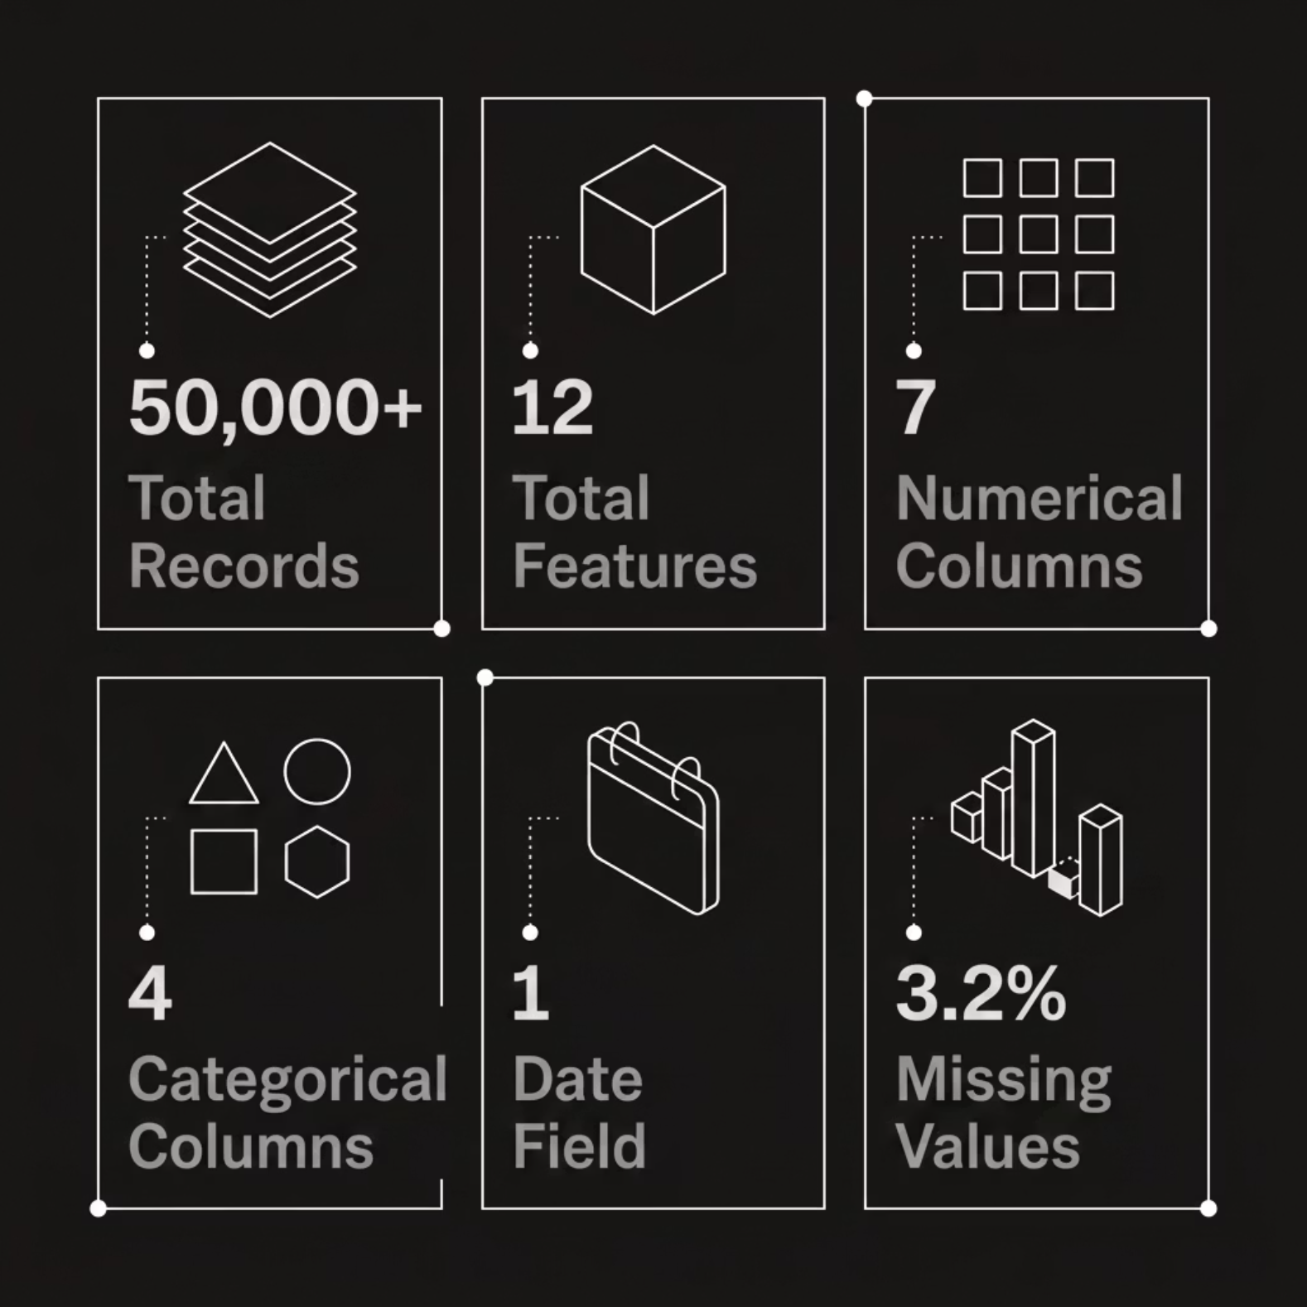
Dataset Overview
Business Context
Retail transaction data capturing orders, customers, products, and regional performance — the foundation for revenue and behavior analysis.
Multi-dimensional retail dataset
Supports revenue and segmentation analysis
Enables hypothesis-driven decision-making

Slide 5
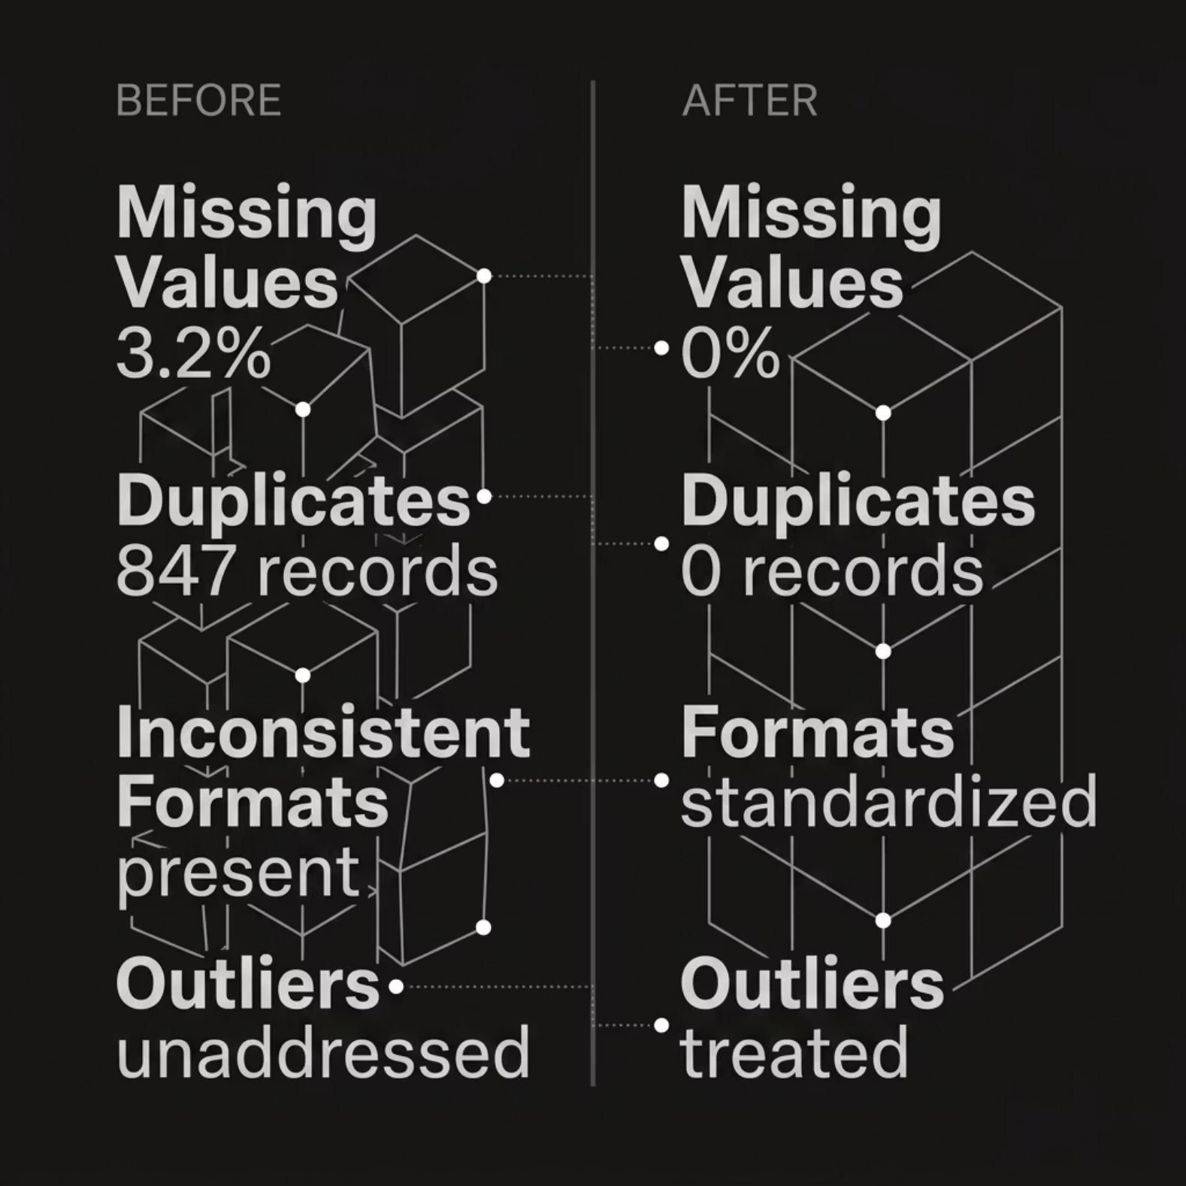
Data Quality Assessment
Problems Identified
Missing values across key fields
Duplicate records inflating counts
Inconsistent formats and outliers
Solutions Applied
Imputation, deduplication, standardization
Outlier treatment using IQR method

Slide 6

Data Cleaning Results
50K
48.9K
1.6K
Rows Before
Rows After
Missing Values
847
3
Duplicates Removed
Features Engineered
Quality Audit
Cleaning Applied
Assess missing values and duplicates.
Remove duplicates and impute values.
Raw Import
Analysis-Ready
Ingest raw rows from sources.
Features engineered and rows validated.

Slide 7
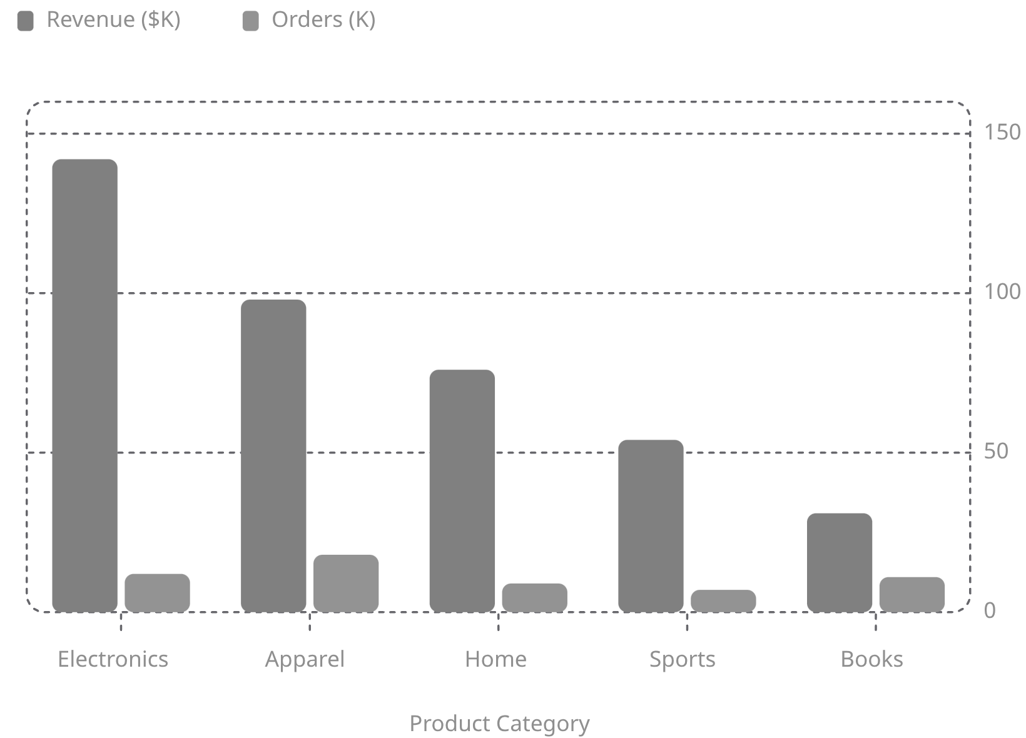
Exploratory Data Analysis
Key Patterns Discovered
Electronics leads revenue; Apparel leads order volume
Right-skewed distributions in order value
Seasonal peaks in Q4 across all categories

Slide 8
KPI Dashboard & Business Insights
Total Revenue
Total Orders
Avg Order Value
$401K
57K
$7.04
Customers
YoY Growth
18K
+14%
Key Findings
Electronics = highest revenue contributor
North region = best-performing market
Q4 shows strongest growth trend

Slide 9
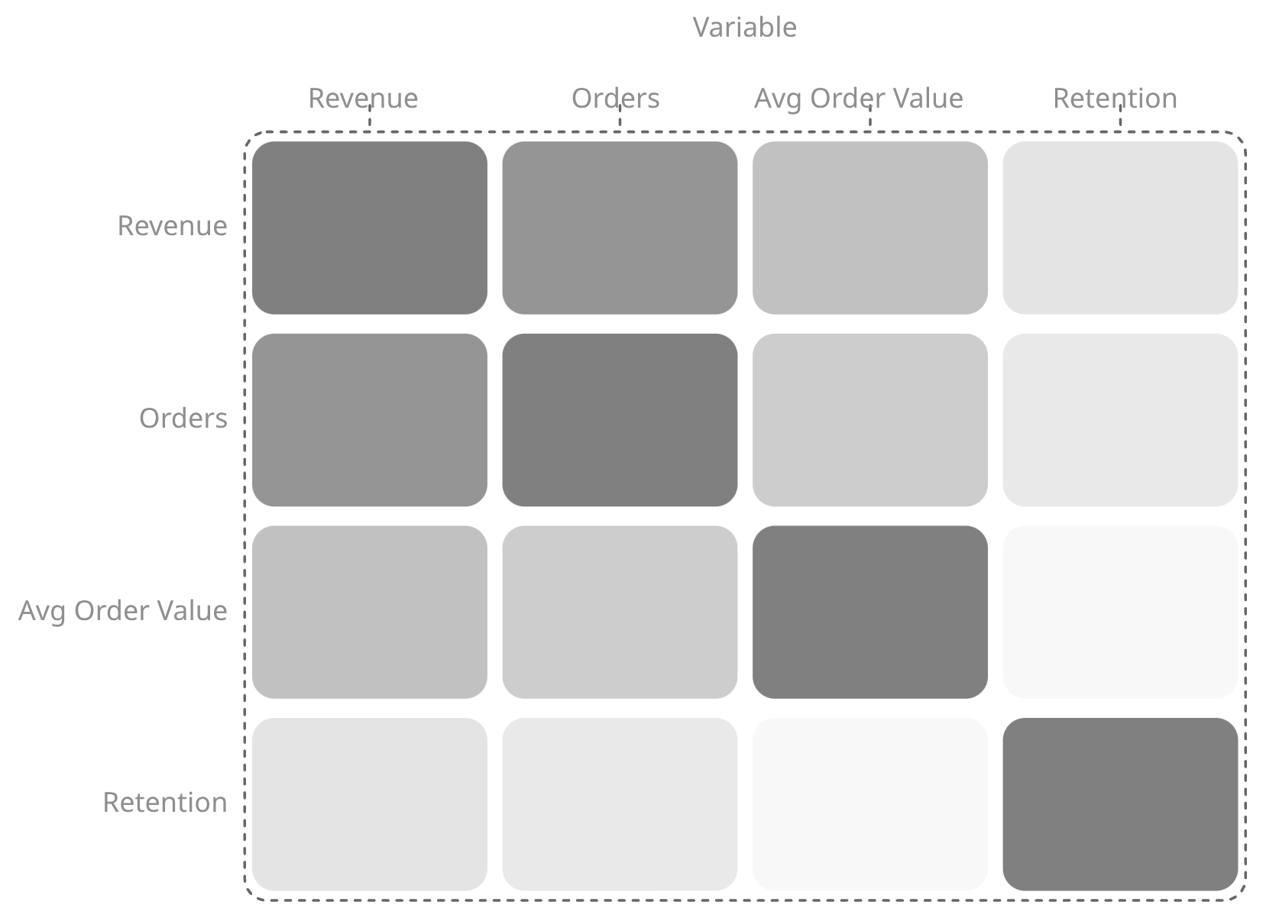
SQL Analytics & Multivariate Analysis
Sample Queries
Correlation Heatmap
SELECT product, SUM(revenue)
FROM sales
GROUP BY product
ORDER BY 2 DESC;
SELECT region, AVG(order_value)
FROM orders
GROUP BY region;
Queries uncovered top products, monthly revenue trends, customer retention rates, and regional performance.
Revenue–Orders correlation (0.87) confirms volume-driven growth; Retention shows independent influence.

Slide 10


Hypothesis Testing & Statistical Validation
Business Question
Results
"Did the new strategy significantly improve performance?"
Test Statistic: t = 2.34
p-value: 0.021
Confidence Interval: [1.2, 4.8]
Decision: p < 0.05 → Reject H₀
H₀
No significant effect
Finding is statistically significant — strategy had measurable impact.
H₁
Significant effect exists
Method
T-Test · 95% Confidence

