Slide 1
Dungeon Adventure
Created by Russell Miller

Slide 2
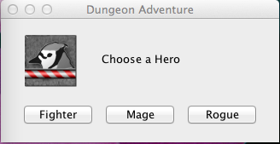
GamePlay
You are stuck in a dungeon, fight your way out while find new equipment along the way!
Choose your hero between a Fighter, a Mage, and a Rogue
Type in your desired name
Choose whether you want to play in a Fog of War or not
Use arrow keys or WASD controls to move
And…. That’s about it. You’ll figure it out.

Slide 3
GAMEPLAY! YAY!

Slide 4
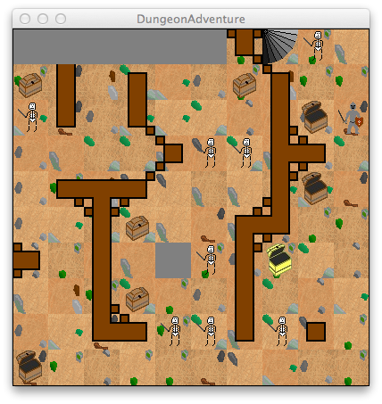
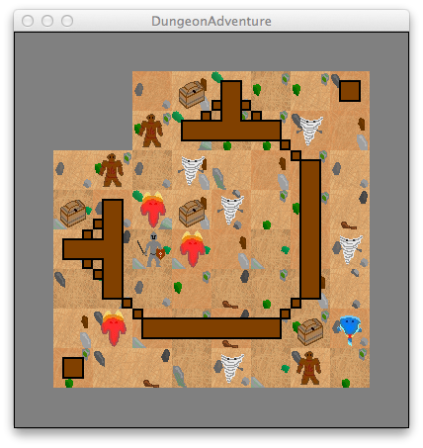
Screenshots!!! :D

Slide 5
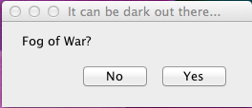
EnterDungeon (Driver)
Choose and create a Hero
Input the name of the hero
Choose FogOfWar or not
Create a GUI object (controller)
If you care, I just accidentally pressed command+k while making this…

Slide 6
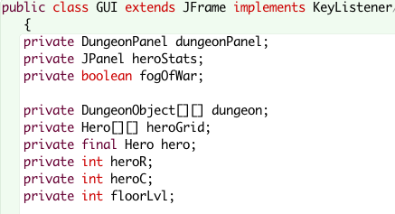
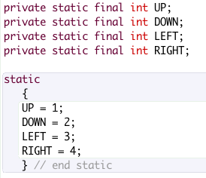
GUI (runs everything)
Extends Jframe implements KeyListener
Creates dungeon
Controls movement
Checks if hero can move
Checks for monsters
Checks for stairs
+ Gui: Hero h, boolean fogOfWar
- dungeonPanel: DungeonPanel
- fogOfWar: boolean
- dungeon: DungeonObject[][]
- heroGrid: Hero[][]
- hero: Hero
- heroR: int
- heroC: int
- floorLvl: int
- UP: static final int
- DOWN: static final int
- LEFT: static final int
- RIGHT: static final int
+ keyTyped: void
+ keyReleased: void
+ keyPressed: void
- move: boolean
- canMove: boolean
- CheckForMonster: void
- CheckForStairs: void

Slide 7




DungeonPanel (graphics)
Extends Jpanel
Dungeon Graphics
Oh, by the way
It’s an INNER CLASS :0
Inside the GUI
Repaint() method
+ DungeonPanel:
+ PaintComponent: void

Slide 8
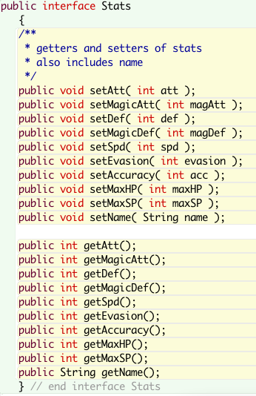
Interface Stats
It’s an interface!!
It has getters and setters for ALL the stats
…it’s really kinda useless… yay for getting the requirements done…
att
magicAtt
Def
magicDef
Spd
Evasion
Accuracy
maxHP
maxSP
Name
I just pressed command+k again…

Slide 9
Character (abstract) (all creatures great and small)
Implements Stats
Methods:
dodge(): void
attack(): void
rest(): void
guard(): void
gainSP(): void
resetTempStatBonuses(): void
getters and setters
getImage(): String
All variables are private:
-att: int
-magicAtt: int
-def: int
-magicDef: int
-spd: int
-evasion: int
-accuracy: int
-maxHP: int
-HP: int
-maxSP: int
-SP: int
tempBonuses for all of those ^
Except maxHP, HP, maxSP, and SP
-name: String

Slide 10
Monster (abstract) (evil little things)
Extends Character implements DungeonObject
+ chooseMove: void
+ dodge: void
+ rest: void
+ attack: void
+ specAttack: void
Getters and setters
+ getPathBlocked: boolean
-exp: int
-specAttackCost: int
-magicUser: boolean

Slide 11
Hero (abstract) (omg it’s you! (the player) )
Extends Character
+gainExp: void
+lvlUp: void
+ chooseMove: void
+ dodge: void
+ rest: void
+ attack: void
+ powerAttack: void
+ aimedAttack: void
+ recover: void
+ calculateStats: void
+ equip: void
+equipUsable: boolean
+checkEquip: boolean
-compareEquips: String
Getters and setters
-lvl: int
-exp: int
-expToLvl: int
All stats for equipment
-eAtt: int
-eMagicAtt: int
Etc.
-moves: ArrayList<String>
-hasAttacked: boolean
There I go, with command+k…

Slide 12
Equipment (abstract) (it can be worn)
Implements Stats
-eSlotNum: int
-floorLvl: int
+Equipment: int floorLvl
+setStats: void
+setName: void
Setters and getters
Each Equipment has randomized stats, a name based on those stats
The stats are based on the floorLvl
That is all… lots of code,
Simple concept

Slide 13
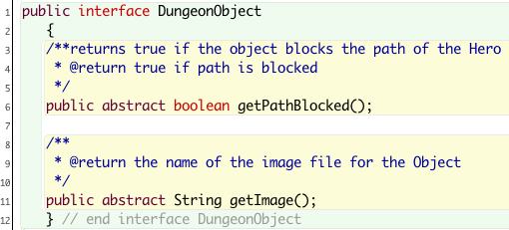
DungeonObject (These are ‘things’)
Another Interface!!
This one is more important…
It involves polymorphism ^
+getPathBlocked: boolean
Does this object block the path of the Hero
+getImage: String
String leading to file with image

Slide 14




Wall and Stairs (yup. These are objects too… surprise!)
They both implement DungeonObject
Stairs:
+goUpstairs: int
Increases floorLvl

Slide 15




Chest and GoldChest (they’re quite the find)
Implements DungeonObject
-isOpen: boolean
+openChest: Equipment
Creates an Equipment
GoldChest makes a better “Shiny” Equipment
That can always be equipped

Slide 16
Battle (abstract) (Fight! Fight! Fight!)
Static methods!
+startBattle: boolean
+getFirstAttacker: boolean
+attack: void
+magicAttack: void
Turn Based battling
These things do damage!
Chance to dodge
Overloaded methods!

Slide 17
GridCreator (abstract) (it creates things :o )
More static methods!
+getGrid: String
Pre-made dungeon layouts
+createHeroGrid: Hero[][]
+getHeroRow: int
+getHeroCol: int
+createDungeon: DungeonObject[][]
-createMonster: Monster

Slide 18
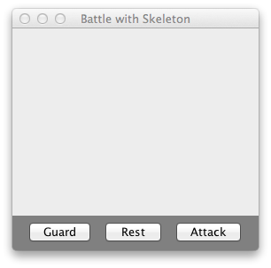
BattleScreen
FYI… it doesn’t work. Or at least there are a few problems
Extends Jframe
Implements ActionListener, KeyListener, Runnable
Multithreading – it’s confusing…
Oh wait! ArrayLists!
I had ArrayLists for the attackMoves
But the battle System doesn’t work, so these ArrayLists aren’t actually used ☹

Slide 19



Fighter, Mage, Rogue
They override methods…
Nothing new

Slide 20





Skeleton, Elementals
They also override stuff
Nothing new here either

Slide 21
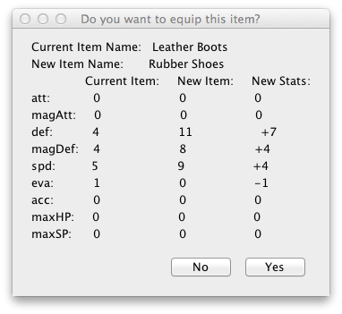
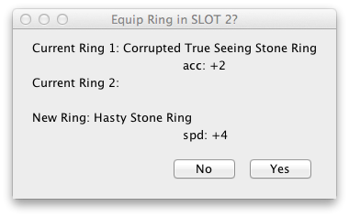
equips
Sword, Shield - Fighter
Staff, Pendant - Mage
Dagger(s) - Rogue
Helmet, Shirt, Pants, Gloves, Shoes
Ring(s) – You can wear 2
Only overridden methods, nothing new
(except a tiny method in Ring, along with 2-3 instance variables… but not very important)

Slide 22
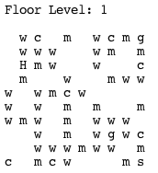
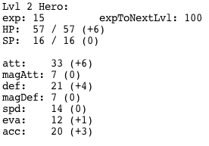
GridPrinter (it prints stuff)
It was used for testing before graphics existed
It made text grids of the Objects

Slide 23
EtcCode
It is literally
ALL
Commented code
I use it to save code for cut & paste
(like the gridCreator layouts)

Slide 24
objects
All the Monster/Equipment/Hero classes have different stats from each other
That is my justification
Not images.
I can make images appear out of nowhere. ;)
(it’s easy when you finally figure it out… but hard until you do…)

Slide 25
Inheritance
If you notice, the only concrete class that has a new method… is the Chest
And the Ring… but that’s really minor
(this is not including the GUI and BattleScreen)

Slide 26
Interface Use
Interface Stats – I admit… it’s useless
Interface DungeonObject however…
2D array of DungeonObjects
I needed a way to put all my objects into one grid
I could also use Object[][]… but there’s something else!
It also uses polymorphism.

Slide 27
Polymorphism (taken from GUI)
/**
* Checks whether the Hero can move to the moveLocation
* If the moveLocation has a chest, the Chest is opened
* @param the object in the location the Hero is trying to move to
* @return if the path is blocked
*/
private boolean canMove( DungeonObject moveLocation )
{
if( moveLocation == null )
{
return true;
} // end if
else if( moveLocation instanceof Chest )
{
Chest chest = (Chest) moveLocation;
if( chest.getIsOpen() == false )
{
hero.equip( chest.openChest( floorLvl, hero ) );
} // end if
} // end if
return !moveLocation.getPathBlocked();
} // end method canMove

Slide 28
Polymorphism2 (taken from Hero) I left out a lot of code in this… it may not make much sense
/**asks the player if he wants to equip the equipment found, if possible
* puts the equipment in the appropriate equips[] slot
* @param the Equipment found
*/
public void equip( Equipment e )
{
…………….code was left out here………………….
else if( checkEquip( equips[ slotNum ], e ) )
{
equips[ slotNum ] = e;
} // end if
} // end if
calculateStats();
} // end if
} // end method equip()

Slide 29
Special Features!
fogOfWar
Personalized Graphics
3 different Heroes with specialized attacks and Equipment
Lots of different Monsters! (more can be added very easily)
A really cool turn-Based Battle System
It brings up its own Battle Screen where you can choose your attacks!

Slide 30
BUGS (oh noes!)
I think sometimes a ring can not be equipped?
Source: unknown
Battle System does not work
Source: infinite while loop occurs making you unable to press attackButtons
Solutions: Tried multithreading – sooooo confusing
-- Could possibly use JOptionPane to fix
Temporary Solution: auto-Battle
BattleScreen buttons don’t fit onto the BattleScreen
Source: frame/panel formatting?
Solution: It doesn’t matter, the Battle System doesn’t work anyway…

Slide 31
2nd Party Code
Interfaces KeyListener, ActionListener, Runnable
Jframe, Jpanel
JOptionPane
Image - Swing

Slide 32
Conclusion
Difficulty – 8/10
Had to look up a LOT of stuff
I feel like I was pressed for time ( ex: I wrote this PP… today)
Fun – 10/10
I think I spent too much of my time on this
Evaluation
It’s pretty complicated, I just kept coming up with new methods as was needed, not necessarily as was planned
I wrote a lot of stuff before it was implemented
Ex: attack methods, never get used now ☹
New Knowledge
KeyListener, ActionListener
Override JPanel for graphics, some other graphics code

Slide 33
Questions
Suggestions:
Graphics
fogOfWar
keyListener
Static methods
And Yes, I drew all those pictures

