Slide 1

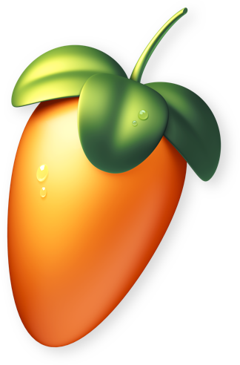



Generating ‘Mood’ Music with Generative Adversarial Networks
Aims for my GAN:
Creates new Music:
Produces Realistic, Multi-track Music:
Music conveying different moods:
Real Audio
Discriminator
Real or Fake?
Model 1: Happy
Model 2: Sad / Emotional
Blaine Ramsden, 984084,
Supervisor:
Ben Mora
Generated Audio
Random Noise
Generator
Model 3: Dark / Emotional

