Slide 1
Databases
An Introduction

Slide 2
What is it?
In its simplest form a database is:
1. An organized collection of data
2. Related to a person, place or thing – known as an entity
3. In a relational database (e.g. MySQL or MariaDB) the data is organized using
A. Columns or Fields – the attributes of the entity
B. Rows or Records – representing each individual aspect of the entity

Slide 3
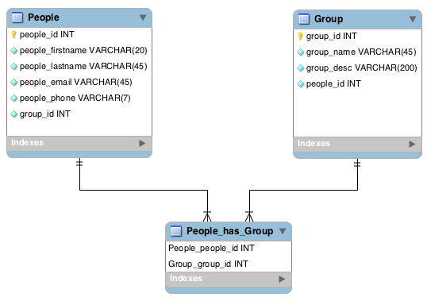
An Example

Slide 4
A Database Design
The previous example was built to illustrate Exercise 16-2.2 found in the Murach text on page 538.
In this case we have two entities: People and Groups
Both entities have attributes (People names, email addresses and phone numbers, Group name and description).
When people join groups and groups have more than one person we represent those relationships in a “Join Table”.
The lines running between the tables represent these relationships.

Slide 5
Working with Data in a Database
The primary means of interacting with the data in a database is by using Structured Query Language or SQL.
The four basic data interactions are: Insert, Select, Update and Delete.
Carefully review pages 102 through 107 in the Murach text to see examples of each.

Slide 6
Why is this important?
Every dynamic web site stores the data to be displayed in a database.
When the site visitor requests some view (a web page) the data for that view is read (selected) from the database and placed into the page (using PHP) and then delivered to the browser.
Your data must be organized so it can be maintained and interacted with.
You must have the correct SQL in place to work with the data.
You must have the correct PHP in place to know when and how to select, insert, update or delete data as needed.

Slide 7
Review of the Week
Make sure you carefully read chapters 3 and 16.
Follow the provided videos and directions to create:
1- The database on your hosting server for the guitar1 database by:
Using the MySQL Databases tool (in the cPanel) to
Creating the database
Creating a proxy user
Assigning the proxy user to use the database with Insert, Select, Update and Delete privileges
Using the PHPMyAdmin tool (in the cPanel) to
import the guitar1.sql.zip file to populate the database with the tables and data

Slide 8
Review of the Week (continued)
2 – Starting your local XAMPP Apache and MySQL server, then:
Go to http://localhost/phpmyadmin
Create the local version of the database - it must have the exact same name as the remote version!
Create a local version of the proxy user – it must have the exact same name and password as the remote version!
Import the same guitar1.sql.zip file to create the tables and data

Slide 9
Review of the Week (continued)
3 – Complete Exercise 3-1
You do not have to reset the password for the Root user (steps 1 – 3) as long as you remember to turn on the local servers when you use them and turn them off when you’re done.
If you do not reset the root user password then you can also skip steps 12 and 13.
Complete all other steps by using the SQL tab to write SQL statement against the database to test your skills with selecting, inserting, updating and deleting data from the table(s) in the guitar 1 database.
If needed you can re-import the guitar1.sql.zip file to overwrite any changes at the end of your practice to return the database to its original condition.
Indicate on the exercises page if the exercise was completed or not

Slide 10
Review of the Week (continued)
4 – Complete Exercise 16-2.1
You can use any means to produce your design (mysql workbench, another computer program or paper and pencil)
Refer to page 535 for an example of what a finished Entity Relationship Diagram (ERD) should look like.
Post a picture of your ERD to the weekly collaboration board for others to see and comment on.
Indicate on the exercises page if the exercise was completed or not

Slide 11
A Thought to Consider
It is no coincidence that FamilySearch and other tools have come forth at a time when young people are so familiar with a wide range of information and communication technologies. Your fingers have been trained to text and tweet to accelerate and advance the work of the Lord—not just to communicate quickly with your friends. The skills and aptitude evident among many young people today are a preparation to contribute to the work of salvation.
(Elder David A. Bednar, The Hearts of the Children Shall Turn, October 2011 General Conference)

