Slide 1
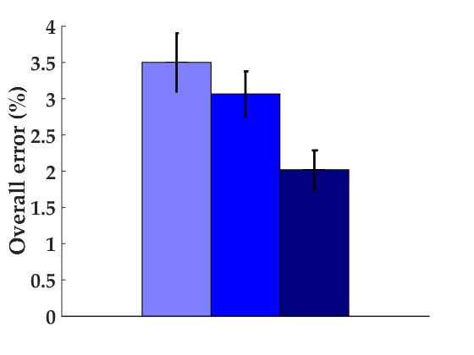
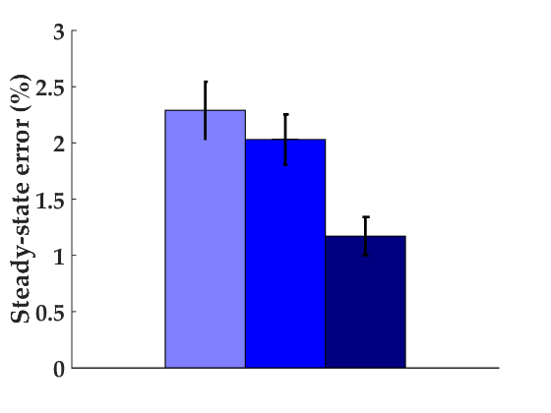
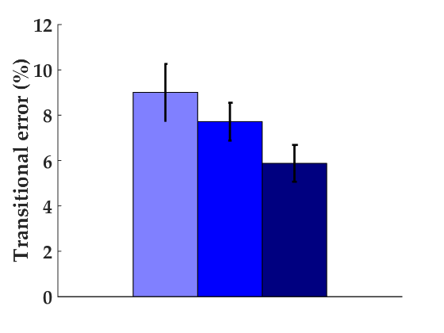
Above-knee
Below-knee
All ipsi.
Above-knee
EMG: VL, RF, BF, ST
Goniometer: Knee position and velocity
IMU: Thigh A_{x-z}, G_{x-z}
The classification is the same as the paper:
10 subjects
Leg/mode/phase-specific classifiers (e.g. RHC_{LW} , LTO_{SA})
10-fold cross-validation with LDA
Below-knee
EMG: TA, MG, SOL
Goniometer: Ankle position and velocity
IMU: Shank A_{x-z}, G_{x-z}

