Slide 1
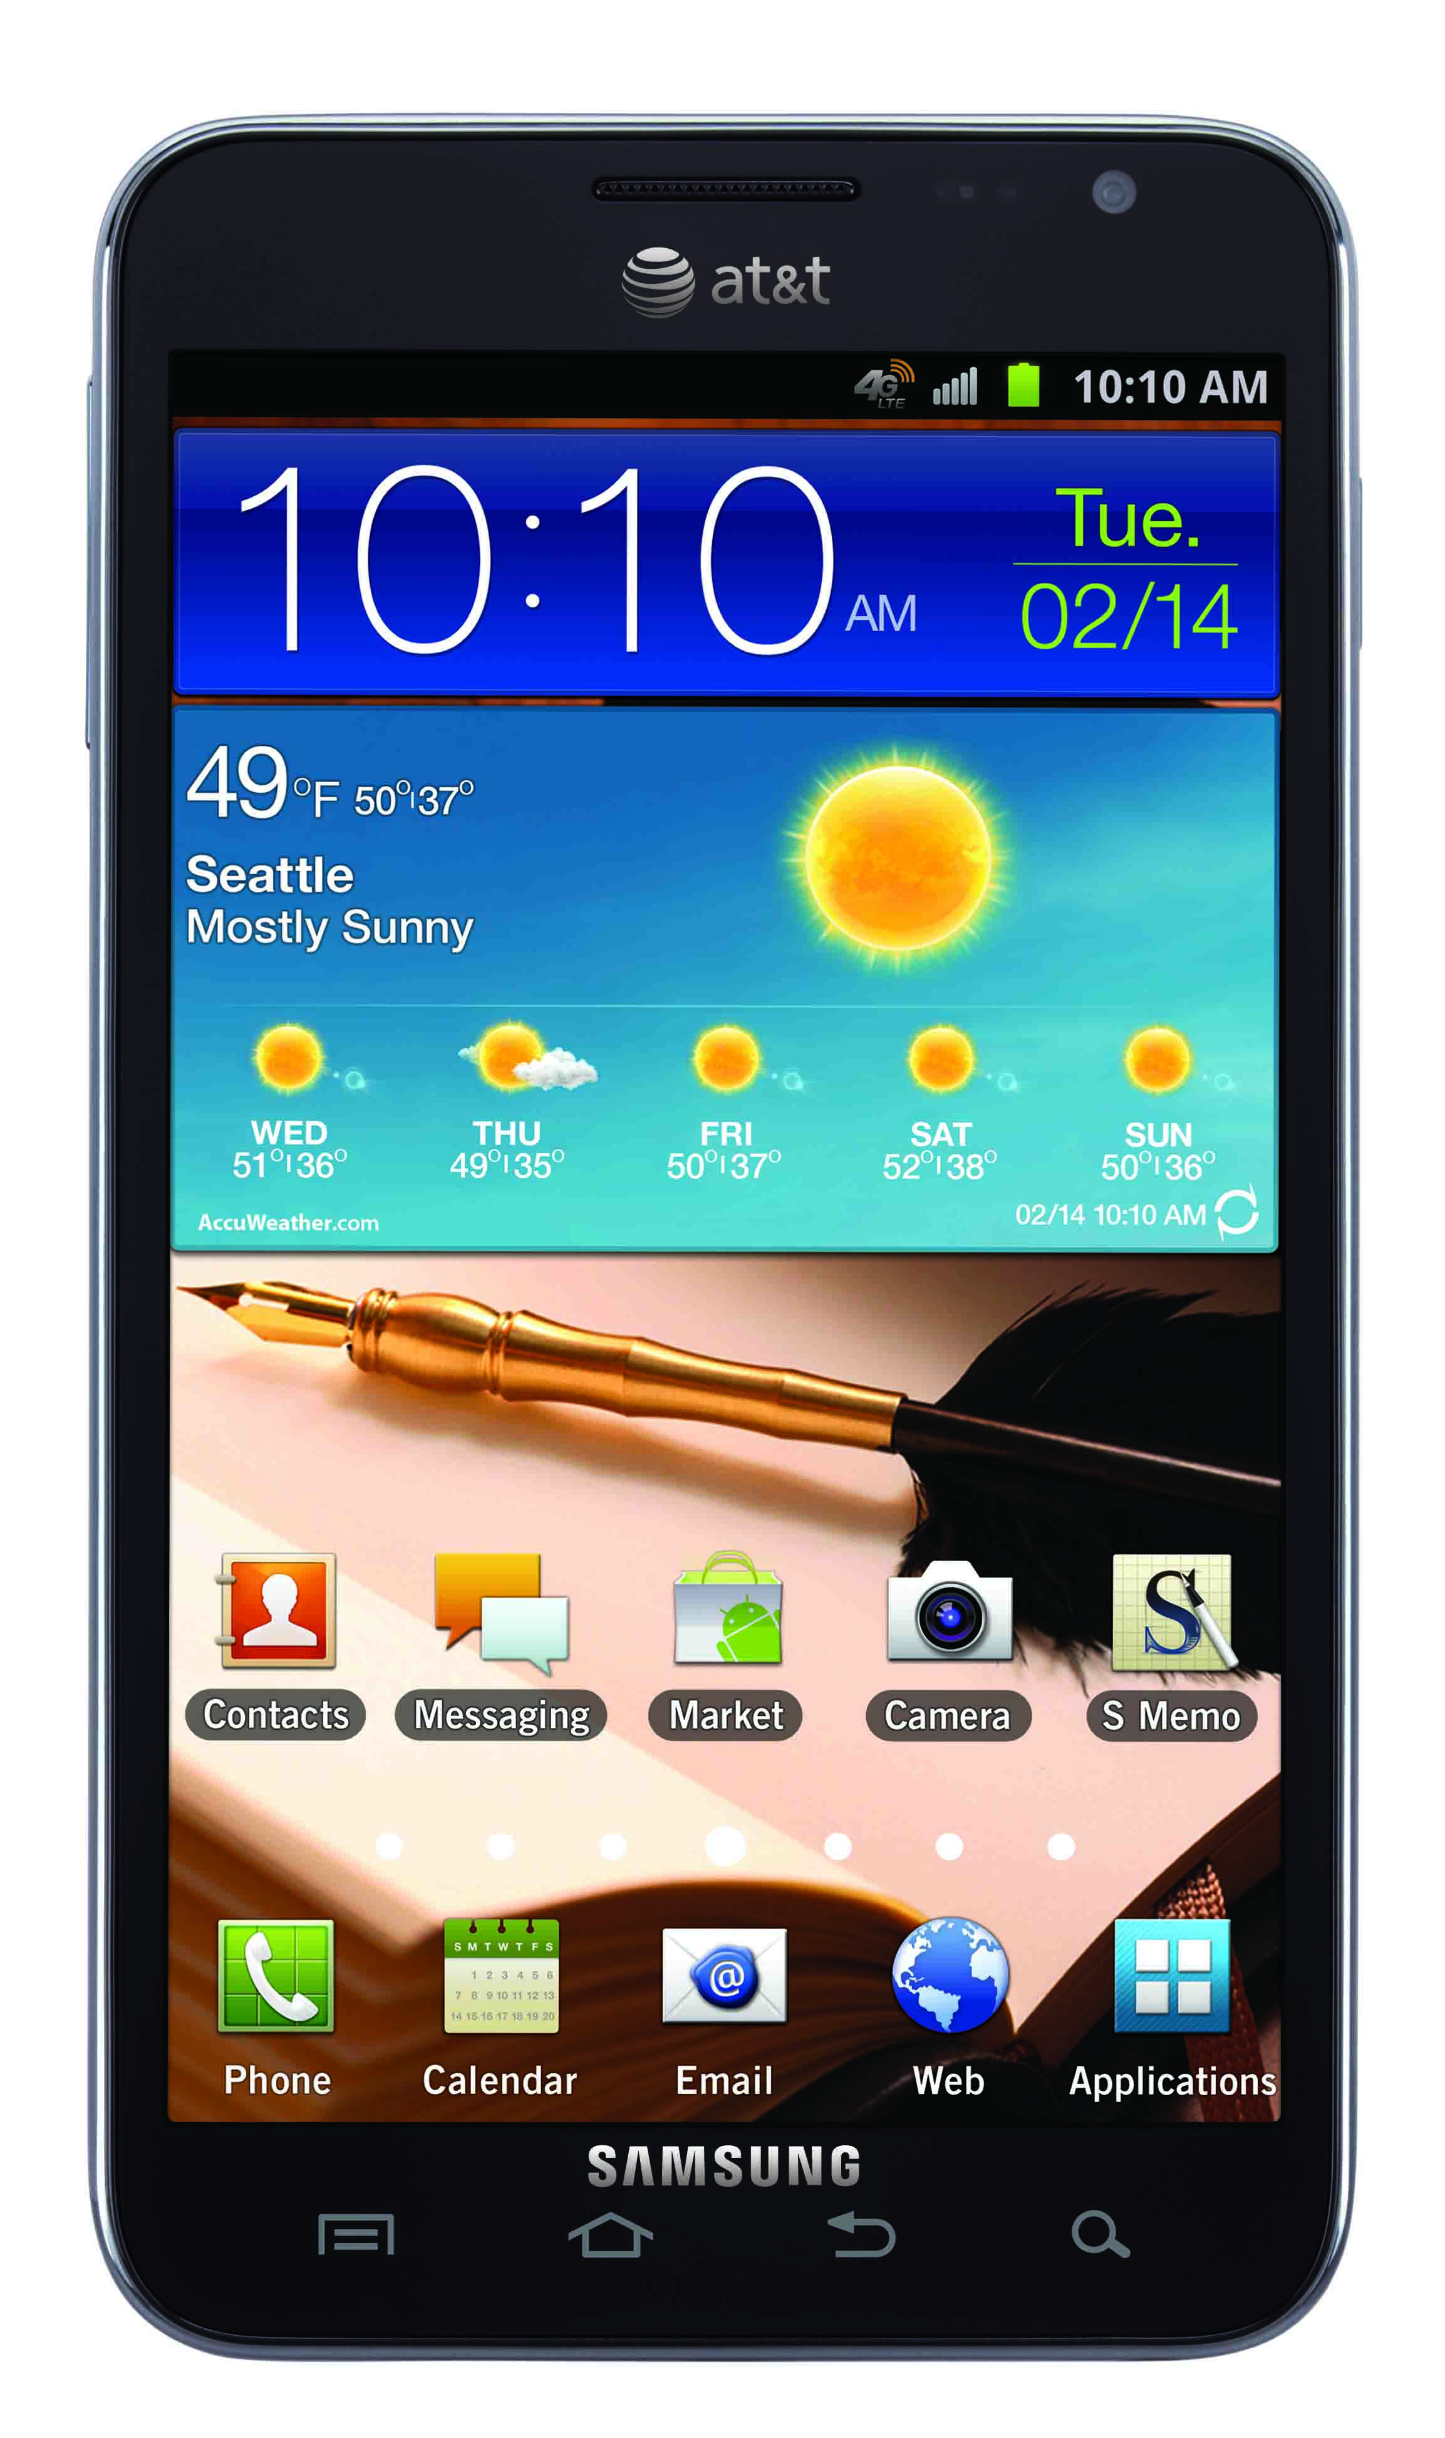
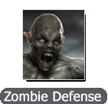

Slide 2
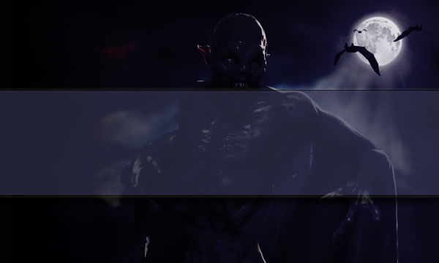


Main Screen
Resume
Game
New Game
Achievements

Slide 3
Starting a new game will replace the existing game.
Main Screen
Resume
Game
New Game
Achievements
Overwrite old game and start a new one
Keep existing game

Slide 4
Main Screen
Resume
Game
New Game
Achievements

Slide 5
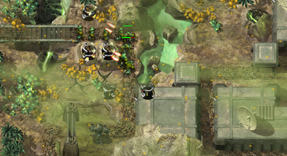

Swipe to change maps. Tap map to begin.
Map Editor Screen
Coming soon
Coming soon
Map info
Easy
Hard

Slide 6


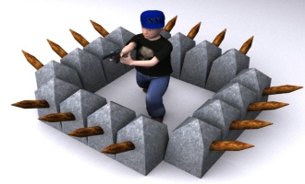
Prevent zombies from killing all towers!
Tap a tower on the map
to show upgrade/sell menu
Survive 100 waves to win.
In Game Screen
Drag a tower to the map. Release it to begin.
$11900
Towers
Wave
19/100
Zombies Killed: 119
$10

Slide 7



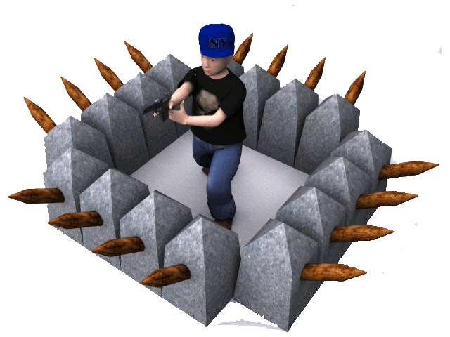
In Game Screen
$11900
Towers
Wave
19/100
Zombies Killed: 119
$10

Slide 8

$5
$15
In Game Screen
$11900
Towers
Wave
19/100
Zombies Killed: 119
$10

Slide 9
You won!
Zombies killed: 1000
Cash earned: $24900
Towers destroyed: 150
Ammo used: 15000 rounds
Time taken: 45 minutes, 30 seconds
Main Menu

Slide 10
Achievements
Killed 10,000 zombies
Killed the golem
Finished with full health
Achievement screen

Slide 11


Options
Background sound
Options screen
Sound effects
OK

Slide 12
Are you sure you want to exit?
I’ll save your game so you can resume it later.
Exit confirmation
Continue Game
Exit Game
Main Menu
$11900
Towers
Wave
19/100
Zombies Killed: 119

