Slide 1
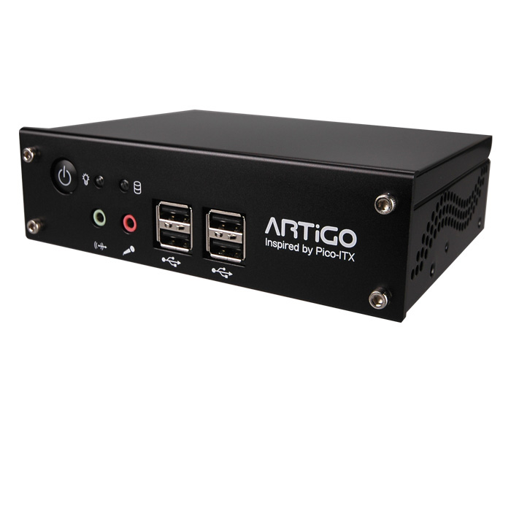
The Hoot System Hardware
Via ARTiGO A1000
  C7 x86 Processor
  1GB RAM
  80GB Storage
  On Board Video and Audio
  60 watt power supply
  4 USB 2.0 Slots

Slide 2
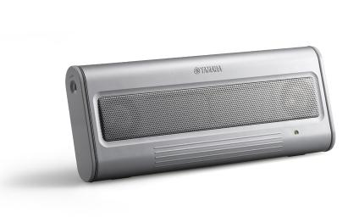
Audio Input
Yamaha USB Speakers
Sennheiser Microphone
  USB adapter cables

Slide 3
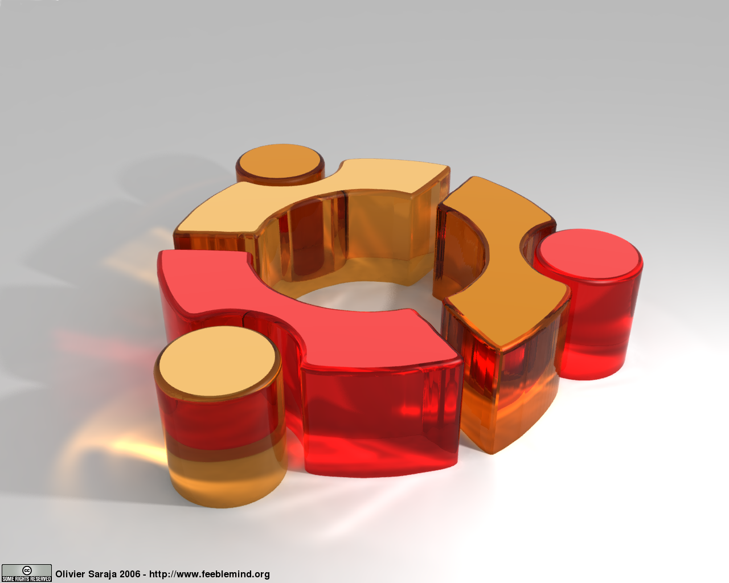
Operating System
Ubuntu 9.10
  Karmic Koala
  System has been modified.
    Removed support for on board audio
    ALSA has been modified to treat USB speakers and Microphone as a single device

Slide 4
System Start
System startup scripts and OS scripts
  Detect USB Drive
    Program files to system
    Upload Audio files
  Start Hoot Daemon
  Set wake

