Slide 1
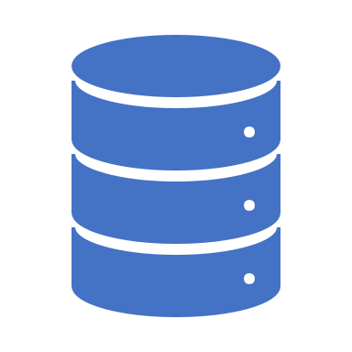
Querying Databases in R

Slide 2




Connection requirements
Credentials
Location
Driver

Slide 3
Requirement definitions
User name & password
Token
URL
IP Address
ODBC (Used by ADO & OLE DB)
JDBC

Slide 4








Connection info
Connection Info

Slide 5

Data Source Name (DSN)
Alias
DSN_1
DSN_2

Slide 6
The ideal connection
DSN
Alias
User’s network ID (a.k.a. Windows sign-on)

Slide 7


Why DSN?
Old
DSN_1
Current
Dev
Script
New Dev
DSN_1
Prod

Slide 8
Alternatives for securing connections
config
keyring
Environment variables
options()
Prompt for credentials

Slide 9
Velocity
Volume
Value
Variety
Veracity
Data > RAM
Garrett Grolemund
Remote Data
Edgar Ruiz (circa 2018)

Slide 10

Big Data in R
Remote Data
Data
RAM
Small Conduit

Slide 11
Big Data Strategies
Sample
Parts
Whole
Most common approach for modeling
Most common approach for general analysis
In most cases, the preferred approach, it’s just not feasible

Slide 12
Parts - “The Method”
ETL
Analysis
.CSV
.CSV
.CSV

Slide 13






Typical DS project
Import
Wrangle
Learn
Share

Slide 14

Remote Data Sources
Flat Files
Only Data
Remote Sources
Data & Compute engine

Slide 15
Wrangle inside the DB
Push Compute
Extract Data
Collect Results
Notes:
1. You can overwhelm R

Slide 16
Options to Push Compute
Write SQL statements
Use dplyr verbs
SELECT "name", COUNT(*) AS "n"
FROM "vwFlights"
GROUP BY "name"
flights %>%
group_by(name) %>%
tally()
Notes:
1. You can overwhelm R

Slide 17
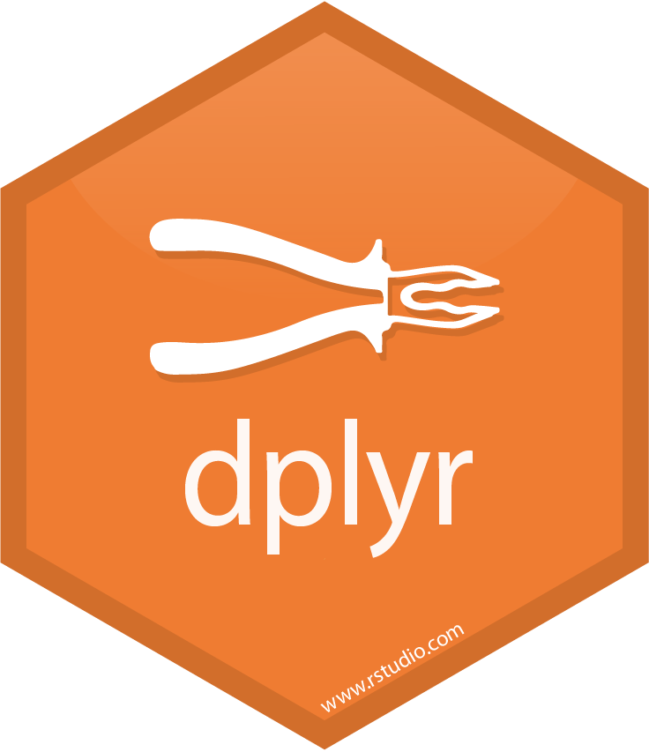
Advantages
dplyr translates to SQL
Take advantage of piped code
All your code is in R!
Push Compute
Collect Results

Slide 18
DS project using DBs
Access
Wrangle
Learn
Share
In the database

Slide 19
How to access a database
R Package – As implemented by RPostgreSQL and others
ODBC - As implemented in odbc package
JDBC - As implemented in RJDBC and other

Slide 20
Packages
dplyr – Simplifies data wrangling
dbplyr – Provides database specific translation
DBI – Common interface for Databases and R
DB R Package – Back-end interface for a specific database, such as RPostgreSQL
odbc – Back-end interface to a database using an ODBC driver

Slide 21

Architecture
Use dplyr
Write SQL
SQL Commands
Translates to
SQL
DBI
dbplyr
rpostgres
odbc
ODBC Driver
Back-end communication
PostgreSQL

Slide 22
How dbplyr translates
class(con)
[1] "Microsoft SQL Server"
MS SQL Server
Translation
2nd Level Translation
1st Level Translation
nchar()
LEN
LENGTH
paste0()
CONCAT
abs()
ABS

Slide 23
Translations available in dbplyr
Microsoft SQL Server
Oracle
Apache Hive
Apache Impala
PostgreSQL
MS Access
MariaDB (MySQL)
SQLite
Amazon Redshift
Teradata

Slide 24
Some advice…
1. Think before you collect()
2. Just a bit off the top, use head()
3. Be select()ive of fields to bring back
4. tbl(con, "No SQL statements in tbl")

Slide 25
Resources
db.rstudio.com
bit.ly/odbc-webinar

