Slide 1

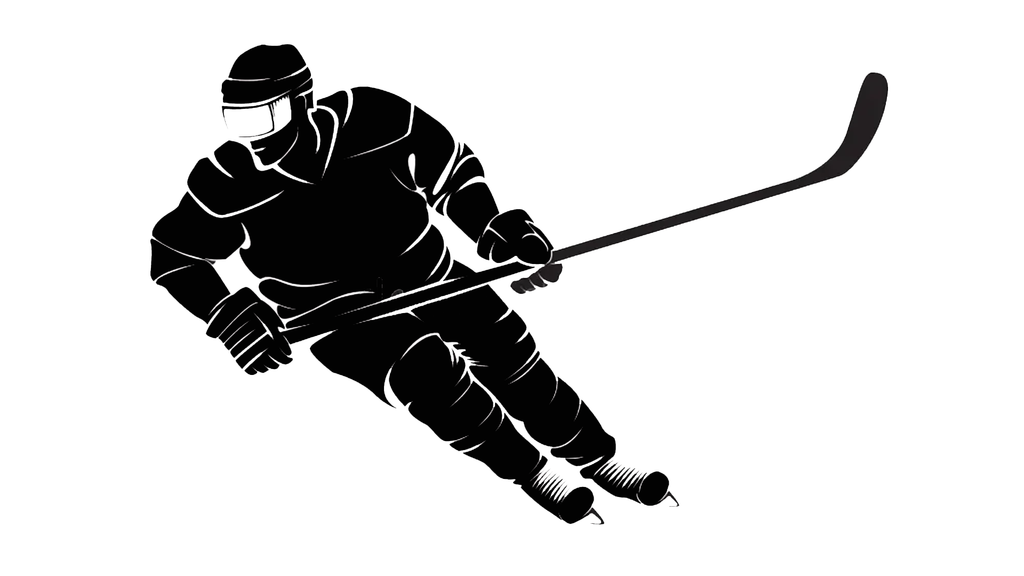
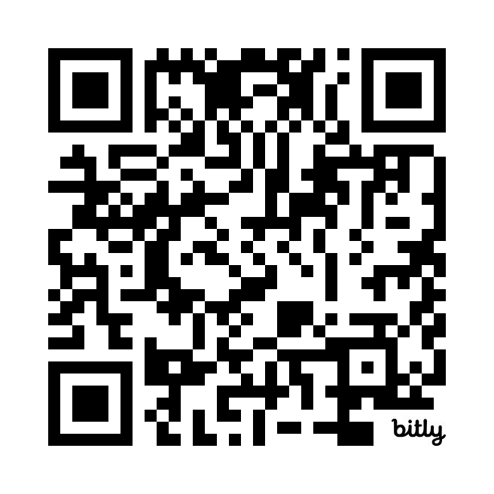
NHL Recommender
https://bit.ly/4kVqT5V
Improve your daily fantasy team
Created by blair cheredaryk

Slide 2
Can we use AI to Recommend Players for DFS Hockey?
What if we want a NHL fantasy team with a salary cap of $30M?
Where do we get the data?
What are the metrics?
What type of AI model to use?

Slide 3
Data
Using data from MoneyPuck.com and QuantHockey api’s, we are able
To get the necessary features to build an AI model to predict our team.
Since the data is scraped from a few sites, we needed to clean up the
Features before using them.
We also needed to gather salary information and join it to the player’s features
What are the metrics?

Slide 4
Metrics
We load in our metrics into components for the model to use Euclidean distance measurements to find the player who plays in the most similar style throughout their career.
Some features include, Goals, Shots, CorsiFor, High Danger Shots, and more!
When using all of the metrics we can build a game engine that will predict the best team score between the user and the AI recommender

Slide 5
AI Recommender Engine
We use an AI recommender engine much like you would see for suggesting movies on Netflix to recommend 5 players closest to the player the user has selected using our metrics
After choosing your team, our Recommender Engine will choose it’s best team based off your first selection using the same metrics provided
Now for the fun part…The NHL Recommender Game

Slide 6
What Would I Do With More Time?
Enhance User Interface
- add images
Update live salaries
- retrieve dfs salaries
Update daily schedule
- use active players only
Implement goalies
- add goalies to roster

Slide 7
NHL Recommender
Thank You for Participating!
Improve your daily fantasy team
Created by blair cheredaryk

