Slide 1
CS 4873: Computing, Society & Professionalism Blair MacIntyre | Professor | School of Interactive Computing
Week 2: Case Study: Therac-25
January 25, 2021
Slides adapted from Sauvik Das, Munmun de Choudhury, and Amy Bruckman

Slide 2
Homework 1
Available on Canvas
Due: Feb 1st, 2020 (11:59pm Eastern Time)
Submission on Canvas.

Slide 3
Why you, as a CS major need to know about ethics…

Slide 4
Genesis of the Therac-25
Atomic Energy of Canada Ltd (AECL) and French company CGR built Therac-6 and Therac-20
Delivered 25 MeV photons or electrons of various energies
History before Therac-20
Software to convenience hardware
Therac-25 built by AECL
Tensions between the two orgs
PDP-11 an integral part of system
Hardware safety features replaced with software to cut costs
Reused code from Therac-6 and Therac-20
Compact, economic advantage
First Therac-25 shipped in 1983
Patient in one room
Technician in adjoining room

Slide 5
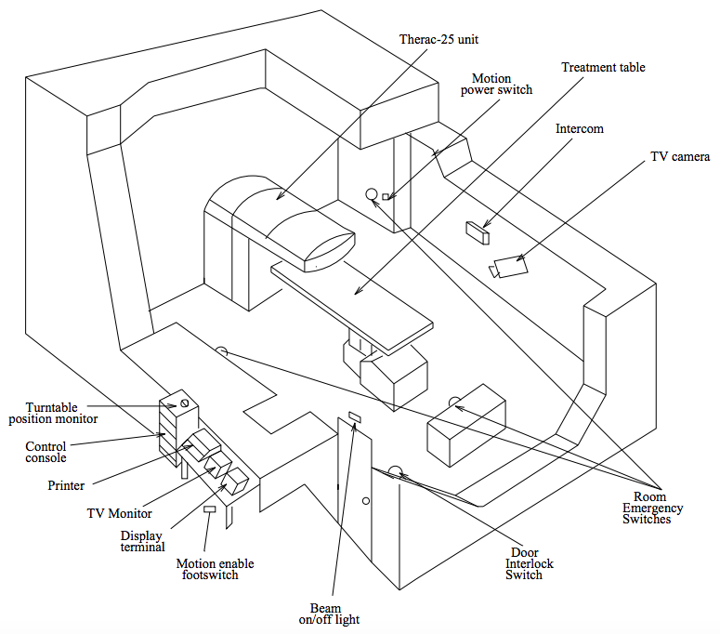

Slide 6
Operation
The radiation software required that three essential programming instructions be saved in sequence:
first, the quantity or dose of radiation in the beam;
then a digital image of the treatment area; and
finally, instructions that guide the multileaf collimator.

Slide 7
Electron mode
5-25 MEV
Magnets spread beam
Ion chamber monitor
X-ray mode
25 MEV electrons hit target
“Beam flattener” attenuates
100x beam current
Ion chamber monitor
Field-light mode
No current
Mirror & light used to check alignment
No ion chamber (since not treating)

Slide 8
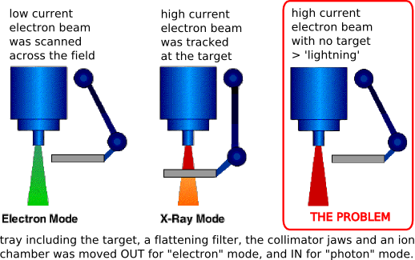
Operation

Slide 9
Role of the Software

Slide 10
The Context
Radiation therapy
Many people with cancer were diagnosed and treated, but were also exposed more radiation than they needed

Slide 11
The Context
11 installed machines (5 US; 6 Canada); 6 major accidents; 3 deaths
Improper scanning of the spread of the radiology beam, causing radiation burn and secondary cancer
Machine recalled in 1987
Denial – manufacturer and operation refused to believe that the system could make a mistake

Slide 12
Case 1: Marietta, GA
Breast cancer patient, receiving therapy on nearby lymph nodes
Felt a “tremendous force of heat” when the machine was turned on
Technician on site (Tim Still) contacts AECL about possible bug, but was told it was impossible
Later found out that she received between 15,000 – 20,000 rads (typical dose is 200, 1000 can be lethal if delivered to whole body).
Shoulder/arm was paralyzed, breast had to be removed

Slide 13
Case 2: Ontario
Patient came in for 24th treatment. Operator put in routine dosage
Therac shut down after 5 seconds an error message, saying No Dose had been administered. Operator hit “proceed” command to deliver dose.
Repeated process 4 times.
Patient complained of a burning sensation around treatment area (hip)
Later hospitalized. Died because of cancer, but would have needed total hip replacement because of radiation overexposure

Slide 14
Case 3: East Texas
Experienced operator made a mistake in configuring the treatment
Entered “x” for x-ray, when she meant to enter “e” for electron
Realized her mistake after entering all the other parameters and fixed the mistake by using keyboard navigation shortcuts
Audio / video facilities weren’t working that day, so operator couldn’t see patient
Turned on beam, but the treatment stopped prematurely and reported an underdose. So she proceeded with the treatment.
Unbeknownst to operator, patient felt strong pain after the first beam and attempted to get up when second beam hit. Was banging on the door to alert her to stop

Slide 15
What Went Wrong: Gap in End Users’ Understanding
When the computer kept crashing, the operator did not realize that her instructions had not been noticed by system
Software errors showing dose was not delivered, technician failed to verify
* Another therapist failed to catch the error; errors were cryptic numbers (Malfunction 1 – 64) that provided no indication that a patient might be at risk.

Slide 16
What Went Wrong: Infrastructural Gaps
(For the later accidents in the optional NYTimes Reading)
It was customary — though not mandatory — that the physicist would run a test before the first treatment to make sure that the computer had been programmed correctly. But the hospital had a staffing shortage.

Slide 17
What Went Wrong: Issues in the Design of Therac-25
AECL focused on fixing individual bugs not testing the whole system
Manufacturer would not believe that machine could fail
System not designed to be fail-safe
Industry standards not followed
No proper hardware was installed to catch safety glitches
No devices to report overdoses
AECL did not communicate fully with customers
Lack of communication and organization between hospitals, government and manufacturer

Slide 18
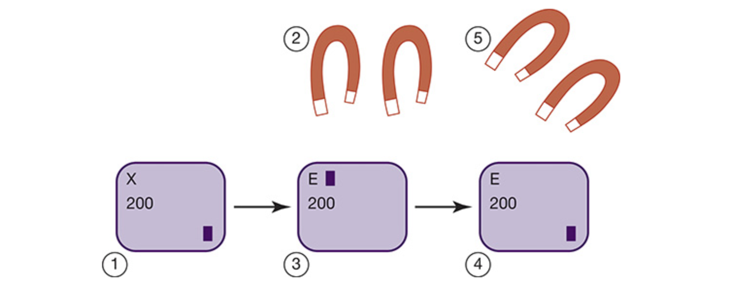
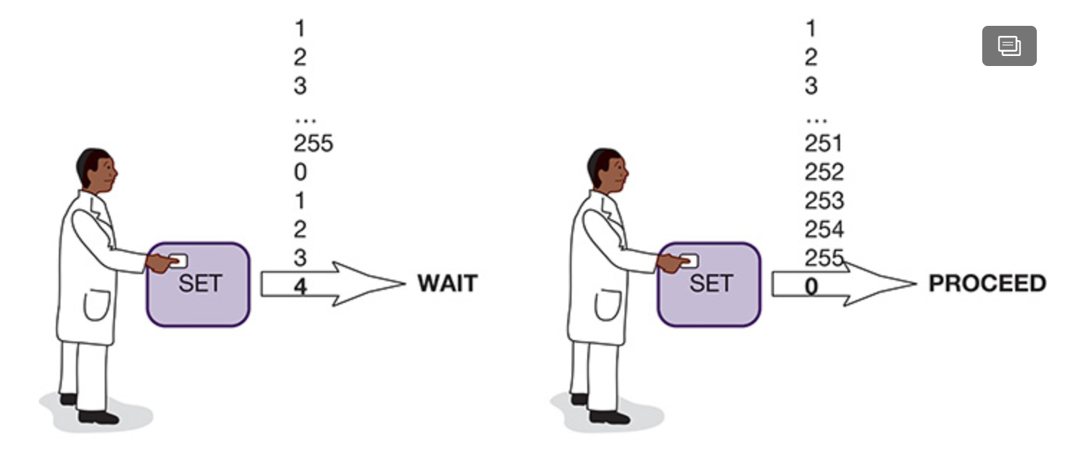
What Went Wrong: Software Errors
Race conditions.

Slide 19
What Went Wrong: A Lack of Fault Tolerance
One therapist mistakenly programmed the computer for “wedge out” rather than “wedge in,” as the plan required.
And the physics staff repeatedly failed to notice it during their weekly checks of treatment records.

Slide 20
Dr. Howard I. Amols, chief of clinical physics at Memorial Sloan-Kettering Cancer Center in New York:
“Linear accelerators and treatment planning are enormously more complex than 20 years ago. But hospitals are often too trusting of the new computer systems and software, relying on them as if they had been tested over time, when in fact they have not.”

Slide 21
What Went Wrong: Partial automation, forgetting the human
Computerization reduced human time needed to calibrate machines and perform safety checks
But human intervention was still needed to check whether the technology’s software came up with a good treatment solution for a patient
Don’t Forget the Human!

Slide 23
What Went Wrong: Human Factors
People respond to their work environments. Things that affect judgment:
Staffing shortages
What is rewarded; what is punished
Prior experience
Hubris: “We’ve made this 5 orders of magnitude safer!”

Slide 24
A Philadelphia hospital gave the wrong radiation dose to more than 90 patients with prostate cancer — and then kept quiet about it.
A Florida hospital disclosed that 77 brain cancer patients had received 50 percent more radiation than prescribed because one of the most powerful — and supposedly precise — linear accelerators had been programmed incorrectly for nearly a year.

Slide 25
What Went Wrong: Regulation loopholes
The FDA does not approve each new medical device on the market
Medical accelerators only required “pre-market notification” — i.e., “firm must establish it is equivalent in safety to a product already on the market.”
Because Therac-6 and 20 were already in the market, this was easy for the -25 because, in theory, it had the same safety features (only in software not hardware)
Only changed to needing approval from FDA after first few safety incidents.

Slide 26
Why Detection is Difficult
Identifying radiation injuries can be difficult.
Organ damage and radiation-induced cancer might not surface for years or decades, while underdosing is difficult to detect because there is no injury.
For these reasons, radiation mishaps seldom result in lawsuits, a barometer of potential problems within an industry.
Under-reporting of “accidents”

Slide 27
People involved in the tragedies
Company who made the software for the accelerometers
Programmers and testers behind the software
Doctors who prescribed medication
Staff and technicians who managed the accelerometers
** Think about it for your recitation section!

Slide 28
Post Mortem
Software lessons
Difficult to debug programs with concurrent tasks
Design must be as simple as possible
Documentation crucial
Code reuse does not always lead to higher quality

Slide 29
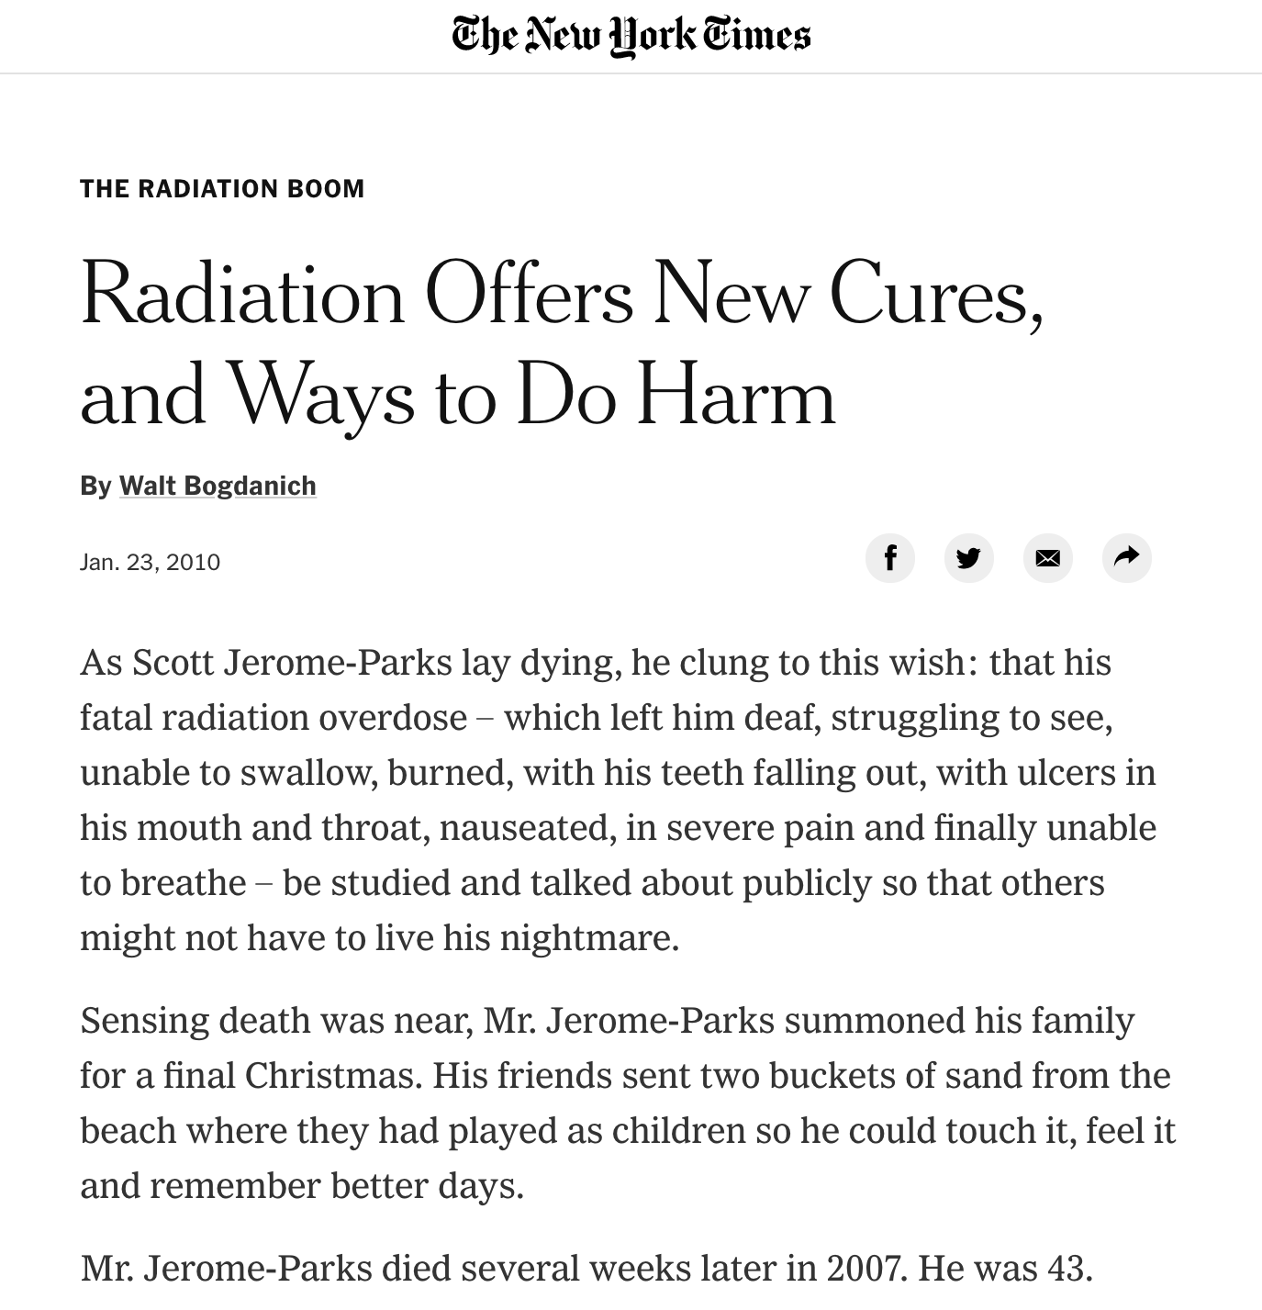
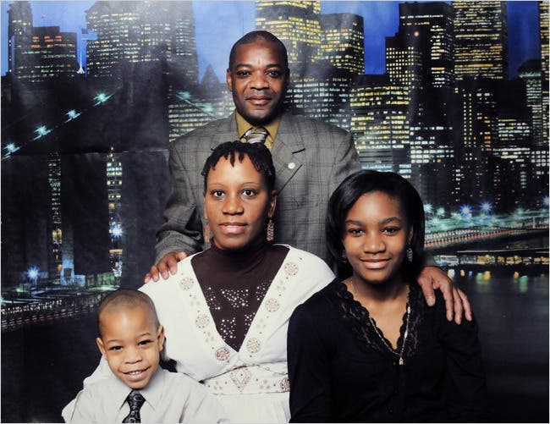
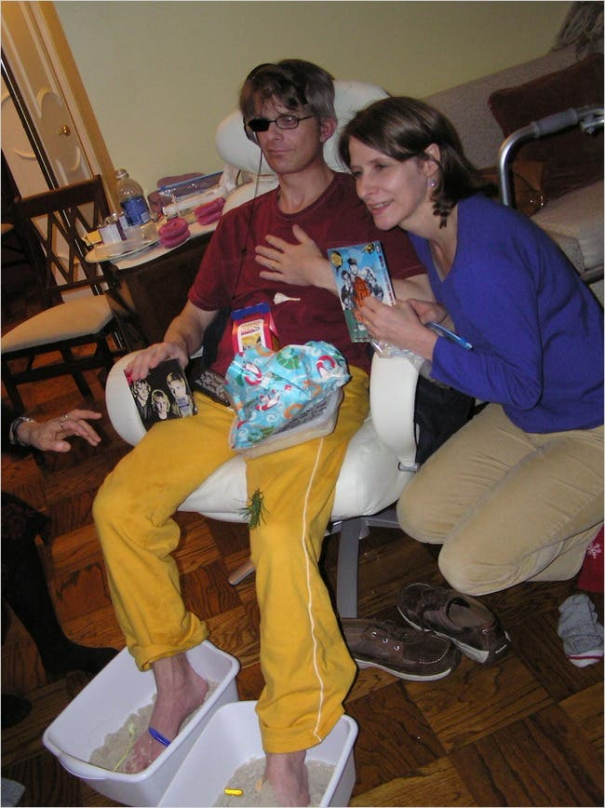
That was like 30 years ago …

Slide 30
Solution?
“Mistakes are a fact of life. It is the response to the error that counts.”
- American writer and educator Nikki Giovanni

Slide 31
Lesson: Adopt Systems Thinking
Don’t just monitor, learn from mistakes
“Blame culture” should give way to “Learn culture!”
A well-designed incident learning system in a radiotherapy program consists of several steps
occurrence of incidents,
their identification and response,
reporting,
investigation,
causal analysis,
corrective actions,
Learning
All included in a cyclic feedback loop
A nationwide public mandatory reporting system

Slide 32
Lesson: Use Defensive Design
Designing for when things go wrong.
Defensive design is the practice of anticipating ways that an end-user could misuse a device, and designing the device so as to make such misuse difficult or impossible (e.g., by eliminating race conditions).

Slide 33
Lesson: Accounting for the human-in-the-loop
Automating away parts that are tricky for humans can be great, if well-tested, but many systems will always require a human-in-the-loop
For these situations, it is not enough to write good code—the interface must account for human variance and error.
Human-centered design:
Safe defaults
Interpretable errors
Intuitive design

Slide 34
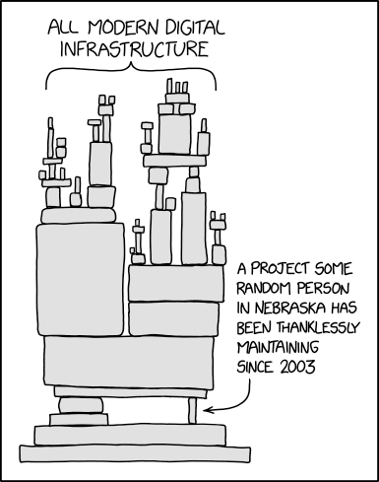
Another Lesson Learned ….
The software we produce can have significant upstream implications. We’re not just twiddling bits!
While most of you may not be working directly on life-critical applications, who knows how your software will be used in the future.
Assumptions made for Therac-6 and 20 didn’t hold for 25.
Check your assumptions, code defensively, and make the easiest path the safest path.

