Slide 1
CS 4873: Computing, Society & Professionalism Blair MacIntyre | Professor | School of Interactive Computing
Week 4: Social Contract Theory
February 10, 2021
Slides adapted from Sauvik Das, Munmun de Choudhury, and Amy Bruckman

Slide 2
Deontology Review
Notes:
Who wants to briefly recap utilitarianism for the class?

Slide 3
Deontology
Morality is based on reason
An act is right iff it conforms to the relevant moral obligation; and it is wrong iff it violates the relevant moral obligation.
Unlike utilitarianism: the consequences of an action are irrelevant to moral evaluation
The value of an action lies in motive – especially motives of obligation
You’re not on the hook for sending your allergic aunt flowers in the hospital!
Notes:
Extreme position:
Accidentally killing people with new vaccine for HIV?
Therac-25 AECL folks were well-meaning in trying to produce a machine that eradicated tumorous cells?

Slide 4
Kantianism
Based on the writing of philosopher Immanuel Kant (1724 – 1804)
People should be guided by universal moral laws. Must be based on reason.
The only thing that is good without qualification is good will.
Morality derived from this starting premise.
A person has good will only if the motive of his or her action is based on moral obligation, derived from universally valid norms.

Slide 5
Categorical Imperative: Formulation One
Act only from moral rules that you can at the same time will to be universal moral laws.
In layman’s terms: If it’s okay for you now, it should be okay for everyone at anytime.
Remember: Kant’s argument is not based on consequences. He argues that breaking the categorical imperative is illogical / against reason.
Notes:
Example of breaking a promise:
If breaking a promise were universalized (everyone broke promises), no one would ever expect a promise to be kept, and therefore promises would have no meaning. Logical inconsistency.

Slide 6
Categorical Imperative: Formulation Two
Act so that you always treat both yourself and other people as ends in themselves and never only as a means to an end.
In layman’s terms: Do unto others as you would have them do unto you.
Human beings have inherent value because we can “rise above our instincts”
Objects have instrumental value (e.g., car keys)
By treating a human as a means to an end, you are neglecting their inherent value and treating them like an instrument.
Notes:
Human beings have inherent value, according to Kant, because we can “rise above our instincts”.
Car keys have instrumental value.
By treating a human as a means to an end, you are neglecting their inherent value and reducing them to an instrument (like car keys).

Slide 7
Social Contract Theory

Slide 8
Social contract theory
Based on the writings of English philosopher Thomas Hobbes.
Lived during the English civil war (mid-1600s) and saw the consequences of social anarchy.
In his book, Leviathan, Hobbes wrote: “In a state of nature, no one would do anything productive because someone else would just ruin it”
“a war of all against all”

Slide 9
Hobbes’ “Life in a State of Nature”
No laws or government.
No rules or morality.
Everyone for themselves.
Why?
Equality of need
Scarcity of resources
Essential equality of human power
Limited altruism

Slide 10
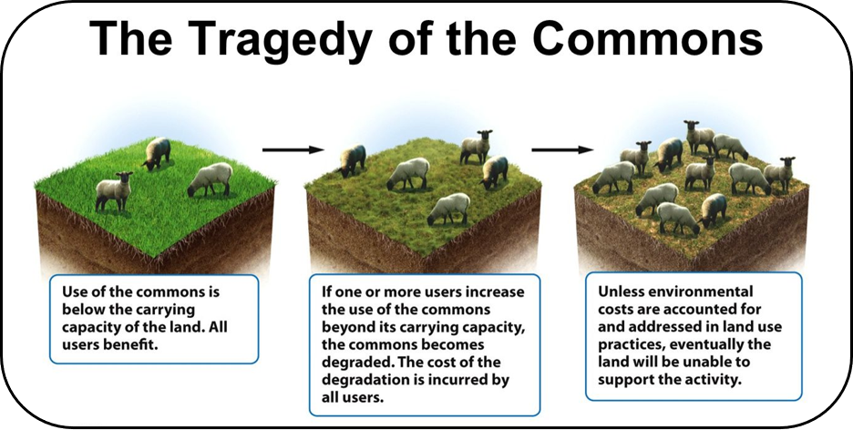
Photo credit: https://blogs.ntu.edu.sg/hp3203-2018-29/files/2017/11/Picture14-21nrrzy.png
Conflict for resources between individual interests and the common good.
Notes:
Common grazing ground for cattle.
Cheaper to graze sheep there too, but sheep will overgraze commons and ruin it for everyone.
If everyone only grazes cattle -> grounds remain healthy and free for everyone.
But cheaper for any given individual to allow sheep to graze too.

Slide 11

Social contract theory
Moral rules “are necessary if we are to gain the benefits of social living.”
Basic idea: Everyone agrees to give up some liberties (e.g., obey property rights) in order to reap the benefits of a civilized society
We need two things:
A set of moral rules to govern relations among citizens
A government capable of enforcing them

Slide 12

Morality in social contract theory
Morality is the set of rules that rational people will agree to obey, for their mutual benefit, provided that other people will obey them as well.

Slide 13
Need for rules
Five main reasons that laws are required in society (Pollock, 2007):
The harm principle: to prevent the serious physical assault against others that would be victimized.
The offense principle: to prevent behavior that would offend those who might otherwise be victimized.
Legal paternalism: to prevent harm against everyone in general with regulations.
Legal moralism: to prevent immoral activities
Benefit to others: to prevent actions that are detrimental to a segment of the population

Slide 14
The language of rights
Negative right: freedoms / liberties (example: free speech)
Positive right: obligations to you from others, and to others from you (example: free education, healthcare)
Absolute right: guaranteed without exception
Limited right: Restricted under some circumstances
Negative rights are usually absolute
Positive rights are usually limited

Slide 15
The Stop Sign with Social Contract Theory
You are driving out in the desert. You can see in all directions for miles. No one else is around. You see a stop sign. Do you stop? Why or why not?
Notes:
Part of the social contract is obeying road signs. So, you should obey road signs.

Slide 16
How do we form the contract?

Slide 17
SCT is not necessarily authoritarian
Hobbes was a pessimist about human nature and an absolute monarchist, but SCT is compatible with many forms of governance.
Jean-Jacques Rousseau:
Believed that humans are born inherently good
Notion of private property resulted in a “fall from grace” for mankind
Posited that Hobbes’ social contract was made at the suggestion of the rich and powerful who tricked the general population into surrendering their liberties and instituted inequality as a fundamental feature of society
Advocated for direct democracy: community will determine the rules for its members, and no individual could be above the rules.

Slide 18
John Rawles
To prevent people from promoting selfish interests, each person must voice their opinion behind a veil of ignorance:
They must agree before they know what place they will hold in society
Ignorant of their own: sex, race, ethnicity, intellectual capacity etc.
Assuming this is possible, there are two key principles to the social contract:

Slide 19
Rawl’s principles of justice
Each person may claim a “fully adequate” number of basic rights and liberties so long as these claims are consistent with everyone else having a claim to the same rights and liberties.
Examples: freedom of thought and speech, freedom of association, the right to be safe from harm, the right to own property, right to privacy
Any social and economic inequalities must satisfy two conditions:
They are associated with positions in society that everyone has a fair and equal opportunity to assume
They are ”to be of the greatest benefit to the least-advantaged members of society” (difference principle)
Notes:
Difference principle: inequalities are justifiable only if, in total, they benefit the least advantaged

Slide 20
Example: The Proxy Server
Your company has blocked access to social media websites. You have access to a proxy server. You want to read reddit on your lunch hour.
According to SCT, is it ethical for you to access your proxy server to access reddit? Why or why not?
What if, instead of reddit, it was an “adult” website?
Notes:
Need to think of the “rights” of the rational agents involved.
Do you have a “right” to access your proxy server?
Does your company have a “right” to control your access to the internet on time they are paying you to work?
Not easy to “solve” outright

Slide 21
The Proxy Server
Rational agents:
You
Your employer
“Rights” of the rational agents
You: Do you have a “right” to do as you please on your lunch hour? To access your own property (the proxy server)?
Employer: Does your employer have a “right” to govern and restrict what you do while they are paying you?
Context:
How do these rights vary based on situational context? Is reddit okay but an adult website not okay?
Not easy to “solve” outright, requires deliberation.

Slide 22
SCT Advantages
It is framed in the language of rights
Has explanatory power:
Explains why people act in self interest in the absence of an agreement
“tragedy of the commons”
Explains why civil disobedience is sometimes ethical. Why?
Notes:
SCT assumes everyone bears burdens equally – if that is not the case, civil disobedience is justified

Slide 23
SCT Disadvantages
None of us signed the contract
Doesn’t explain what to do when you have conflicting rights
Difficult to apply to dilemmas
May be unfair to people who can’t hold up their side of the contract
for those who do not (or cannot agree) to the contract, no moral obligations exist (they have none to us and we have none to them).
animals and people with mental or physical health impairments are not owed any duties on the social contract view

Slide 24
SCT vs. Other Rule-Based Frameworks

Slide 25
Reason for making rules is different
Kantianism: Can the rule be universalized without resulting in a logical inconsistency?
Rule Utilitarianism: Does the rule result in the greatest happiness?
Social Contract Theory: Would rational people collectively accept the rule as binding because of its benefit to the community?

Slide 26
Application of rules is different
Kantianism: Evaluate the rule against the categorical imperative.
Rule Utilitarianism: Calculate total happiness.
Social Contract Theory: Evaluate the agreed upon “rights” of the rational agents involved.

