Slide 1
CS 4873: Computing, Society & Professionalism Blair MacIntyre | Professor | School of Interactive Computing
Week 5: Stakeholder Analysis
February 15, 2021
Slides adapted from Sauvik Das, Munmun de Choudhury, and Amy Bruckman

Slide 2
Start Thinking about your Term Paper
Pick an an issue about computing and society that you are initially undecided about
Pick a reasonable sized question to explore
Find high-quality references
Be precise about the issue, and related terms
Spend time on your organization and writing
Make good use of the space, don’t use filler, don’t go too long
Start thinking about term paper topics
Discuss with your TA, or me
Proposals due March 1!

Slide 3
Who are Stakeholders?
Mostly discussed in the context of business ethics.
Stakeholders are broadly defined as anyone who is impacted by a decision-maker’s decision.
Some examples of corporate stakeholders would be shareholders, employees, customers, suppliers, financiers, families of employees and the community in which the corporation is located.
Stakeholders could also be less directly related to the operations of a corporation.

Slide 4
Ethical Dilemma’s and Stakeholder Analysis
Make a list of all the stakeholders involved
Try to balance the positive and negative impact on people
Missing some has led to many unethical decisions
Not an ethical theory in itself
A useful way of looking at things
Profit vs low wages
production vs pollution
…
Focus on ethics vs other uses of SA
Not strategic analysis (optional reading)
Not UX

Slide 5
We will Return to This Over Semester
Useful in most issues we discuss
Lots of “hot” examples in Tech
E.g., Uber / Gig companies

Slide 6
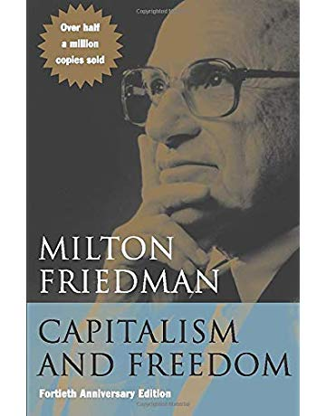
Milton Friedman
American Economist
1976 Nobel in Economics
1962 book: “Capitalism and Freedom”
The book focuses on the connection between economic freedom, political freedom, and the important impact this connection has on an economy

Slide 7
Milton Friedman’s Philosophy
“The social responsibility of business is to increase its profits.”
A survey asked the top 25 percent of income earners holding a university degree in each country surveyed whether they agree with Milton Friedman’s philosophy.
The results...

Slide 8
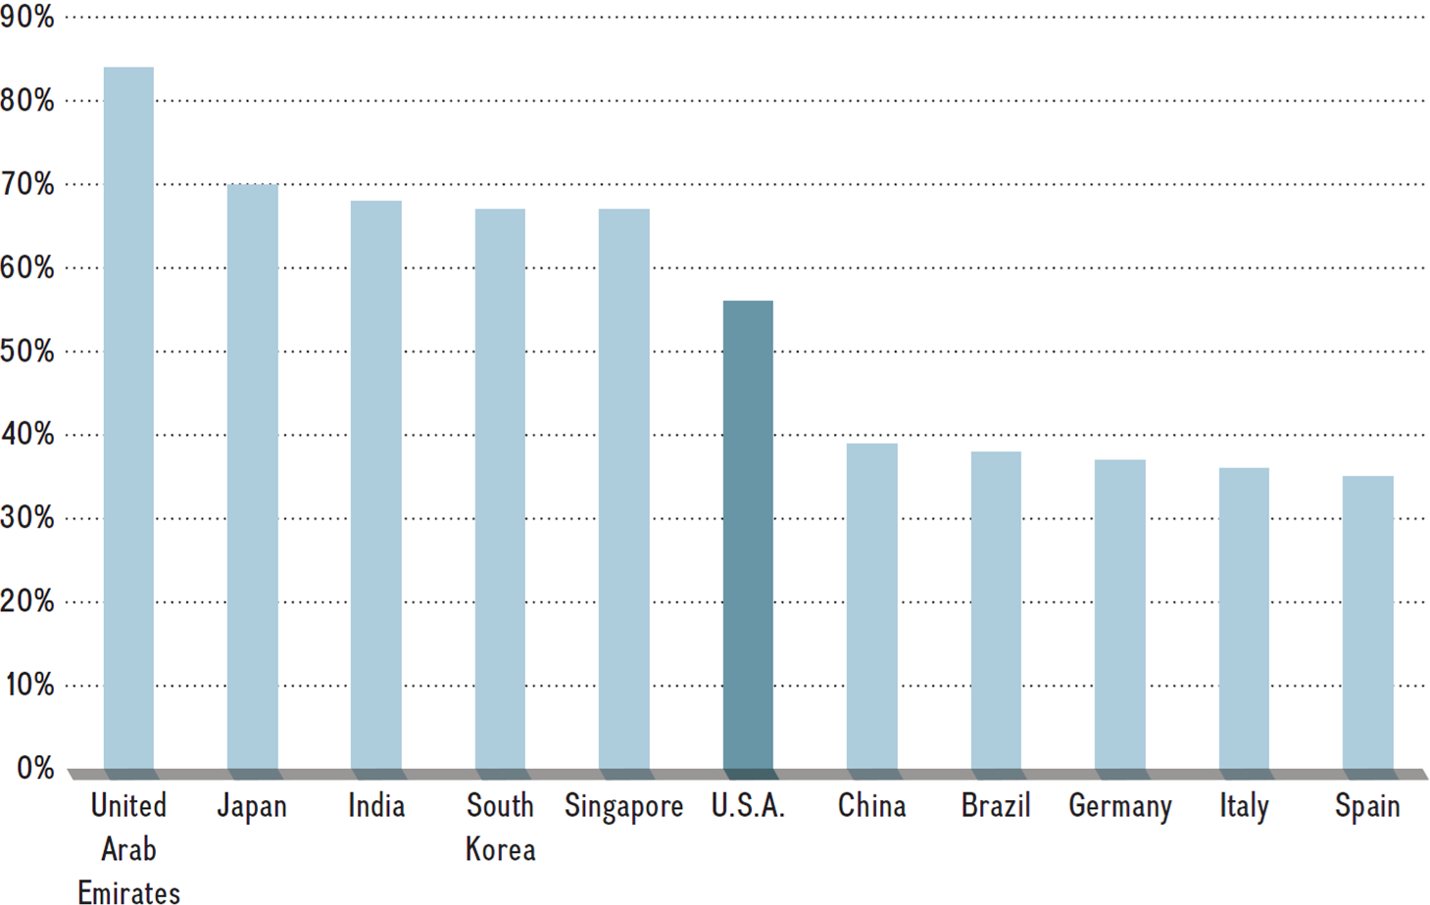
Percent of “Informed Public” Who “Strongly/Somewhat Agree” with Milton Friedman in 2011
SOURCE: Author’s depiction of data from Edelman’s (2011) Trust Barometer as included in “Milton Friedman goes on tour,” The Economist, January 27, 2011.

Slide 9
Example: GM and the 1980’s Poletown Case
GM needed to build a new assembly plant, shut down others including 2 in Detroit
Eliminate jobs in poor area
Could work with city to use eminent domain to get 500 acres
Poletown neighborhood a mixture of 4200 poor Polish and African Americans
Would keep jobs in Detroit
More expensive than building elsewhere

Slide 10
Stakeholders in Poletown
GM Stockholders
Suppliers
Old and new plant employees
City of Detroit
Residents of Poletown
Plant was built, shut down recently https://www.bloomberg.com/news/articles/2018-12-10/the-history-of-gm-poletown-and-its-impact-on-detroit

Slide 11
The Shared Value Creation Framework
Porter, Kramer and others argue that executives should not concentrate exclusively on increasing firm profits.
Rather, the strategist should focus on creating shared value, a concept that involves:
Creating economic value for shareholders
Creating social value by addressing society’s needs and challenges

Slide 12
The Shared Value Creation Framework
It is a model proposing that managers have a dual focus on:
Shareholder value creation
Value creation for society
Example: GE’s ecomagination initiative
To provide cleaner and more efficient sources of energy
To provide abundant sources of clean water anywhere in the world
To reduce emissions

Slide 13
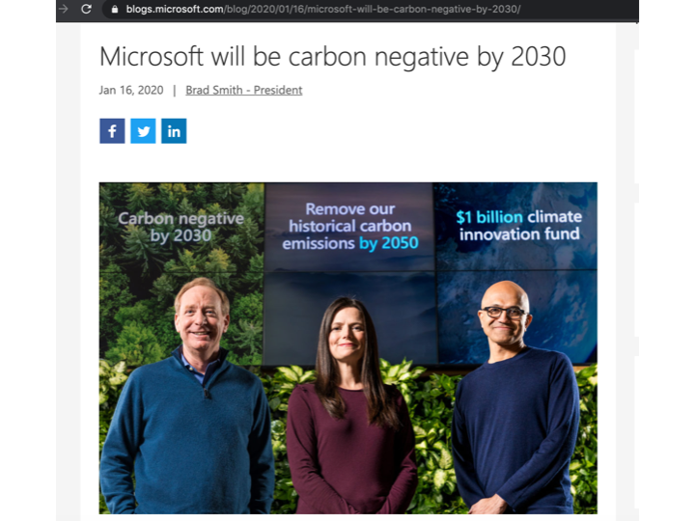

Slide 14
Understanding your Stakeholders
Gilligan is reacting to Kohlberg’s stages of moral development
Illustrates the need to understand stakeholders
Kohlberg’s stages of moral development
Stages 1 & 2: egocentric understanding of fairness based on individual need (kids)
1. obedience & punishment orientation
2. self-interest orientation (what's in it for me)
Stages 3 & 4: shared concept of fairness based in societal agreement
3. interpersonal accord and conformity (good boy/girl attitude)
4. Authority and social-order maintaining (law and order morality)
Stages 5 & 6: free-standing logic of equality and reciprocity
5. social contract orientation
6. universal ethical principles (Kant)

Slide 15
Not About Gender
Gilligan says this is about gender
Seems unclear
But it’s still important

Slide 16
Heinz’s Dilemma
Should he steal the drug to save his wife’s life?
What is 11-year-old Jake’s answer?
The value of life outweighs the value of property
Logical analysis
What is 11-year-old Amy’s answer?
Can’t he talk to the druggist?
If Heinz goes to jail, he can’t help his wife in the future
The ethical dilemma exists in a web of human relationships

Slide 17
Exercise: Your Cubemate the ACNH Addict
Your office mate is playing a video game for five hours each work-day
When anyone else comes in, he quickly turns it off or hides the Switch
Do you say anything to him?
Suppose you did say something to him, and nothing changed.
Do you talk to his boss?
Think about this from ethical theories and stakeholders:
What would an act utilitarian do?
What would a rule utilitarian do?
What would a deontologist do?
What does stakeholder analysis contribute?
What would you really do?

Slide 18
Version II
What if he’s on a cancer support site all day
His child has cancer
Is this the same dilemma or different?
Why?

Slide 19
For Next Time
Virtue Ethics reading
Quinn
Stanford Encyclopedia of Philosophy
Put a quote from the Stanford Encyclopedia of Philosophy virtue ethics reading on your section’s Canvas
Tool to help you tell if a reference is peer reviewed

