Slide 1
Irrational Numbers
A journey through Rational Approximations, Continued Fractions, and Pell's Equation

Slide 2
Outline
Measuring Irrationality
Diophantine Approximations
Dirichlet's Approximation Theorem
Roth's Theorem
Continued Fractions
Properties of Convergents
Periodicity
Pell's Equation
How do we find solutions?
Archimedes' Cattle Problem

Slide 3
Measuring Irrationality
What is the "most irrational" number you can think of?
sqrt(2) ?
π ?
0.5000...000314159… ?
What does it mean for a number to be irrational?
Are some irrationals are more irrational than others? What is the "most irrational" number?
Notes:
Main takeaway: An irrational number that can be closely approximated by a rational is, in a sense, "less irrational."

Slide 4
Diophantine Approximations
Let's try to approximate π with a rational p/q.
Can we minimize |π - p/q| ?
Yes, easily
Consider: 3/1, 31/10, 314/100, …
Higher denominators is cheating!
For any q, we can select a p such that π is within 1/q of p/q.
Can we also minimize q * |π - p/q| ? What about q² * |π - p/q| ?
These are not so obvious...
Notes:
This second measure of "closeness" is what we will be using for the rest of the lecture.

Slide 5


Dirichlet's Approximation Theorem
For a real number α and a positive integer N, there exists a rational p/q such that 1 ≤ q ≤ N and , and thus
Corollary: For any irrational number α, there are infinitely many rationals p/q that satisfy
Notes:
Proof of corollary: Clearly, at least one such rational exists. Assume there are only finitely many. Pick a large N such that 1/N < |q*alpha-p| for each of the (p,q) pairs, so none of the known pairs satisfy the result of the theorem with this N. But the approximation theorem, there exists p,q such that |alpha - p/q| < 1/q^2, contradiction.

Slide 6

Dirichlet's Approximation Theorem (cont.)
Proof of Dirichlet's Theorem:
Consider the N+1 numbers a_{i} = {i * α} for i = 0,1,...,N. Each number lies in the interval [0, 1), so by the Pigeonhole principle, at least two of these numbers differ by less than 1/N.
Let these two numbers be a_{x} and a_{y}, with x > y. We may write which gives us our two integers p and q.
Notes:
Proof follows the one given in http://faculty.wwu.edu/woll/DirichletApproximations.pdf

Slide 7

Roth's Theorem
Thue-Siegel-Roth Theorem
For any irrational algebraic number α and any ε > 0, there are only a finite number of solutions to
If ε = 0, the theorem no longer holds!
This theorem and Dirichlet's Theorem establish tight bounds on approximability.
Notes:
Main takeaway: the most interesting rational approximations p/q to look at are those that are within 1/q^2 of alpha.

Slide 8

Continued Fractions
Compact form: a = [a₀; a₁, a₂, ...]
Definition: The nth convergent to a is the result of truncating the continued fraction of a at a_{n}.
Theorem: Every irrational number has exactly one continued fraction representation.
Example: π = [3; 7, 15, 1, 292, 1, …] and the 1st convergent to π is 22/7.
This has absolutely nothing to do with rational approximations.
Notes:
Reference: https://crypto.stanford.edu/pbc/notes/contfrac/definition.html
Technically, these are only the simple, or regular continued fractions, but saying "simple" every time is a lot of work.
Note that the continued fraction for a rational number is always finite (proof: the Euclidean algorithm terminates), and the continued fraction for an irrational number is always infinite.

Slide 9

Convergents
Let p_{i}/q_{i} be the ith convergent to a = [a₀; a₁, a₂, ...]. Then p_{i} and q_{i} can be computed recursively, with initial values p₋₂ = 1, q₋₂ = 0, p₋₁ = 1, q₋₁ = 0, and recurrence relations p_{i} = a_{i}p_{i-1} + p_{i-2} and q_{i} = a_{i}q_{i-1} + q_{i-2} for nonnegative i.
Can be proved using induction (left as an exercise to the reader)
Example: the "magic table", for a = sqrt(2)
Corollary: q_{k}p_{k-1} - p_{k}q_{k-1} = (-1)^{k}
This can also be proved by induction, using the theorem above (also related to EGCD).
Implications: convergents converge to a, and each convergent alternates between overshooting and undershooting a.
Notes:
For more details on the first induction proof, see https://math.stackexchange.com/a/2175967
If a_i is really big, p_i and q_i become really big.
Second proof implies that the difference between convergents is an alternating series.

Slide 10
Convergents (cont.)
If p/q is a convergent to a and p'/q' is closer to a than p/q, then q' > q.
Lemma: if x/y < z/w < x'/y' with xy'-x'y = -1, then w is greater than both y and y'.
Proof: subtract x/y from everything to get 0 < (zy-xw)/yw < (x'y-xy')/yy' = 1/yy', and thus w>y'. A similar process shows that w>y.
The main result follows from this lemma and the previous corollary.
Let x_{i} = [a_{i}; a_{i+1}, a_{i+2}, ...]. Then a = (x_{i}p_{i-1} + p_{i-2})/(x_{i}q_{i-1} + q_{i-2}) for nonnegative i.
This is similar to the theorem on the previous slide, and the proof is also similar (induction)
If we subtract p_{i-1}/q_{i-1}, we obtain
This theorem has a sort of converse, which tells us that every rational p/q that is within 1/(2q²) of a is a convergent (proof linked in speaker notes).
Notes:
literally just copying from https://crypto.stanford.edu/pbc/notes/contfrac/converge.html at this point
importantly, these fractions satisfy the condition in Dirichlet's approximation theorem!!!!

Slide 11
Periodicity
The continued fraction representation of a is eventually periodic if and only if a is the root of a quadratic with integer coefficients.
The continued fraction expansion of sqrt(d) where d is non-square has the form [a1; a2, ... , ak, a2, …, ak, … ].
Examples: sqrt(2) = [1; 2, 2, 2, ...], sqrt(3) = [1; 1, 2, 1, 2, ...], sqrt(19) = [4; 2, 1, 3, 1, 2, 8, ...]
What is the most irrational number?
[1; 1, 1, 1, ...]
It's the golden ratio !!
Notes:
https://crypto.stanford.edu/pbc/notes/contfrac/periodic.html

Slide 12
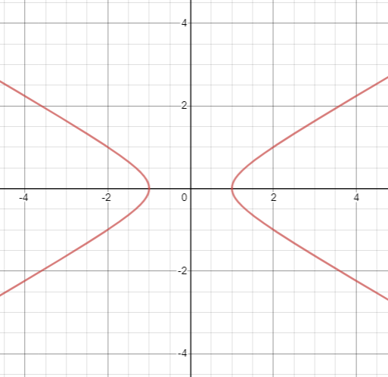
Pell's Equation
For a given d, what are the integer solutions to x² - dy² = 1?
Case 1: d is a square
Easy, just factor
Case 2: d is not a square
Hmmm...
John Pell didn't even discover this; Euler misattributed the equation to Pell after he revised Branker's translation of Rahn's discussion of Brouncker's solution of the equation
It's a hyperbola!
Notes:
The Pell Equation was first analyzed as early as 400 BC in India and Greece. (source: wikipedia)

Slide 13
How can we find solutions?
We can manipulate this equation to get x²/y² = 1/y² + d.
This tells us that x/y ≈ sqrt(d).
Theorem: Suppose that the continued fraction of sqrt(d) repeats with period k. Then (p_{k-1}, q_{k-1}) satisfies x² - dy² = (-1)^{k}.
Proof: sqrt(d) = (x_{k+1}p_{k} + p_{k-1})/(x_{k+1}q_{k} + q_{k-1}), substitute x_{k+1} = x₁ = 1/(sqrt(d)-a₀) and eliminate a₀
Theorem: If (p,q) satisfies x² - dy² = 1, and p,q are coprime, then p/q is a convergent to sqrt(d).
Proof: If d > 3, then |p/q - sqrt(d)| = (p - q*sqrt(d))/q = 1/(q * (p + q*sqrt(d))) < 1/(2q²). The case of d=2,3 can be verified separately.
If the smallest nontrivial solution to Pell's equation is (p,q), then all the solutions to Pell's equation are the coefficients of (p+q*sqrt(d))^{k} for nonnegative k.
Notes:
https://crypto.stanford.edu/pbc/notes/contfrac/pell.html

Slide 14
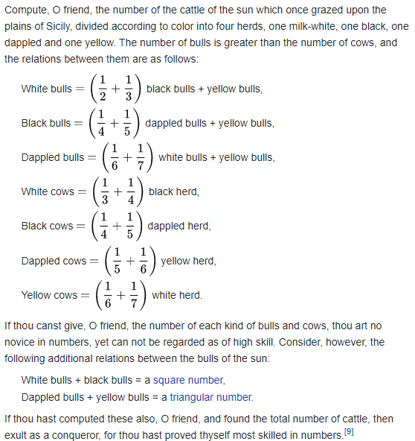
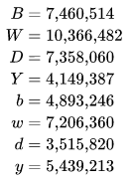
Archimedes' Cattle Problem
Attributed to Archimedes, discovered from a 44-line poem from a Greek manuscript
The first set of equations is linear, and positive integer solutions can be found with relative ease.
But the last two conditions are hard to deal with...
The smallest solution to the first set of equations. All of the other solutions are multiples of this solution.
Notes:
Problem statement (translated to English): If thou art diligent and wise, O stranger, compute the number of cattle of the Sun, who once upon a time grazed on the fields of the Thrinacian isle of Sicily, divided into four herds of different colours, one milk white, another a glossy black, a third yellow and the last dappled. In each herd were bulls, mighty in number according to these proportions: Understand, stranger, that the white bulls were equal to a half and a third of the black together with the whole of the yellow, while the black were equal to the fourth part of the dappled and a fifth, together with, once more, the whole of the yellow. Observe further that the remaining bulls, the dappled, were equal to a sixth part of the white and a seventh, together with all of the yellow. These were the proportions of the cows: The white were precisely equal to the third part and a fourth of the whole herd of the black; while the black were equal to the fourth part once more of the dappled and with it a fifth part, when all, including the bulls, went to pasture together. Now the dappled in four parts were equal in number to a fifth part and a sixth of the yellow herd. Finally the yellow were in number equal to a sixth part and a seventh of the white herd. If thou canst accurately tell, O stranger, the number of cattle of the Sun, giving separately the number of well-fed bulls and again the number of females according to each colour, thou wouldst not be called unskilled or ignorant of numbers, but not yet shalt thou be numbered among the wise.
But come, understand also all these conditions regarding the cattle of the Sun. When the white bulls mingled their number with the black, they stood firm, equal in depth and breadth, and the plains of Thrinacia, stretching far in all ways, were filled with their multitude. Again, when the yellow and the dappled bulls were gathered into one herd they stood in such a manner that their number, beginning from one, grew slowly greater till it completed a triangular figure, there being no bulls of other colours in their midst nor none of them lacking. If thou art able, O stranger, to find out all these things and gather them together in your mind, giving all the relations, thou shalt depart crowned with glory and knowing that thou hast been adjudged perfect in this species of wisdom.

Slide 15
Archimedes' Cattle Problem
The solution we are looking for is k times the solution on the previous slide, for some unknown integer k.
Condition 1: (B+W)k is square => k = 4456749 * r²
Condition 2: (Y+D)k is triangular => 11507447 * k = (s²+s)/2
Combining these conditions: s² + s - 2 * 11507447 * 4456749 * r² = 0
Discriminant must be a square, so t² - 410286423278424 * r² = 1
This is a Pell Equation!!!!!!
Note that 410286423278424 = 4729494 * 9314², so the fundamental solution is a solution to the Pell equation with d = 4729494
The number of cattle of the Sun that once grazed on the plains of Sicily is over 7.76 * 10²⁰⁶⁵⁴⁵.
Notes:
https://www.math.nyu.edu/~crorres/Archimedes/Cattle/Solution2.html
The number of cows given by this problem is far too many to fit on the island of Sicily.

Slide 16
Main Takeaways
The continued fraction of a gives convergents p/q that are within 1/q² of a.
These are, in a sense, the "best" rational approximations for a.
The "most irrational" number is the golden ratio.
Convergents give integer solutions to Pell Equation x² - dy² = 1.
The sun god has a lot of cattle.

