Slide 1
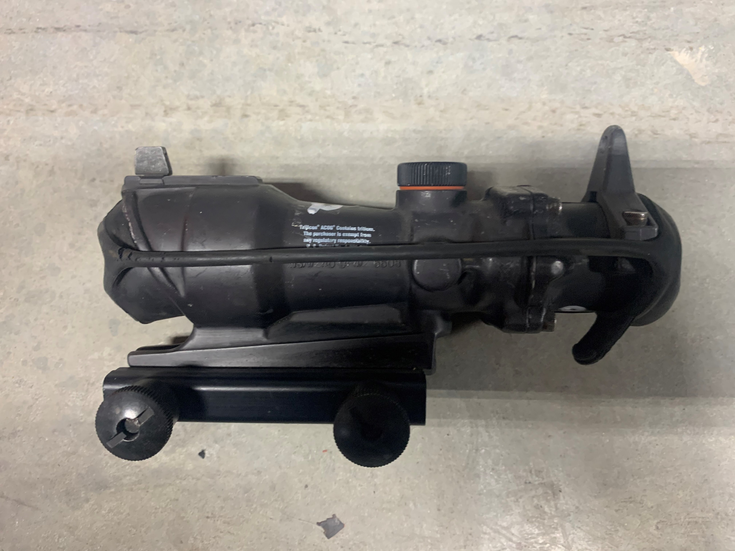
LIN | 69001N
MPO DESCRIPTION | SCOPE RIFLE W/TRIPOD, SPORTING POWER EYE
NSN | 1240014126608
NSN DISCRIPTION | TELESCOPE, STRAIGHT
NAME | ACOG
LOCATION | CAGE 3, SHELF 1
NOTES

