Slide 1
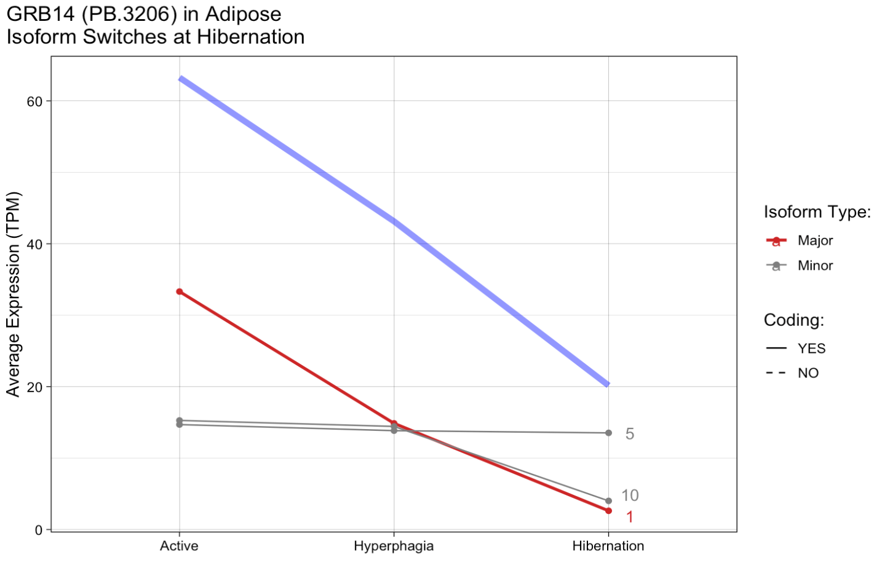
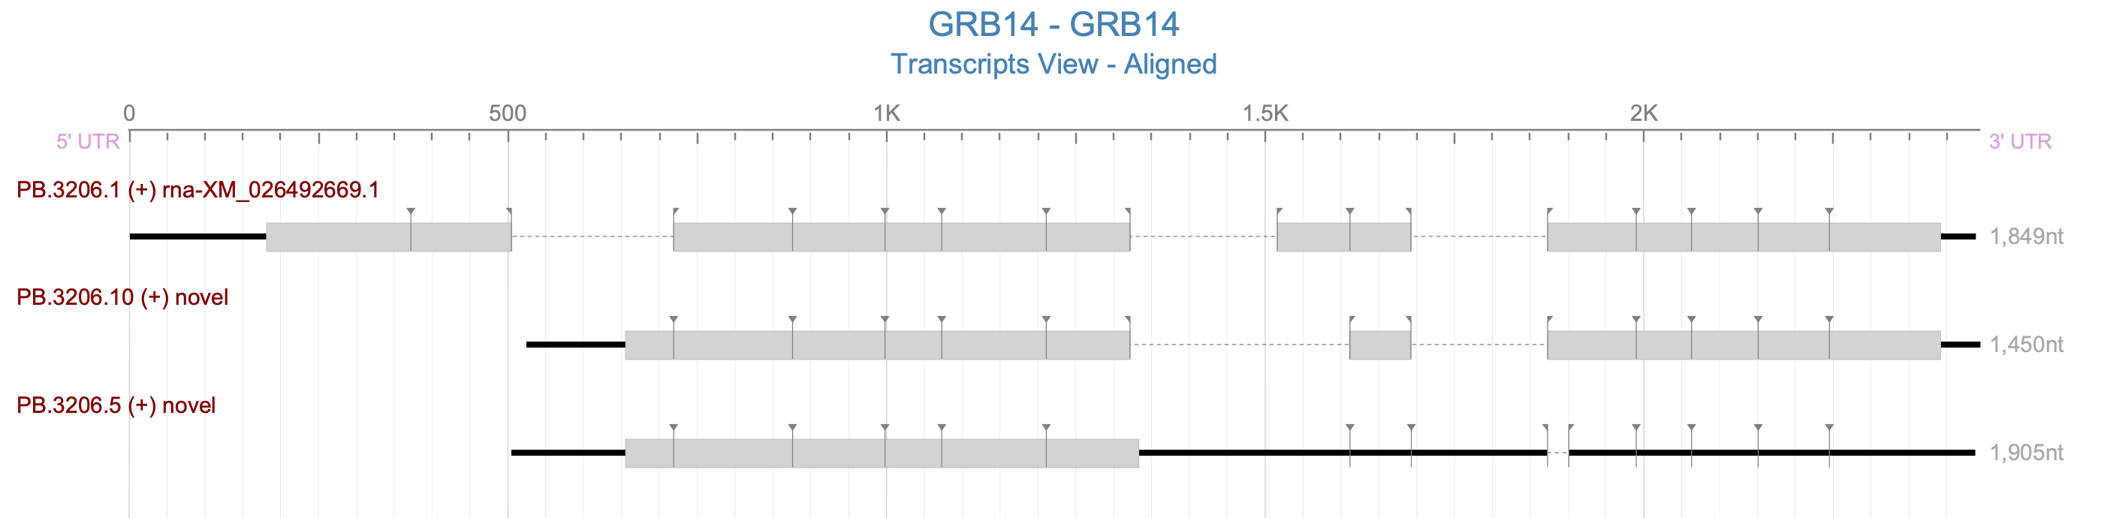
GRB14 - Growth Factor Receptor Bound Protein 14 - Downregulated and DIU at hibernation
UniProtKB/Swiss-Prot Summary for GRB14 Gene
Adapter protein which modulates coupling of cell surface receptor kinases with specific signaling pathways. Binds to, and suppresses signals from, the activated insulin receptor (INSR). Potent inhibitor of insulin-stimulated MAPK3 phosphorylation. Plays a critical role regulating PDPK1 membrane translocation in response to insulin stimulation and serves as an adapter protein to recruit PDPK1 to activated insulin receptor, thus promoting PKB/AKT1 phosphorylation and transduction of the insulin signal. GRB14_HUMAN,Q14449
Gene-level expression
Inhibition of Grb14, a negative modulator of insulin signaling, improves glucose homeostasis without causing cardiac dysfunction
https://www.nature.com/articles/s41598-020-60290-1
Downregulation typically means reduced insulin resistance / improved insulin signaling
Knockdown of GRB14 in mice = improved glucose homeostasis
Isoform 5 is a ‘novel not-in-catolog’ isoform in Sqanti annot.

