Slide 1
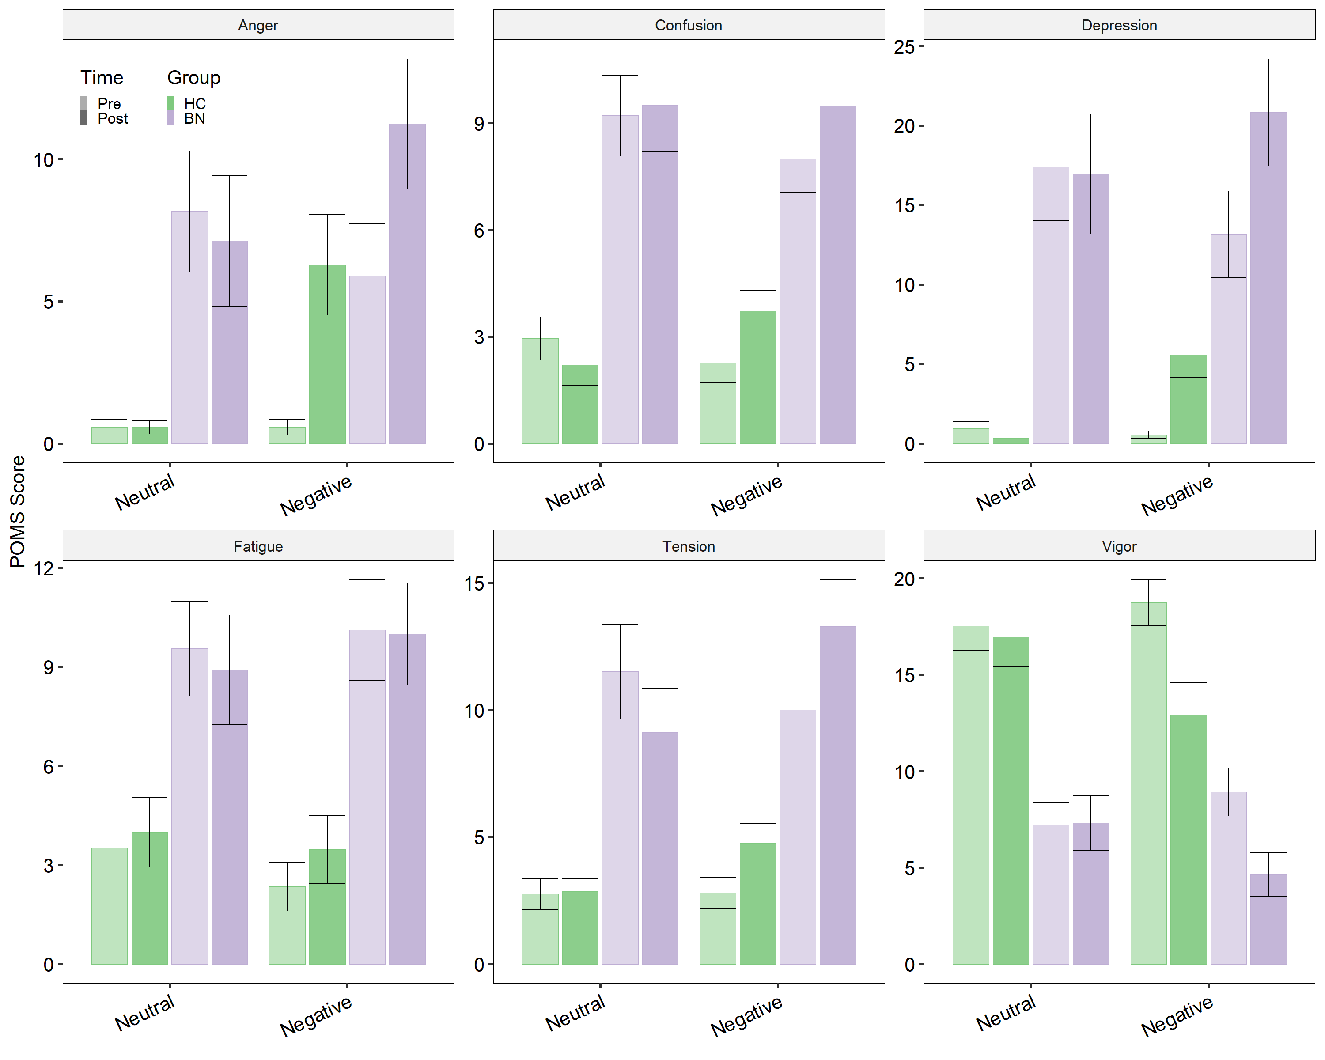
HC BN
Pre induction
Post induction

