Slide 1

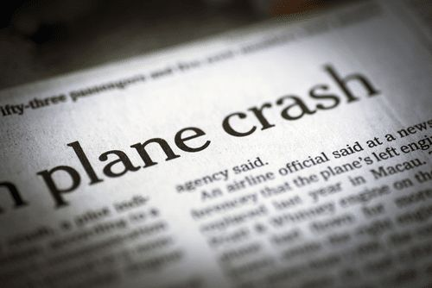
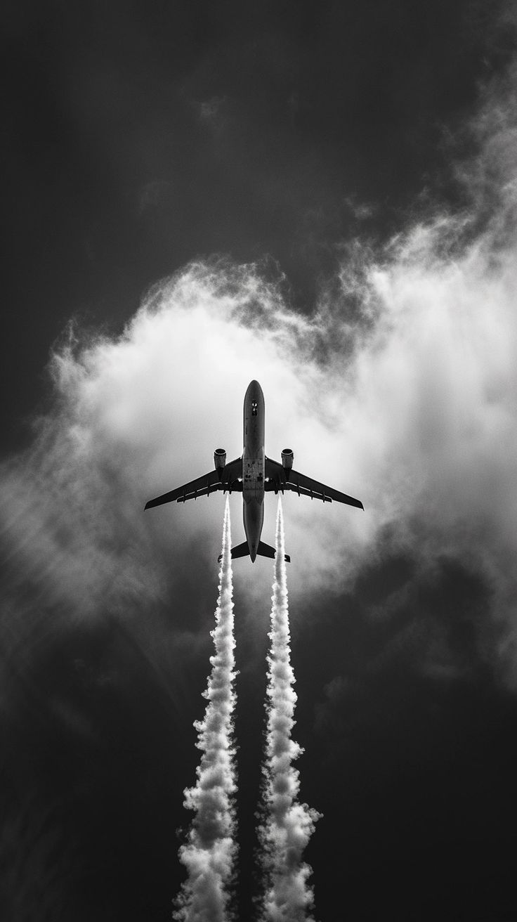
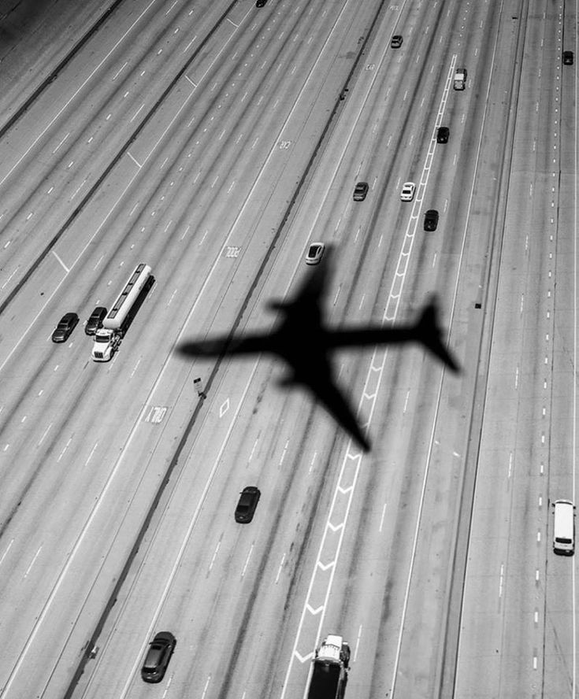
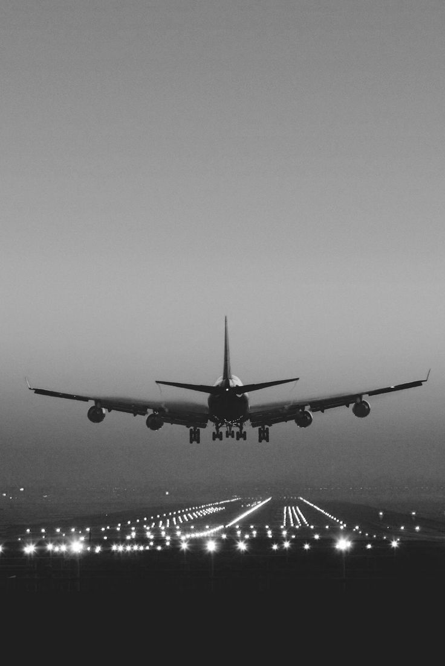
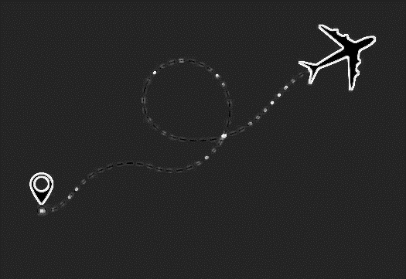
Aviation Analysis
By blaise mwangi

Slide 2
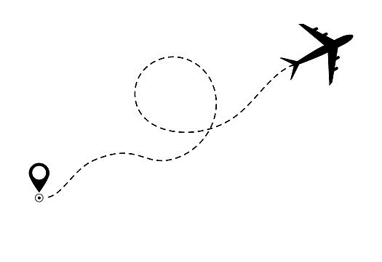
INTRODUCTION
PROBLEM :There is limited knowledge in the aviation industry, the risk of aircrafts being one of them which is crucial for determining which aircraft to purchase
SOLUTION: Analyze an aviation dataset mainly focusing on Make ,Model, No of engine, Engine Type, Aircraft Category and external factors such as Weather, Broad Phase of flight to check for low risk
DATA AND TOOLS USED TO SOLVE: Used an aviation dataset from kaggle to do data visualization using matplotlib and seaborn.Also used Tableau for Data visualization

Slide 3
description of the data and relevant variables
The dataset contains 88,889 aviation accident records with 31 variables but the relevant varibles were Event Date, Location, Country, Injury Severity, Aircraft damage, Aircraft Category ,Make, Model , Number of Engines , Engine Type , Purpose of flight, Total Fatal Injuries,"Total.Serious.Injuries", Total Minor Injuries, Total Uninjured,Weather Condition, Broad phase of flight
Descriptive statistics was used summarize accident trends, aircraft risk factors, and key variables such as make, model, purpose of flight, and injury severity.

Slide 4

Data aNalysis
The first objective the analysis was: Try to give a brief understanding of the potential risks of aircraft which was divided into:
Does weather conditions cause any risk to aircrafts?
Does the engine type cause any risk to aircraft?
Does the number of engine cause any impact to the aircraft?
Does the model contribute to any risk?
Does the aircraft category affect risk?
Identify which phases of flight contribute most to accidents

Slide 5
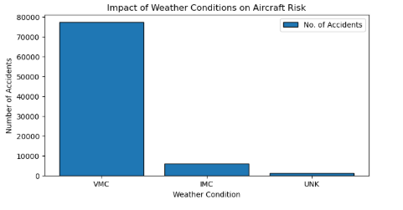
Does weather conditions cause any risk to aircrafts?
VMC (Visual Meteorological Conditions): Most accidents occur in clear weather, where pilots can navigate using visual references.
IMC (Instrument Meteorological Conditions): Requires pilots to rely on instruments due to poor visibility.
Since most accidents happen in VMC, weather does not appear to be a major risk factor.

Slide 6
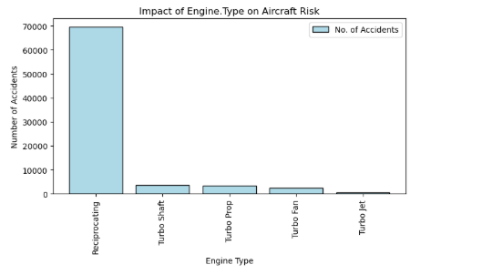
Does the engine type cause any risk to aircraft?
Reciprocating engines are commonly found in general aviation (small aircraft, training planes, and older models), which may contribute to the higher accident count.
Turbine engines are primarily used in commercial and military aircraft, which undergo stricter maintenance and operational controls.

Slide 7
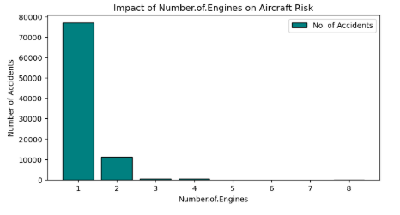
Does the number of engine cause any impact to the aircraft?
Reciprocating engines are commonly found in general aviation (small aircraft, training planes, and older models), which may contribute to the higher accident count.
Turbine engines (Turbo Shaft, Turbo Jet, etc.) are primarily used in commercial and military aircraft, which undergo stricter maintenance and operational controls.

Slide 8
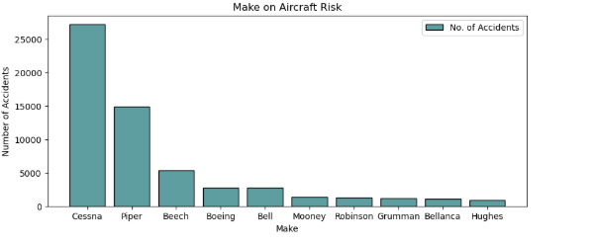
Does the model contribute to any risk?
Cessna has the highest accident count. We can assume this is because of it is less costly for purchasing and maintenance.

Slide 9
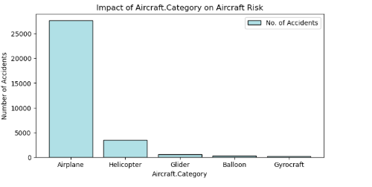
Does the aircraft category affect risk?
Airplanes have the highest number of accidents.This could be because airplanes are the most commonly used aircraft for commercial, private, and general aviation

Slide 10
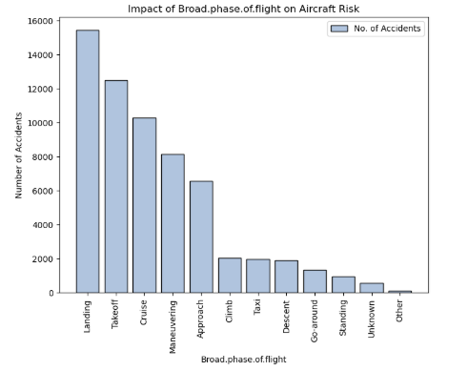
Identify which phases of flight contribute most to accidents
Takeoff: Aircraft accelerates and lifts off; risks include engine failure and runway incidents.
Climb: Gaining altitude; potential risks involve engine stress and weather conditions.
Cruise: Steady flight at altitude; generally safest but can face turbulence or system failures.
Maneuvering: Sharp turns, aerobatics, or low-altitude flying; high risk of loss of control.
Approach: Preparing to land; risks include misalignment, weather, and visibility issues.

Slide 11
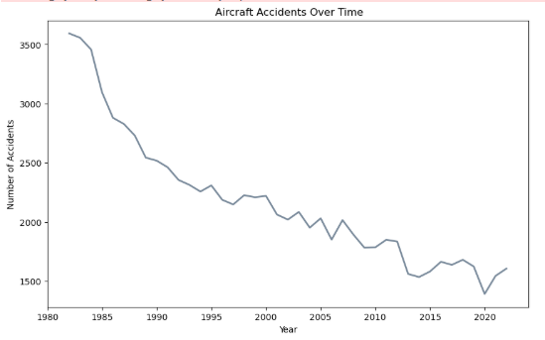
Examine accident occurrences over time
As years go by there is a drop in accident numbers we assume this could be due to improvements in aircraft design(engine type and control systems), pilot training, air traffic control, and safety regulations causing a decrease in accidents.

Slide 12
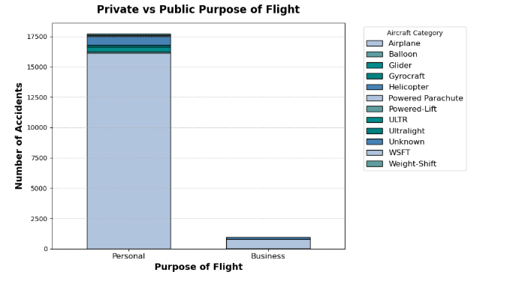
Private vs Public Purpose of Flight
Personal flights have the highest number of accidents withe the airplane being the biggest contributor.Airplanes are less costly in purchase and maintance compared to the other eg helicopters.

Slide 13
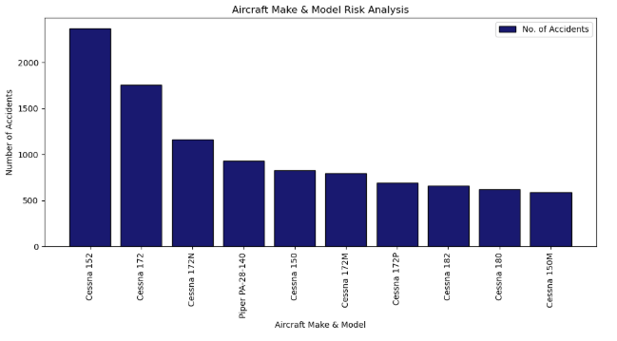
Determining which aircraft are the lowest risk for the company when starting this new business endeavor.
Many of these aircraft are older, with some like the Cessna 150 and 172M). Older planes may have more mechanical issues or wear-and-tear, especially if not properly maintained, which can contribute to accidents.

Slide 14
CONCLUSION
The mojor risk factors are: Number of engines ,Engine type,Model, Aircraft Category, Make ,Model, Broad phaseof flight
As years go by there is a drop in accident numbers
Personal flights have the highest number of accidents withe the airplane being the biggest contributor.
Airplanes are less costly in purchase and maintance compared to the other eg helicoptersWe can conclude that from the model and make of aircraft with most accidents,most of them are old hence there performance reduces with time.

Slide 15
Recommendation
Use modern model aircrafts since they are not worn out hence reducing risk due to model. There will also be chances that theyre are advernsment in these aerolanes.
Invest in business purpose rather than private since they have lesser risk.
Use aircrafts with turbo engine type where the purpose is aerial application instead of Reciprocating Engines
Incase you want to venture into personal flights use helicopters instead of airplanes. They can be expensive to purchase and maintain but its less risky

Slide 16

AVIATION ANALYSIS
THE END
BY BLAISE MWANGI
blaise.mwangi@student.moringaschool.comni

