Slide 1
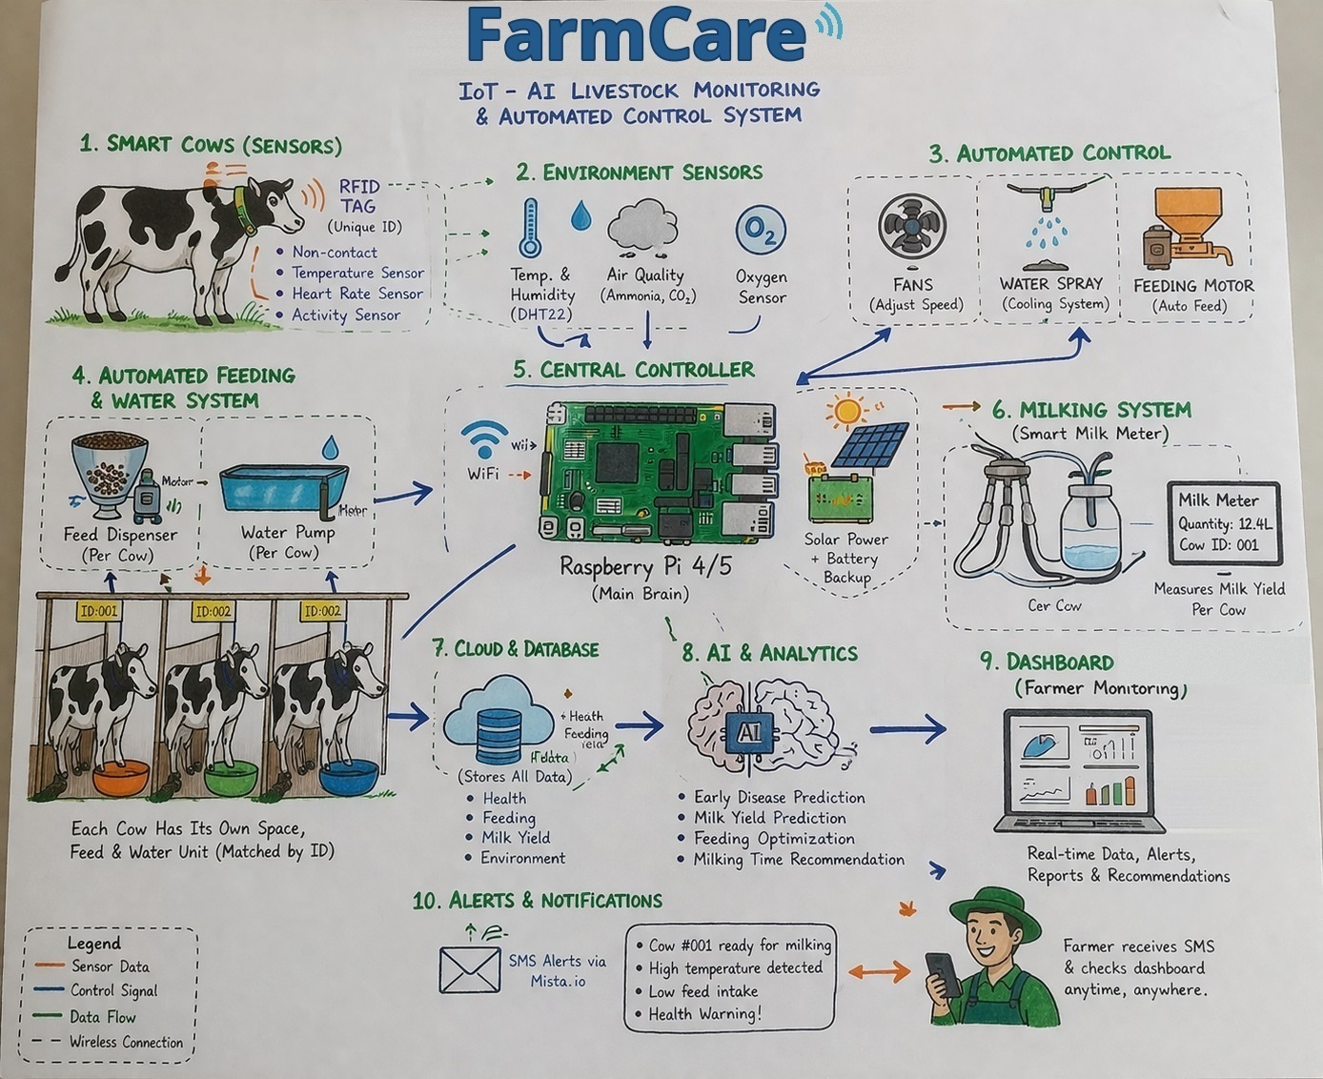
ACTION FAMILY TECH LTD.
FarmCare
AI and IoT for climate-smart dairy farming
A Milking Station, a Barn Monitor and a Health Collar feed one cloud dashboard, turning everyday farm activity into real-time decisions that protect cows, milk and the climate.
Innovate Africa Challenge III · AI for climate-smart agriculture
Bikorimana Jean Claude · IT Specialist & Coordination
bikorimanajeanclaude12@gmail.com · +250 786 144 292
https://farmcareservices.com/
FarmCare system architecture: sensors, control, cloud, AI and alerts
Notes:
Good morning. I am Jean Claude Bikorimana, one of the project partners at Action Family Tech, and this is FarmCare: AI and IoT for climate-smart dairy farming in Rwanda. The picture is our full system architecture. Everything in this deck is marked as live, prototype, planned, or not yet measured, because we would rather show you an honest gap than an unsupported claim.

Slide 2




01 · AGRICULTURAL PROBLEM & ALTERNATIVES
Sick cows, rejected milk, missed pregnancies
1.45–1.73M
60–67%
60%
33–50%
cattle across Rwanda’s dairy belt
of dairy cows have clinical or subclinical mastitis
of milk rejected at collection centres in parts of the North and West
insemination success: over half of cows miss pregnancy
Who is affected: zero-grazing farmers with 1–10 cows in the Eastern Province (Nyagatare, Gatsibo) and the Northern Province (Gicumbi, Burera, Musanze), and the cooperatives and collection centres that absorb rejected milk.
Alternative | What it offers | What it misses
Paper records, vet call-outs | Low cost; the status quo | No sensing: problems found after symptoms; over 95% keep no digital records
Agrotag | Record keeping and traceability tags | No reproduction, feed or live sensing
Difarm | Single-purpose monitoring tools | No link between farm data and collection-centre quality
Imported precision systems | Full sensing and automation | Priced and built for large commercial farms
FarmCare | Breeding, health, feed, milk quality and barn climate in one platform | Links farm data to collection-centre quality and farmer income
Sources: MINAGRI Annual Report 2024/25; RAB and MINAGRI dairy sector data; competitors’ public product information; our own farmer surveys through field visits. Several team members are dairy farmers.
Notes:
Behind every glass of milk is a farmer fighting the odds. Mastitis, rejected milk and missed heat windows drain income every day. The status quo is the real competitor: paper records and calling the vet once a cow is visibly sick. Agrotag gives records and tags; Difarm gives single-purpose monitoring; imported systems do everything at prices no smallholder can pay. FarmCare connects the whole chain on low-cost local hardware.

Slide 3
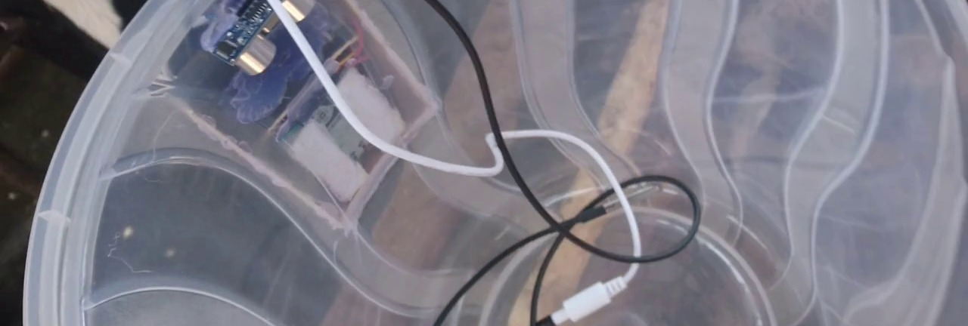
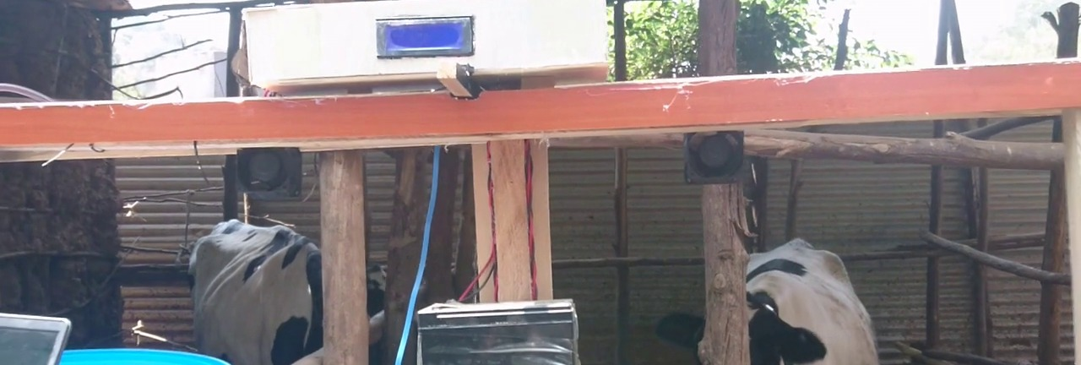
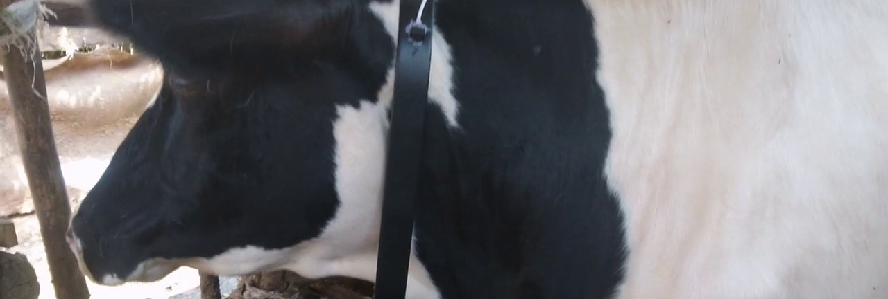


02 · SOLUTION OVERVIEW
One platform. Three connected devices.
FarmCare pairs wearable and barn sensors with a cloud dashboard and AI analytics, turning everyday dairy-farm activity into real-time decisions.
Milking Station
Barn Monitor
Health Collar
RFID identifies the cow; an ultrasonic sensor in the milk container measures litres; TDS and temperature probes check quality.
Reads heat, humidity, two gas sensors, water-tank level and feed weight; runs pump, fan, water spray and buzzer.
Worn by the cow: body temperature, heart rate, SpO2, motion and live GPS location.
RUNNING IN THE COWSHED
RUNNING IN THE COWSHED
RUNNING IN THE COWSHED
Web platform live
Per-cow risk scoring
Field-tested
Stage: TRL 6
Health, milking and barn dashboards at farmcareservices.com/app
Each cow scored against her own 14-day baseline
All three devices in a cowshed in Kanyinya, Nyarugenge
Working application; demo video shows every module
Notes:
FarmCare is three low-cost devices and one platform. The dashboard is live online. All three devices run in a working cowshed in Kanyinya, Nyarugenge, and stream live readings into it, as the demo video shows. We place ourselves at TRL 6, a working application: the platform runs live online and the devices run in a real cowshed. TRL 7, proof of application, needs results from a pilot. The AI models are the next build, and moving to a real pilot is what this support is for.

Slide 4





03 · CLIMATE IMPACT
Climate-smart dairy: adapt, cut emissions, produce more
Adapt · heat stress
Barn Monitor reads heat and humidity every 10 seconds and switches fans and water spray by itself; the demo shows the spray turning on in the cowshed.
WORKING IN THE COWSHED
14.5%
Mitigate · manure gases
MQ-135 and MQ-5 sensors read ammonia, CO₂ and methane-type gases from manure and urine live in the cowshed (4–7% of range), flagging build-up early.
LIVE · UNCALIBRATED
of global greenhouse-gas emissions come from livestock (FAO).
Mitigate · biogas
Rwanda’s Nationally Determined Contribution under the Paris Agreement targets livestock emissions, while hotter barns cut milk yields.
Next: feed captured manure to biogas digesters, with pressure and temperature sensors to optimise methane capture into clean energy.
PLANNED
Produce more per cow
CH₄ · N₂O · CO₂ · NH₃
Earlier heat and disease detection means more milk per cow rather than more cows, which lowers emissions per litre.
NOT YET MEASURED
Planned AI: early warning of emission spikes, mitigation advice and GHG reports for Rwanda’s NDC and green finance. It needs field data first. N₂O needs an electrochemical sensor, not yet fitted.
Notes:
This challenge is about climate-smart agriculture, and FarmCare touches all three pillars. Adaptation: the barn monitor already switches fans and spray when heat crosses 30 degrees, which protects yield as barns warm. Mitigation: our gas sensors track ammonia, CO2 and methane-type gases from manure and urine; they are not yet calibrated to parts per million. Biogas monitoring is planned. Productivity: more milk per cow, rather than more cows, lowers emissions per litre, a hypothesis our pilot will test. The AI emission early warning and NDC reporting are planned, not built.

Slide 5
04 · HOW THE AI WORKS
From sensor reading to farmer action
1 · Data inputs
2 · Edge and cloud
3 · Analysis
4 · Farmer action
Collar: temperature, pulse, SpO2, motion, GPS. Station: RFID, milk level, TDS. Barn: climate, gases, feed, water.
ESP32 and NodeMCU devices post readings every 10 s; cooling and pump rules also run on the device.
Today: vet-range rules plus a risk score against each cow’s 14-day baseline. Next: trained models.
Alert to farmer, vet or technician: cool the barn, inseminate, treat the cow or hold the milk.
Model (in development) | Method | Training data
Heat (estrus) detection | Motion and temperature against each cow’s own baseline | Collar logs labelled by insemination outcome
Milk-quality flag | TDS and temperature anomalies per cow | Station logs labelled by collection-centre tests
Health risk | Fever, activity drop, lower feed and water intake | Barn and collar logs labelled by vet diagnoses
Emission early warning | Gas, heat and humidity trends | Barn gas logs from pilot farms
Running today
Risk score 0–100 per cow: vital-sign ranges plus deviation from her own 14-day average
Readings tied to each cow by RFID
Ultrasonic milk volume in litres
Automatic pump, fan and spray
The risk score is statistical. No machine-learning model is trained yet: the labelled dataset comes from the field pilot.
Notes:
We want to be precise about the word AI. What runs today is statistical, not machine learning: each cow gets a risk score from clinical vital-sign ranges plus how far her readings drift from her own 14-day average, for example 2.7 standard deviations. Alongside it run veterinary thresholds, RFID identity, ultrasonic milk measurement and automatic pump, fan and spray control. The four models in the table are designed, and the data pipeline that feeds them is live, but none is trained yet, because training needs labelled farm data: heats confirmed by insemination outcome, milk confirmed by collection-centre tests, and vet diagnoses.

Slide 6
05 · TEST RESULTS & READINESS
Working in the cowshed; accuracy not yet measured
Signal | Rule or method | Field reading (demo video)
Barn climate | Temperature, humidity; fan and spray | 28.7–29.2 °C, 51–58%; spray switched on
Barn gases | MQ-5, MQ-135: 60% warn, 80% critical | 4–7% of range; uncalibrated
Feed and water | Load-cell feed weight; tank level | ≈37 kg feed; tank 52–56%
Milk volume | Ultrasonic level in a 4 L container | 0.35–3.6 L read live
Collar vitals | Pulse 48–100 bpm; SpO2 below 90% | 60–72 bpm, SpO2 95–96%
Cow risk score | Vital ranges plus 14-day baseline | Flagged a cow live (score 55)
Heat detection | Motion and temperature model | Not yet trained
Known limitations
Collar reads ~32 °C, below core heat: needs better placement
Gas read as % of range, not ppm
Pulse sensor designed for humans
SMS gateway and USSD not yet built
Kinyarwanda interface not yet built
TRL 6
Working application
Evidence: the full platform is live online and the devices stream from a working cowshed. TRL 7, proof of application, needs a multi-farm pilot over one season.
Versus today: farmers notice fever or heat stress by eye, hours to days later. FarmCare updates every 10 seconds and acts by itself. Accuracy against vet diagnosis and a measuring jug: not yet measured.
Notes:
Every reading in the right-hand column comes from our demo video, recorded in the Kanyinya cowshed. One known issue: the collar’s temperature probe reads about 32 degrees, below a cow’s core of about 38.5, so it flags hypothermia; we are improving its placement. What we cannot yet give you is a detection accuracy or false-alarm rate on real cows over time; that needs the pilot. Our TRL 6 evidence is the live platform plus the devices running in a working cowshed, shown on the next slide.

Slide 7
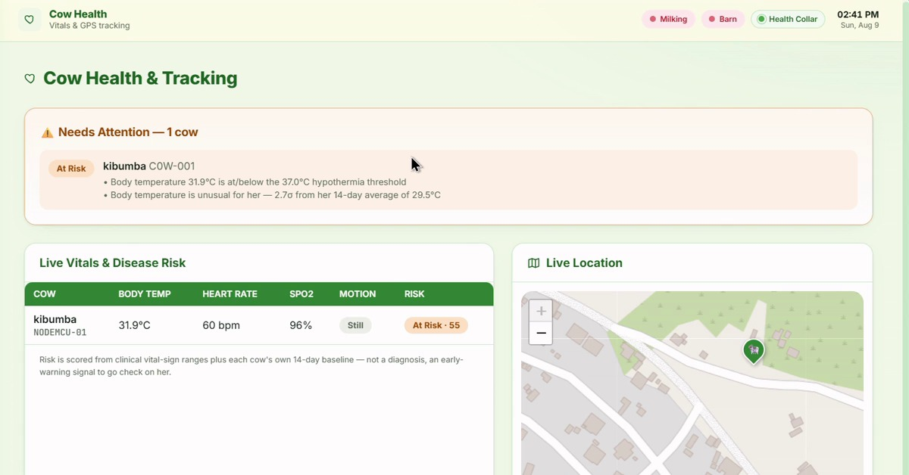
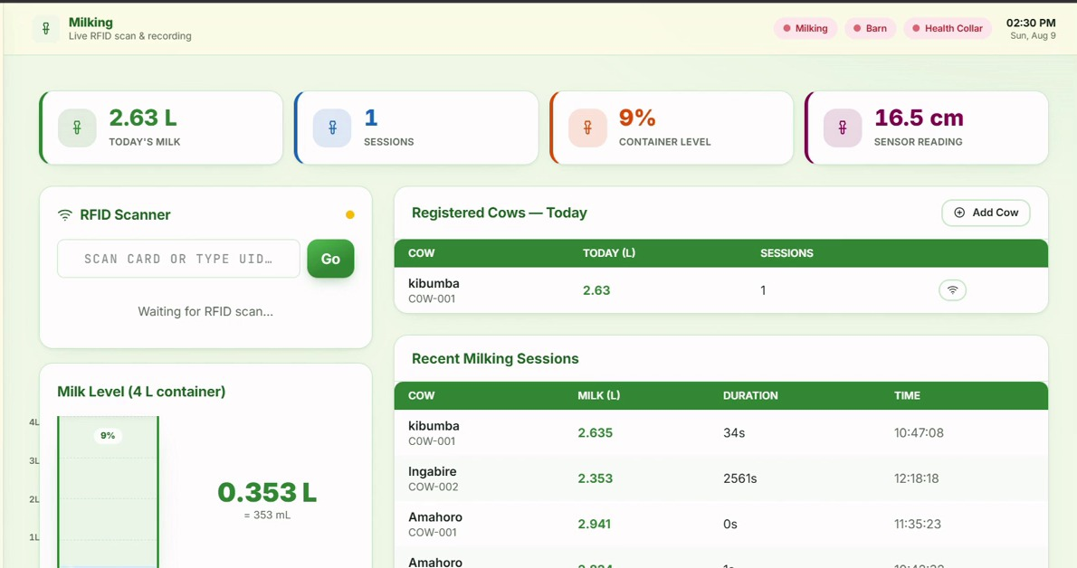
06 · PRODUCT & DEMONSTRATION
Two journeys we will show live
Journey A · The collar flags a cow at risk
1. Collar streams temperature, pulse, SpO2, motion and GPS
2. Risk score compares her with her own 14-day average
3. Kibumba appears under Needs Attention, with reasons
4. Farmer or vet checks her, using her live location
Journey B · Recording milk at the container
1. Farmer scans the cow’s RFID tag
2. Milk goes into the smart container
3. Ultrasonic sensor shows the litres live
4. Record Milk saves the session to her history
Top: Cow Health page. Left: Milking page.
Recorded live in a cowshed in Kanyinya, Nyarugenge.
▶ Watch the demo video
Live on the day at farmcareservices.com/app with the prototype streaming; the demo video is our backup.
Notes:
We will run both journeys live, as in the demo video. Journey A: open Cow Health and show Kibumba flagged At Risk, with the reasons and her live location. Journey B: scan a tag, pour milk into the container, watch the litres rise, and press Record Milk. Keep the demo video open in another tab in case the connection drops. Do not open the Herd Analytics activity chart: its activity values are placeholders, not sensor data.

Slide 8
07 · USERS, DEPLOYMENT & IMPACT
One pilot farm so far; impact not yet measured
REGISTERED USERS
PILOT PARTICIPANTS
PAYING CUSTOMERS
INTENDED BENEFICIARIES
4
1
0
1–10
one per role: admin, farmer, vet, technician
farm: the cowshed in Kanyinya, Nyarugenge
FarmCare is pre-revenue
cows per farm, five dairy districts
Outcome | Baseline, then method | Sample, period
Conception rate | Paper records, then collar heat alerts | Pilot herd, one season
Milk rejection | Collection-centre records, before and after | Each farm, monthly
Mastitis cases | Vet records, then platform alerts | Every case in the pilot
Milk per cow | Farmer records, then station logs | Each cow, 12 months
Heat stress, barn gases | Climate, gas and cooling logs | Each barn, all year
ACHIEVED RESULTS
None yet. Repeat use and farm outcomes are not yet measured.
PROJECTED: HYPOTHESES TO TEST
More pregnancies per insemination
Less milk rejected at collection
Mastitis caught earlier
More milk per cow, lower emissions per litre
Design: baseline and endline on each pilot farm, compared with matched farms without kits.
Notes:
We have one pilot farm, the cowshed in Kanyinya, Nyarugenge, and four registered users, one for each role: administrator, farmer, veterinarian and technician. Nobody pays yet. We keep the four categories the panel asked for separate, so nothing intended is read as achieved. We have no impact numbers; what we have is a measurement design the platform already supports. Numeric targets will be agreed with the pilot cooperative and reported whether results are good or bad.

Slide 9






08 · BUSINESS MODEL & MARKET
Three revenue streams; pre-revenue today
Hardware kits
Milk-linked subscription
Institutional contracts
Who pays: Farmers, cooperatives; instalments
Who pays: Farmers, via their cooperative
Who pays: Inyange, Mukamira, NGOs, banks
One-time purchase; ESP32 parts, assembled in Rwanda.
Dashboard, alerts, records and maintenance, paid only from milk sold.
Bundled deployments with dairy programmes, plus quality data.
Station ≈ RWF 100k · Barn ≈ RWF 250k
Collar ≈ RWF 85k per cow
3% of milk sold; nothing in dry months
Cap: RWF 10,000 per farm a month
Quoted per deployment
FARMCARE REVENUE
COMPANY TURNOVER
GRANTS & INVESTMENT
LETTERS OF INTENT
RWF 0
RWF 3M
RWF 0
0 signed
pre-revenue
last year, informal side projects: AI, IoT design, tech support
founder-funded to date
first cooperative is next
Primary
Secondary
Third
Smallholders with 1–10 cows; 1.45–1.73M cattle nationally
Cooperatives, collection centres and processors
MINAGRI, RAB, FAO, banks and insurers
Prices are estimates from Kigali part costs plus assembly; to be tested in the pilot. Projected revenue: not yet measured.
Notes:
Three revenue streams: kits priced close to the cost of low-cost ESP32 parts, a monthly subscription aimed at cooperatives and commercial farms, and institutional contracts with processors such as Inyange and Mukamira, NGOs, banks and insurers. Selling through cooperatives and institutions keeps the cost of reaching each farmer low. FarmCare itself has earned nothing yet; the company’s RWF 3 million turnover last year came from informal side projects: AI consultancy, IoT design and technical support for other clients. None of it came from FarmCare, and it helped fund the prototype. How we priced the kit: the Milking Station parts (ESP32, RFID reader, ultrasonic sensor, TDS and temperature probes, container, enclosure, power) cost about RWF 77,000 in Kigali, plus assembly, so about RWF 100,000. The Barn Monitor parts (ESP32, temperature and gas sensors, load cell, tank sensor, pump, fan, relays, spray line, display, power) cost about RWF 195,000, plus installation, so about RWF 250,000. Each collar (NodeMCU, temperature, pulse, motion and GPS sensors, battery, strap) costs about RWF 68,000, so about RWF 85,000. A five-cow farm with one station, one barn monitor and two collars pays about RWF 520,000, spread over cooperative or SACCO instalments; cooperatives can share one Milking Station at the collection point. The subscription is 3% of the milk each farm sells through its cooperative, deducted at the collection centre the way cooperatives already deduct fees. A farm selling 600 litres a month at about RWF 400 per litre pays about RWF 7,200; in dry months it pays nothing, and no farm pays more than RWF 10,000 a month. The Milking Station measures the litres, so the fee rests on our own data. We chose 3% rather than 5 or 10% because farm margins are thin; we can raise it once the pilot proves the gains.

Slide 10
09 · TEAM & PARTNERSHIPS
Six people across technology, field operations and climate
Bikorimana Jean Claude
Nindenkimana Blaise
Harerimana Eric
BJ
NB
HE
IT SPECIALIST & COORDINATION
AI ENGINEER
IOT ENGINEER
Technical development: platform, AI models, architecture
Technical development: sensors, RFID and connectivity
Field operations: integration and partnerships
Mucyo Enock
Izere Egide
Niyonsaba Elina
ME
IE
NE
PROJECT DIRECTOR
ENVIRONMENTAL EXPERT
OPERATIONS & SALES
Technical development: machine learning, data security
Agricultural validation: climate-smart fieldwork
Field operations: farmer and cooperative onboarding
Gap: veterinary validation
Active partners: none signed yet
No veterinarian on the team yet. We will secure a veterinary adviser through RAB or the University of Rwanda before the pilot.
Targets: dairy cooperatives in five districts, Inyange and Mukamira, RAB and MINAGRI, University of Rwanda and ILRI, FAO and Smart Africa.
Notes:
Six project partners, all co-owners, covering the three areas the panel asked about. Technical development: Blaise, Eric and Enock. Agricultural and climate validation: Egide. Field operations: Jean Claude and Elina. Our honest gap is veterinary validation, and we name it. We have no signed partners yet. Q and A owners: AI and software, Blaise; hardware, Eric; machine learning and data security, Enock; climate, Egide; farmers and sales, Elina; strategy and partners, Jean Claude.

Slide 11





10 · SCALING TO NEW COUNTRIES
Rwanda first, then Smart Africa member states
Phase 1 · Build
Phase 2 · Pilot
Phase 3 · Scale
Small production run of field-ready kits: boards, sensors and enclosures
First cooperative agreement; field test with a real herd; first trained models
More Rwandan dairy zones, then other Smart Africa member states
Local data
Recalibrate thresholds and retrain models on local breeds, climate and farm data
Languages
English today; Kinyarwanda next, then a language pack per country for the dashboard, SMS and USSD
Connectivity
Wi-Fi today; SMS and USSD for basic phones through a local telecom partner
Regulation
Check data-protection law and IoT import rules before the first kit ships
Extension systems
Share herd, milk-quality and emission data with ministry and extension systems through our API
Status: not yet deployed beyond our pilot farm in Kanyinya, Nyarugenge. SMS, USSD and Kinyarwanda are planned, not built.
Notes:
The hardware is commodity ESP32 and NodeMCU parts available across Africa, and the platform already supports many farms and regions. What changes per country is data, language, telecom access, regulation and the anchor partner. Each new country starts with a local cooperative or institutional partner, the same model as in Rwanda.

Slide 12


FarmCare
AI and IoT for climate-smart dairy farming
It already runs
Climate-smart
One connected view
Ready for the field
Three devices and a live platform, tested in a working cowshed
Cools barns in heat, tracks manure gases, more milk per cow
Breeding, health, feed and milk quality, linked to the buyer
Your support takes FarmCare from prototype to a real herd
Thank You
Ready for your questions
Bikorimana Jean Claude · bikorimanajeanclaude12@gmail.com · +250 786 144 292
Izere Egide · +250 787 979 145 · https://farmcareservices.com/ · ACTION FAMILY TECH LTD
Notes:
Close on the ask: this support pays for the production run, the first cooperative pilot and the dataset that trains our first models. Then hand over to the Q and A owners listed on the team slide. If we do not have a number, say so.

