Slide 1
Verification of DNNs
Kuldeep S. Meel
NUS, Singapore => University of Toronto
Blaise Genest
CNRS, DesCartes & IPAL, France
Intern: Marius Belly, summer 2022
RA: Shaan Aryaman, Jan-Aug 2023
RF: Liao Yuke, Sept 2023+

Slide 2
Current results on “Lipschitz”
DNN 5x100 natural training (average Δ=2.4)
ε = 0.001
 | Average Gamma= max(|x-x’|) | Total Time
Mathematical bound | 284 | 0s
LP with (x,x’) + y_i constraints | 29 (10x better) | 14min (830s)
pMILP with x,x’ (17-36 nodes x2) | 16.9 (17x better) | 6h42min (24053s)
pMILP with y’ (23-80 nodes) | 10.78 (26x better) | ~2 days
DNN 5x100 Diff-AI training, (average Δ=1)
ε = 0.001
Methods | Average Gamma=max(|x-x’|) | Time
Mathematical bound | 2.88 | 0s
LP with (x,x’) constraints | 0.456 (6x better) | 11 min (695s)
pMILP with x,x’ (17-36 nodes x2) | 0.28 (10x better) | 5h21min (19270s)

Slide 3
Pass rate of different epsilon
For 1 corner (top-left) with epsilon = 1/255, The largest gamma of output layer is 0.8969.
95.7% of images over 1000 images will be safe by Lipschitz constant.
For the case of All pixels, epsilon = 0.001: The largest gamma of output layer is 1.1.
Then 92.1% images over 1000 images will be safe by Lipschitz constant.
For the case of 1 corner (top-left) , epsilon = 1/255, when we take epsilon = 1/255 * 3.6, the pass rate will be 67.4% > 66%.
For the case of All pixels, epsilon = 0.001, when we take epsilon = 0.001 * 2.1, the pass rate will be 69.7% > 66%.

Slide 4
DIFFAI
Full epsilon

Slide 5
Average gamma of layer 3 (first ReLU layer) when choosing X MILP layer1-nodes
ε = 0.001
DiffAI , 5layers*100 nodes, ReLU,
Number X | TO =1200 | TO =3600 | TO =7200 | TO=14400 | Random (k=1)
0 |  |  |  |  | 0.018049
24 | 0.0124162 Sol=0.0124162 | 0.0124162 Sol=0.0124162 | 0.0124162 Sol=0.0124162 |  | 0.015147
26 |  |  | 0.0120622 Sol=0.0120622
27 |  |  | 0.0118876 Sol=0.0118876 |  | 0.014877
29 |  |  | 0.01161687 Sol=0.0115536
32 |  |  |  | 0.0113178 Sol=0.011064
35 |  |  |  | 0.0114356 Sol=0.010600

Slide 6
Average gamma of layer 5 (first ReLU layer) when choosing X MILP layer1-nodes
ε = 0.001
DiffAI , 5*100 nodes, ReLU,
Number X of nodeschosen | Old method TO=1200 | New method TO =1200 | New method TO =3600 | New method TO =7200 | Random (k=1)
0
27 |  | 0.02671103 Sol = 0.0266334 | 0.0266334 Sol=0.0266334 | 0.0266334 Sol=0.0266334
30 |  |  |  | 0.0259595 Sol=0.0259562
33 |  | 0.02673540 Sol = 0.0253129
36

Slide 7
DiffAI 1pixel

Slide 8
Average gamma of layer 5
ε = 1, only change middle point
DiffAI , 5layers*100 nodes, ReLU,
Layer 3: 0.07811540 (>21 nodes)
Number X of nodeschosen | Old method TO=1200 | New method TO =1200 | New method TO =3600 | New method TO =7200 | Random (k=1)
0
33 |  | 0.1531428 Sol=0.1531428
39 |  |  | 0.1455664 Sol=0.1455664
42 |  |  | 0.1420947 Sol=0.1420947
45 |  |  |  | 0.1390425 Sol=0.1387150
51 |  |  |  | 0.1349531 Sol=0.1326257
For comparison full epsilon
Layer 3: 0.0113178 (32 nodes)
Layer 5: 0.0259595 (30 nodes)

Slide 9
DiffAI ¼, Four corners, epsilon = 0.001

Slide 10
Average gamma of layer 3 (first ReLU layer)
= 0.001,
1 of 4 corners can change
DiffAI , 5layers*100 nodes, ReLU,
TO = 1800s
Number X of nodes chosen | Corner 0 | Corner 1 | Corner 2 | Corner 3 | Sum
21 | 0.00349 T= 67.92 | 0.00297 T=56.49 | 0.00384 T=67.99 | 0.00265 T=63.90 | 0.01295 T = 256.299
27 | 0.003241 T=318.6 | 0.002776 T=170.9 | 0.0035629 T=361.2 | 0.002473 T=224.8 | 0.01205 T=1075.5
39 | 0.002936 T=7223 | 0.002467 T=4395 | 0.003247 sol= T=7387 | 0.002206 Sol= T=5815 | 0.010856 Sol = T=24820
42 | 0.002924 T=8108 | 0.0024405 T=6703 | 0.003244 T=8333 | 0.002196 T=8037 | 0.0108045 T=31181
For comparison full epsilon
Layer 3: 0.0113178 (32 nodes)
T=57745s

Slide 11
Average gamma of layer 5 (first ReLU layer)
= 0.001,
1 of 4 corners can change
DiffAI , 5layers*100 nodes, ReLU,
TO = 1800s
Number X of nodes chosen | Corner 0 | Corner 1 | Corner 2 | Corner 3 | Sum | Full
24 | 0.0071552 Sol=0.0071552 T=569 | 0.00606 Sol=0.00606 T=544 | 0.00797 Sol=0.00797 T=767 | 0.00543 Sol=0.00543 T=739 | 0.026625 Sol=0.026625 T=2621 | 0.026679 Sol=0.026679 T=1765
27 | 0.0069824 Sol=0.0069824 T=1672 | 0.0059192 Sol=0.005912 T=1426 | 0.007773 Sol=0.007773 T=2315 | 0.005304 Sol=0.005304 T=1935 | 0.02597 Sol=0.02597 7350 | 0.0260424 Sol=0.0260232 T=4145

Slide 12
DiffAI ¼, bottom right corner

Slide 13
Average gamma of layer 3 (first ReLU layer)
ε = 1/255, ¼ of all pixels can change
DiffAI , 5layers*100 nodes, ReLU,
Number X of nodeschosen | Old method TO=1200 | New method TO =1200 | New method TO =3600 | New method TO =7200 | Random (k=1)
21 |  | 0.0104170 Sol=0.0104170
27 |  | 0.0096987 Sol=0.0096987
33 |  |  | 0.0090740 Sol=0.0090740
39 |  |  | 0.0085227 Sol=0.0085227
42 |  |  | 0.0082788 Sol=0.0082758
45 |  |  |  | 0.0081315 Sol=0.0080366
48 |  |  |  | 0.00805609 Sol=0.0078136
51 |  |  |  | 0.0080593 Sol=0.0076127
For comparison full epsilon
Layer 3: 0.0113178 (32 nodes)
Layer 5: 0.0259595 (30 nodes)

Slide 14
Average gamma of layer 5
ε = 1/255, ¼ of all pixels can change
DiffAI , 5*100 nodes, ReLU,
Number X of nodeschosen | Old method TO=1200 | New method TO =1200 | New method TO =3600 | New method TO =7200 | Random (k=1)
21 |  | 0.0209724 Sol=0.0209724
27 |  | 0.0200344 Sol=0.0200344
33 |  |  |  | 0.0191519 Sol=0.0191519
39 |  |  |  | 0.01874301 Sol=0.0183314
42 |  |  |  | 0.01879405 Sol=0.0179390
45
For comparison full epsilon
Layer 3: 0.0113178 (32 nodes)
Layer 5: 0.0259595 (30 nodes)

Slide 15
Average gamma of layer 7
ε = 1/255, ¼ of all pixels can change
DiffAI , 5*100 nodes, ReLU,
Number X of nodeschosen | Old method TO=1200 | New method TO =1200 | New method TO =3600 | New method TO =7200 | Random (k=1)
27 |  | 0.0481897 Sol=0.0481897
33 |  |  | 0.0463297 Sol=0.0463297
39 |  |  |  | 0.0446721 Sol=0.0446721
45 |  |  |  | 0.0434286 Sol=0.0434286
51 |  |  |  | 0.04281953 Sol=0.0416161
54 |  |  |  | 0.04276183 Sol=0.0409519
57 |  |  |  | 0.04314244 Sol=0.0402797
For comparison full epsilon
Layer 3: 0.0113178 (32 nodes)
Layer 5: 0.0259595 (30 nodes)

Slide 16
Average gamma of layer 9
ε = 1/255, ¼ of all pixels can change
DiffAI , 5*100 nodes, ReLU,
Number X of nodeschosen | Old method TO=1200 | New method TO =1200 | New method TO =3600 | New method TO =7200 | Random (k=1)
27 |  | 0.1216680 Sol=0.1216680
33 |  | 0.1176666 Sol=0.1176666
39 |  |  |  | 0.1141555 Sol=0.1141166
45 |  |  |  | 0.1108248 Sol=0.1105362
48 |  |  |  | 0.1098206 Sol=0.1090068
51 |  |  |  | 0.1088315 Sol=0.1075164
54 |  |  |  | 0.1081948 Sol=0.1061048
For comparison full epsilon
Layer 3: 0.0113178 (32 nodes)
Layer 5: 0.0259595 (30 nodes)

Slide 17
Verification agnostic

Slide 18
5*100 nodes, ReLU,
ε = 0.001
Average gamma of layer 3 (first ReLU layer) when choosing X MILP layer1-nodes
Number X of nodes chosen | pMILP with x, x’, 2 binary per neuron | pMILP with y=x-x’ 1 binary per neuron | Old method Bound TO=1200 | New method TO = 1200 | Random (k=1)
0 | 0.312 | 0.312 |  |  | 0.312
15 (x2) – 15 (x1) | 0.249 | 0.249 | 0.2431998 Sol=0.2431998 | 0.242876 Sol=0.242876 | 0.288
18 (x2) | 0.236 |  | 0.230834 Sol=0.230834 | 0.230483 Sol=0.230483 | 0.280
21 (x2) | 0.229 |  | 0.2190487 Sol=0.219035 | 0.218768 Sol=0.218768 | 0.273
24 (x2) – 24 (x1) | 0.244 | 0.219 | 0.209758 Sol=0.207809 | 0.213138 Sol=0.200354 | 0.264
26 |  | 0.2084 Sol = 0.205 | 0.212751 Sol=0.200610 | 0.214580 Sol=0.196863 | 0.2558
27 (x1) |  | Bound= 0.205 Sol= 0.1999 | 0.214417 Sol=0.197126 | 0.215740 Sol=0.19002 | 0.2553
29 |  | 0.2099 SOL=0.195 | 0.215375 Sol=0.1902639 | 0.217052 Sol=0.18028 | 0.2498
32 |  | 0.212 (SOLUTION 0.188)
11.7% BETTER

Slide 19
Normal, 5layers*100 nodes, ReLU,
ε = 0.001
Average gamma of layer 3 (first ReLU layer) when choosing X MILP layer1-nodes
Number X of nodes chosen | New method | New method solution | Random (k=1)
0 |  |  | 0.316779
15 |  |  | 0.282238
18 |  |  | 0.275292
21 |  |  | 0.267934
24 |  |  | 0.261951
26 |  |  | 0.257107
27 |  |  | 0.253257
29 |  |  | 0.248635
32

Slide 20
DiffAI, 5layers*100 nodes, ReLU,
ε = 0.001
Average gamma of layer 3 (first ReLU layer) when choosing X MILP layer1-nodes
Number X of nodes chosen | New method |  | Random (k=1)
0 | 0.018049 |  | 0.018049
15 | 0.014831 |  | 0.016237
18 | 0.014328 |  | 0.015963
21 | 0.013895 |  | 0.015588
24 | 0.013465 |  | 0.015147
27 | 0.013108 |  | 0.014877
30 |  |  | 0.014515
33
36

Slide 21
Average uncertainty of layer 5 (first ReLU layer) when choosing MILP layer1+3-nodes focusing on compensation vs random choice
Bounds of layer 3 computed using pMILP on layer 3.
Number X of nodes chosen | pMILP (k=2) With x,x’ | pMILP (k=2) With y | Old method | New method Bound On L3 only | New method Bound L1+L3 | Random (k=2) With x,x’
0-1 | 1.148 | 1.066 |  |  |  | 1.148
17 (x2) | 0.966 |  |  |  |  | 1.11
20 (x2) | 0.948 |  |  |  |  | 1.09
23 (x2) | 0.969 |  |  |  |  | 1.085
26 (x2) | 0.983 |  |  | 0.79346 Sol= 0.79325 | 0.79340 Sol= 0.79323 | 1.069
31 |  | 0.796 Sol=0.782 |  | 0.79017 Sol= 0.75450 | 0.7880351 Sol= 0.754513
33 |  | 0.7768 Sol= 0.755 | 0.78959 Sol =0.75498 | 0.79488 Sol= 0.739789 | 0.792930 Sol= 0.7397564
37 |  | 0.802 Sol=0.736 |  | 0.79881 Sol= 0.711441
5*100 nodes, ReLU,
22% BETTER cumulative

Slide 22
5layers*100 nodes, ReLU,
Average uncertainty of layer 7 (first ReLU layer) when choosing MILP layer3+5-nodes focusing on compensation vs random choice
Bounds of layer 5 computed using CMP on layer 5.
Number X of nodes chosen | CMP (k=2) With x,x’ | CMP (k=2) With y | Random (k=2) With x,x’
0-1 | ? | ? | ?
(x2)
(x2)
36 (x2) – 36(x1) | 3.82 | 3.35
(x2)
57 |  | 3.168 Sol=3.1366
72 |  | 3.068 Sol= 2.99
81 |  | 2.94 Sol= 2.787 2.727 with ¼ constant
40% BETTER cumulative

Slide 23
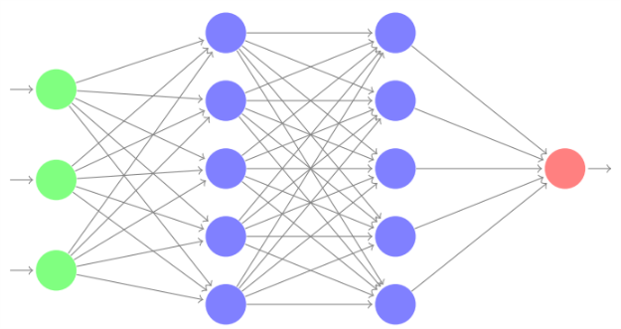
AI/ML is a great tool but…

Slide 24
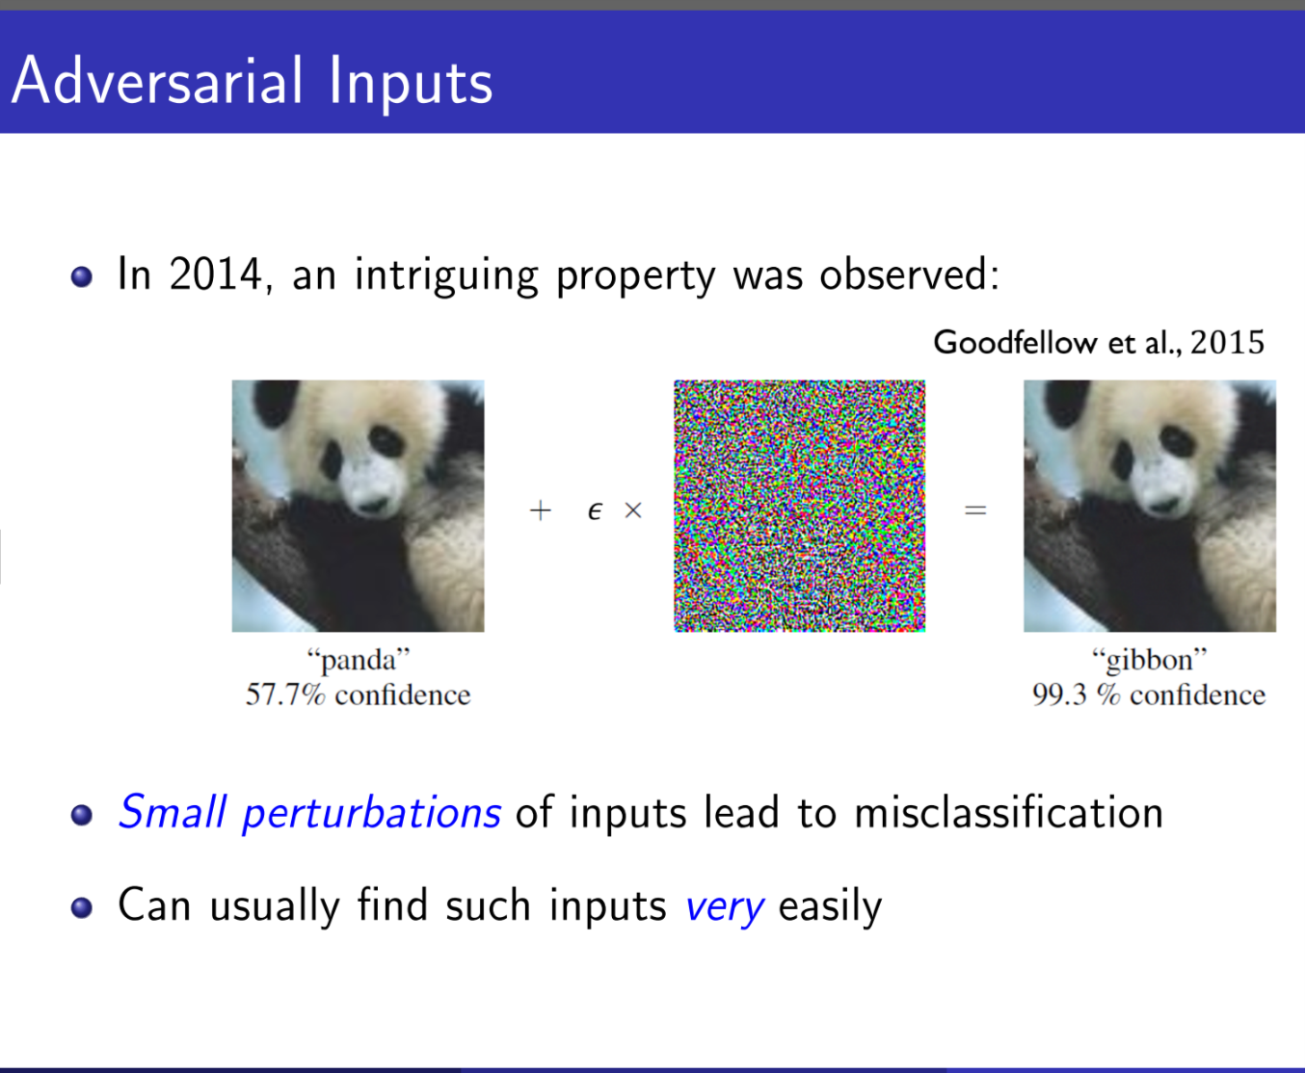
Animal Classification
Panda with 57.7% confidence

Slide 25
Animal Classification
Gibbon
with 99.3% confidence
Small perturbations can lead to wrong outcomes.

Slide 26
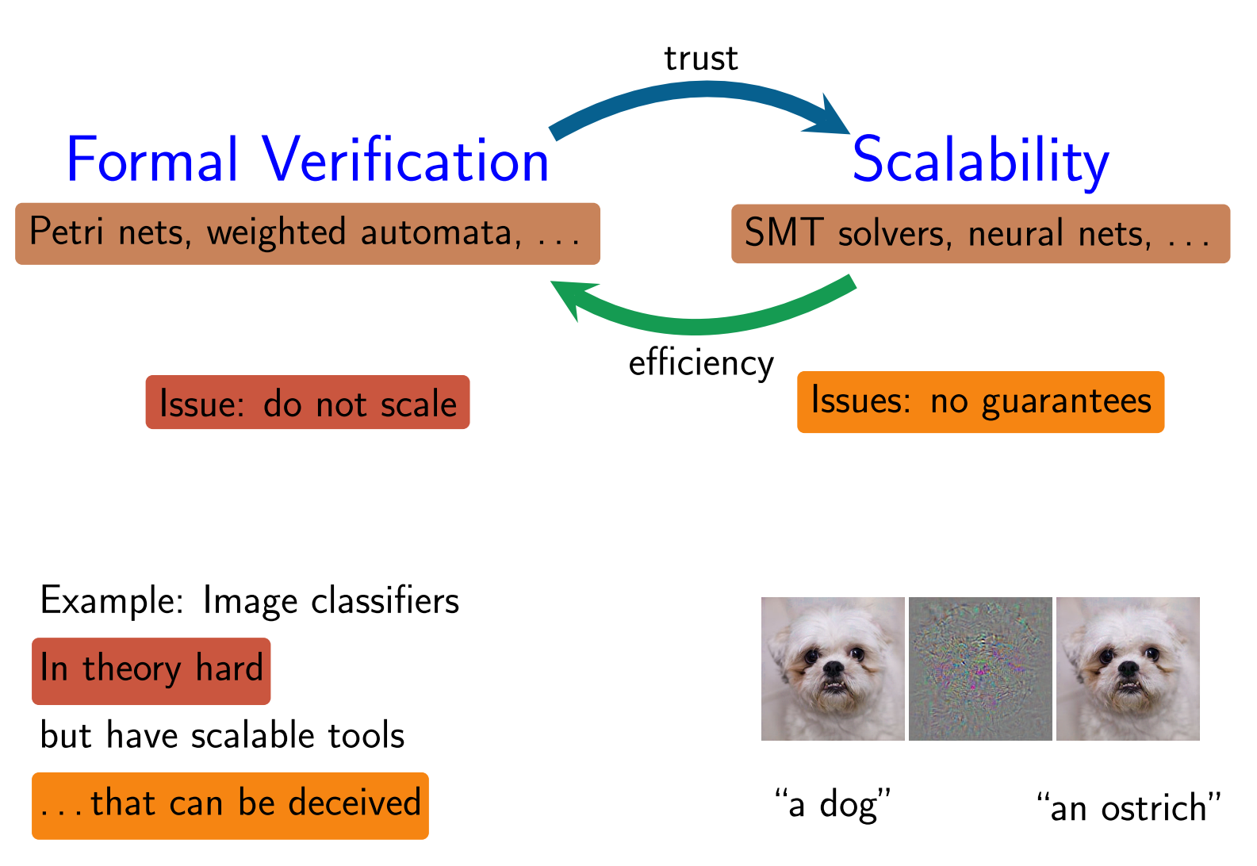
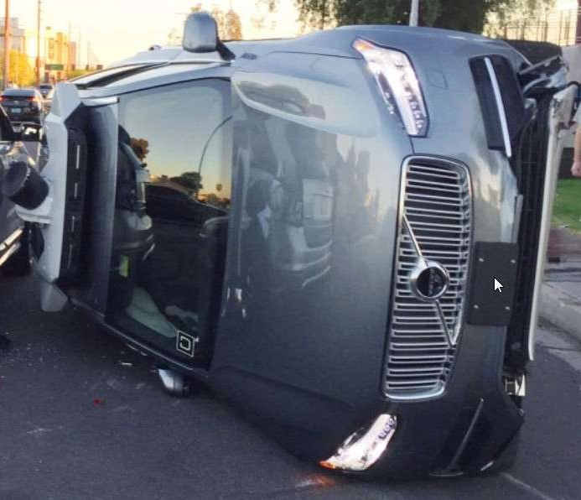
AI/ML is a great tool but…very brittle!
Example:
Uber Self driving cars
Would you use that in a critical system (plane…)?
Industrial partners we talk to are sceptical.

Slide 27
Robustness Certification:
(lack of) Robustness
Can we certify that a DNN is robust?

Slide 28
Standard Problem: Local Robustness
DNN
perturbation
Input image I
ε = 0.01
Question : does there exist another input image I’ with d(I-I’) < ε and I’ and I have different classification.
For efficiency, d(.) is usually L∞ : all the pixel can change a bit, changes are independent.
Local because we look around one input image.

Slide 29
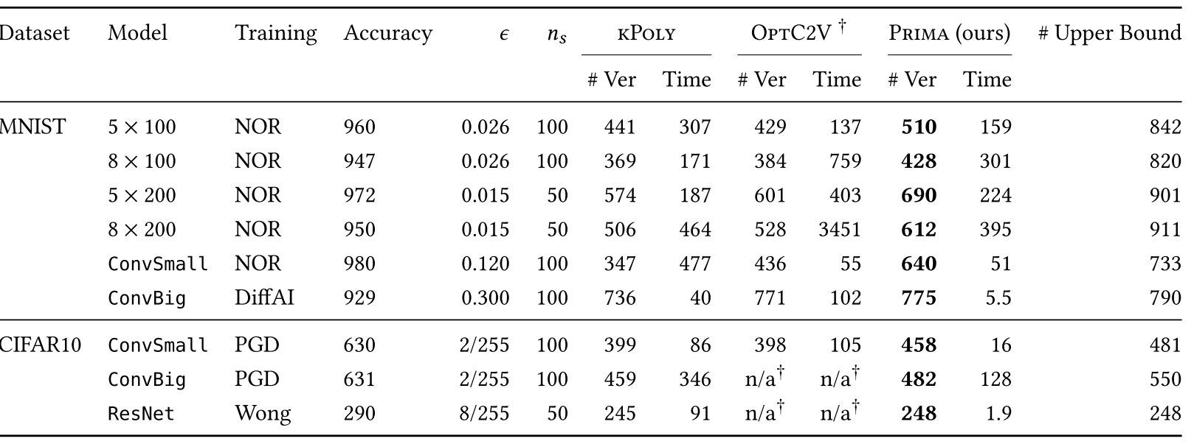


Standard Problem: Local Robustness
% attacks
12%
13%
7%
4%
25%
What to do with such results?
Offline certification/attack on 1000 images is not sufficient:
Every network have 8%-18% of images where we find attack or simply wrong outcome
Between 65% to 81% of images can be certified only (with our method, better than PRIMA and Beta CROWN).
No Networks is robust on all images.
Even if robust, we only tested 1000 images, cannot generalize.
Online certification: not fast enough for certification, delay > seconds (problem w/ video stream, <1sec decision…).
Need special training or a Global notion (for all images)

Slide 30










Robustness-aware Training ?
% attacks
12%
13%
7%
4%
25%
15%
24%
13%
17%
No good solution (accurate + robust + easy to verify)
ε
CIFAR10
79
2/255

Slide 31
Global Robustness ?
DNN
perturbation
Input image I
ε = 0.01
Global robustness makes no sense: robust for all Images = constant function.
In practice, it s ok not to be robust: there are images at the boundary between 2 classes, a bit of difference will make it fall in one or another class, perfectly normal.

Slide 32
Proposal of Global notion: “Lipschitz”-continuous instead
DNN
perturbation
Constant
ε = 0.01
k = 1
Does there exist I,I’ with d(I,I’) < ε, output neuron n and |value_{n}(I) -value_{n}(I’)| > k ?
Harder (I can be anywhere) but do not need to consider many input images.
Makes more sense: images around boundaries are allowed to switch classification

Slide 33
Proposal of Global notion: “Lipschitz”-continuous instead
perturbation
Constant
ε = 0.01
k = 1
Assume we proved offline the global notion:
For all I,I’ with d(I,I’) < ε, for all output neuron n we have |value_{n}(I) -value_{n}(I’)| < 1 ?
Online: for image I, we can check in real time if Δ = max_{n’}(Δ_{n,n’}=|value_{n}(I) –value_{n’}(I)|) > 2
for class n of image I
Then we know the network is robust and we can trust the image.
Else we skip the image. (or can have a set of images, several captors…)

Slide 34
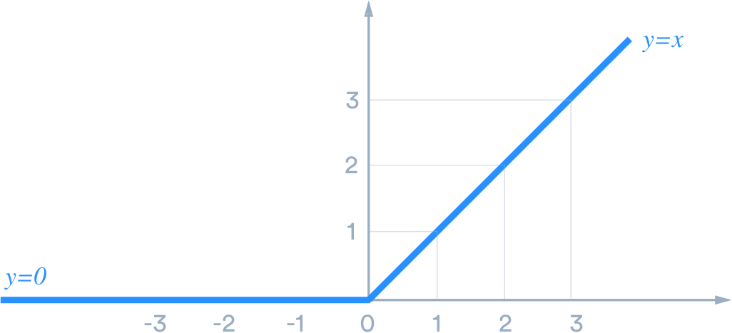
Formal Verification of Robustness of FF-DNNs
ReLU: f(x)=x if x>0, and f(x)=0 otherwise
2 activation phases (each phase is linear)
v₁
v₂
V₃
w1
w2
w3
V₄
weights
$$v4=activation_function(w1v1+w2 v2+w3v3)$$
(e.g. ReLU)
Variables v_{i}, v’_{i} to represent the input and its small deviation, with |v_{i} -v’_{i} | < ε
Double the number of variables compared with local robustness.

Slide 35






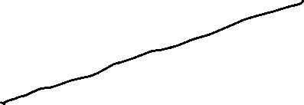
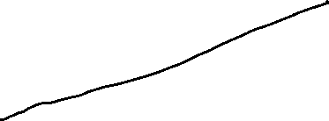
LP/MILP constraints with variables x_{i} & x’_{i}
Use standard variables x_{i} and x’_{i}
Standard MILP encoding of ReLU(x), ReLU(x’)
ReLU(x)
x
and similarly for x’_{i}
ReLU(x’)
2 binary variable a for each neuron i.
MILP encoding is exact but much too hard to solver.
LP relaxation for x,x’ is very inacurate for x-x’ (worse than mathematical bound). Partial MILP worse than mathematical bound.
X’

Slide 36
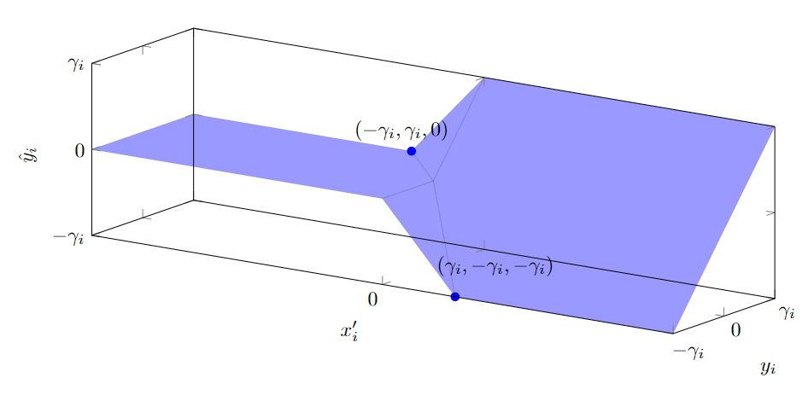




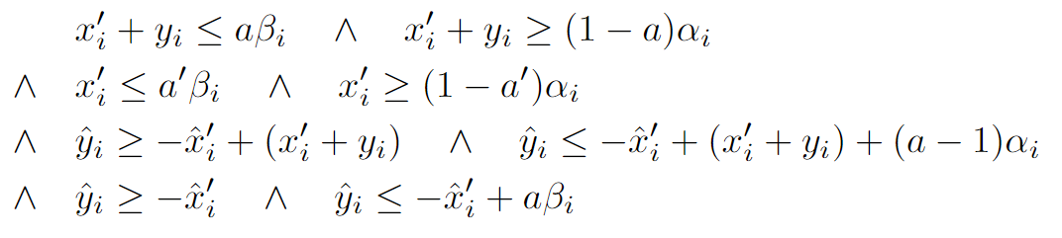







LP/MILP constraints with x’_{i} & y_{i}
use y_{i} variables + x’_{i}
=
=
a,a’ binary variables to encode the 4 blue hyperplans
a=1 iff x_{i} >0 and a’=1 iff x’_{i}>0.
Plus 2 usual constraints for a / x’_{i}
LP only:
^
With constraint: - γ_{i} =min(y_{i}) < y_{i} < max(y_{i}) = γ_{i}
(recover the mathematical bound)
Add y_{i} < ½ y_{i} + ½ max(y_{i})
(similar to DeepPoly => 10x better than mathematical bound)
^
Still 2 binary variable a for each neuron i.

Slide 37
5layers*100 nodes, ReLU,
ε = 0.001
Average gamma of layer 3 (first ReLU layer) when choosing X MILP layer1-nodes focusing on compensation vs random choice
Number X of nodes chosen | pMILP with x, x’, 2 ReLU per neuron |  | Random (k=1)
0 | 0.312 |  | 0.312
15 (x2) | 0.249 |  | 0.288
18 (x2) | 0.236 |  | 0.280
21 (x2) | 0.229 |  | 0.273
24 (x2) | 0.244 |  | 0.264

Slide 38
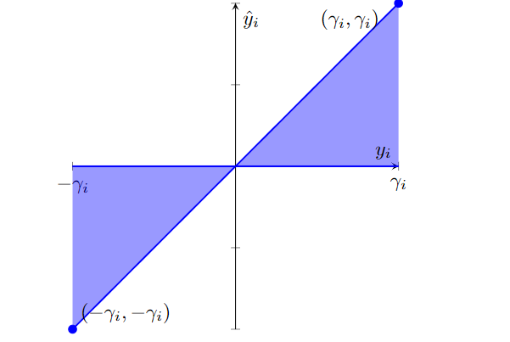
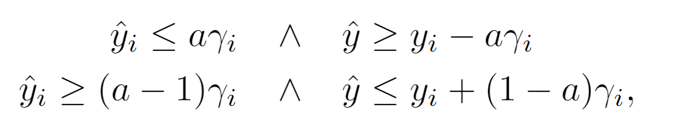




LP/MILP constraints with y_{i}
=
=
use only y_{i} variables.
1 binary variable a for each

Slide 39
DNN 5x100 natural training
ε = 0.001
 | Average Gamma=x-x’ | Total Time
Mathematical bound | 284 | 0s
LP with (x,x’) constraints | 29 (10x better) | 14min (830s)
CMP (17-36 nodes x2) | 16.9 (17x better) | 6h42min (24053s)
DNN 5x100 Diff-AI training
ε = 0.001 (x2.4)
Methods | Average Gamma=x-x’ | Time
Mathematical bound | 2.88 | 0s
LP with (x,x’) constraints | 0.456 (6x better) | 11 min (695s)
CMP (17-36 nodes x2) | 0.28 (10x better) | 5h21min (19270s)

Slide 40
