Slide 1
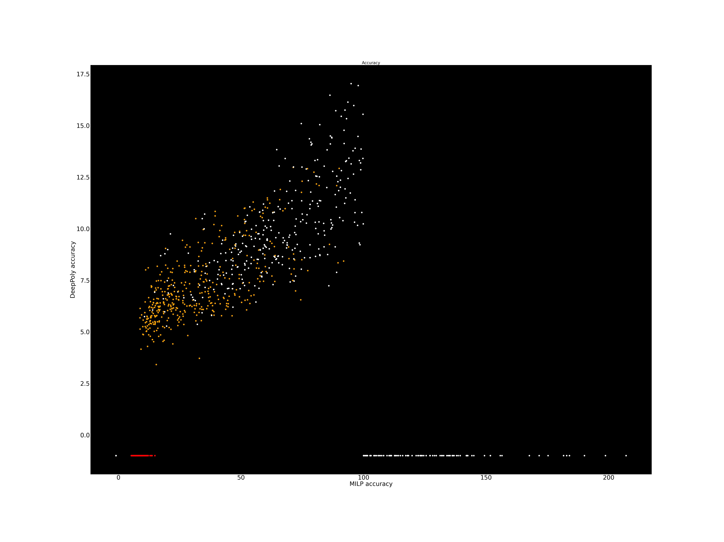
NEW RUN DNN 5x100, Over 100 images
ε = 0.026
Methods | number certif images | Average Time per Image
Beta Crown TO=30s | 35% | 18s per image
Upper bound | 90%
pMILP | 77% | 46s per image
Refined Beta Crown | 77% | 98s per image
Accuracy MILP
sliding window k=1
Orange+red = certified
DeepPoly Accuracy Red=certified

Slide 2
NEW RUN DNN 5x200, Over 100 images
ε = 0.015
Methods | number certif images | Average Time per Image
Beta Crown TO=30s | 48% | 17s per image
Upper bound | 96%
Pmilp (new) | 88% | 71s
Refined Beta Crown | 87% | 80s per image

Slide 3







NEW RUN DNN 8x100, Over 100 images
ε = 0.026
Methods | number certif images | Average Time per Image
Beta Crown TO=30s | 28% | 20s per image
Upper bound | 86%
pMILP (old) | 72% (% better) (76% 91s??) | 81s per image
Pmilp (new) | 64% (75%) | 155s (183s) 135s of fast.
Pmilp([21-24], 10s,100s,400s) | 60% / 69% / 71% / 75% | 69s / 91s / 61s / 113s
Refined Beta Crown | 65% | 102s per image

Slide 4
NEW RUN DNN 8x200, Over 100 images
ε = 0.015
Methods | number certif images | Average Time per Image
Beta Crown TO=10s | 35% | ~7s per image
Upper bound | 91%
Alpha-Beta Crown TO=2000s | % | s per image
Pmilp (new) ([21-24], 10s,150s,600s) | 77% / 83% | 59s / 78s
Refined Beta Crown | 75% | 82s per image

Slide 5
















NEW RUN DNN 6x500, Over 100 images
ε = 0.035
Methods | number certif images | Average Time per Image
Alpha-Beta Crown TO=10s | 41% | ~6s per image
Alpha-Beta Crown TO=30s | ~42% | ~15s per image
Alpha-Beta Crown TO=2000s | 44% | 1002s per image
Upper bound | 94%
pMILP ([21-24], 10s,1000s,4000s) | 84% | 402s per image

Slide 6
CNN A-ADV MNIST, Over 100 images
ε = 0.3?
Methods | number certif images | Average Time per Image
Beta Crown TO=10s
Beta Crown TO=30s | ~% | s
Beta Crown TO=200s
Upper bound | ?%
pMILP | % (% better) | s per image (% better)
Pmilp (new) ([21-24], 10s,500s,2000s)

Slide 7
CNN B-ADV CIFAR, Over 100 images
ε = 2/255?
Methods | number certif images | Average Time per Image
Beta Crown TO=30s | 40% | 15s ?
Beta Crown TO=90s | 41% | 32s
Beta Crown TO=2000s | 42% | 373s
Beta Crown TO=10.000s | 44% | 1919s
Upper bound | 62% (first 100)
Pmilp (new) fast | 51% | 417s

Slide 8






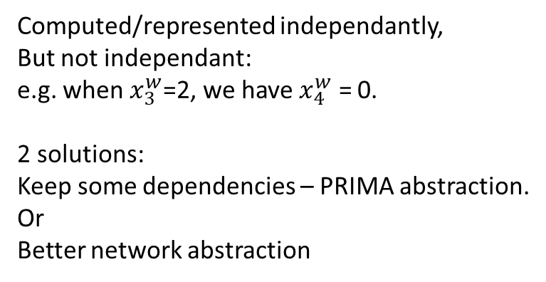








ERAN-DeepPoly
DeepPoly Abstraction idea is very interesting.
Very efficient but sometimes imprecise.
Use that as base + other techniques to improve the accuracy when needed.
Main issue:
$$x1 ε [−1,1]$$
$$x_{3}^{w}ε [−2,2]$$
$$1$$
$$ReLU$$
$$x_{1}$$
$${x_{3}^{w}}_{ }$$
Computed/represented independantly,
But not independant:
e.g. when $x_{3}^{w}$=2, we have $x_{4}^{w}$ = 0.
2 solutions:
Keep some dependencies – PRIMA abstraction.
Or
Better network abstraction
$$1$$
$$1$$
$$x_{2}$$
$${x_{4}^{w}}_{ }$$
$$−1$$
$$ReLU$$
$$x2 ε [−1,1]$$
$$x_{4}^{w} ε [−2,2]$$

Slide 9










Better network abstraction with compensation
$$ReLU$$
$$1$$
$$b$$
$$c_{ }$$
$$1$$
a
d
$$−1$$
$${b′}_{ }$$
$${c′}_{ }$$
$$1$$
$$ReLU$$
These two paths (abcd, ab’c’d) « compensate » each other if no ReLU, and mostly compensate with ReLU (cause 1x1 > 0 > -1x1).
Can have compensation using several ReLU layers, but the more ReLU the weakest the compensation (more chance of clipping).
=> Intuitively, Most compensations are 1 ReLU Layer away
=> Use sliding window computation: only previous layer is exact (using MILP encoding of ReLU with 1 Binary variable).
=> MILP (Gurobi) with limited number of binary variables. Should work well for deep NN.

Slide 10
The Compensation Theorems
$$ReLU$$
$$1$$
$$b$$
$$c_{ }$$
$$1$$
a
d
$$−1$$
$${b′}_{ }$$
$${c′}_{ }$$
$$1$$
$$ReLU$$
Theorem 1: If for all (a,d) there is no compensation paths (π,π’) in the network from a to d, then the LP approximation is
100% accurate (or deepoly with the f(x) ≥ 0 abstraction only, never using the f(x) ≥ ID abstraction). [proved]
Theorem 2: If all compensation paths (π,π’) between any (a,d) (e.g. (abcd,ab’c’,d)) have all the intermediate states (e.g. b,c,b’,c’)
as integer variables (or they are always ≥ 0 or always ≤0), then MILP approximation is 100% accurate
(or deepoly with the f(x) ≥ 0 abstraction only, never using the f(x) ≥ ID abstraction). [a bit harder, to be done]

Slide 11










Selection of Binary Relu nodes.
Look for 4uples (a,b,b’,c) where (a,b’,c) compensate (a,b,c). => Select (b,b’) as binary MILP nodes.
Sort by: weight(a,b,b’,c) = |max(a)| min( |ab*bc| , |ab’*b’c|)
Choose 30 nodes b/b’, starting with highest weights first.
$$ReLU$$
$$1$$
$$b$$
$$c_{ }$$
$$1$$
a
d
$$−1$$
$${b′}_{ }$$
$${c′}_{ }$$
$$1$$
$$ReLU$$

Slide 12
5layers*100 nodes, ReLU, image n°59 (hard)
Average uncertainty of layer 3 (first ReLU layer) when choosing X MILP layer1-nodes focusing on compensation vs random choice
Number X of nodes chosen | Compensation (k=1) | Random (k=1)
0 | 2.22 | 2.22
10 | 1.84 | 2.03
20 | 1.50 | 1.82
30 | 1.28 | 1.62
40 | 1.14 | 1.44
50 | 1.06 | 1.23
61 (max) | 1.05 | 1.05

Slide 13
5layers*100 nodes, ReLU, image n°59 (hard)
Average uncertainty of layer 5 (first ReLU layer) when choosing MILP layer1+3-nodes focusing on compensation vs random choice
Number X of nodes chosen | Layer 1&3: Compensation (vs random) | Layer 3: Compensation (vs Random)
0 | 1.758 | 1.758
10 | 1.677 (1.695) | 1.677 (1.70)
20 | 1.539 (1.622) | 1.567 (1.639)
30 | 1.431 (1.542) | 1.489 (1.578)
40 | 1.329 (1.47) | 1.454 (1.514)
50 | 1.243 (1.39) | 1.432 (1.455)
ALL NODES OF LAYER 3 (k=1) |  | 1.422
ALL NODES OF LAYER 1+3 (k=2) | 1.184

Slide 14
NEW RUN DNN 5x100, Over 100 images
ε = 0.026
Methods | number certif images | Average Time per Image
Beta Crown TO=30s | 35 % | 5s per image
Upper bound | 90%
pMILP | 79% | 69s per image
Refined Beta Crown | 77% | 98s per image
Accuracy MILP
sliding window k=1
Orange+red = certified
DeepPoly Accuracy Red=certified

Slide 15
DNN 5x100, Over 1000 images
ε = 0.026
Methods | number certif images | Average Time per Image
Eran (DeepPoly) | 16.0 % | 5s per image
Refined PRIMA 2021 | 51% | 159s per image with GPU
Vericompensate (50 nodes in 1,2) | 65.3% 68.4% adding k=2 for min>-1.5 | 117s per image NO GPU 142s per image NO GPU
Refined Beta Crown | 69.9% | 102s per image with GPU
Accuracy MILP
sliding window k=1
Orange+red = certified
DeepPoly Accuracy Red=certified

Slide 16
DNN 8x100, Over 1000 images
ε = 0.026
Methods | number certif images | Average Time per Image
Eran (DeepPoly) | 18.2 % | 11s per image (our implem)
Refined PRIMA 2021 | 42.8% | 301s per image with GPU
Vericompensate(50 nodes) | 61.4% | ~170s per image No GPU
Vericompensate(K=2, new long) | 65.8% | 346s per image NO GPU (can lower the time)
Standard Beta Crown (BAB) | 23.6% - on first 500 | 179s per image
Refined Beta Crown (refined BAB) | 62% | 103s per image with GPU – try no GPU?

Slide 17
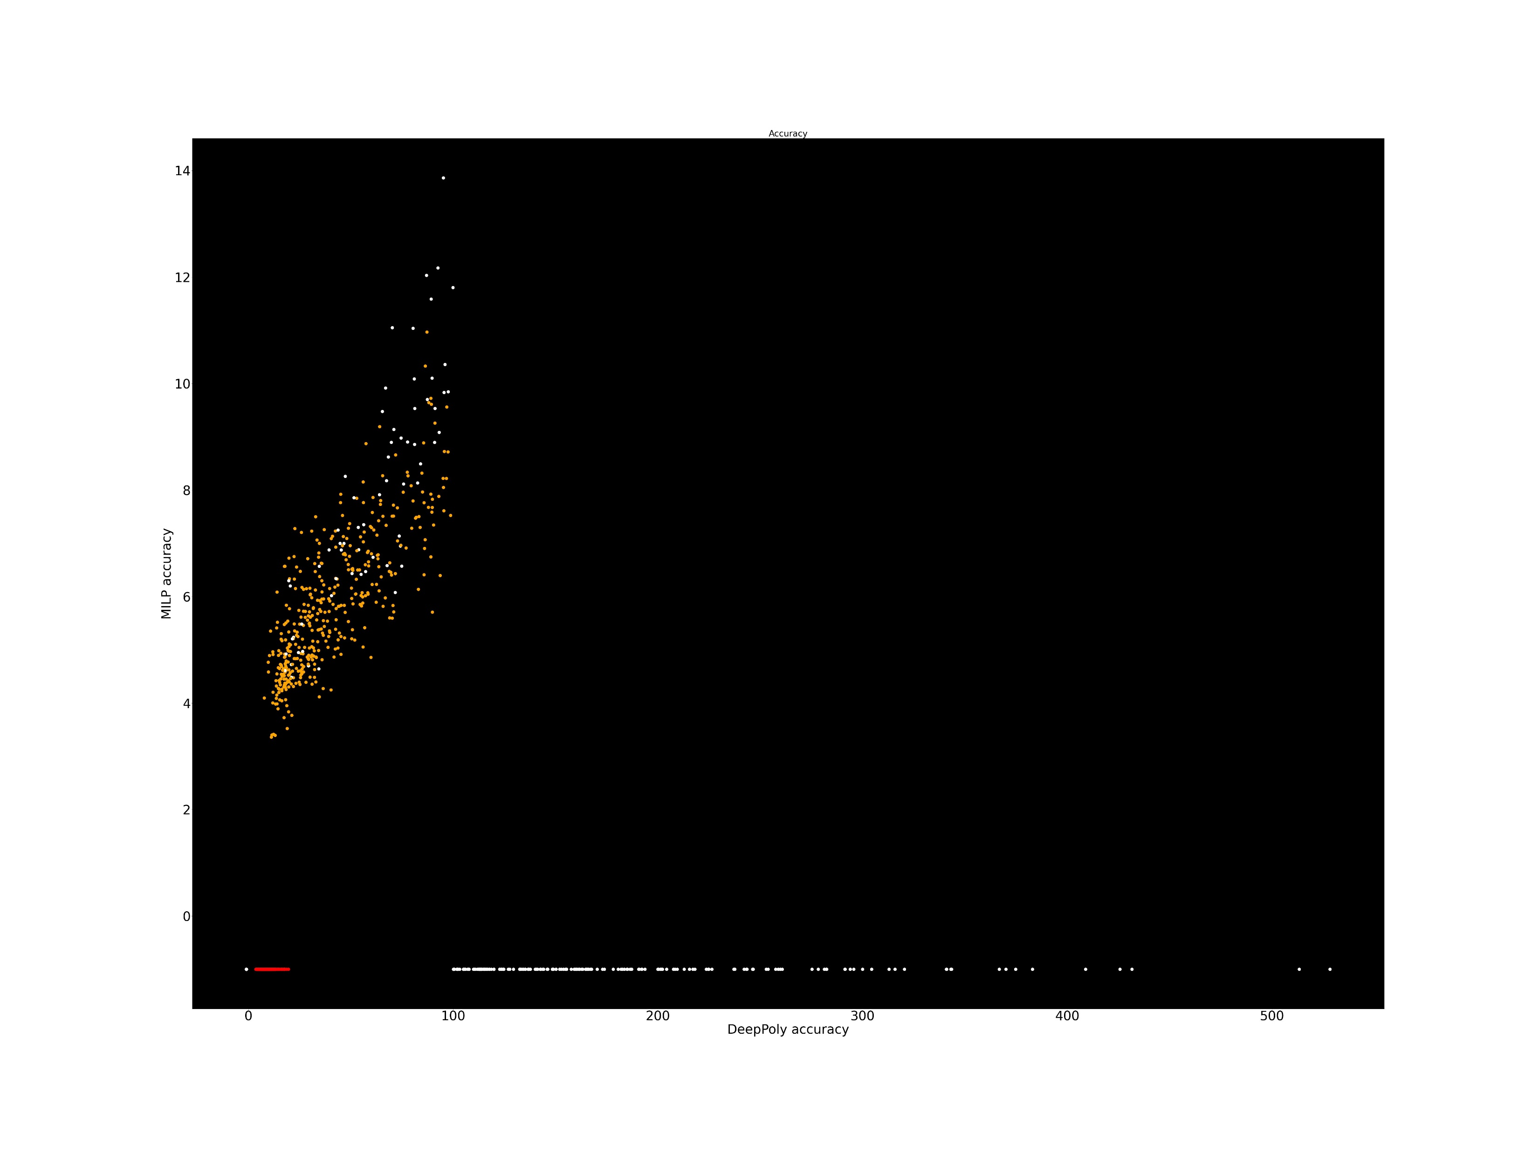
DNN 5x200, Over 1000 images
ε = 0.015
Methods | number certif images | Average Time per Image
Eran (DeepPoly) | 29.2 % | ?s per image (our implem)
Refined PRIMA 2021 | 69% | 224s per image with GPU
Vericompensate 40/32 nodes | 71.9% < 100 (74.8% <150) | 206s (248s) per image No GPU
Vericompensate+ 60 nodes ( k=2) | 76.8% <150 (77.4% k=2) | 279s (309s) per image NO GPU
Standard Beta Crown (BAB) | ? | ?s per image
Refined Beta Crown (refined BAB) | 77.4% | 86s per image with GPU
Accuracy MILP
sliding window k=1
Orange+red = certified
DeepPoly Accuracy Red=certified

Slide 18
DNN 8x200, Over 1000 images
ε = 0.015
Methods | number certif images | Average Time per Image
Eran (DeepPoly) | 25.9 % | 17s per image (our implem)
Refined PRIMA 2021 | 62.4% | 395s per image with GPU
New_adapt compensate Stop at 0/2 for fast Stop at 1/4 for slow | 1) 72 - 78 /100 2) 73 - 79/100 3) 74 - 77/100 4) 68 - 80 /100 5) 52 - 78 /100 6) 70 – 75 / 100 7) 54 – 84 /100 8) 79 – 85 /100 9) 79 – 82 /100 10) 60 – 73 /100 | 310s-472s 349s-524s 297s-506s 354s-620s 174s – 598s 291s - 454s 174s – 586s 363s – 522s 395s – 557s 258s – 521s
New_adapt compensate fast | 68.1% /1000 | 297s /1000
New_adapt compensate fast+slow | 79.1% /1000 | 535s /1000
Vericompensate(fast), old v | 72.6% (363/500) - 77/100 first | 480s- per image NO GPU
Standard Beta Crown (BAB) | ? | ?s per image
Refined Beta Crown (refined BAB) | 73.5% | 95s per image with GPU

Slide 19
Overall Recap
 | DeepPoly Our imp | PRIMA 2021 refined | VeryCompFast | VeryComp Fast+Slow | BetaCrown Pure | BetaCrown Refined
5x100 | 16% (5s) | 51% (159s) | 65.3% (117s) | 68.4% (142s) | ? | 69.9% (102s)
5x200 | 29.2% (8s) | 69% (224s) | 72% (206s) | 76.8% (279s) | ? | 77.4% (86s)
8x100 | 18.2% (11s) | 42.8% (301s) | 61.4% (170s) | 65.8% (346s) | 23.6% (179s) | 62% (103s)
8x100a | 18.2% (11s) | 42.8% (301s) | 52.7% (92.3s) | 59.7% (179s) | 23.6% (179s) | 62% (103s)
8x200 | 25.9% (17s) | 62.4% (395s) | 68.1% (297s) | 79.1% (535s) | ? | 73.5% (95s)
5x500 | 26% (34s) |  | 63.3% (814s) |  | 32%? (/20) | Fail (/50)

Slide 20
Overall Recap
 | DeepPoly Our imp | PRIMA 2021 refined | VeryComp Fast adaptative | VeryComp Fast+Slow adaptative | VeryComp Fast+Slow fixed | BetaCrown Pure | BetaCrown Refined
5x100 | 16% (5s) | 51% (159s) |  | 65.3% (117s) | 68.4% (142s) | ? | 69.9% (102s)
5x200 | 29.2% (?s) | 69% (224s) |  | 72% (206s) | 76.8% (279s) | ? | 77.4% (86s)
8x100 | 18.2% (11s) | 42.8% (301s) | 52.7% (92.3s) | 59.7% (179s) | 65.8% (346s) | 23.6% (179s) | 62% (103s)
8x200 | 25.9% (17s) | 62.4% (395s) | 68.1% (297s) | 79.1% (535s) | too slow | ? | 73.5% (95s)
6x500 | 26% (34s) | Max 84% | 65% (927s) /200 | Too slow | Pure B 44.5% 576s, 1200s | 32%? () /20, 30s | Fail to run

Slide 21










Conclusion
Looking for the compensations is both novel and seems a good criteria to choose MILP nodes.
Outperform Prima, both in time and in accuracy, with similar process but different focus (dependencies vs compensation.
Still beaten by Beta Crown both in time (but we use 100% python) and accuracy (k=2 is close),
But very different process.
=> we need to go through every nodes from start,
while beta crown starts from the end and only focus on important nodes.
Finding could be interesting, to be used in Beta Crown, or combined with Prima.
Could also use some CEGAR techniques to choose the node to compute accurately to save on time.
$$ReLU$$
$$1$$
$$b$$
$$c_{ }$$
$$1$$
a
d
$$−1$$
$${b′}_{ }$$
$${c′}_{ }$$
$$1$$
$$ReLU$$

