Slide 1
Verification of DNNs
Kuldeep S. Meel
NUS, Singapore
Blaise Genest
CNRS, DesCartes & IPAL, France
Intern: Marius Belly, summer 2022
RA: Shaan Aryaman, Jan-Aug 2023
RF: Liao Yuke, Oct 2023+

Slide 2
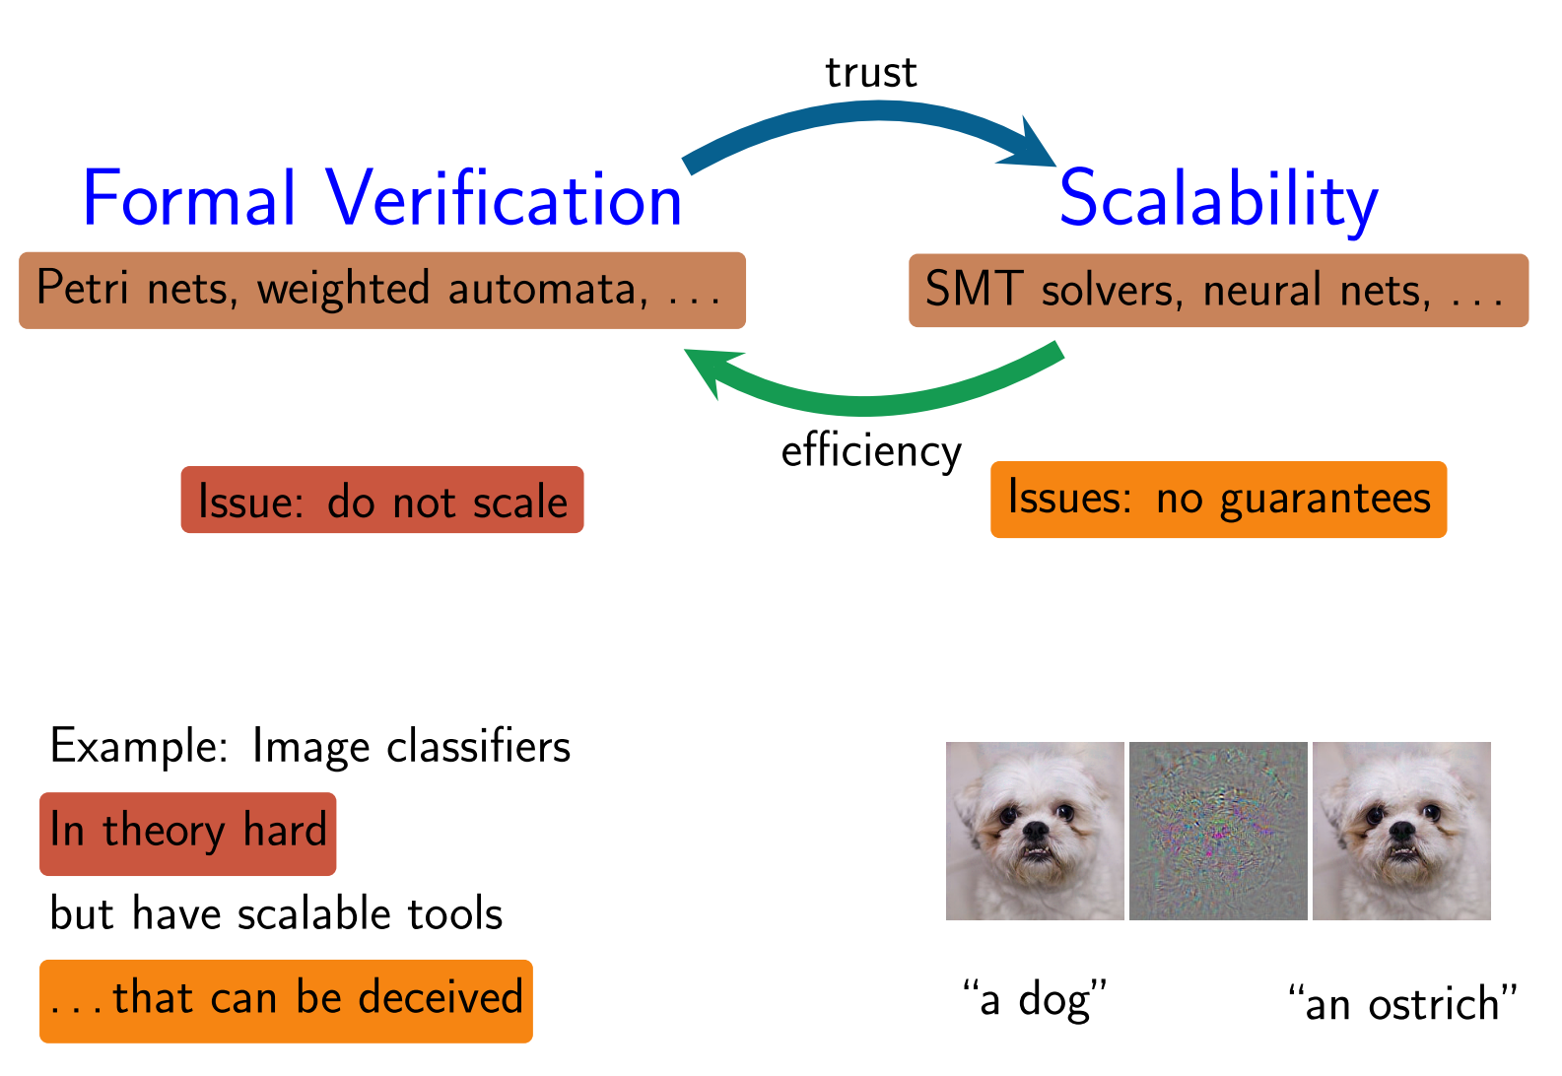
Problem we consider:
(lack of) Robustness
Can we verify that a DNN is robust?

Slide 3
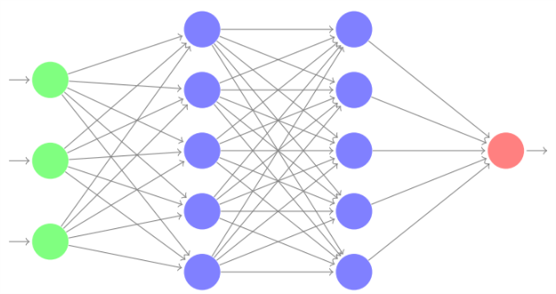
Standard Problem: Local Robustness
DNN
perturbation
Input image I
ε = 0.01
Question : does there exist another input image I’ with d(I-I’) < ε and I’ and I have different classification.
For efficiency, d(.) is usually L∞ : all the pixel can change a bit, changes are independent.
Local because we look around one input image. Global robustness makes no sense: robust for all I = constant function.

Slide 4
Proposal of Global: “Lipschitz”-continuous instead
DNN
perturbation
Constant
ε = 0.01
k = 10
Does there exist I,I’ with d(I,I’) < ε, output neuron n and |NN_{n}(I) -NN_{n}(I’)| > k ?
Harder (I can be anywhere) but do not need to consider many input images.
Makes more sense: images around boundaries are allowed to switch classification

Slide 5
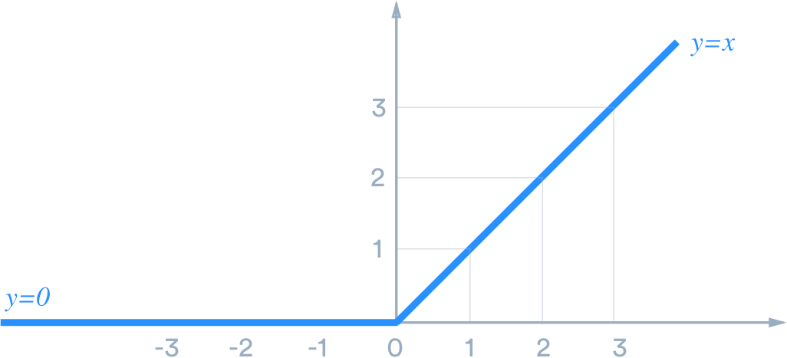
Formal Verification of Robustness of FF-DNNs
ReLU: f(x)=x if x>0, and f(x)=0 otherwise
2 activation phases (each phase is linear)
v₁
v₂
V₃
w1
w2
w3
V₄
weights
$$v4=activation_function(w1v1+w2 v2+w3v3)$$
(e.g. ReLU)
A priori, need to consider all activation phases of all neurons: 2^{N} cases to consider. Too many cases

Slide 6
Formal Verification of Robustness of FF-DNNs
Main tools:
Marabou/Reluplex (Stanford): Complete (always give an answer).
Modified LP solver Can handle up to 10 000 neurons (need days).
ERAN (ETH Zurich): Incomplete, return « I dont know » ~50% of the time.
Abstract interpretation Can handle up to 100 000 neurons in minutes.
β-crown (CMU): Complete and incomplete
Modified MILP solver Very efficient for both.
(complete can only handle small instances)

Slide 7
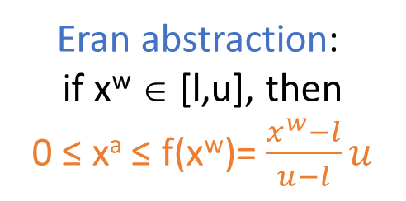
ERAN (ETH Zurich)
Joint work with
Idea: Use fixed abstraction to scale to larger DNNs
xª
xª
u
f(x^{w})
0
x^{w}
x^{w}
l u
0
l u
Box abstraction:
if x^{w} ∈ [l,u], then xª ∈ [max(0,l),u]
Eran abstraction:
if x^{w} ∈ [l,u], then
0 ≤ xª ≤ f(x^{w})= $\frac{x^{w}−l}{u−l}u$

Slide 8






















Abstractions: the Box (interval) abstraction
$$x1 ε [−1,1]$$
$$x_{3}^{w}ε [−2,2]$$
$$x_{3}^{a}ε \left[0,2\right]$$
$$1$$
$$ReLU$$
$$x_{1}$$
$${x_{3}^{w}}_{}$$
$${x_{3}^{a}}_{}$$
$$1$$
$$1$$
$$x_{5}$$
$$1$$
$${x_{4}^{w}}_{}$$
$${x_{4}^{a}}_{}$$
$$1$$
$$x5 ε \left[0,4\right]$$
$$x_{2}$$
$$−1$$
$$ReLU$$
$$x2 ε [−1,1]$$
$$x_{4}^{w} ε [−2,2]$$
$$x_{4}^{a}ε \left[0,2\right]$$
xª
u
0
x^{w}
l u

Slide 9
























Abstractions: the ERAN abstraction
$$x_{3}^{a}ε \left[0,2\right]$$
$$x1 ε [−1,1]$$
$$x_{3}^{w}ε [−2,2]$$
$$x_{3}^{a}≤\frac{1}{2}x1+\frac{1}{2}x2+1$$
$$1$$
$$ReLU$$
$$x_{1}$$
$${x_{3}^{w}}_{ }$$
$${x_{3}^{a}}_{ }$$
$$1$$
$$1$$
$$x_{5}$$
$$1$$
$${x_{4}^{w}}_{ }$$
$${x_{4}^{a}}_{ }$$
$$1$$
$$x5 ≤x1+2$$
$$x5 ε \left[0,3\right]$$
$$x_{2}$$
$$−1$$
$$ReLU$$
$$x_{4}^{a}≤\frac{1}{2}x1−\frac{1}{2}x2+1$$
$$x2 ε [−1,1]$$
$$x_{4}^{a}ε \left[0,2\right]$$
$$x_{4}^{w} ε [−2,2]$$
xª
f(x^{w})
0
x^{w}
l u

Slide 10
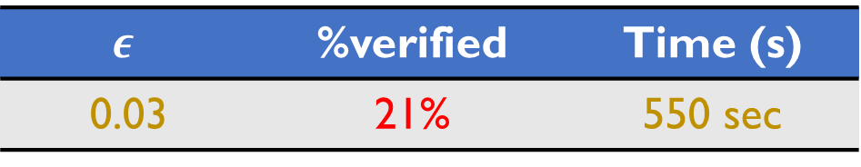
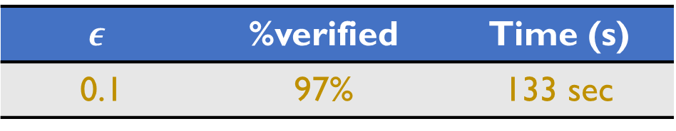
Results
Aircraft collision avoidance system
Reluplex | Neurify | ERAN
> 32 hours | 921 sec | 227 sec
Much more efficient than Reluplex:
Can scale to tens of thousands of neurons:
MNIST CNN with > 88K neurons
$$ε$$ | %verified | Time (s)
0.1 | 97% | 133 sec
CIFAR_10
But the abstraction is not always precise enough:
(~80% of cases where cannot answer)
$$ε$$ | %verified | Time (s)
0.03 | 21% | 550 sec

Slide 11






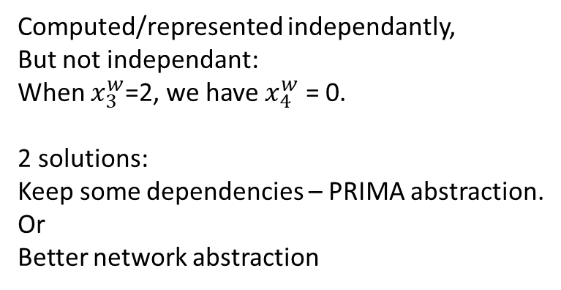








ERAN
Abstraction idea is very interesting.
Very efficient but sometimes imprecise.
Use that as base + other techniques to improve the accuracy when needed.
Main issue:
$$x1 ε [−1,1]$$
$$x_{3}^{w}ε [−2,2]$$
$$1$$
$$ReLU$$
$$x_{1}$$
$${x_{3}^{w}}_{ }$$
Computed/represented independantly,
But not independant:
When $x_{3}^{w}$=2, we have $x_{4}^{w}$ = 0.
2 solutions:
Keep some dependencies – PRIMA abstraction.
Or
Better network abstraction
$$1$$
$$1$$
$$x_{2}$$
$${x_{4}^{w}}_{ }$$
$$−1$$
$$ReLU$$
$$x2 ε [−1,1]$$
$$x_{4}^{w} ε [−2,2]$$

Slide 12






















Better network abstraction
$$x1 ε [−1,1]$$
$$x_{3}^{w}ε [−2,2]$$
$$x_{3}^{a}ε \left[0,2\right]$$
$$1$$
$$ReLU$$
$$x_{1}$$
$${x_{3}^{w}}_{ }$$
$${x_{3}^{a}}_{ }$$
$$1$$
$$1$$
$$x_{5}$$
$$x5 ε \left[0,3\right]$$
$$1$$
$${x_{4}^{w}}_{ }$$
$${x_{4}^{a}}_{ }$$
$$1$$
$$x_{2}$$
$$−1$$
$$ReLU$$
$$x2 ε [−1,1]$$
$$x_{4}^{a}ε \left[0,2\right]$$
$$x_{4}^{w} ε [−2,2]$$
These two paths « compensate » each other if no ReLU, and mostly compensate with ReLU.
Can have compensation using several ReLU layers, but the more ReLU the weakest the compensation (more chance of clipping).
=> Intuitively, Most compensations are 1 ReLU Layer away
=> Use sliding window computation: only previous layer is exact (using MILP encoding of ReLU with 1 Binary variable).
=> MILP (Gurobi) with limited number of binary variables. Should work well for deep NN.

Slide 13
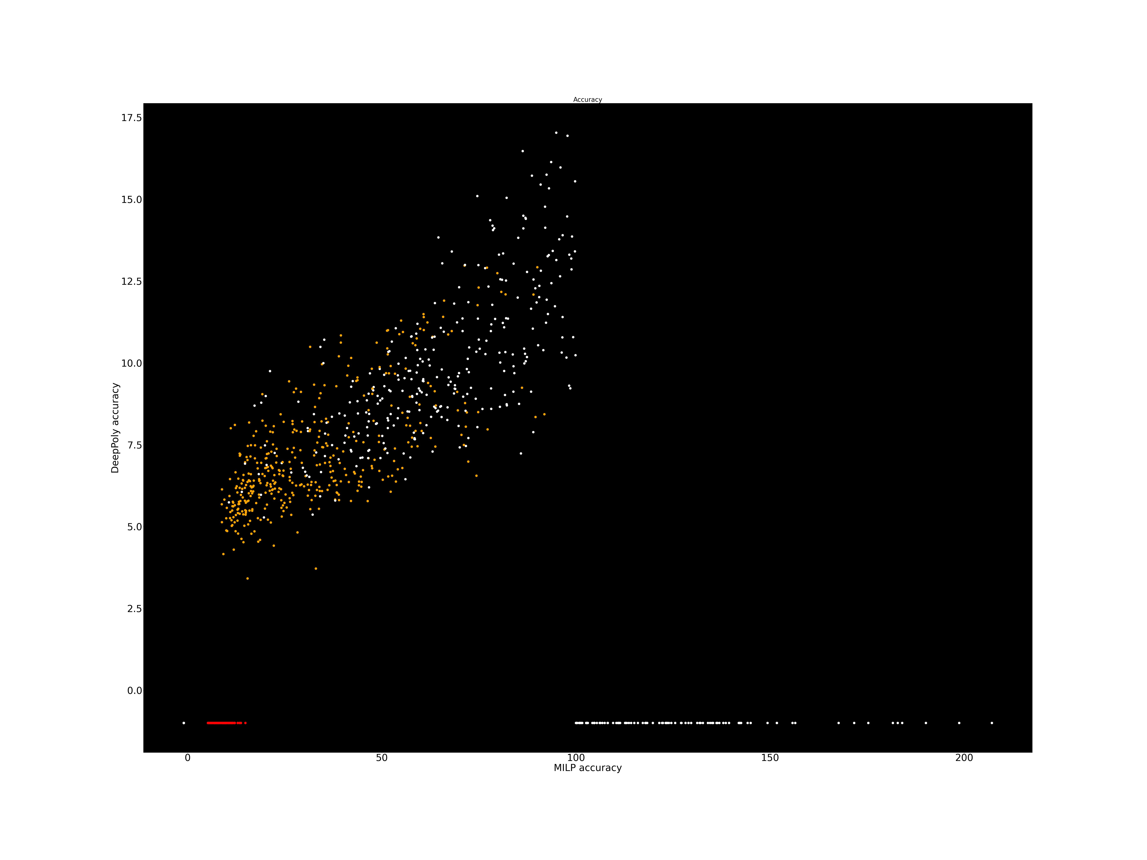
DNN 5x100, Over 100 images
ε = 0.026
Methods | number certif images | Average Time per Image
Eran (DeepPoly) | 16.0 % | 11s per image
PRIMA | 51% | 159s per image
MILP K=1 + LP relax | 56.1% | ??<200s per image
MILP K=2 + LP relax | 66% | ??<300s per image
Beta Crown | 69.9% | 102s per image
Accuracy MILP
sliding window k=1
Orange = certified
ε = 0.026
DeepPoly Accuracy Red=certified

Slide 14
DNN 8x100, Over 100 images
ε = 0.026
Methods | number certif images | Average Time per Image
Eran (DeepPoly) | 18.2 % | 11s per image
PRIMA | 42.8% | 301s per image
MILP K=1 + LP relax | 48.1% | 230s per image
MILP K=2 + LP relax | ??% | ??s per image
Beta Crown | 62% | 103s per image

Slide 15
5layers*100 nodes, ReLU, image n°59 (hard)
Average uncertainty of layer 3 (first ReLU layer) when chosing X MILP nodes in layer 1 (vs random choice)
Nodes | chosen (k=1) | Random (k=1)
0 | 2.22 | 2.22
10 | 1.80 | 2.03
20 | 1.51 | 1.82
30 | 1.33 | 1.62
40 | 1.15 | 1.44
50 | 1.13 | 1.23
61 (max) | 1.05 | 1.05
=> Could also choose some b,b’ from deeper layers if weight is very high (2,3 layers before…) !

Slide 16
OLD: DNN: 6layers*100 nodes, ReLU, image n°60 (easy)
ε = 0.018
Methods | Average (UB-LB) last layer | Total Time taken
ERAN DeepPoly | 19.97 | DeepPoly using Gurobi : 75s (Direct Deep Poly: 13.47s)
LP relaxation | 15.32 | 94s
MILP K=1 + LP relax | 7.10 (certif) | 601s
MILP K=2 + LP relax | 5.44 (certif) | 1098s
MILP K=3 + LP relax | 5.512 (certif) | 1946s
or
K=1 layer of ReLU using MILP seems the good balance.
Works well on this image cause most ReLU are known (<32% ReLU nodes have 2 modes on each layer).

Slide 17
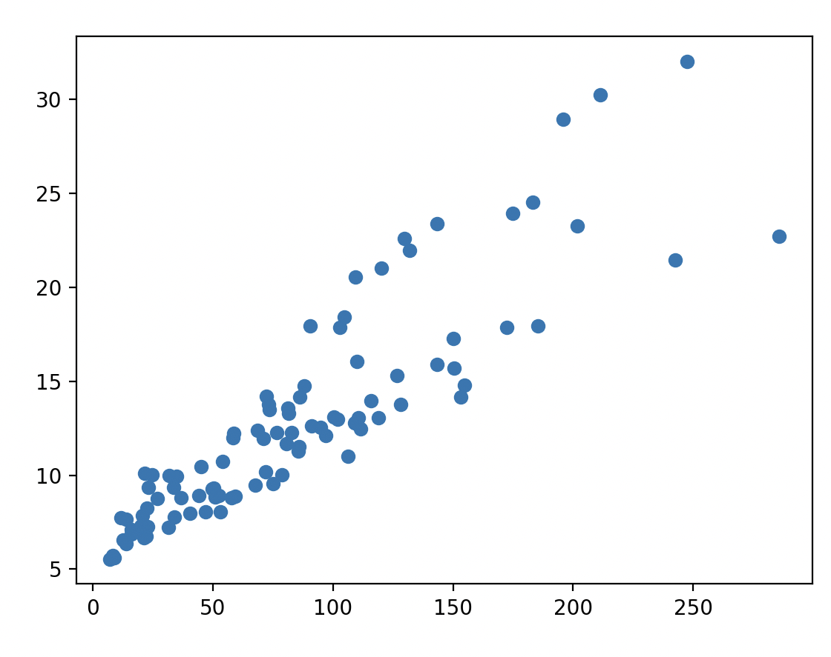
Over 100 images
Methods | number certif images | Total Time taken for ALL images
ERAN (DeepPoly) | 6 /100 | 44s => .5s per image.
MILP K=1 + LP relax | 41 /100 | 54.000s => >500S per image.
Accuracy MILP
sliding window k=1
n°59
10x more accurate on a shallow NN
(6 layers)
ε = 0.018
n°60
Accuracy Deep Poly

Slide 18
6layers*100 nodes, ReLU, image n°59 (hard)
ε = 0.018
Methods | Average (UB-LB) last layer | Total Time taken | Certified
ERAN DeepPoly | 242.5 | 75s (13.47s) | No
LP relaxation | 107 | 98s | No
MILP K=1 + LP relax | 18.3 | 23 451s (=6.5 hours) | No
Problem: 100% ReLU nodes with 2 modes in several layers
ERAN-DeepPoly: Very inacurrate
MILP K=1: Very slow
Too many binary variables => Select most important variables to help Gurobi.

Slide 19
6layers*100 nodes, ReLU, image n°59 (hard)
Methods | Average (UB-LB) last layer | Total Time taken | Certified
DeepPoly | 242.5 | 13.47s | No
LP relaxation (k=0) | 107 | 98s | No
MILP K=1 + LP relax, 10⁻¹ precision, Step Back=1 | ~30 | ~8000s | No
K=1, TO=3sec | 26.13 | 2264s | No
Select 30 MILP nodes | 24.4 (22.4 no paral) | 1453s (5487s no paral) | No
MILP K=1 + LP relax, 10⁻¹ precision, Step Back=2 | 20.25 | 12573s | No
MILP K=1 + LP relax, 10⁻¹ precision | 18.3 | 23451s | No
Slow because several layers have 100% ReLU nodes with 2 modes.
Too many binary variables => Select most important variables to help Gurobi.

Slide 20












Selection of Binary Relu nodes.
Look for 4uples (a,b,b’,c) where (a,b’,c) compensate (a,b,c). => Select (b,b’) as binary MILP nodes.
Sort by: weight(a,b,b’,c) = |max(a)| min( |ab*bc| , |ab’*b’c|)
Choose 30 nodes b/b’, starting with highest weights first.
$$1$$
$$ReLU$$
$$b$$
$$1$$
$$1$$
$$c$$
$$1$$
$$a_{}$$
$$b′$$
$$1$$
$$−1$$
$$ReLU$$

Slide 21












Conclusion
Looking for the compensations is both novel and seems a good criteria to choose MILP nodes.
Several things to try:
Add some cheap preprocessing (e.g. selecting and partitioning couple of sensitive inputs) => fails
Replace Gurobi by β-crown (doable?).
Tweak β-crown with this finding (very technical).
Use Hybrid Prima (constraints between nodes of the same layer) + few MILP nodes.
$$1$$
$$ReLU$$
$$b$$
$$1$$
$$1$$
$$c$$
$$1$$
$$a_{}$$
$$b′$$
$$1$$
$$−1$$
$$ReLU$$

Slide 22
Merci / Thanks! Question?

