Slide 1
Verification of DNNs
Kuldeep S. Meel
NUS, Singapore => University of Toronto
Blaise Genest
CNRS, DesCartes & IPAL, France
Intern: Marius Belly, summer 2022
RA: Shaan Aryaman, Jan-Aug 2023
RF: Liao Yuke, Sept 2023+

Slide 2
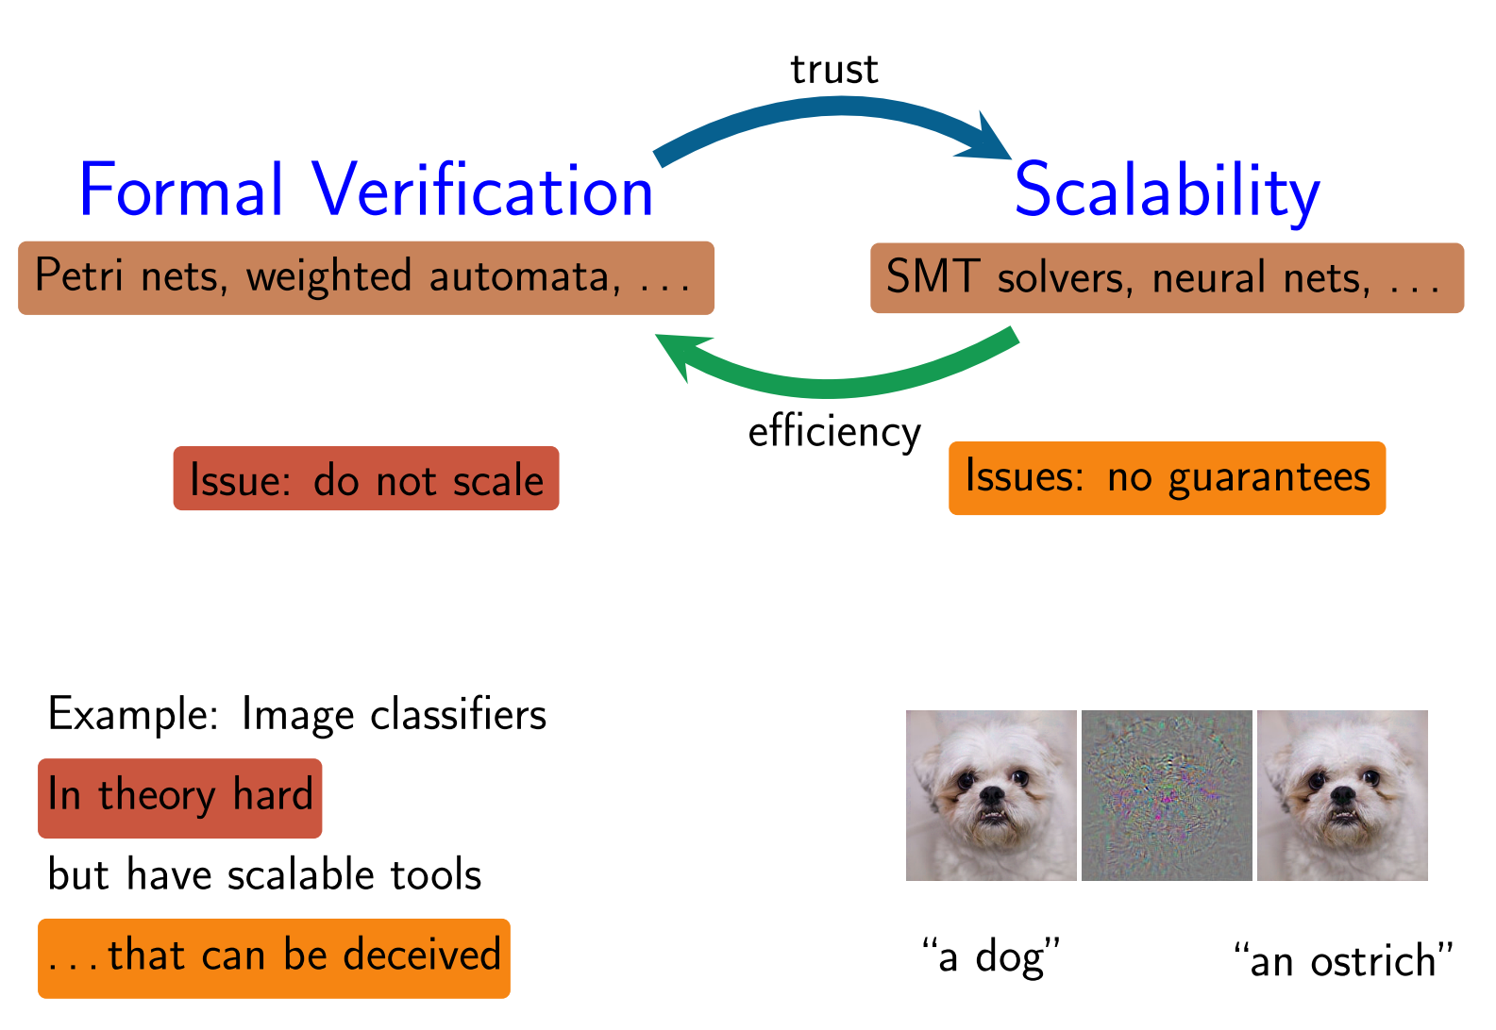
Problem we consider:
(lack of) Robustness
Can we verify that a DNN is robust?

Slide 3
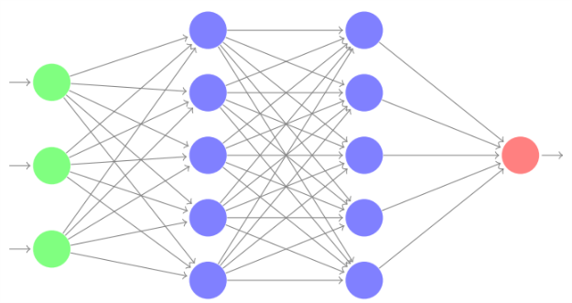
Standard Problem: Local Robustness
DNN
perturbation
Input image I
ε = 0.01
Question : does there exist another input image I’ with d(I-I’) < ε and I’ and I have different classification.
For efficiency, d(.) is usually L∞ : all the pixel can change a bit, changes are independent.
Local because we look around one input image.

Slide 4
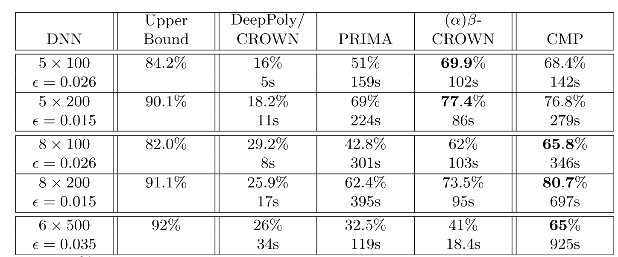
Standard Problem: Local Robustness
What to do with such results?
Offline certification/attack on 1000 images is not sufficient:
Every network have 8%-18% of images where we find attack
Between 65% to 80% of images can be certified only
No Networks is robust on all images.
Even if robust, we only tested 1000 images, cannot generalize.
Online certification: not fast enough for neither certif nor attack, delay >> seconds (video stream…).
Need a Global notion
(for all images)

Slide 5
Standard Problem: Global Robustness ?
DNN
perturbation
Input image I
ε = 0.01
Global robustness makes no sense: robust for all Images = constant function.
In practice, it s ok not to be robust: there are images at the boundary between 2 classes, a bit of difference will make it fall in one or another class, perfectly normal.

Slide 6
Proposal of Global notion: “Lipschitz”-continuous instead
DNN
perturbation
Constant
ε = 0.01
k = 1
Does there exist I,I’ with d(I,I’) < ε, output neuron n and |value_{n}(I) -value_{n}(I’)| > k ?
Harder (I can be anywhere) but do not need to consider many input images.
Makes more sense: images around boundaries are allowed to switch classification

Slide 7
Proposal of Global notion: “Lipschitz”-continuous instead
perturbation
Constant
ε = 0.01
k = 1
Assume we proved offline the global notion:
For all I,I’ with d(I,I’) < ε, for all output neuron n we have |value_{n}(I) -value_{n}(I’)| < 1 ?
Online: for image I, we can check in real time if Δ = max_{n’}(Δ_{n,n’}=|value_{n}(I) –value_{n’}(I)|) > 2
for class n of image I
Then we know the network is robust and we can trust the image.
Else we skip the image. (or can have a set of images, several captors…)

Slide 8
Current results on “Lipschitz”
DNN 5x100 natural training (average Δ=2.4)
ε = 0.001
 | Average Gamma= max(|x-x’|) | Total Time
Trivial L1 Mathematical bound | 284 | 0s
LP with (x,x’) constraints | 29 (10x better) | 14min (830s)
CMP with x,x’ (17-36 nodes x2) | 16.9 (17x better) | 6h42min (24053s)
DNN 5x100 Diff-AI training, (average Δ=1)
ε = 0.001
Methods | Average Gamma=max(|x-x’|) | Time
Trivial L1 Mathematical bound | 2.88 | 0s
LP with (x,x’) constraints | 0.456 (6x better) | 11 min (695s)
CMP with x,x’ (17-36 nodes x2) | 0.28 (10x better) | 5h21min (19270s)

Slide 9
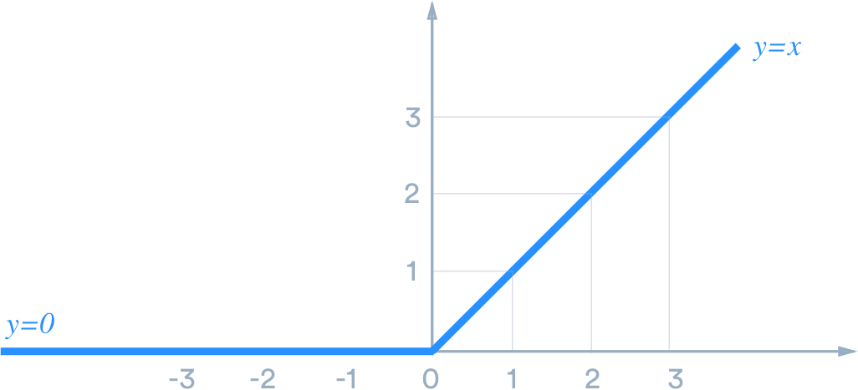
Formal Verification of Robustness of FF-DNNs
ReLU: f(x)=x if x>0, and f(x)=0 otherwise
2 activation phases (each phase is linear)
v₁
v₂
V₃
w1
w2
w3
V₄
weights
$$v4=activation_function(w1v1+w2 v2+w3v3)$$
(e.g. ReLU)
Variables v_{i}, v’_{i} to represent the input and its small deviation, with |v_{i} -v’_{i} | < ε
Double the number of variables compared with local robustness.

Slide 10






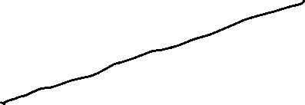
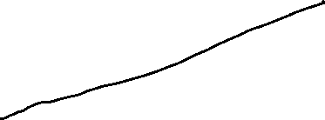
LP/MILP constraints with variables x_{i} & x’_{i}
Use standard variables x_{i} and x’_{i}
Standard MILP encoding of ReLU(x), ReLU(x’)
ReLU(x)
x
and similarly for x’_{i}
ReLU(x’)
2 binary variable a for each neuron i.
LP relaxation for x,x’ is very inacurate for x-x’ (worse than mathematical bound)
Add constraint: min(x_{i} – x’ _{i}) < x_{i}-x’_{i} < max(x_{i} – x’ _{i}) (recover the mathematical bound)
Add x_{i}-x’_{i} < ½ x_{i}-x’_{i} + ½ max(x_{i} – x’ _{i}) (similar to DeepPoly => 10x better than mathematical bound)
X’
^
^
^
^

Slide 11
5layers*100 nodes, ReLU,
ε = 0.001
Average gamma of layer 3 (first ReLU layer) when choosing X MILP layer1-nodes focusing on compensation vs random choice
Number X of nodes chosen | CMP with x, x’, 2 ReLU per neuron |  | Random (k=1)
0 | 0.312 |  | 0.312
15 (x2) | 0.249 |  | 0.288
18 (x2) | 0.236 |  | 0.280
21 (x2) | 0.229 |  | 0.273
24 (x2) | 0.244 |  | 0.264

Slide 12
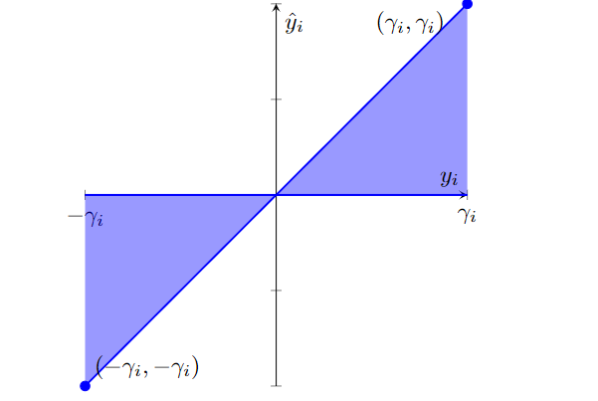




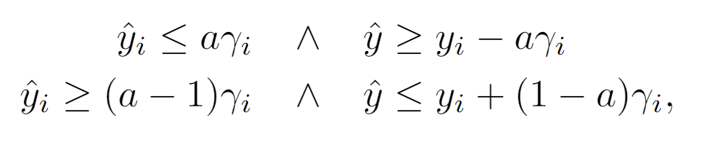




LP/MILP constraints with y_{i}
=
=
use only y_{i} variables.
1 binary variable a for each

Slide 13
5layers*100 nodes, ReLU,
ε = 0.001
Average gamma of layer 3 (first ReLU layer) when choosing X MILP layer1-nodes focusing on compensation vs random choice
Number X of nodes chosen | CMP with x, x’, 2 binary per neuron | CMP with y=x-x’ 1 binary per neuron | Random (k=1)
0 | 0.312 | 0.312 | 0.312
15 (x2) – 15 (x1) | 0.249 | 0.249 | 0.288
18 (x2) | 0.236 |  | 0.280
21 (x2) | 0.229 |  | 0.273
24 (x2) – 24 (x1) | 0.244 | 0.219 | 0.264
26 |  | 0.2084 Sol = 0.205
27 |  | Bound= 0.205 Sol= 0.1999
29 |  | 0.2099 SOL=0.195
32 |  | 0.212 (SOLUTION 0.188)
11.7% BETTER

Slide 14
5layers*100 nodes, ReLU,
Average uncertainty of layer 5 (first ReLU layer) when choosing MILP layer1+3-nodes focusing on compensation vs random choice
Bounds of layer 3 computed using CMP on layer 3.
Number X of nodes chosen | CMP (k=2) With x,x’ | CMP (k=2) With y | Random (k=2) With x,x’
0-1 | 1.148 | 1.066 | 1.148
17 (x2) | 0.966 |  | 1.11
20 (x2) | 0.948 |  | 1.09
23 (x2) | 0.969 |  | 1.085
26 (x2) | 0.983 |  | 1.069
31 |  | 0.796 Sol=0.782
33 |  | 0.7768 Sol= 0.755
37 |  | 0.802 Sol=0.736
22% BETTER cumulative

Slide 15
5layers*100 nodes, ReLU,
Average uncertainty of layer 7 (first ReLU layer) when choosing MILP layer3+5-nodes focusing on compensation vs random choice
Bounds of layer 5 computed using CMP on layer 5.
Number X of nodes chosen | CMP (k=2) With x,x’ | CMP (k=2) With y | Random (k=2) With x,x’
0-1 | ? | ? | ?
(x2)
(x2)
36 (x2) – 36(x1) | 3.82 | 3.35
(x2)
54 |  | 3.195 Sol= 3.164
57 |  | 3.168 Sol=3.1366
72 |  | 3.068 Sol= 2.99
24.4% BETTER cumulative

Slide 16
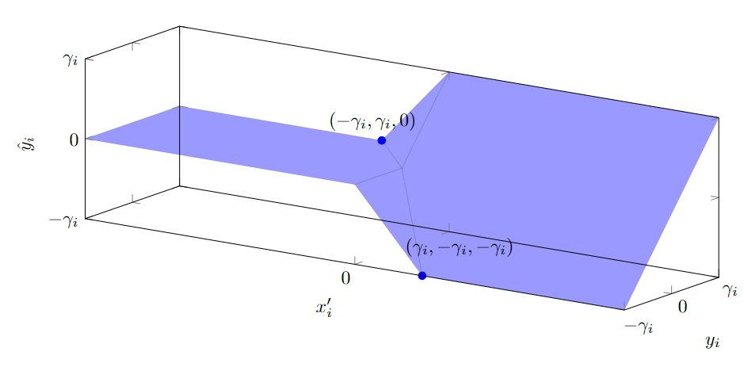
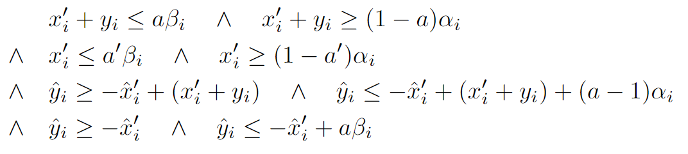







LP/MILP constraints with x’_{i} & y_{i}
use y_{i} variables + x’_{i}
=
=
a,a’ binary variables to encode the 4 blue hyperplans
a=1 iff x_{i} >0 and a’=1 iff x’_{i}>0.
Plus 2 usual constraints for a / x’_{i}

Slide 17
DNN 5x100 natural training
ε = 0.001
 | Average Gamma=x-x’ | Total Time
Trivial L1 Mathematical bound | 284 | 0s
LP with (x,x’) constraints | 29 (10x better) | 14min (830s)
CMP (17-36 nodes x2) | 16.9 (17x better) | 6h42min (24053s)
DNN 5x100 Diff-AI training
ε = 0.001 (x2.4)
Methods | Average Gamma=x-x’ | Time
Trivial L1 Mathematical bound | 2.88 | 0s
LP with (x,x’) constraints | 0.456 (6x better) | 11 min (695s)
CMP (17-36 nodes x2) | 0.28 (10x better) | 5h21min (19270s)

