Slide 1
Verification of DNNs
Kuldeep S. Meel
NUS, Singapore => University of Toronto
Blaise Genest
CNRS, DesCartes & IPAL, France
Intern: Marius Belly, summer 2022
RA: Shaan Aryaman, Jan-Aug 2023
RF: Liao Yuke, Sept 2023+

Slide 2
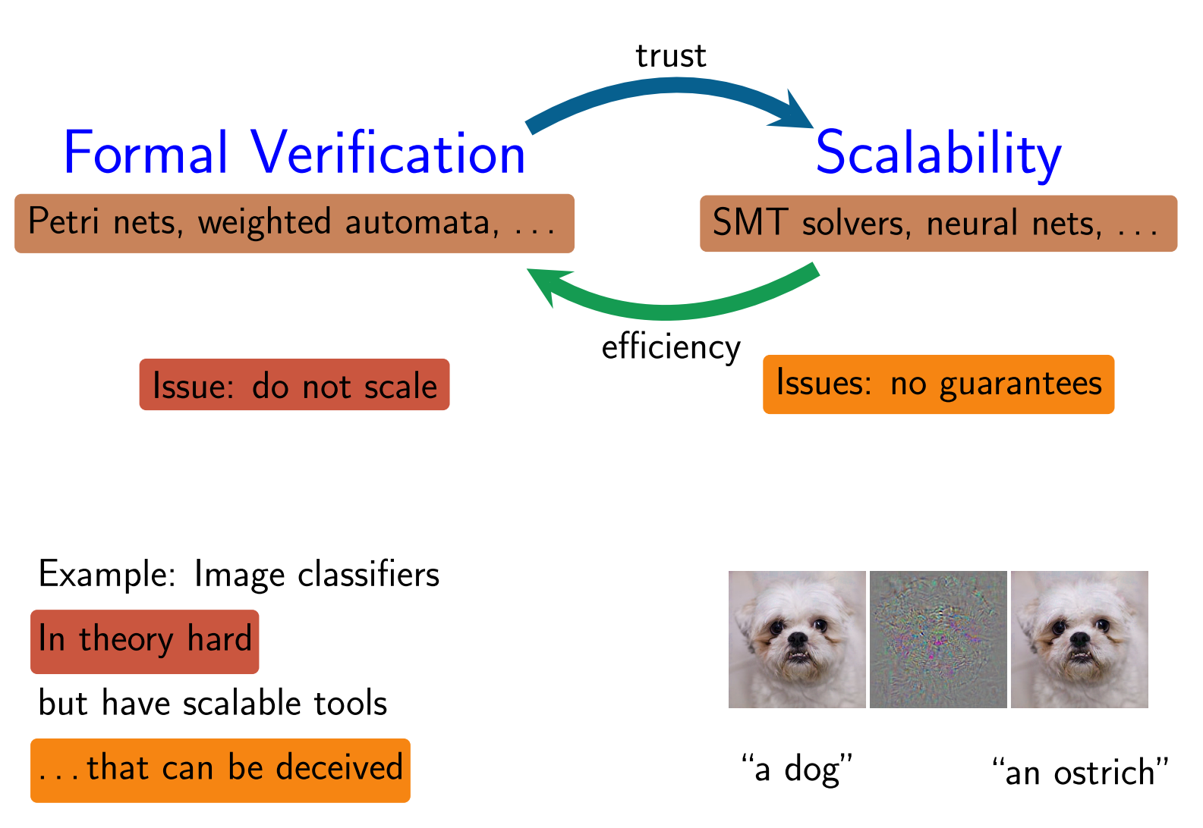
Problem we consider:
(lack of) Robustness
Can we verify that a DNN is robust?

Slide 3
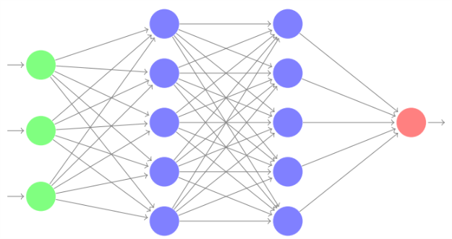
Standard Problem: Local Robustness
DNN
perturbation
Input image I
ε = 0.01
Question : does there exist another input image I’ with d(I-I’) < ε and I’ and I have different classification.
For efficiency, d(.) is usually L∞ : all the pixel can change a bit, changes are independent.
Local because we look around one input image.

Slide 4
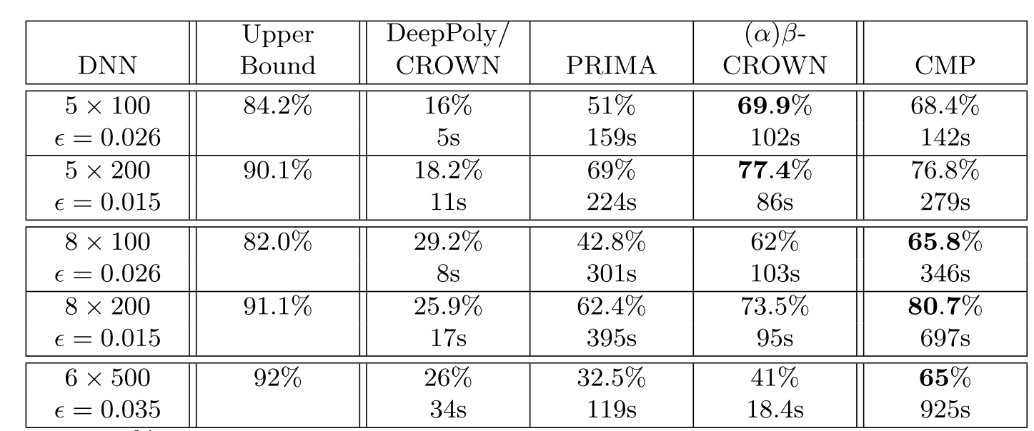
Standard Problem: Local Robustness
What to do with such results?
Offline certification/attack on 1000 images is not sufficient:
Every network have 8%-18% of images where we find attack
Between 65% to 80% of images can be certified only
No Networks is robust on all images.
Even if robust, we only tested 1000 images, cannot generalize.
Online certification: not fast enough for neither certif nor attack, delay >> seconds (video stream…).
Need a Global notion
(for all images)

Slide 5
Standard Problem: Global Robustness ?
DNN
perturbation
Input image I
ε = 0.01
Global robustness makes no sense: robust for all Images = constant function.
In practice, it s ok not to be robust: there are images at the boundary between 2 classes, a bit of difference will make it fall in one or another class, perfectly normal.

Slide 6
Proposal of Global notion: “Lipschitz”-continuous instead
DNN
perturbation
Constant
ε = 0.01
k = 1
Does there exist I,I’ with d(I,I’) < ε, output neuron n and |value_{n}(I) -value_{n}(I’)| > k ?
Harder (I can be anywhere) but do not need to consider many input images.
Makes more sense: images around boundaries are allowed to switch classification

Slide 7
Proposal of Global notion: “Lipschitz”-continuous instead
perturbation
Constant
ε = 0.01
k = 1
Assume we proved offline the global notion:
For all I,I’ with d(I,I’) < ε, for all output neuron n we have |value_{n}(I) -value_{n}(I’)| < 1 ?
Online: for image I, we can check in real time if for all n’, |value_{n}(I) –value_{n’}(I)|>2
for class n of image I
Then we know the network is robust and we can trust the image.
Else we skip the image. (or can have a set of images, several captors…)

Slide 8
Current results on “Lipschitz”
DNN 5x100 natural training
ε = 0.001
 | Average Gamma=x-x’ | Total Time
Trivial L1 Mathematical bound | 284 | 0s
LP with (x,x’) constraints | 29 (10x better) | 14min (830s)
CMP (17-30 nodes x2) | 16.9 (17x better) | 6h42min (24053s)
DNN 5x100 Diff-AI training
ε = 0.001 (x2.4)
Methods | Average Gamma=x-x’ | Time
Trivial L1 Mathematical bound | 2.88 | 0s
LP with (x,x’) constraints | 0.456 (6x better) | 11 min (695s)
CMP (17-30 nodes x2) | 0.28 (10x better) | 5h21min (19270s)

Slide 9
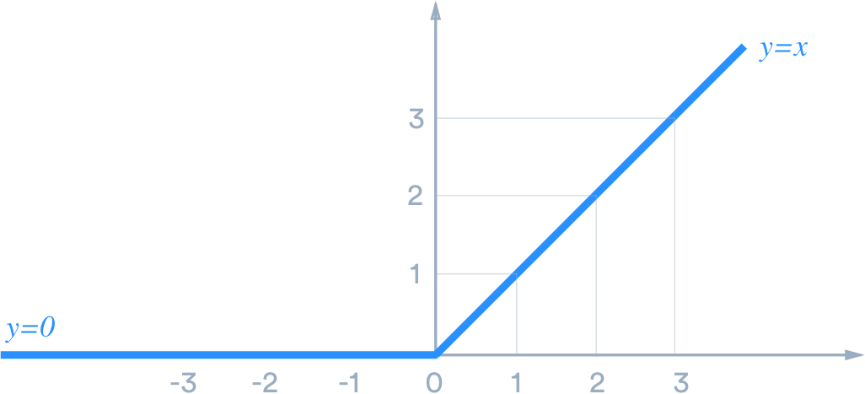
Formal Verification of Robustness of FF-DNNs
ReLU: f(x)=x if x>0, and f(x)=0 otherwise
2 activation phases (each phase is linear)
v₁
v₂
V₃
w1
w2
w3
V₄
weights
$$v4=activation_function(w1v1+w2 v2+w3v3)$$
(e.g. ReLU)
A priori, need to consider all activation phases of all neurons: 2^{N} cases to consider. Too many cases

Slide 10
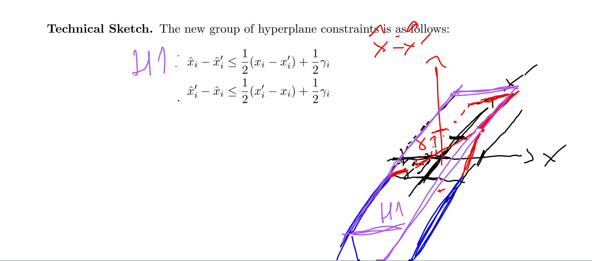
LP constraints
Constraints 1: - γ_{i} < x_{i} – x_{i}’ < γ_{i} = |x_{i} – x’_{i}|

Slide 11
5layers*100 nodes, ReLU,
ε = 0.001
Average gamma of layer 3 (first ReLU layer) when choosing X MILP layer1-nodes focusing on compensation vs random choice
Number X of nodes chosen | CMP (k=1) | CMP with y=x-x’ constraints | Random (k=1)
0 | 0.312 |  | 0.312
15 (x2) | 0.249 |  | 0.288
18 (x2) | 0.236 |  | 0.280
21 (x2) | 0.229 |  | 0.273
24 (x2) | 0.244 |  | 0.264
27 (x2) |  |  | 0.261
35 |  | 0.212 (SOLUTION ~0.16?)

Slide 12
5layers*100 nodes, ReLU,
Average uncertainty of layer 5 (first ReLU layer) when choosing MILP layer1+3-nodes focusing on compensation vs random choice
Bounds of layer 3 computed using CMP on layer 3.
Number X of nodes chosen | CMP (k=2) | Random (k=2)
0-1 | 1.479 | 1.479
17 (x2) | 0.966 | 1.11
20 (x2) | 0.948 | 1.09
23 (x2) | 0.969 | 1.085
26 (x2) | 0.983 | 1.069
29 (x2) | 0.988 | 1.056

Slide 13
DNN 5x100 natural training
ε = 0.001
 | Average Gamma=x-x’ | Total Time
Trivial L1 Mathematical bound | 284 | 0s
LP with (x,x’) constraints | 29 (10x better) | 14min (830s)
CMP (17-30 nodes x2) | 16.9 (17x better) | 6h42min (24053s)
DNN 5x100 Diff-AI training
ε = 0.001 (x2.4)
Methods | Average Gamma=x-x’ | Time
Trivial L1 Mathematical bound | 2.88 | 0s
LP with (x,x’) constraints | 0.456 (6x better) | 11 min (695s)
CMP (17-30 nodes x2) | 0.28 (10x better) | 5h21min (19270s)

Slide 14
DEPTH

