Slide 1
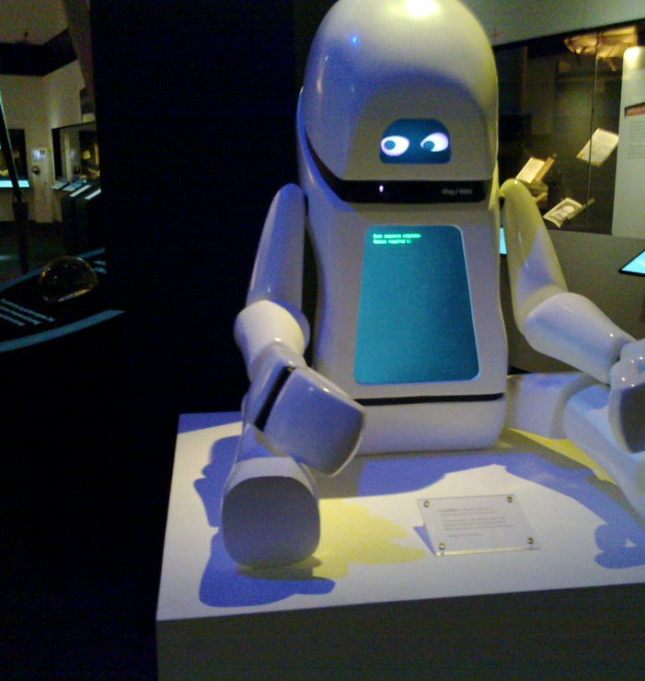

CS 5/7320 Artificial Intelligence Intelligent Agents AIMA Chapter 2
Slides by Michael Hahsler based on slides by Svetlana Lazepnik with figures from the AIMA textbook.
This work is licensed under a Creative Commons Attribution-ShareAlike 4.0 International License.
Image: "Robot at the British Library Science Fiction Exhibition" by BadgerGravling
Online Material

Slide 2
Outline
Rationality
PEAS (Performance measure, Environment, Actuators, Sensors)
Environment types
Agent types
What is an intelligent agent?

Slide 3
Outline: What is an Intelligent Agent
Rationality
PEAS (Performance measure, Environment, Actuators, Sensors)
Environment types
Agent types
What is an intelligent agent?

Slide 4
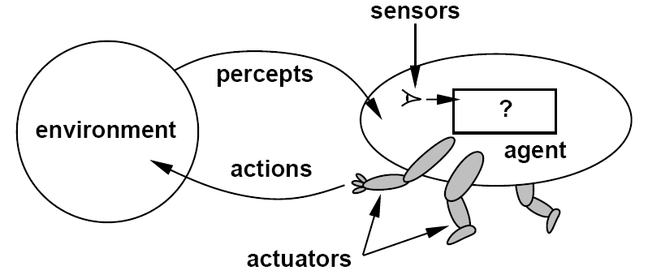
What is an Agents?
An agent is anything that can be viewed as perceiving its environment through sensors and acting upon that environment through actuators.
Control theory: A closed-loop control system (= feedback control system) is a set of mechanical or electronic devices that automatically regulate a process variable to a desired state or set point without human interaction. The agent is called a controller.
Softbot: Agent is a software program that runs on a host device.

Slide 5




Agent Function and Agent Program
The agent function maps from the set of all possible percept sequences $P^{∗}$to the set of actions $A$formulated as an abstract mathematical function.
$f : P^{∗} →A$
The agent program is a concrete implementation of this function for a given physical system.
Agent = architecture (hardware) + agent program (implementation of $f$)
$$p$$
$$a = f(p)$$
$$a$$
Sensors
Memory
Computational power

Slide 6
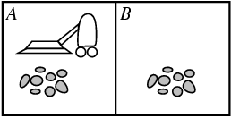
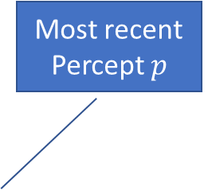
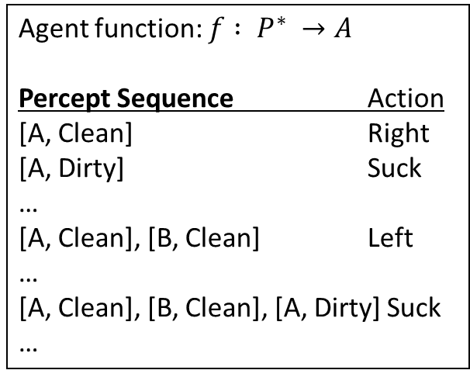
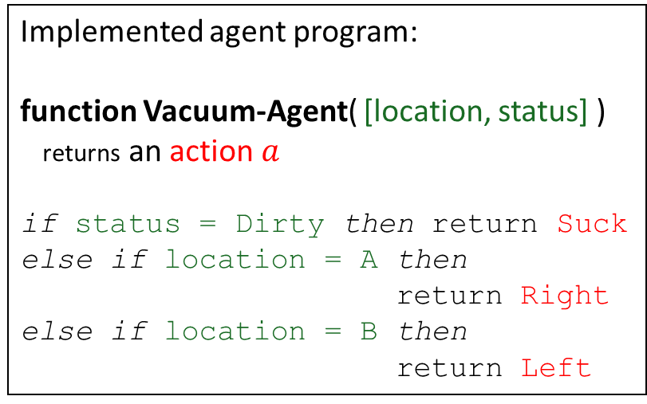
Example: Vacuum-cleaner World
Percepts: Location and status, e.g., [A, Dirty]
Actions: Left, Right, Suck, NoOp
Most recent Percept $p$
Agent function: $f : P^{∗} →A$
Percept Sequence Action
[A, Clean] Right
[A, Dirty] Suck
…
[A, Clean], [B, Clean] Left
…
[A, Clean], [B, Clean], [A, Dirty] Suck
…
Implemented agent program:
function Vacuum-Agent( [location, status] ) returns an action $a$
if status = Dirty then return Suck
else if location = A then return Right
else if location = B then
return Left
Problem: This table can become infinitively large!

Slide 7
Outline: Rationality
Rationality
PEAS (Performance measure, Environment, Actuators, Sensors)
Environment types
Agent types
What is an intelligent agent?

Slide 8
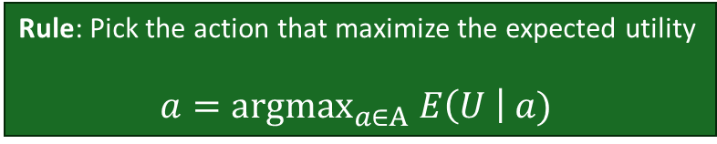
Rational Agents: What is Good Behavior?
Foundation
Consequentialism: Evaluate behavior by its consequences.
Utilitarianism: Maximize happiness and well-being.
Definition of a rational agent:
“For each possible percept sequence, a rational agent should select an action that maximizes its expected performance measure, given the evidence provided by the percept sequence and the agent’s built-in knowledge.”
Performance measure: An objective criterion for success of an agent's behavior (often called utility function or reward function).
Expectation: Outcome averaged over all possible situations that may arise.
Rule: Pick the action that maximize the expected utility
$$a={\text{argmax}}_{a∈A} E\left(U \right| a)$$
Notes:
ExpectedUtility(action) = sum_outcomes Utility(outcome) * P(outcome)

Slide 9
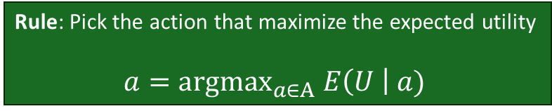
Rational Agents
Rule: Pick the action that maximize the expected utility
$$a={\text{argmax}}_{a∈A} E\left(U \right| a)$$
This means:
Rationality is an ideal – it implies that no one can build a better agent
Rationality ≠ Omniscience – rational agents can make mistakes if percepts and knowledge do not suffice to make a good decision
Rationality ≠ Perfection – rational agents maximize expected outcomes not actual outcomes
It is rational to explore and learn – I.e., use percepts to supplement prior knowledge and become autonomous
Rationality is often bounded by available memory, computational power, available sensors, etc.
Notes:
ExpectedUtility(action) = sum_outcomes Utility(outcome) * P(outcome)

Slide 10
Example: Performance Measure for the Vacuum-cleaner World
Percepts: Location and status, e.g., [A, Dirty]
Actions: Left, Right, Suck, NoOp
Agent function:
Percept Sequence Action
[A, Clean] Right
[A, Dirty] Suck
…
[A, Clean], [B, Clean] Left
…
Implemented agent program:
function Vacuum-Agent( [location, status] ) returns an action
if status = Dirty then return Suck
else if location = A then return Right
else if location = B then return Left
What could be a performance measure?
Is this agent program rational?

Slide 11
Outline: PEAS
Rationality
PEAS (Performance measure, Environment, Actuators, Sensors)
Environment types
Agent types
What is an intelligent agent?

Slide 12
Problem Specification: PEAS
Performance measure
Performance measure
Environment
Actuators
Sensors
Defines utility and what is rational
Components and rules of how actions affect the environment.
Defines available actions
Defines percepts

Slide 13
Example: Automated Taxi Driver
Performance measure
Safe
Environment
Roads
Actuators
Steering wheel
Sensors
Cameras
other traffic
pedestrians
customers
accelerator
brake
signal
horn
sonar
speedometer
GPS
Odometer
engine sensors
keyboard
fast
comfortable trip
legal
maximize profits

Slide 14
Example: Spam Filter
Performance measure
Accuracy: Minimizing false positives, false negatives
Environment
A user’s email account
Actuators
Mark as spam
Sensors
Incoming messages
email server
delete
etc.
other information about user’s account

Slide 15
Outline: Environment Types
Rationality
PEAS (Performance measure, Environment, Actuators, Sensors)
Environment types
Agent types
What is an intelligent agent?

Slide 16
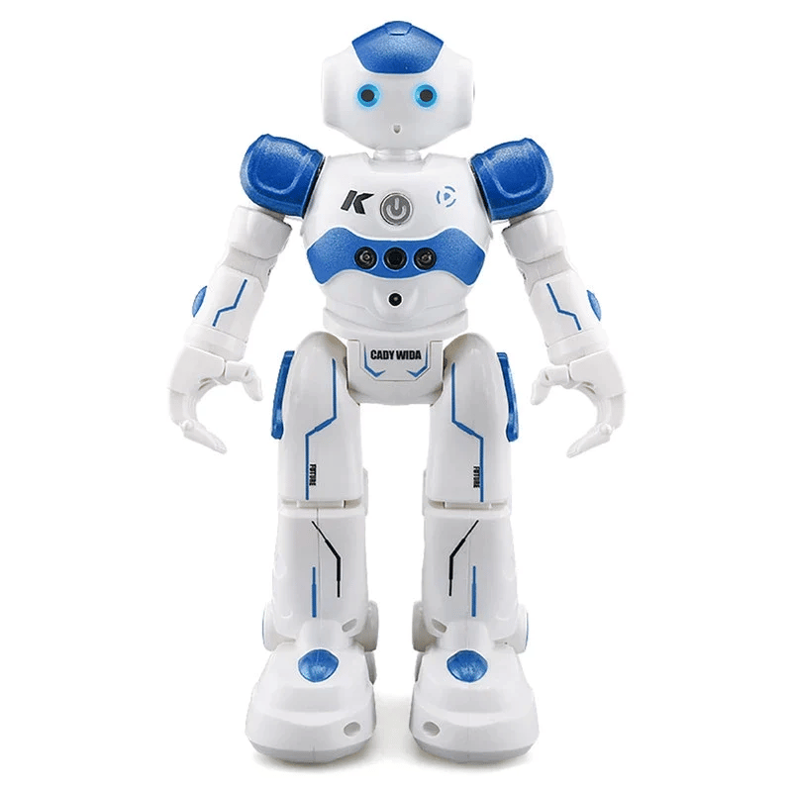
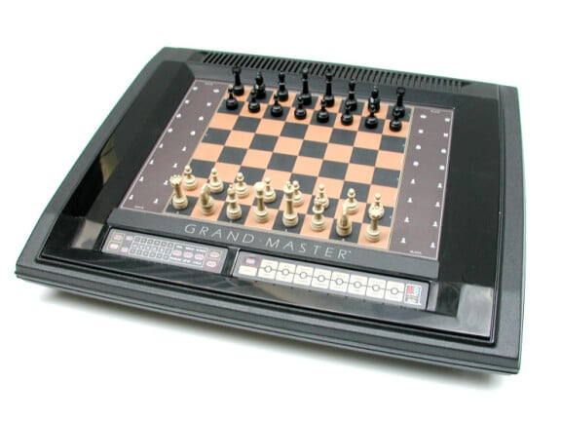
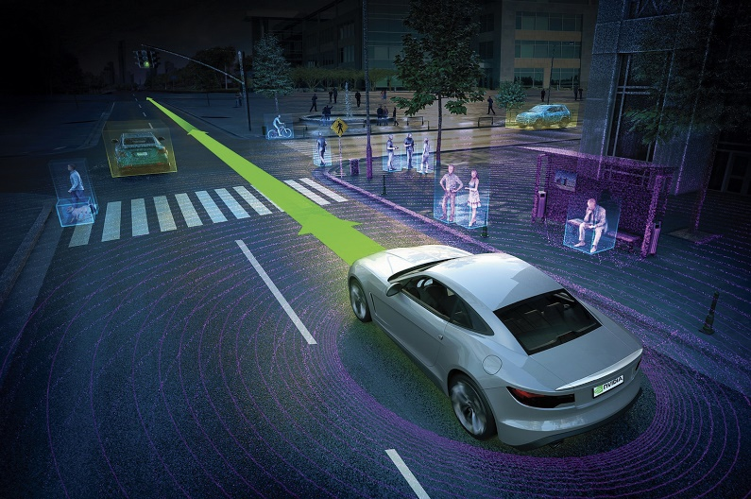
The Environment
Examples:
We typically consider everything outside the agent function (the agent’s brain) as the agent’s environment.
This means that the sensors and actuators are part of the environment.
The agent function receives already preprocessed percepts and acts by issuing high-level instructions to the actuators.

Slide 17
Environment Types
Fully observable: The agent's sensors give it access to the complete state of the environment. The agent can “see” the whole environment.
Partially observable: The agent cannot see all aspects of the environment. E.g., it can’t see through walls
vs.
Stochastic: Changes cannot be determined from the current state and the action (there is some randomness). Strategic: The environment is stochastic and adversarial. It chooses actions strategically to harm the agent. E.g., a game where the other player is modeled as part of the environment.
Deterministic: Changes in the environment is completely determined by the current state of the environment and the agent’s action.
vs.
Known: The agent knows the rules of the environment and can predict the outcome of actions.
vs.
Unknown: The agent cannot predict the outcome of actions.

Slide 18
Environment Types (cont.)
Static: The environment is not changing while agent is deliberating. Semidynamic: the environment is static, but the agent's performance score depends on how fast it acts.
Dynamic: The environment is changing while the agent is deliberating.
vs.
Discrete: The environment provides a fixed number of distinct percepts, actions, and environment states. Time can also evolve in a discrete or continuous fashion.
Continuous: Percepts, actions, state variables or time are continuous leading to an infinite state, percept or action space.
vs.
Episodic: Episode = a self-contained sequence of actions. The agent's choice of action in one episode does not affect the next episodes. The agent does the same task repeatedly.
Sequential: Actions now affect the outcomes later. E.g., learning makes problems sequential.
vs.
Single agent: An agent operating by itself in an environment.
vs.
Multi-agent: Agent cooperate or compete in the same environment.

Slide 19
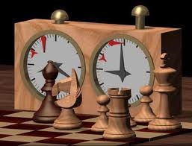
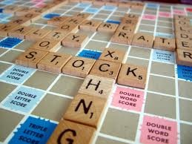
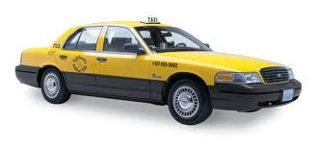
Examples of Different Environments
Vacuum cleaner world
Chess with a clock
Scrabble
Taxi driving
Observable
Deterministic
Episodic?
Static
Discrete
Single agent
Partially
Fully
Partially
Partially
Determ. game Mechanics
+ Strategic*
Stochastic +Strategic
Deterministic
Stochastic
Episodic
Episodic
Episodic
Sequential
Static
Semidynamic
Static
Dynamic
Discrete
Discrete
Discrete
Continuous
Single
Multi*
Multi*
Multi*
* Can be models as a single agent problem with the other agent(s) in the environment.

Slide 20
Outline: Agent Types
Rationality
PEAS (Performance measure, Environment, Actuators, Sensors)
Environment types
Agent types
What is an intelligent agent?

Slide 21
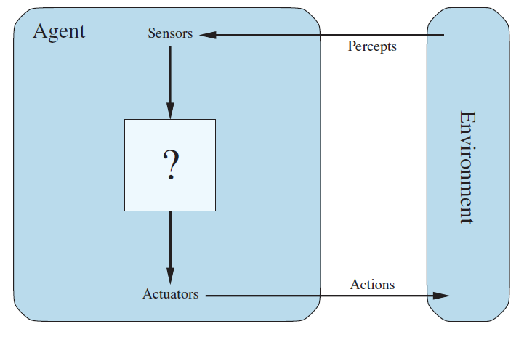


Designing a Rational Agent
Remember the definition of a rational agent:
“For each possible percept sequence, a rational agent should select an action that maximizes its expected performance measure, given the evidence provided by the percept sequence and the agent’s built-in knowledge.”
$$f$$
action
Hardware + an event loop
Read the sensors
Ask agent function for action
Execute action
Percept to the agent function
Important: Everything outside the agent function represents the environment.
This includes the physical robot, its sensors and its actuators, and event loop!
Agent Function
Represents the “brain”
Assess performance measure
Remember percept sequence
Built-in knowledge
$$a=f(p)$$
Action from the agent function to execute

Slide 22
Hierarchy of Agent Types
Utility-based agents
Simple reflex agents
Goal-based agents
Model-based reflex agents

Slide 23
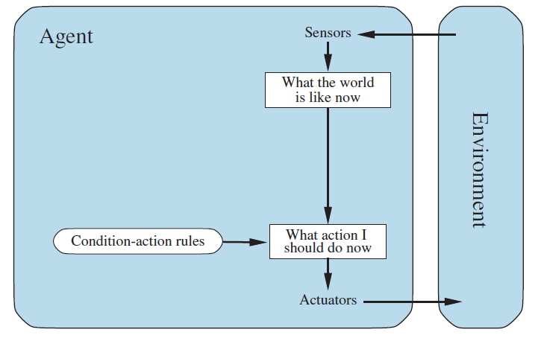
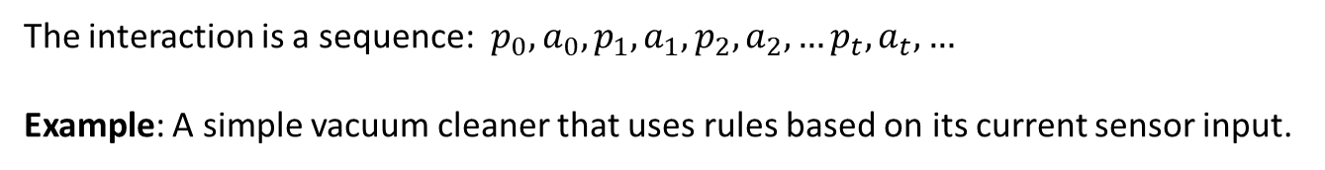

Simple Reflex Agent
Uses only built-in knowledge in the form of rules that select action only based on the current percept. This is typically very fast!
The agent does not know about the performance measure! But well-designed rules can lead to good performance.
The agent needs no memory and ignores all past percepts.
$$a=f(p)$$
The interaction is a sequence: $p_{0},a_{0},p_{1},a_{1},p_{2},a_{2},…p_{t},a_{t},…$
Example: A simple vacuum cleaner that uses rules based on its current sensor input.

Slide 24
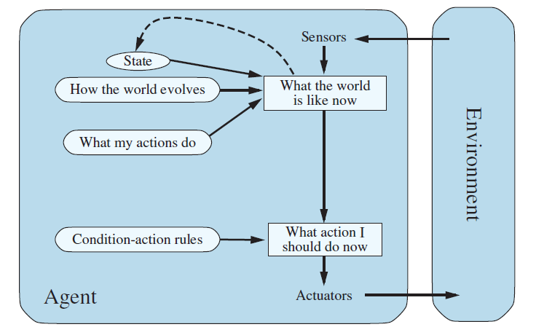



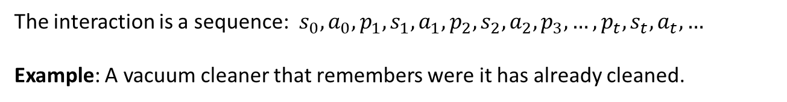
Model-based Reflex Agent
Maintains a state variable to keeps track of aspects of the environment that cannot be currently observed. I.e., it has memory and knows how the environment reacts to actions (called transition function).
The state is updated using the percept.
There is now more information for the rules to make better decisions.
$$s$$
$$s^{′}=T(s,a)$$
$$a=f(p,s)$$
The interaction is a sequence: $s_{0},a_{0},p_{1},s_{1},a_{1},p_{2},s_{2},a_{2},p_{3},…, {p_{t},s}_{t},a_{t},…$
Example: A vacuum cleaner that remembers were it has already cleaned.

Slide 25
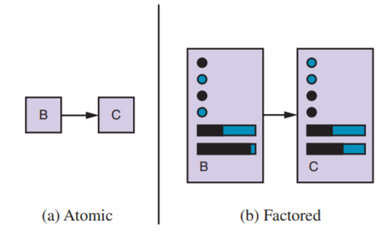
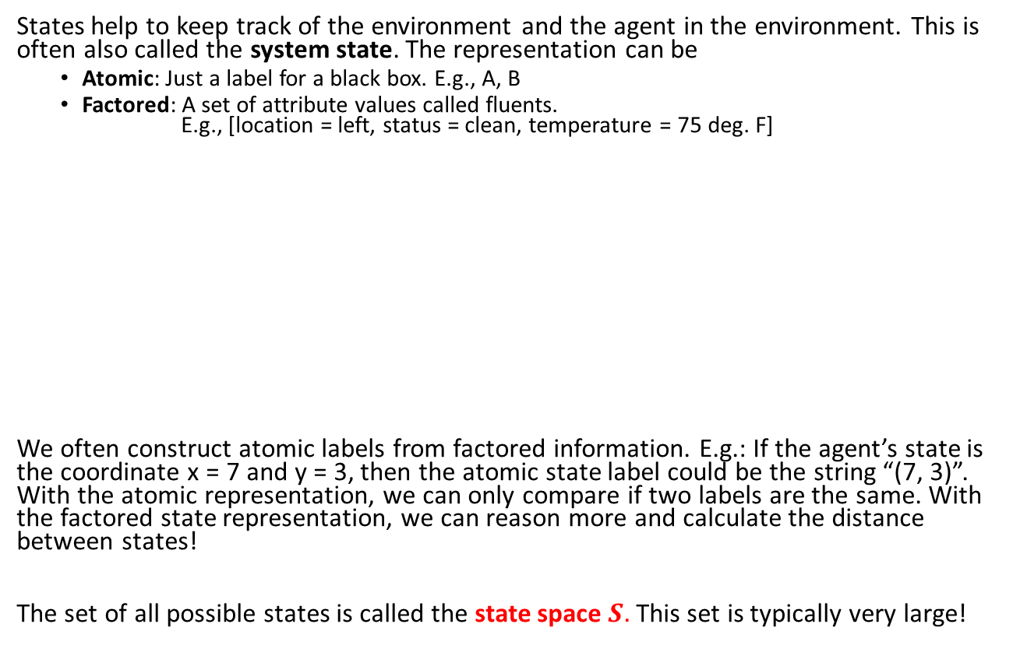
State Representation
States help to keep track of the environment and the agent in the environment. This is often also called the system state. The representation can be
Atomic: Just a label for a black box. E.g., A, B
Factored: A set of attribute values called fluents. E.g., [location = left, status = clean, temperature = 75 deg. F]
We often construct atomic labels from factored information. E.g.: If the agent’s state is the coordinate x = 7 and y = 3, then the atomic state label could be the string “(7, 3)”. With the atomic representation, we can only compare if two labels are the same. With the factored state representation, we can reason more and calculate the distance between states!
The set of all possible states is called the state space $S.$ This set is typically very large!
Action causes transition
Variables describing the system state are called “fluents”

Slide 26
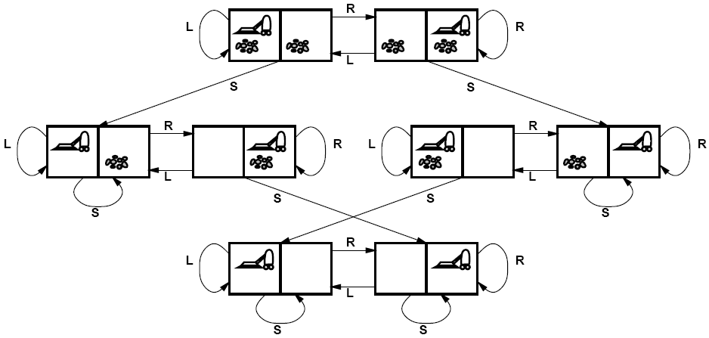

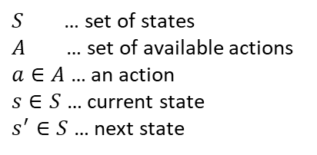

Transition Function
State
The environment is modeled as a discrete dynamical system.
Example of a state diagram for the Vacuum cleaner world.
States change because of
System dynamics of the environment (the environment evolves by itself).
The actions of the agent.
Both types of changes are represented by the transition function written as
Action
$$T:S×A→S$$
or
$$s′=T(s,a)$$
$S$ … set of states
$A$ … set of available actions
$a∈A$ … an action
$s∈S$ … current state
$s^{′}∈S$ … next state

Slide 27
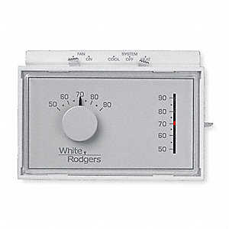
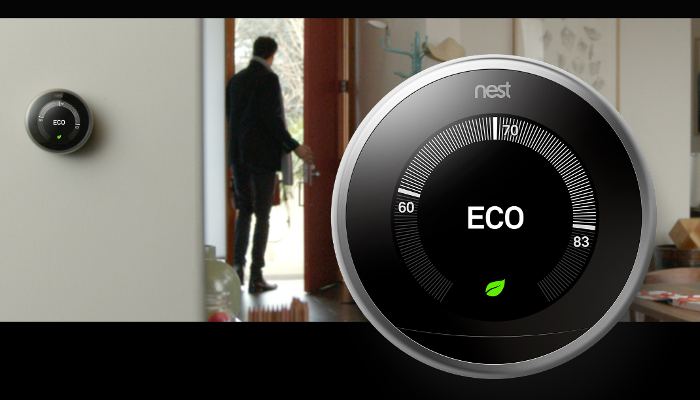
Old-school vs. Smart Thermostat
Old-school thermostat
Smart thermostat
Percepts
States
Percepts
States

Slide 28
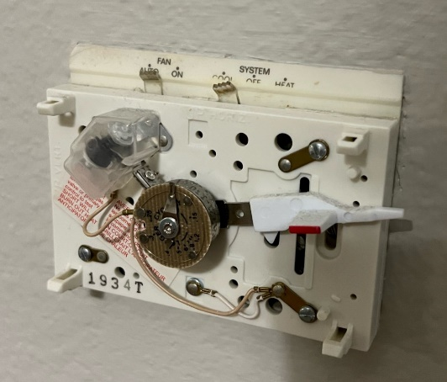
Old-school vs. Smart Thermostat: Solution
Many sensors, internet connectivity, memory.
Contacts
Setting
Change temperature when you are too cold/warm.
Set target temperature
Bi-metal spring
Old-school thermostat
Smart thermostat
Percepts
States
Percepts
States
Sensors
Temp: deg. F
Someone walking by
Someone changes temp.
Internet
Outside temp.
Weather report
Energy curtailment
Day & time
…
Factored states
Estimated time to cool the house
Someone home?
How long till someone is coming home?
Schedule
….
Setting: Cool, off, heat
Contact:
Open, closed
No states (only reacts to the current percepts)

Slide 29
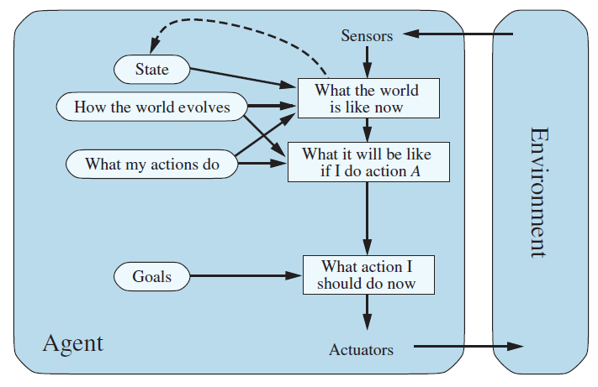
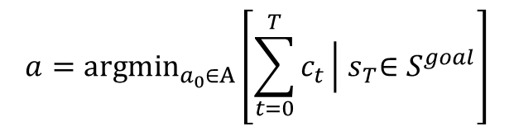
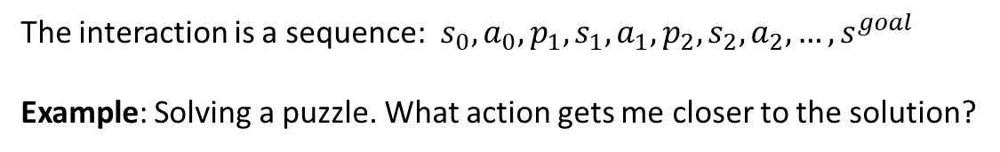
Goal-based Agent
The agent has the task to reach a defined goal state and is then finished.
The agent needs to move towards the goal. As special type is a planning agent that uses search algorithms to plan a sequence of actions that leads to the goal.
Performance measure: the cost to reach the goal.
$$a={argmin}_{a_{0}∈A}\left[\sum_{t=0}^{T}{c_{t}}\left|{ s}_{T}∈S^{goal}\right.\right]$$
plan
Sum of the cost of a planed sequence of actions that leads to a goal state
The interaction is a sequence: $s_{0},a_{0},p_{1},s_{1},a_{1},p_{2},s_{2},a_{2},…,s^{goal}$
Example: Solving a puzzle. What action gets me closer to the solution?
cost

Slide 30
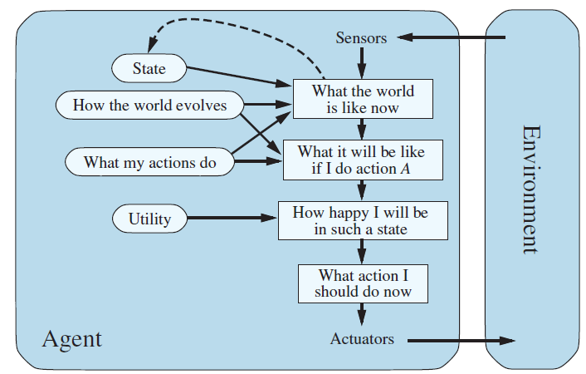
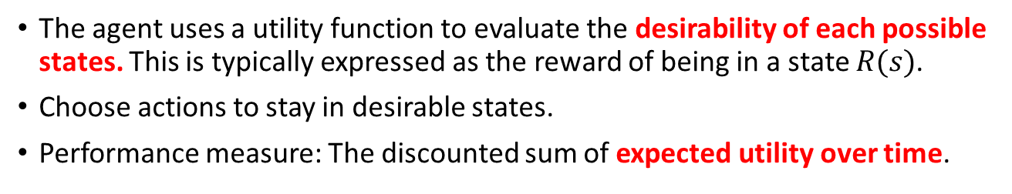
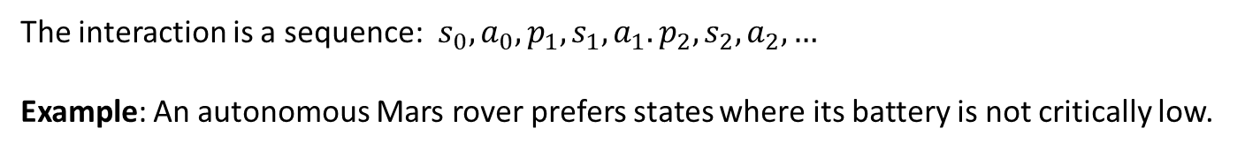
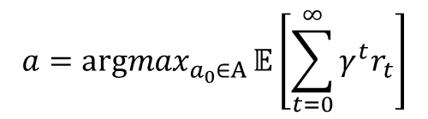
Utility-based Agent
The agent uses a utility function to evaluate the desirability of each possible states. This is typically expressed as the reward of being in a state $R(s)$.
Choose actions to stay in desirable states.
Performance measure: The discounted sum of expected utility over time.
$$a={argmax}_{a_{0}∈A}{𝔼\left[\sum_{t=0}^{∞}{γ^{t}r_{t}}\right]}$$
Utility is the expected future discounted reward
Techniques: Markov decision processes, reinforcement learning
The interaction is a sequence: $s_{0},a_{0},p_{1},s_{1},a_{1}.p_{2},s_{2},a_{2},…$
Example: An autonomous Mars rover prefers states where its battery is not critically low.
reward

Slide 31
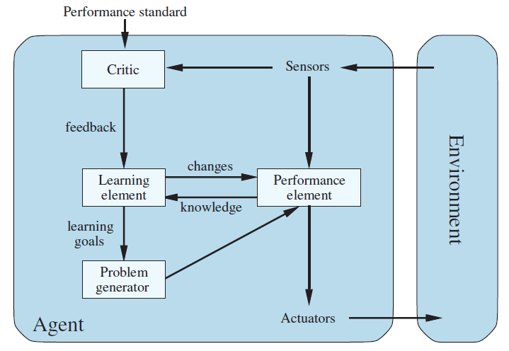
Agents that Learn
The learning element modifies the agent program (reflex-based, goal-based, or utility-based) to improve its performance.
How is the agent currently performing?
Updates how the performance element chooses actions.
Generate actions for exploration

Slide 32
Smart Thermostat: What Type of Agent is it?
Change temperature when you are too cold/warm
Simple Reflex Agent?
Smart thermostat
Model-based Reflex Agent?
Percepts
Sensors
Temp: deg. F
Someone walking by
Someone changes temp.
Internet
Outside temp.
Weather report
Energy curtailment
Day & time
…
States
Factored states
Estimated time to cool the house
Someone home?
How long till someone is coming home?
Schedule
….
Goal-based?
Utility-based?

Slide 33
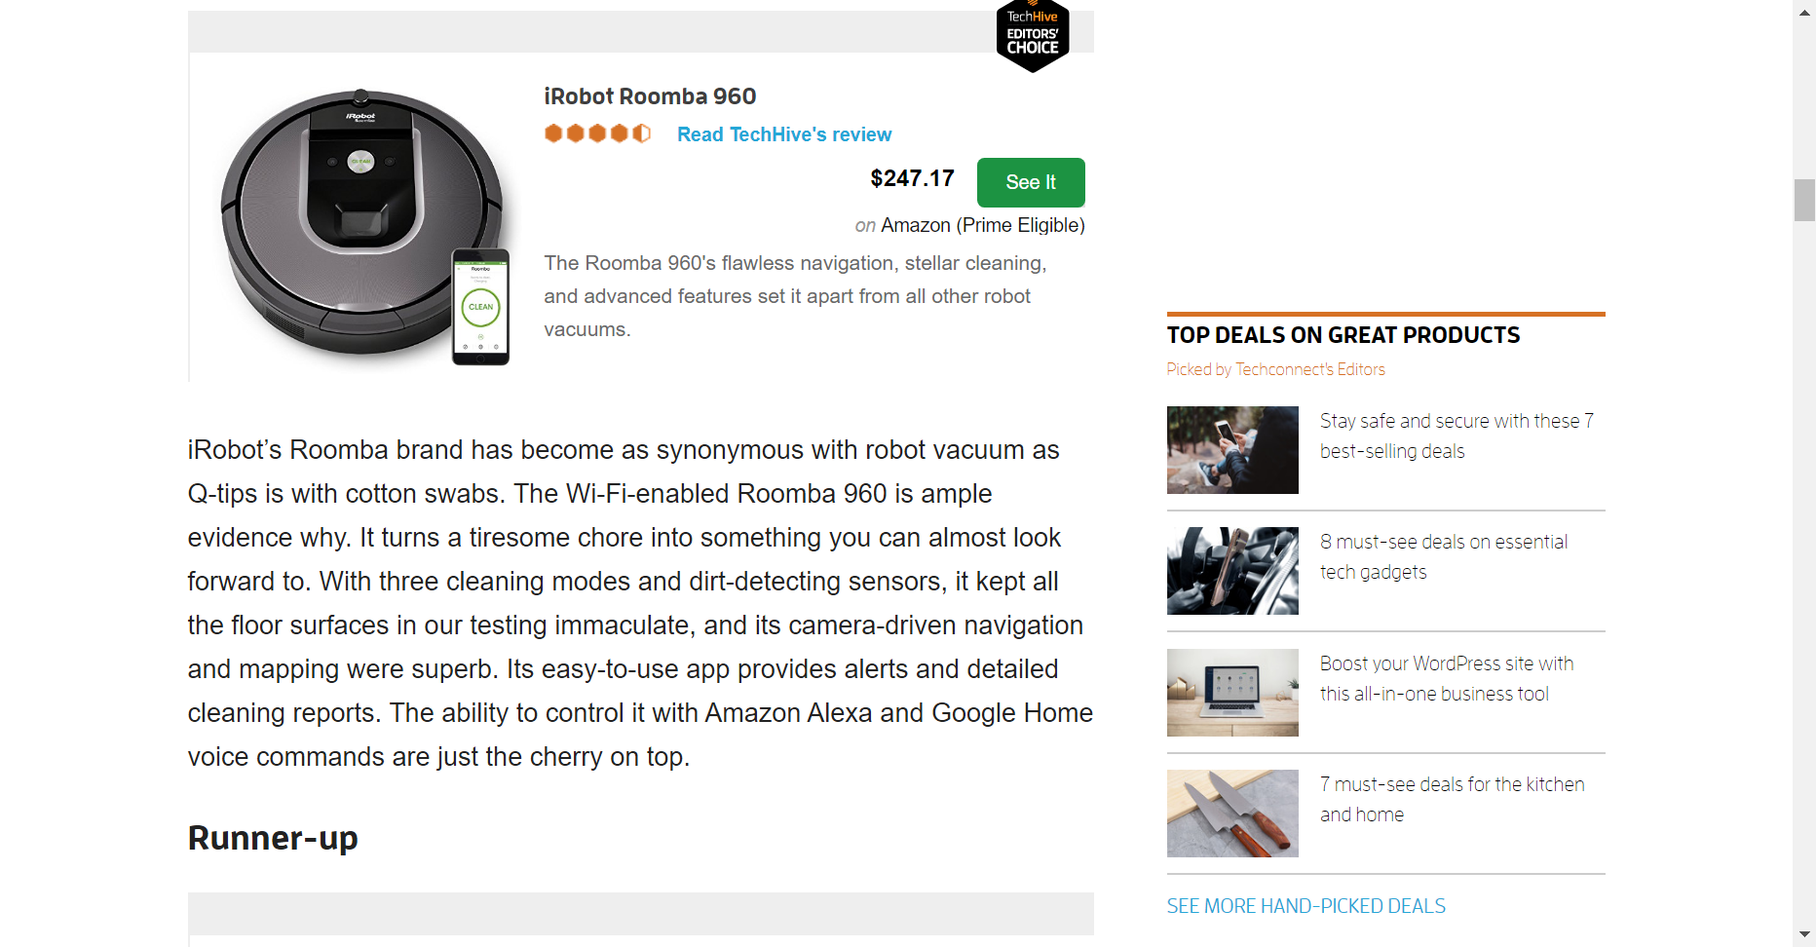
Example: Modern Vacuum Robot
Features are:
Control via App
Cleaning Modes
Navigation
Mapping
Boundary blockers
Source: https://www.techhive.com/article/3269782/best-robot-vacuum-cleaners.html

Slide 34
PEAS Description of a Modern Robot Vacuum
Performance measure
Environment
Actuators
Sensors

Slide 35
PEAS Description of a Modern Robot Vacuum: Solution
Performance measure
Environment
Actuators
Sensors
Time to clean 95%
Rooms
Obstacles
Dirt
People/pets
Wheels
Brushes
Blower
Sound
Communicate to server/app
Bumper
Cameras/dirt sensor
Motor sensor (overheating)
Laser
Cliff detection
Home base locator
Does it get stuck?
…

Slide 36

What Type of Intelligent Agent is a Modern Robot Vacuum?
Utility-based agents
Simple reflex agents
Goal-based agents
Model-based reflex agents
Does it collect utility over time? How would the utility for each state be defined?
Does it have a goal state?
Is it learning?
Does it store state information. How would they be defined (atomic/factored)?
Does it use simple rules based on the current percepts?
Check what applies

Slide 37

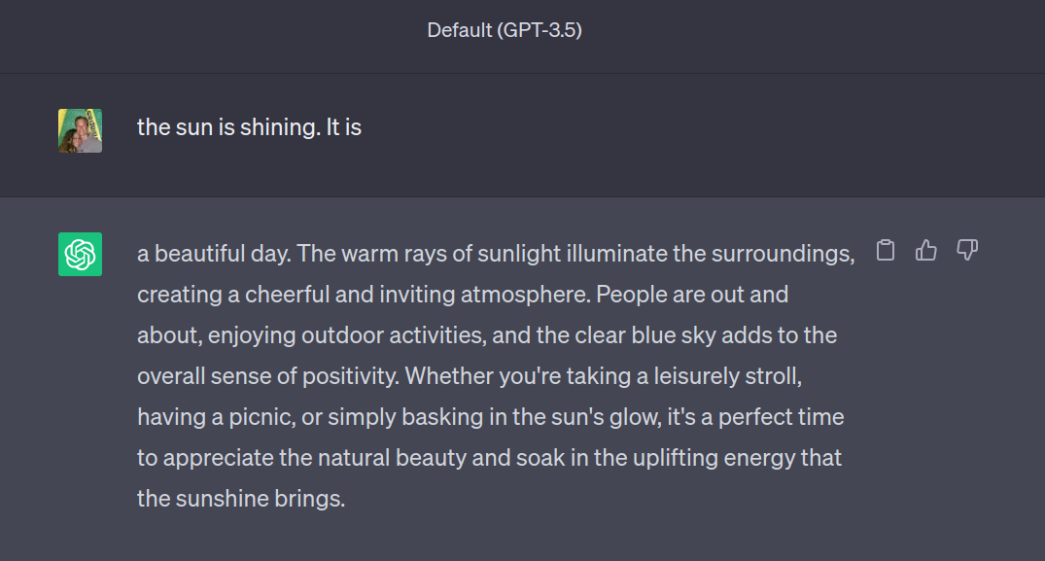
Example: Large Language Models

Slide 38
PEAS Description of ChatGPT
Performance measure
Environment
Actuators
Sensors

Slide 39
What Type of Intelligent Agent is ChatGPT?
Utility-based agents
Simple reflex agents
Goal-based agents
Model-based reflex agents
Does it collect utility over time? How would the utility for each state be defined?
Does it have a goal state?
Is it learning?
Does it store state information. How would they be defined (atomic/factored)?
Does it use simple rules based on the current percepts?
Answer the following questions:
Does ChatGPT pass the Touring test?
Is ChatGPT a rational agent? Why?
Check what applies
We will talk about knowledge-based agents later.

Slide 40

Intelligent Systems a Sets of Agents: Self-driving Car
Utility-based agents
Simple reflex agents
Goal-based agents
Model-based reflex agents
Make sure the passenger has a pleasant drive (not too much sudden breaking = utility)
High-level planning
Plan the route to the destination.
It should learn!
Remember where every other car is and calculate where they will be in the next few seconds.
React to unforeseen issues like a child running in front of the car quickly.
Low-level planning

Slide 41
Some Environment Types Revisited
Fully observable: The agent’s sensors always show the whole state.
vs.
Partially observable: The agent only perceives part of the state and needs to remember or infer the test.
Deterministic:
Percepts are 100% reliable
Changes in the environment are completely determined by the current state of the environment and the agent’s action.
Stochastic:
Percepts are unreliable (noise distribution, sensor failure probability, etc.). This is called a stochastic sensor model.
The transition function is stochastic leading to transition probabilities and a Markov process.
vs.
Known: The agent knows the transition function.
vs.
Unknown: The needs to learn the transition function by trying actions.
We will spend the whole course on discussing algorithms that can deal with environments that have different combinations of these three properties.

Slide 42
AI Areas
Intelligent agents inspire the research areas of modern AI
Search for a goal (e.g., navigation).
Optimize functions (e.g., utility).
Stay within given constraints (constraint satisfaction problem; e.g., reach the goal without running out of power)
Deal with uncertainty (e.g., current traffic on the road).
Learn a good agent program from data and improve over time (machine learning).
Sensing (e.g., natural language processing, vision)

Slide 43


What You Should Know
What an agent function $a = f\left(percepts\right)$ is and how it interacts with the environment.
What are states and what is the transition function?
How environments differ in terms of observability, uncertainty (stochastic behavior), and if the transition function is known.
How to identify different types of agents.

