Slide 1
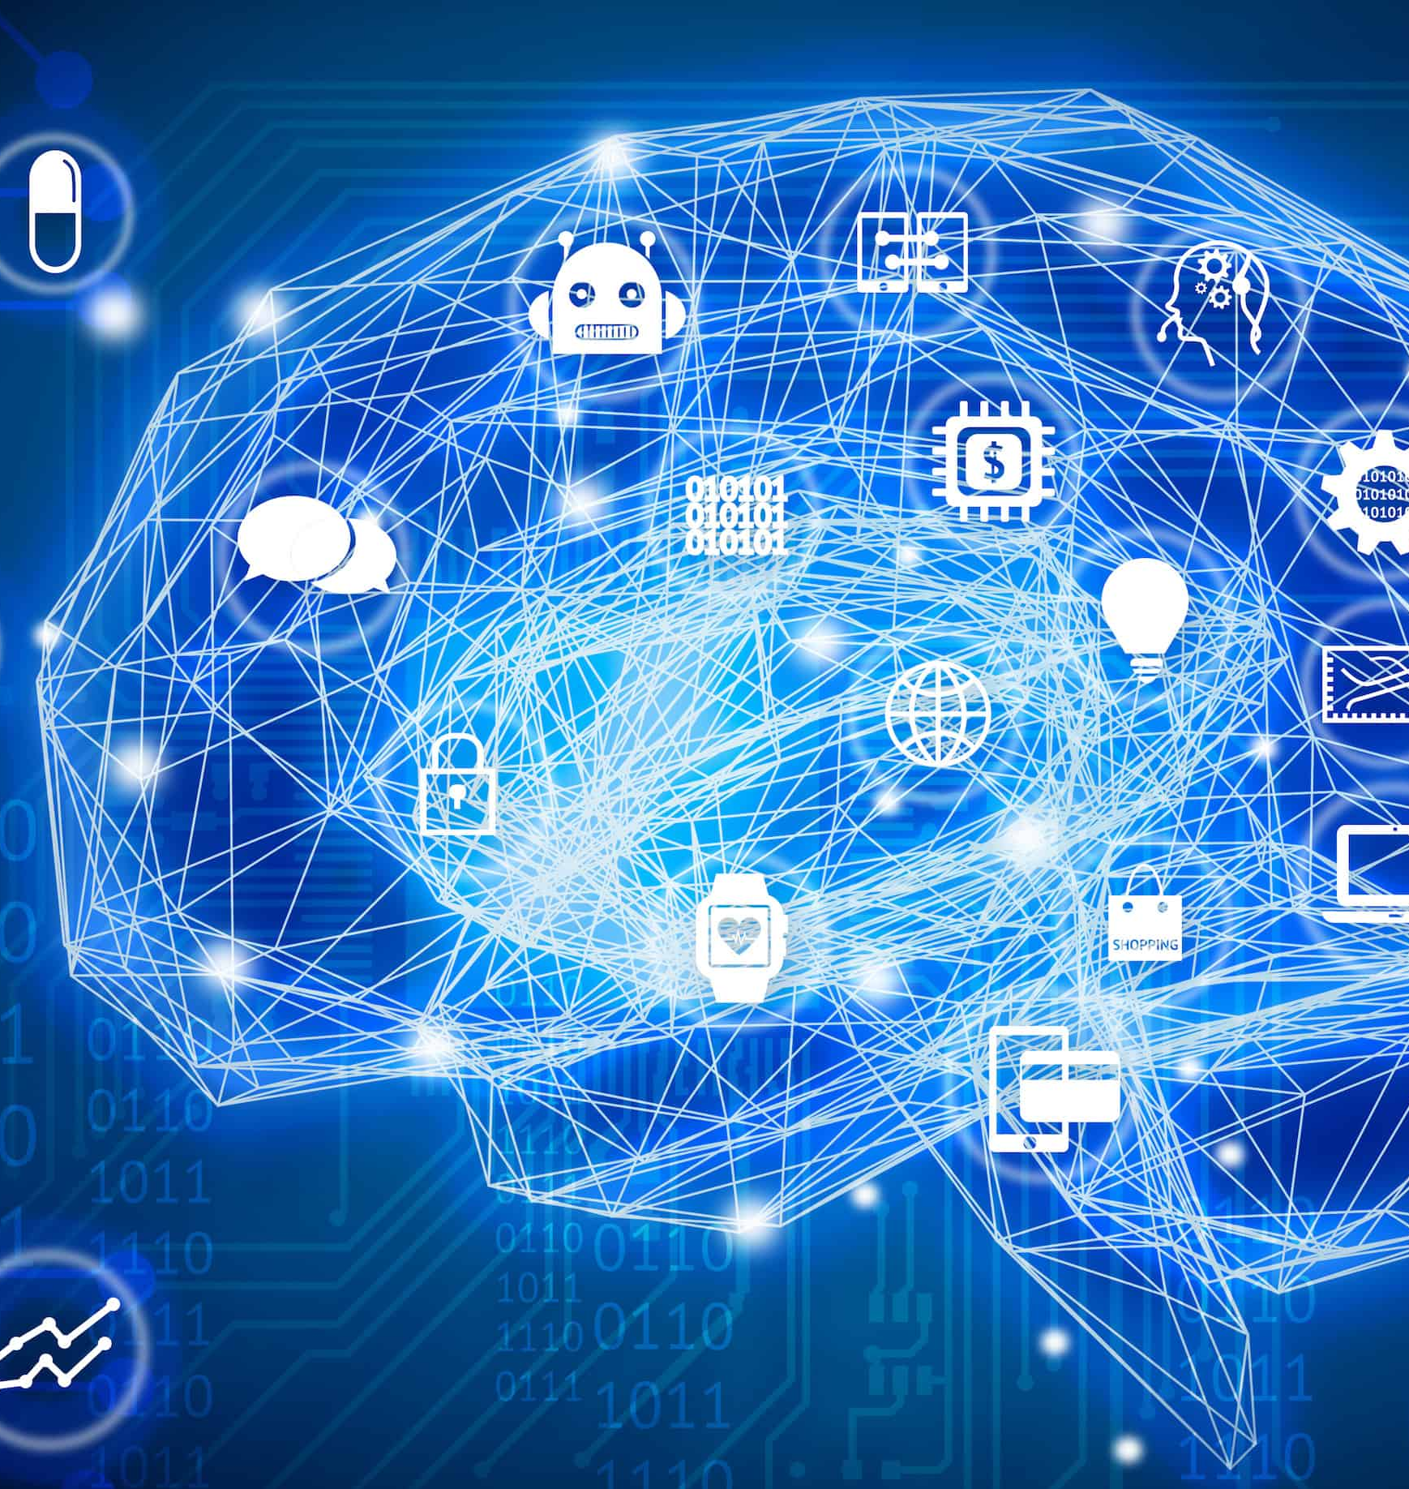
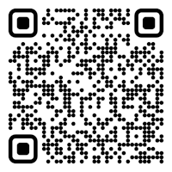
CS 5/7320 Artificial Intelligence More Important AI Topics
Slides by Michael Hahsler
This work is licensed under a Creative Commons Attribution-ShareAlike 4.0 International License.
Online Material

Slide 2
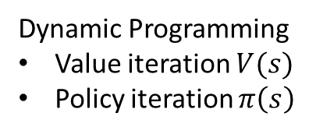
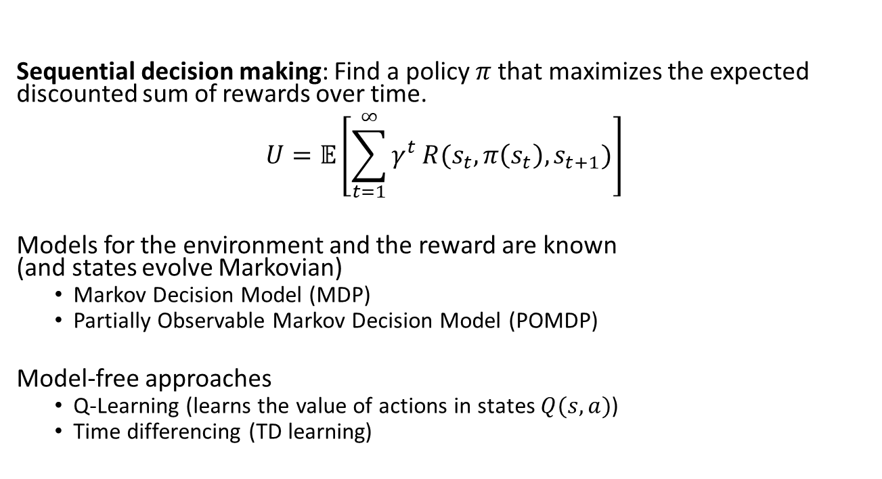
Reinforcement Learning
action
observation + reward
action
observation + reward
…
Max. reward over time
Sequential decision making: Find a policy $π$ that maximizes the expected discounted sum of rewards over time. $$U=𝔼\left[\sum_{t=1}^{∞}{γ^{t}}R(s_{t}, π\left(s_{t}\right), s_{t+1})\right]$$
Models for the environment and the reward are known (and states evolve Markovian)
Markov Decision Model (MDP)
Partially Observable Markov Decision Model (POMDP)
Model-free approaches
Q-Learning (learns the value of actions in states $Q(s,a)$)
Time differencing (TD learning)
Dynamic Programming
Value iteration $V(s)$
Policy iteration $π\left(s\right)$
Learn iteratively

Slide 3
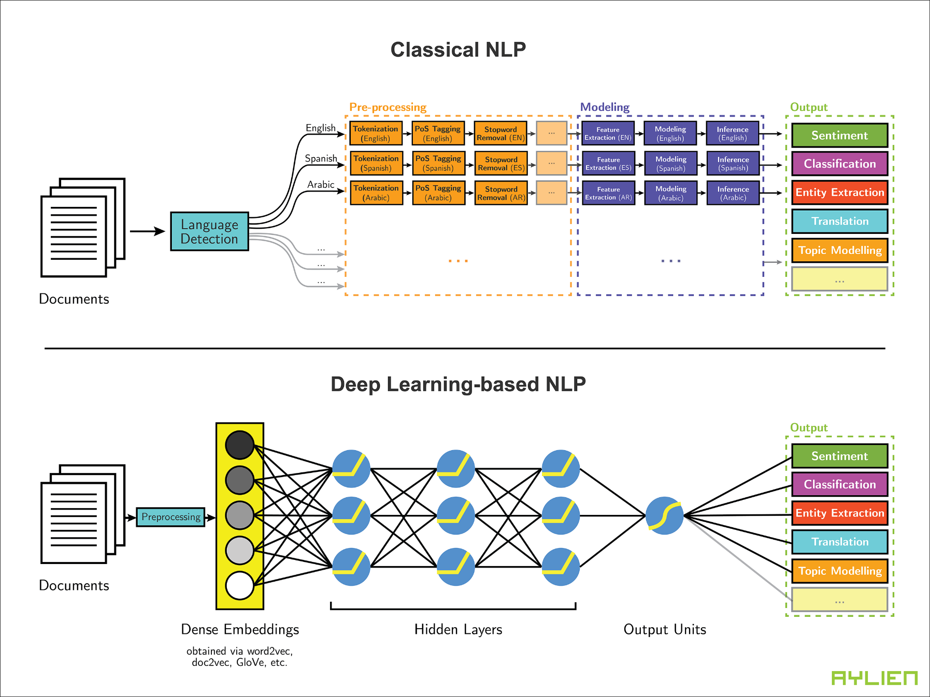
Natural Language Processing
Speech recognition
Information Retrieval
Language Models
Source: Leveraging Deep Learning for Multilingual Sentiment Analysis - AYLIEN News API

Slide 4
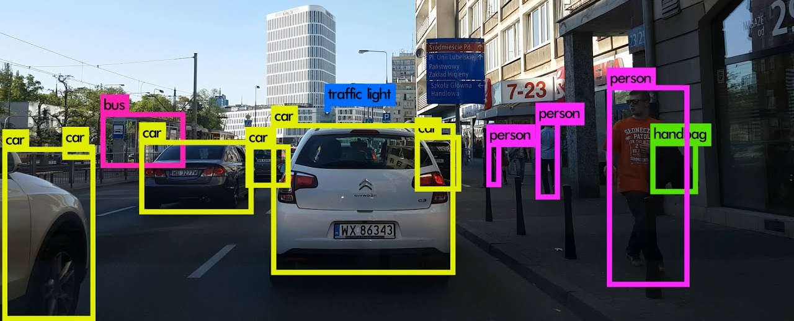
Computer Vision Image Processing & Object Recognition Uses Deep Convolutional Neural Networks

Slide 5
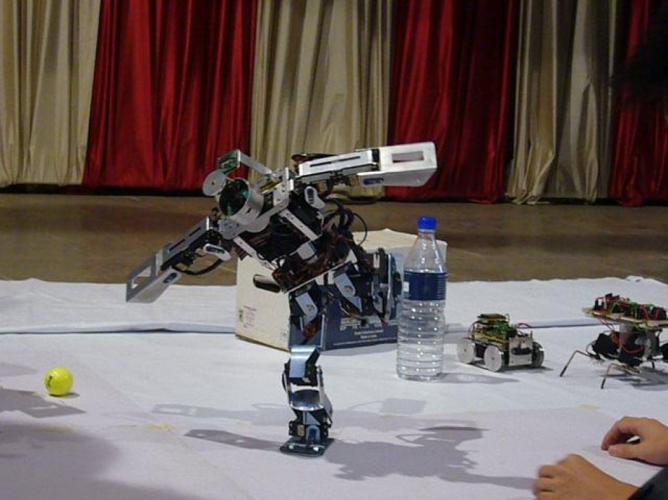
Robotics
Hardware, sensors, control theory (feedback-based controllers)

