Slide 1
Cleaning up Garbage with In-Place Oracles

Slide 2
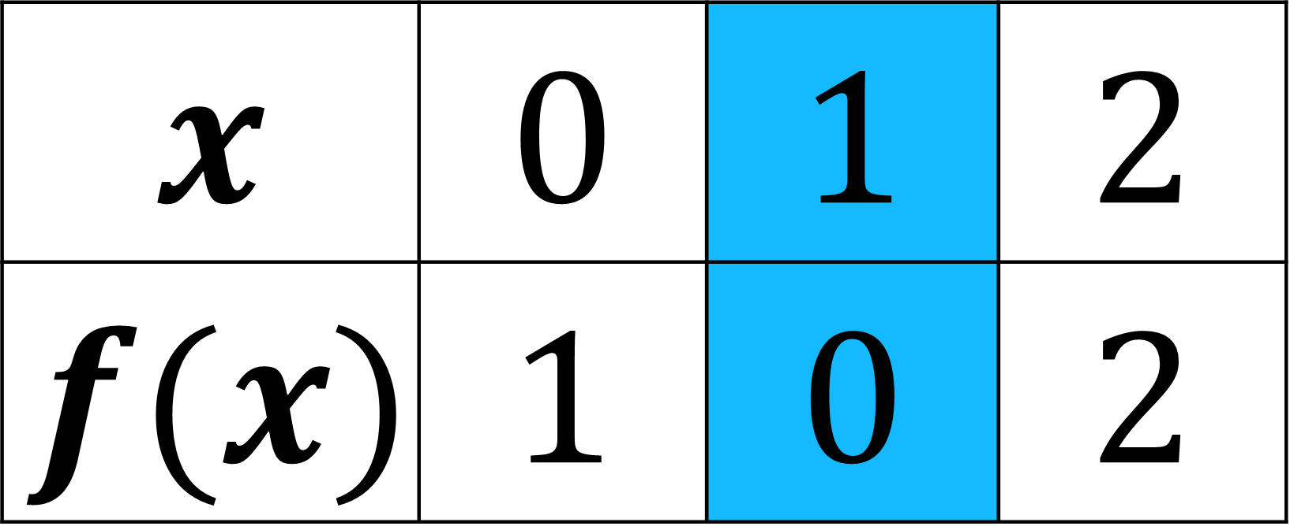
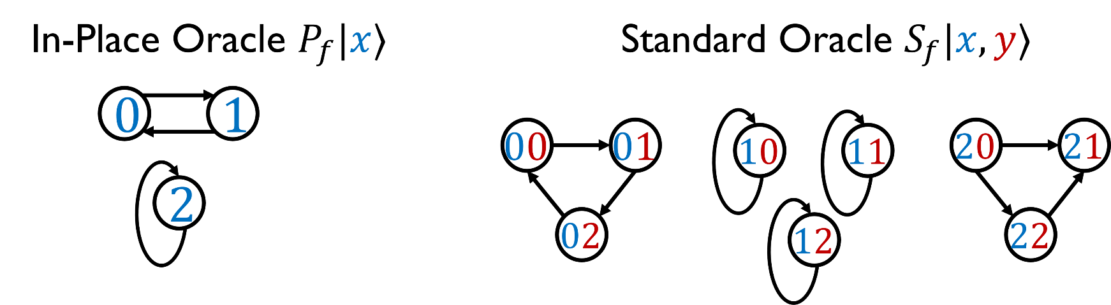

Standard and In-Place Oracles
$f$ is a permutation on $\{0,1,…,n−1\}$
Standard Oracles: $S_{f}\left|x, y\right\rangle =\left|x,f\left(x\right)⊕y\right\rangle$
In-Place Oracles: $P_{f}\left|x\right\rangle =\left|f\left(x\right)\right\rangle$

Slide 3
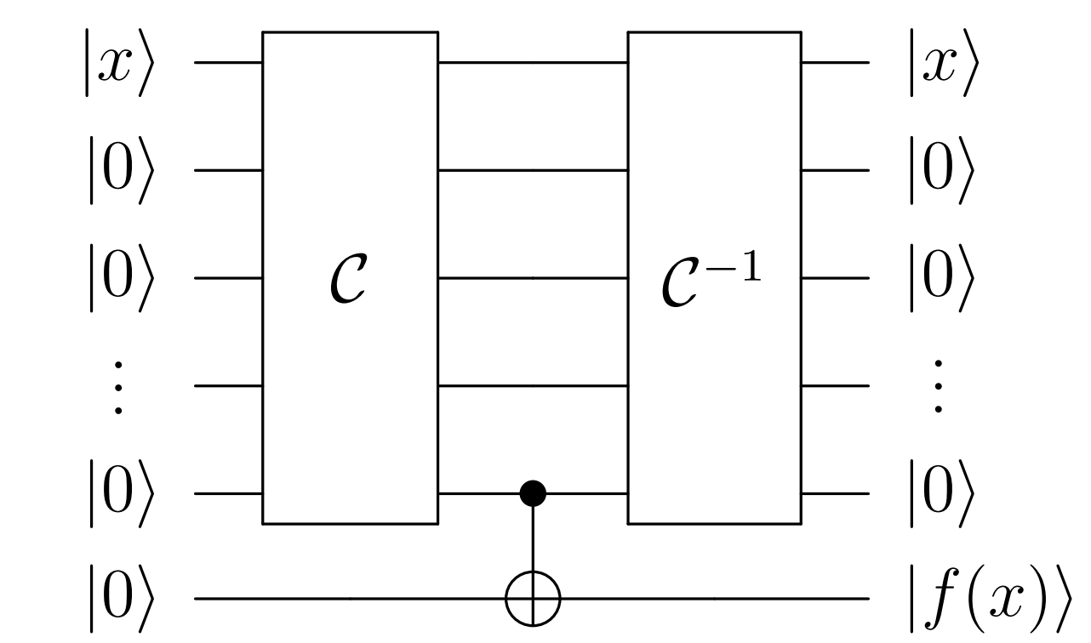




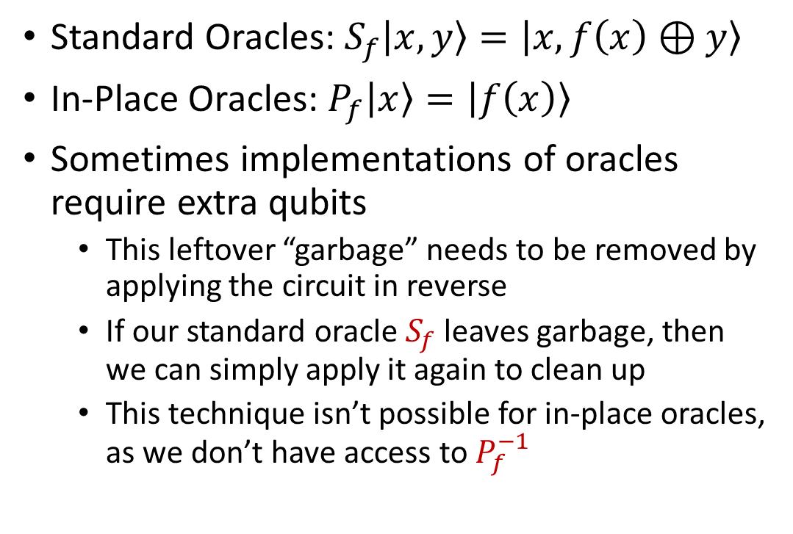

Uncomputing Garbage
Standard Oracles: $S_{f}\left|x, y\right\rangle =\left|x,f\left(x\right)⊕y\right\rangle$
In-Place Oracles: $P_{f}\left|x\right\rangle =\left|f\left(x\right)\right\rangle$
Sometimes implementations of oracles require extra qubits
This leftover “garbage” needs to be removed by applying the circuit in reverse
If our standard oracle $S_{f}$ leaves garbage, then we can simply apply it again to clean up
This technique isn’t possible for in-place oracles, as we don’t have access to $P_{f}^{−1}$
$S_{f}$
$S_{f}$
$S_{f}$
$S_{f}$

Slide 4
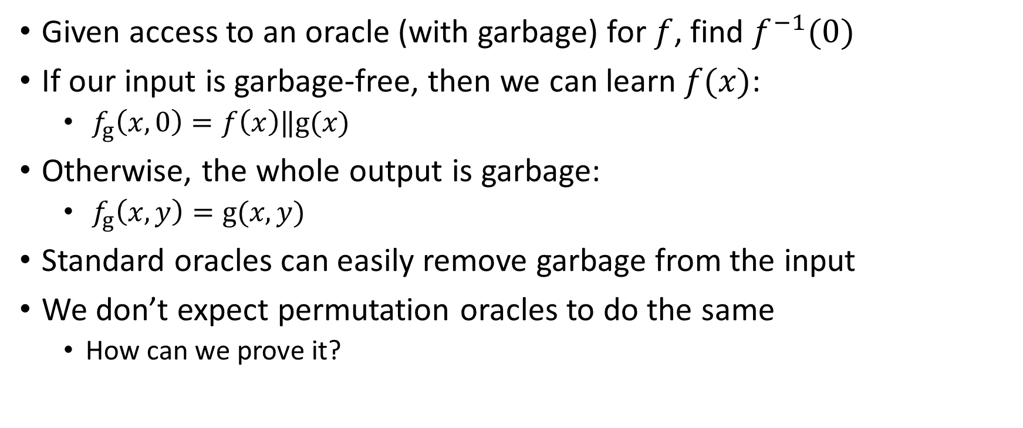
Permutation Inversion with Garbage
Given access to an oracle (with garbage) for $f$, find $f^{−1}(0)$
If our input is garbage-free, then we can learn $f(x)$:
$f_{g}\left(x,0\right)=f\left(x\right)‖g(x)$
Otherwise, the whole output is garbage:
$f_{g}\left(x,y\right)=g(x,y)$
Standard oracles can easily remove garbage from the input
We don’t expect permutation oracles to do the same
How can we prove it?

Slide 5


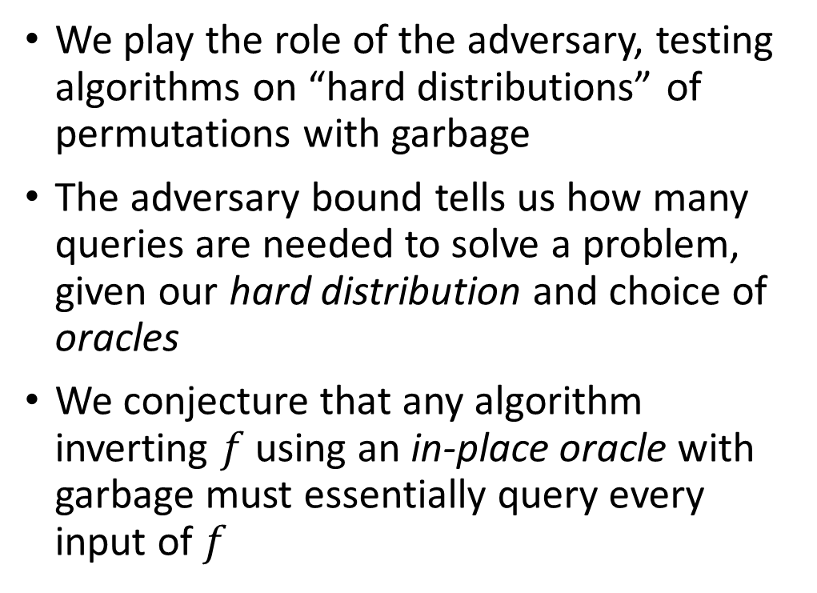
The Quantum Adversary Bound
We play the role of the adversary, testing algorithms on “hard distributions” of permutations with garbage
The adversary bound tells us how many queries are needed to solve a problem, given our hard distribution and choice of oracles
We conjecture that any algorithm inverting $f$ using an in-place oracle with garbage must essentially query every input of $f$
$$𝓐^{P_{f}}$$

