Slide 1
Optimal Trajectories
19-Jun-23 3:05pm

Slide 2
Variations
Starting point in grid
Max acceleration constraint
Cost computation for path selection:
  Time: total time taken by path through grid
  Energy: acc^2 integrated over time.

Slide 3
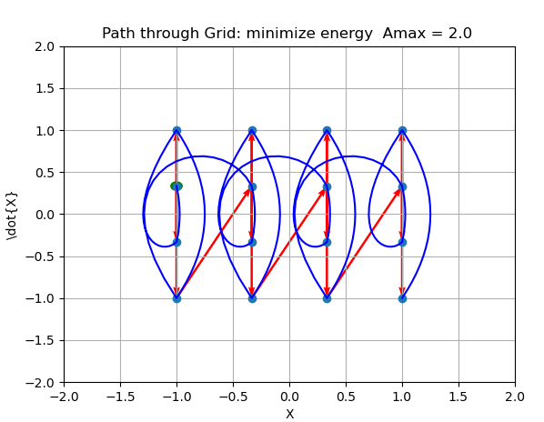
Minimize \sum (a^2 dt)
Constrain:
|Amax| = 2

Slide 4
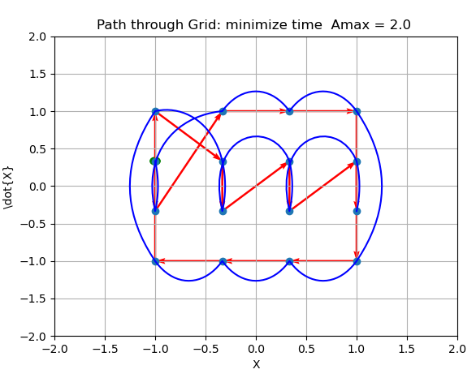
Minimize \sum (dt)
Normalize traj to max|acc| = 2.0

Slide 5
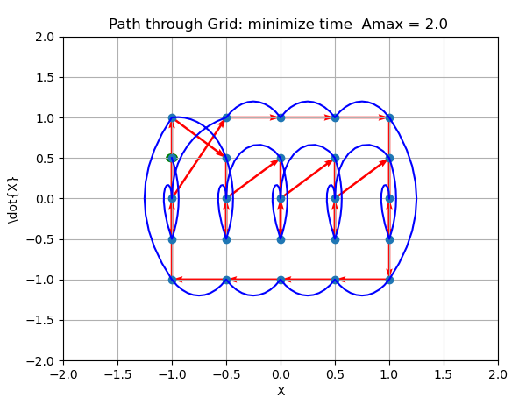
5x5 grid: visit v=0 points
Minimize \sum (dt)
Normalize traj to max|acc| = 2.0

Slide 6
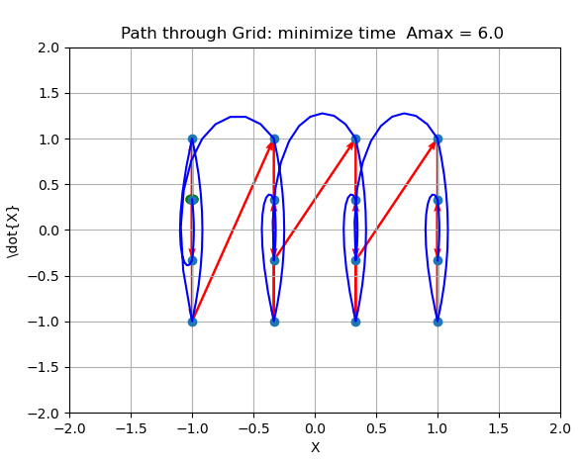
Minimize \sum (dt)
Normalize traj to max|acc| = 6.0

Slide 7
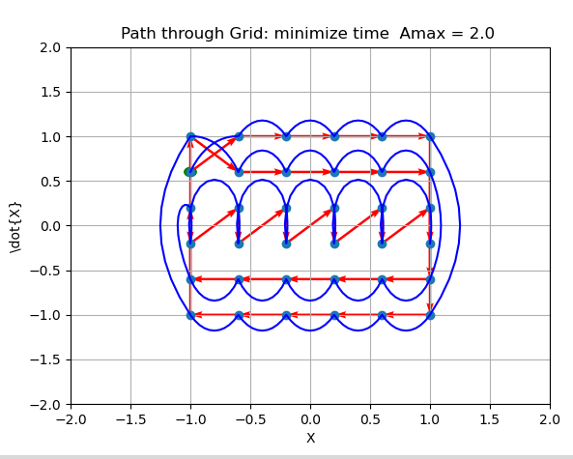
6x6 grid

Slide 8
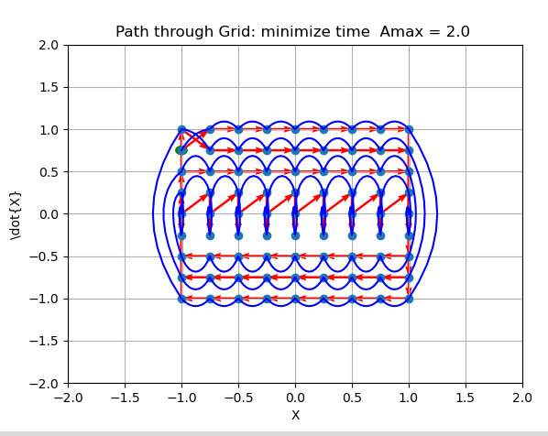
9x9 grid

Slide 9
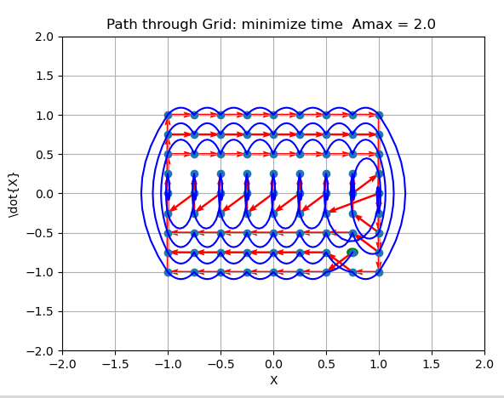
9x9 grid
Change starting point to 7,7

Slide 10
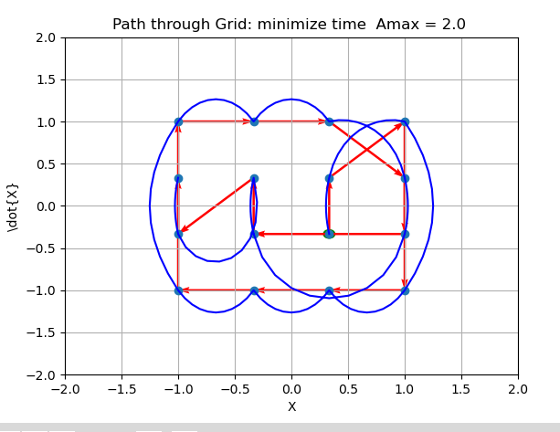
New starting point (-.33,-.33)

Slide 11
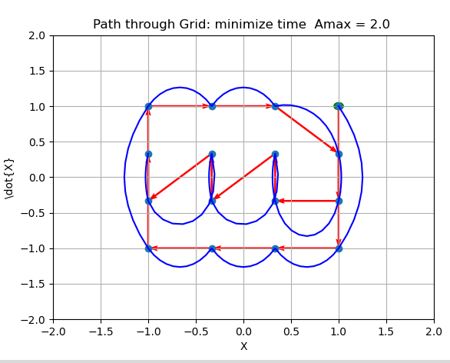
New starting point: (0,1)

Slide 12
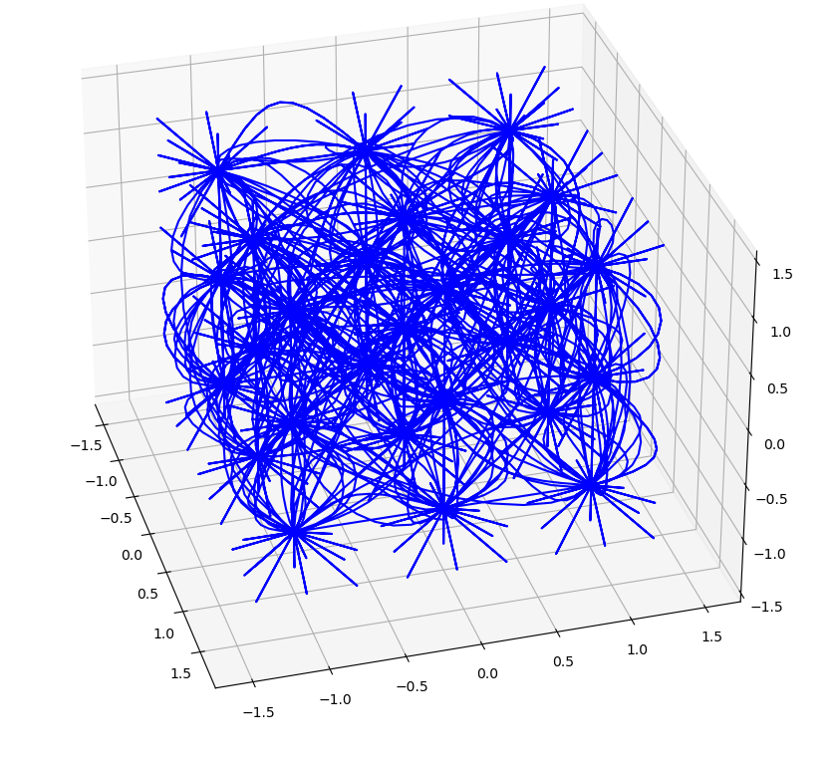
3D is pretty interesting!

