Slide 1
Google Merchandise Store Assessment
Blake Kelly Oates
blakekoates@gmail.com

Slide 2
Table of Contents
Overview - Slide 3
Expected Outcomes - Slide 4
Analysis Overview - Slide 5
Analysis Findings - Slide 6 - 10
Code Used - Slide 11 - 12

Slide 3
Overview
Why do we need this analysis?
To further understand bookings and what drives them. This will be achieved using descriptive statistics based on different variables such as marketing source, bounce rates and other factors.
For example, a problem can be that there has been 47,781 new customer transactions but less than half of these new customers are returning, with 20,484 booking incrementally. This analysis will allow management to find solutions, in this instance by identifying the biggest opportunities to drive incremental bookings.

Slide 4
Expected Outcomes
Deliverable 1
Which marketing source delivers the most bookings?
Deliverable 2
How does bounce rate vary by marketing channel (source & medium)? Are the differences significant?
Deliverable 3
Which factors most strongly influence conversion rate (transactions / visit)
Deliverable 4
How complex are the paths a user takes to make a booking?
Deliverable 5
What appears to be the biggest opportunity to drive incremental bookings?

Slide 5
Analysis Overview
Data Source
Google Analytics Case Study.
Pageview_data_bookers & marketing_channel_timeseries CSV files.
It contains data within the range 2017-06-25 to 2017-07-30.
Tools Utilised
SQL for calculations, Google Sheets for charts, Google Slides for presentation.
Defining Calculations
Conversion Rate = transactions / visits.
Incremental Bookings = total_visitor_transactions - transactions.
Assumptions
The path a user takes to make a booking refers to the pagePath column.
Due to the nature of the website, a high bounce rate is considered bad.
The conversion rate is found using the marketing_channel_timeseries table.
Incremental bookings are considered to contain the total amount of transactions within the time period - the transactions during visit number one.

Slide 6
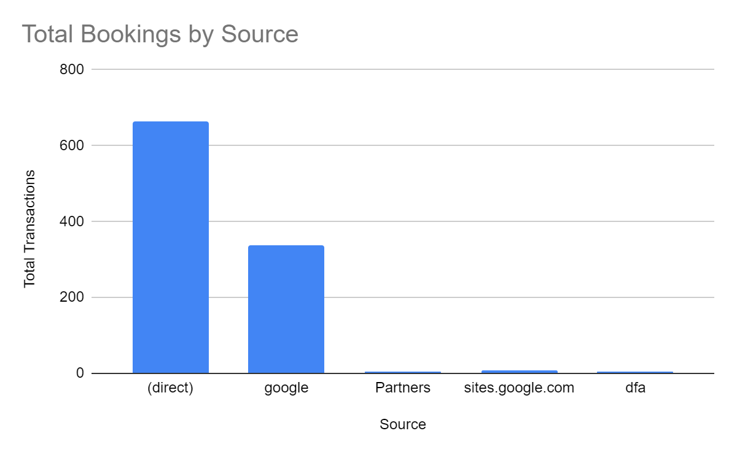
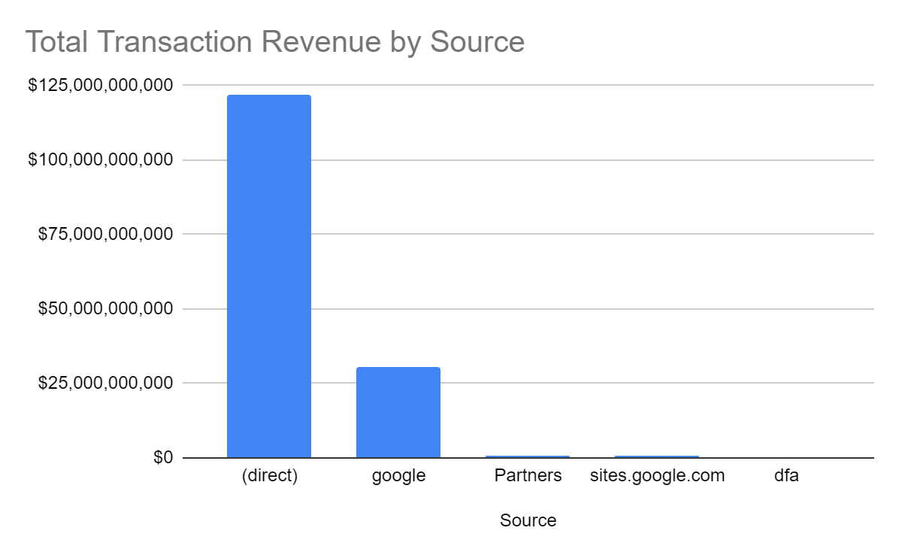
Which marketing source delivers the most bookings?
Direct visits to the Google Merchandise Store accounts for a considerable majority with 65% of total bookings and 79% of total revenue being direct visits.
The other notable source is Google search which accounts for 33% of total bookings and 20% of total revenue.

Slide 7
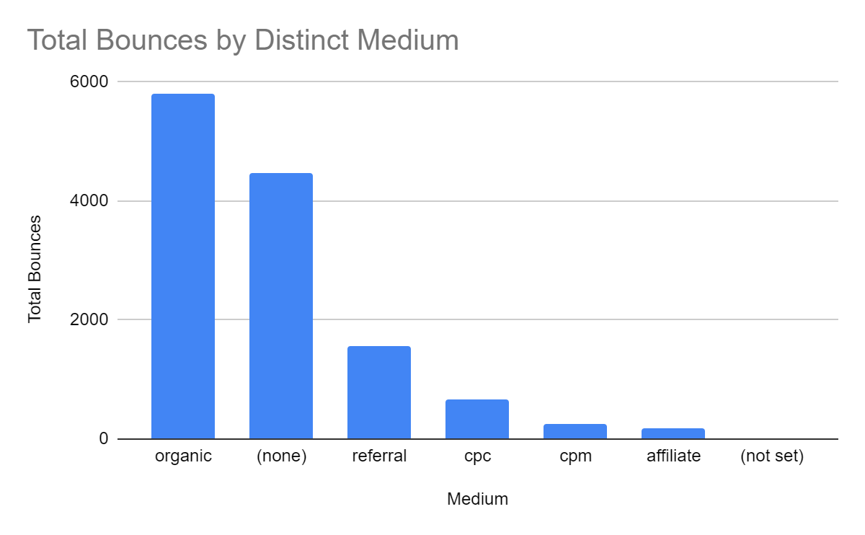
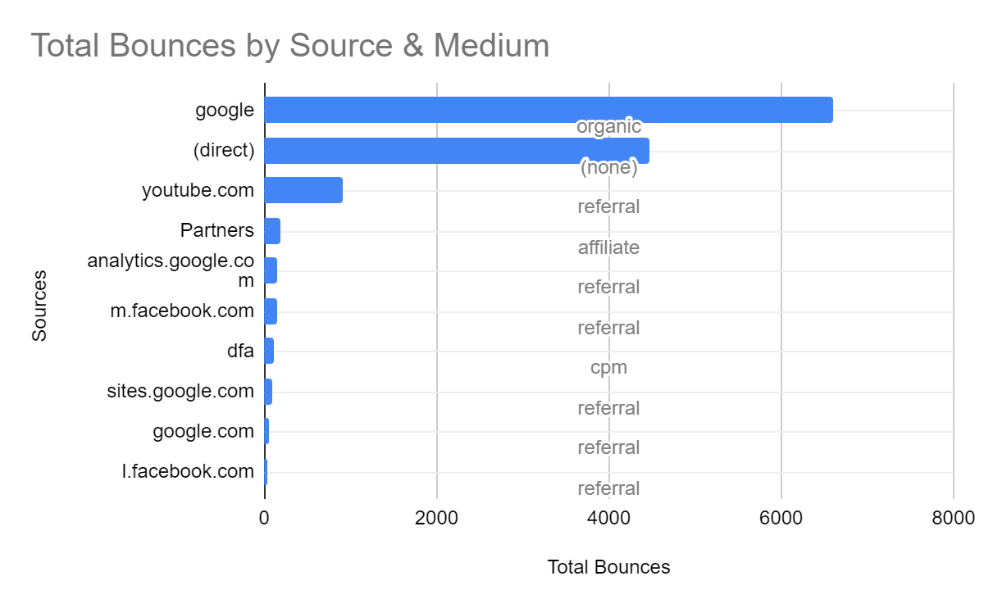
2. How does bounce rate vary by marketing channel (source & medium)? Are the differences significant?
Most bounces are attributed to organic google searches and referrals with a total of 7,361 bounces between the two mediums. In such cases people using Google Search or being referred by other sites do not believe that the Google Merchandise Store will fulfill their needs and they choose to search elsewhere.
Considering that the majority of bookings are direct (none), the total number of bounces being lower at 4,460 is an indicator that those who already understand the value of the Google Merchandise Store will successfully use it, while those who are just discovering the site are more likely to look elsewhere.

Slide 8
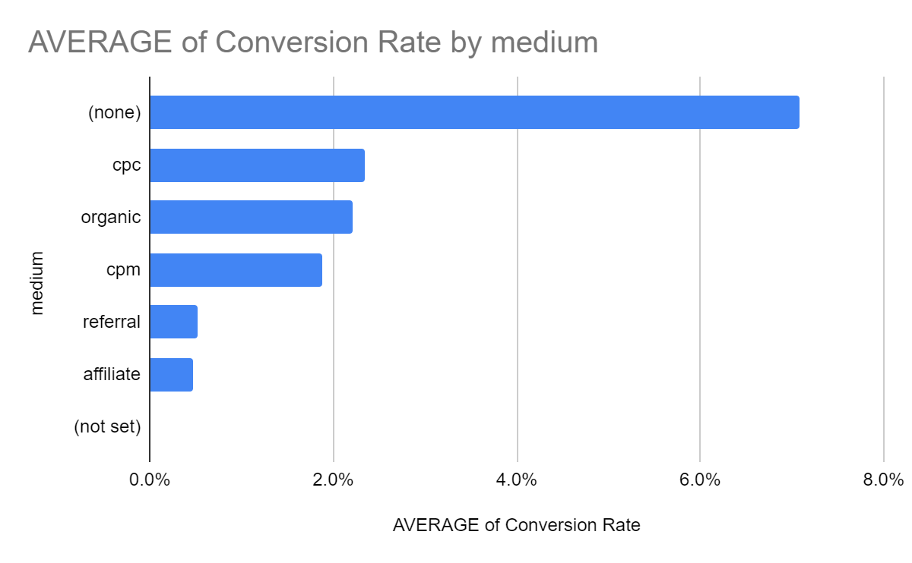
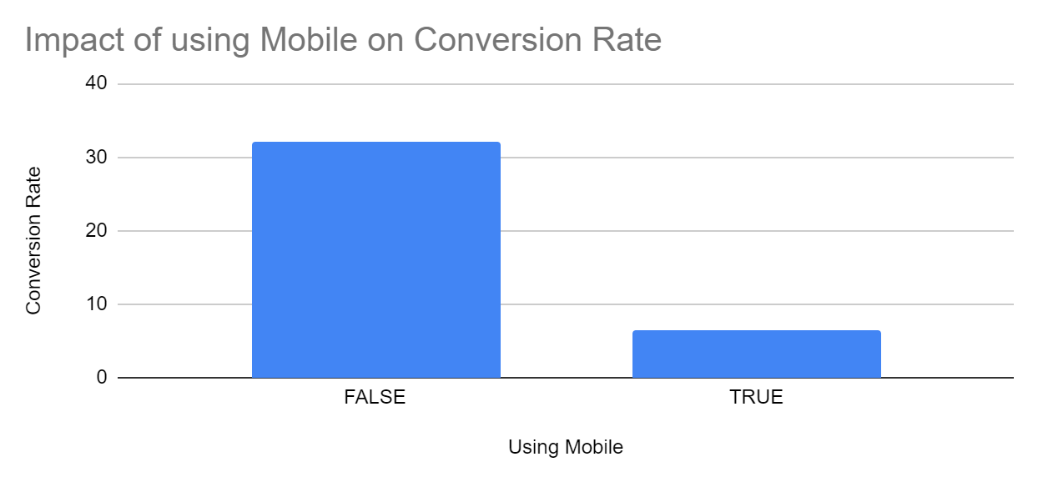
3. Which factors most strongly influence conversion rate (transactions / visit)
Following the trends already discovered, it can be seen that direct (none) visits to the site is most likely to lead to transactions.
Referrals have a considerably low conversion rate coupled with a high bounce rate.
CPC and CPM move in the opposite direction to referrals, having a lower bounce rate while showing a stronger conversion rate.
The vast majority of conversions occur when people are not using mobile phones.

Slide 9
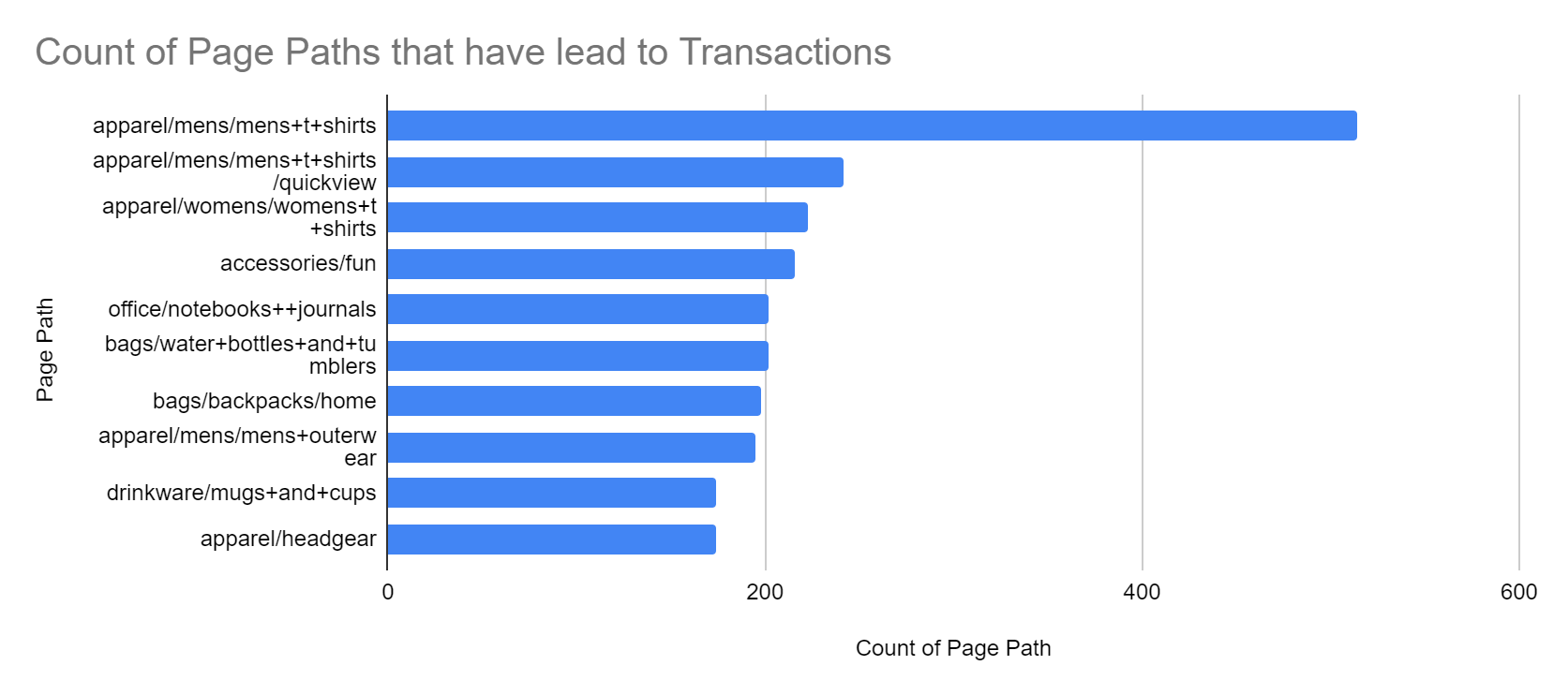
4. How complex are the paths a user takes to make a booking?
There are 393 distinct page paths that users have taken. 382 of these distinct page paths have led to at least one transaction.
Removing the basic web pages such as ‘basket’ or ‘sign in’, we can see the most popular paths that lead to bookings.
Men’s t-shirts are the most popular paths with a combined 1,110 visits while women’s t-shirts are second with 223 visits.

Slide 10
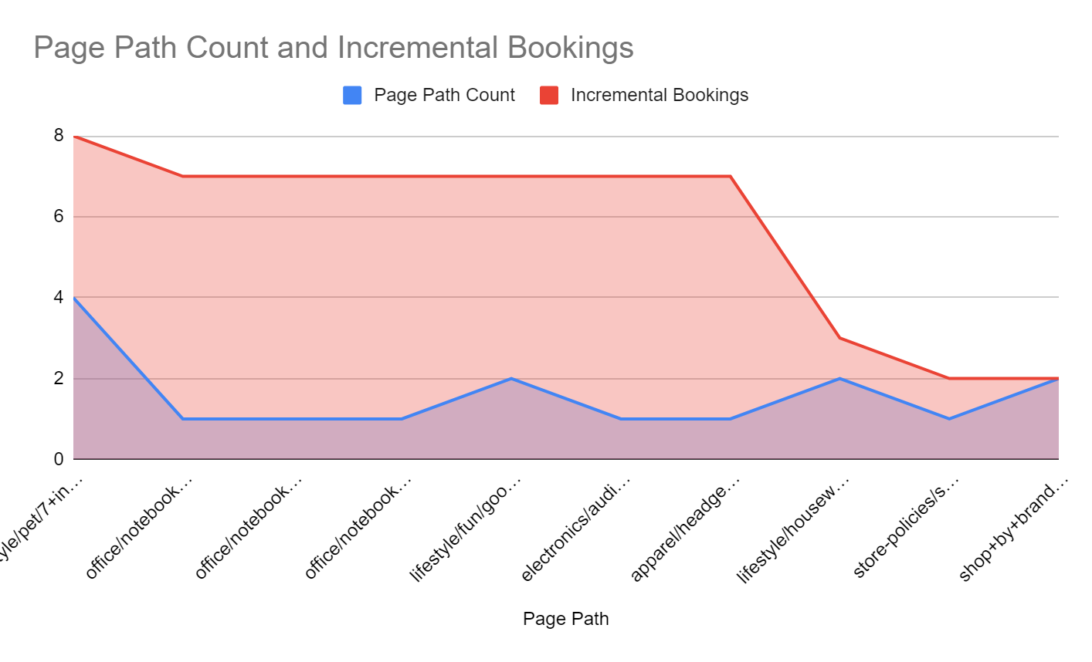
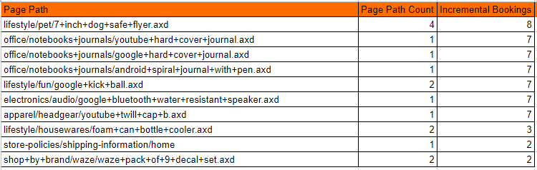
5. What appears to be the biggest opportunity to drive incremental bookings?
Removing the basic web pages such as ‘basket’ or ‘sign in’ again, we can see the paths that drive the highest incremental bookings.
The Top 10 paths that have lead to the highest incremental bookings are also paths that have been less frequently visited.
Thus, these are potentially underutilised paths within the store that can be leveraged to increase incremental bookings.
The area chart below shows the potential these paths have in comparison to their current usage, while the table outlines the full path names to allow users of this deck to further investigate these areas of value.
Table Containing Full Path Names

Slide 11
Code
--Discovering date ranges
select max(date_week), min(date_week) from marketingdata m
--Example Problem
select sum(total_visitor_transactions), sum(total_visitor_transactions - transactions) as "Incremental Bookings Count" from pageviewdata
--Q1
select "source", sum("transactions"), sum("totalTransactionRevenue") as "Total Revenue Sum" from marketingdata m group by 1
order by "Total Revenue Sum" DESC;
--Q2
select "source", medium, referralPath, sum("bounces") as "Bounces Sum" from marketingdata m group by 1
order by "Bounces Sum" DESC;
select distinct medium, sum("bounces") as "Bounces Sum" from marketingdata m group by 1
order by "Bounces Sum" DESC;
--Q3
SELECT CAST( ROUND(transactions *1.00 / visits, 2) AS FLOAT) as "Conversion Rate", visits , transactions , isMobile, "source" , medium , referralPath , totalTransactionRevenue
FROM marketingdata m order by "Conversion Rate" desc

Slide 12
Additional Code
--Q4
SELECT distinct pagePath, count(pagePath) as "Count of Page Path" FROM pageviewdata p
where transactions != ''
group by 1
order by "Count of Page Path" desc
SELECT count(distinct pagePath) FROM pageviewdata p
where transactions != ''
--Q5
SELECT DISTINCT pagePath, count(pagePath), (total_visitor_transactions - transactions) as "Incremental Bookings" from pageviewdata
where visitNumber > 1 and total_visitor_transactions > transactions group by 1
order by "Incremental Bookings" desc
SELECT DISTINCT pagePath, count(pagePath) as "Page Path Count", (total_visitor_transactions - transactions) as "Incremental Bookings" from pageviewdata
where visitNumber > 1 and total_visitor_transactions > transactions group by 1
order by "Page Path Count" desc

Slide 13
Thank You
Questions?

