Slide 1
CS 4287: Final Project
Bao Nguyen, Blake Quigley, and Leqiang Wang

Slide 2

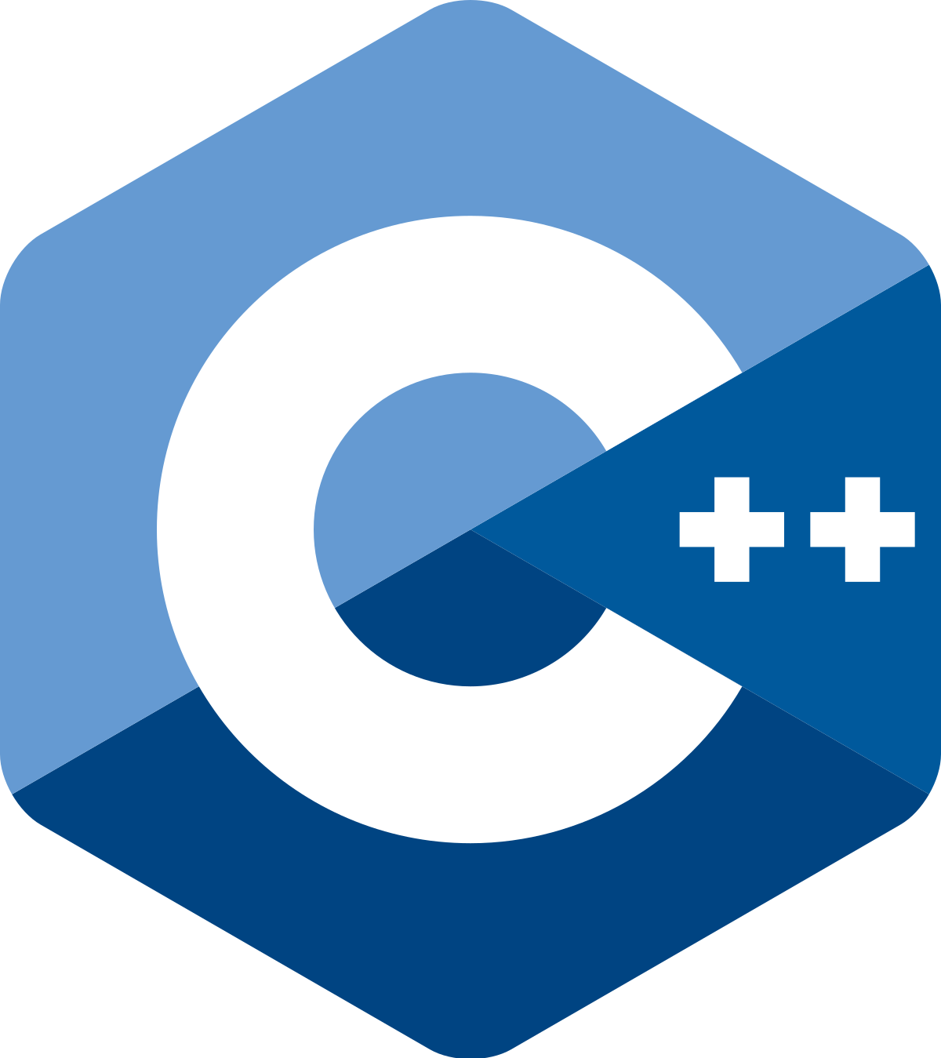

Motivations
An online programming competitive game, specifically geared for educational use
Help students learn programming faster and more effectively through competitive drive
Get younger kids excited about programming through a fun videogame perspective
Utilize cloud computing to compile and run many different programming languages without needing to install on your individual machine
Potential users: STEM summer camps, AP Computer Science teachers, tech company on-campus visits, students preparing for engineering interviews, etc.

Slide 3


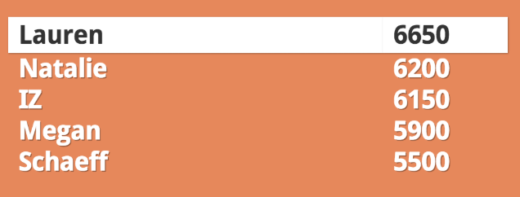
Example Use
Easily and quickly join classroom game with unique game pin
Present user with programming question (of teacher’s desired difficulty level)
Using a variety of possible programming languages, users input code to solve problem
In the cloud, a random input is generated and solved with our own correct solution
The user’s provided code executes with the same input, compares with the correct output, and generates useful statistics
In browser, user receives success/failure, correct output, user’s output, stdout for debugging, execution time, etc.
Users are ranked based on statistics such as execution time,
lines of code, first to successful result, etc.
Sort a list of 100 integers

Slide 4



Cloud Computing Concepts
Website is hosted in the cloud, so we don’t have to buy or set up physical hardware
Website is essentially infinitely scalable through the cloud
AWS chosen for free education credits and to gain experience due to widespread industry use
Kubernetes used to orchestra tasks among Docker Workers executing the user’s code and returning results
Container concepts used for security with arbitrary code execution
HTML/CSS/JS used for simple front-end website interface

Slide 5
Design of Docker Workers
Basic Goals
Execute code (Python to start) with custom input
Limit the running time (in case of infinite loop or otherwise)
Measure the running time
Send back the output of the execution

Slide 6
Design of Docker Workers
Approaches
Use exec to execute Python in a Python based service
Redirect input and output to StringIO
Use time out signal to ensure running time limit
Acquire system time at the start and end point of the execution
Exception handling to handle the errors
Only one docker instance run on every (virtual) machine, no concurrent execution.

Slide 7
Design of Docker Workers
Advanced goals
Have test cases for certain problems and compare user’s code output
Properly schedule to worker nodes when the system is overloaded
Data for test cases can be very large, may use a vm for a database server.
Use cache to improve I/O efficiency (combine with node schedule)
Support multiple languages (i.e. C++)
Security check of the code (prohibit system calls)

Slide 8
Work Responsibility
Bao Nguyen | Blake Quigley | Leqiang Wang
Back End | Front End | Back End
Worker nodes for executing code and communicating results to master / report | User interface / web server setup / PowerPoint / report | Master node for coordinating code execution tasks / report

Slide 9
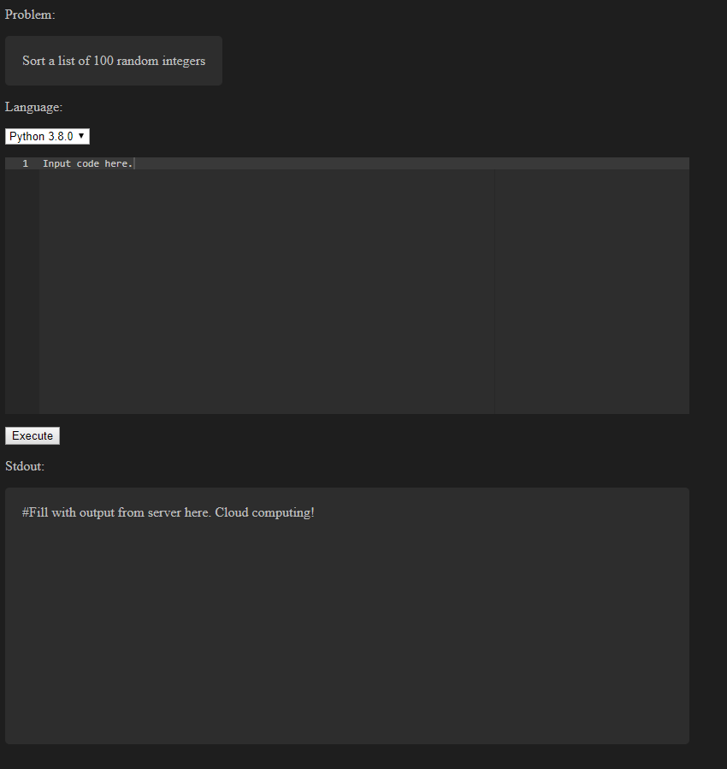
Current Status
Created and iterated on project idea
Architected design for implementation of project proposal
Signed up for AWS with education credits
Started experimenting locally with executing code from external source
Simple website UI for testing (using Ace for code editor)

Slide 10
Next Steps
Finish website that can take user input, execute code in the cloud, and return stdout to the browser in several popular languages
Provide user with random sample problem to solve, check input code for correctness, and return useful statistics
Full, easily joinable competitive game ready for classroom use

Slide 11
Any Questions?

