Slide 1
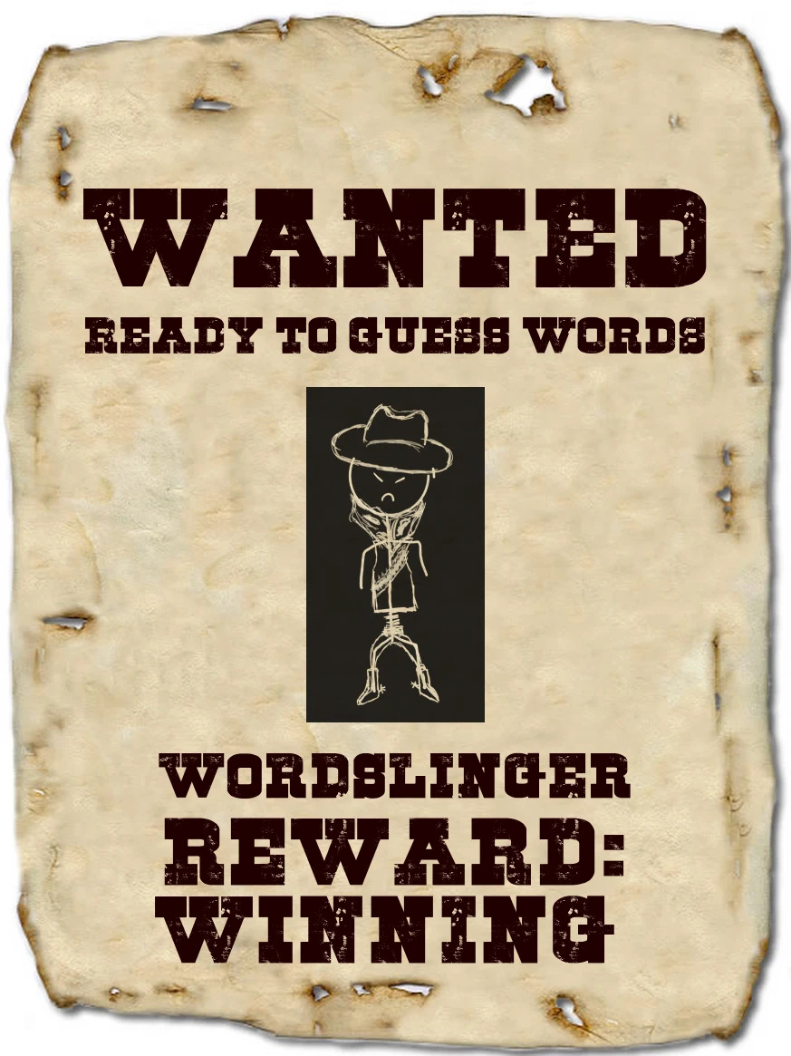
Hangman Game
By: Blake Buskirk

Slide 2
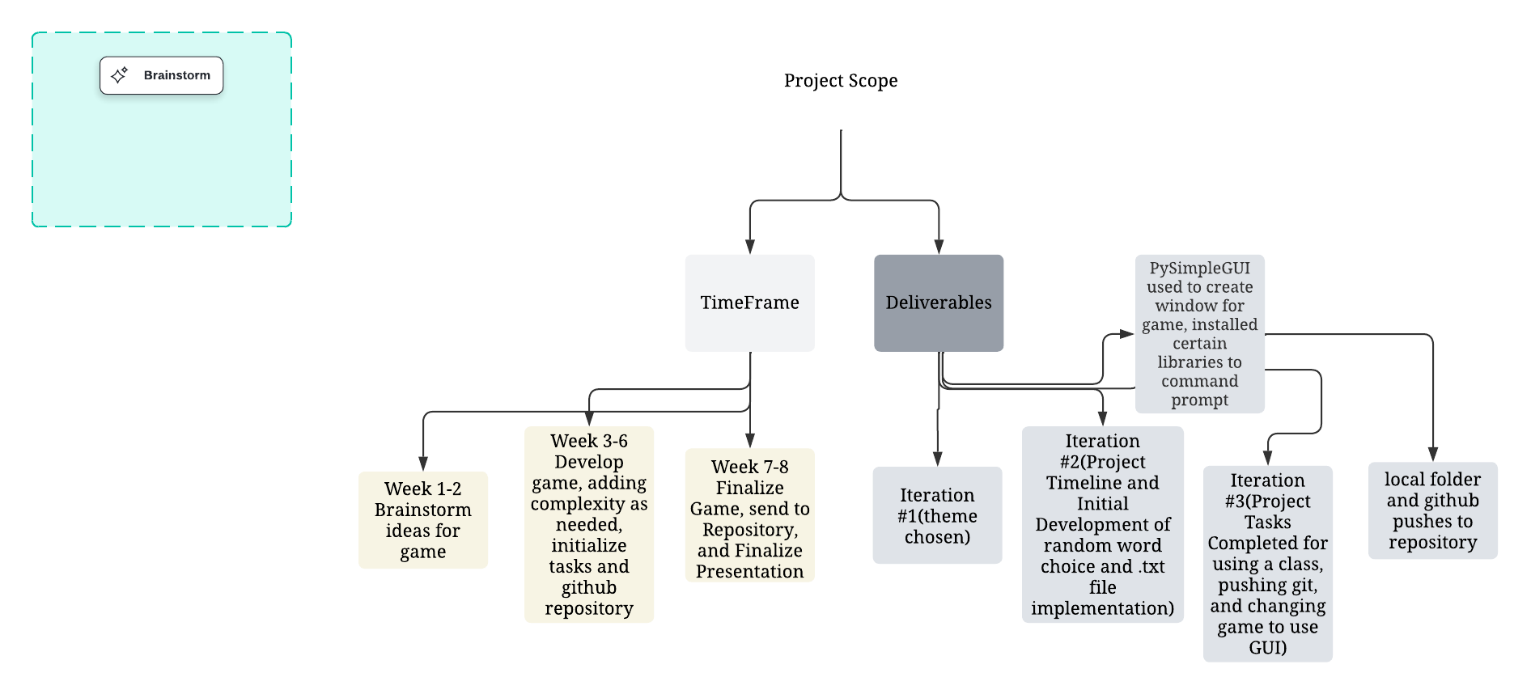
Introduction
Objectives:
Main Objective: Creating a command-line hangman game
Using a class to create methods to implement game functions
Using the class with PySimpleGUI to create another window for the game
Implement lecture techniques for the game
Create a Wild West theme, with cowboy themed word bank, tumbleweed, and cowboy clothing for hanged man drawing

Slide 3
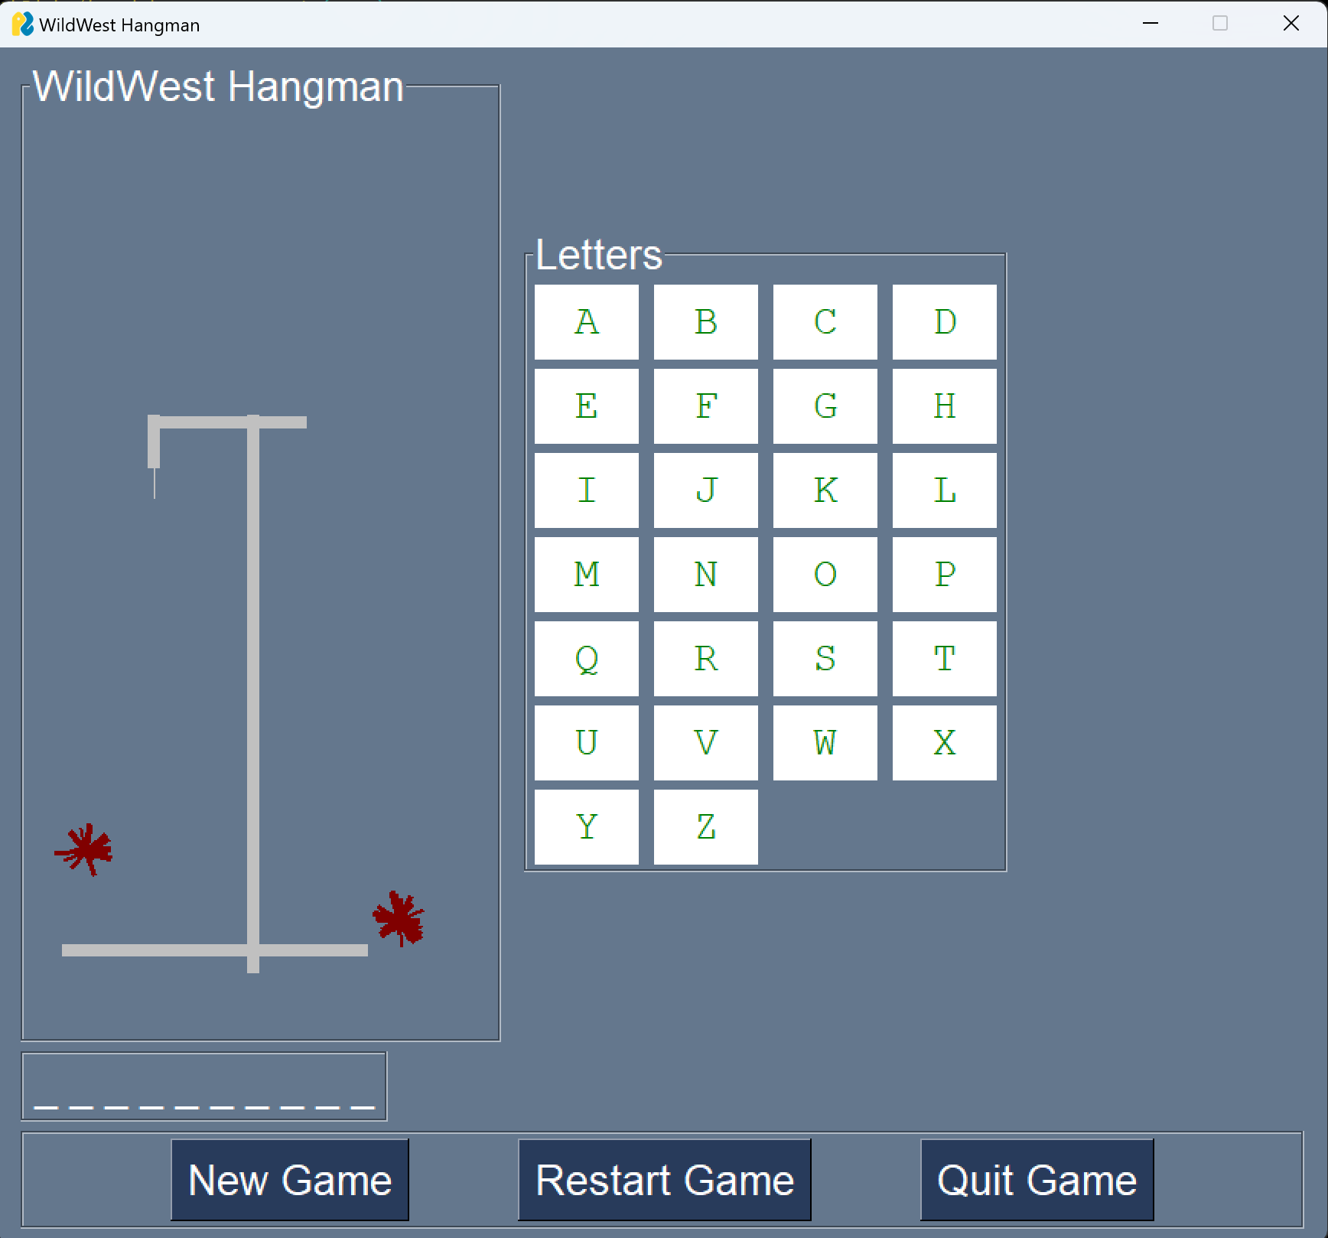
Literature Review
Relevant Existing Work
Many lecture and worked examples provide a layout for using classes and the instance method. For example, the in class work 8.
Previous knowledge in the PySimpleGUI from summer coding projects.
Lecture Practice with random and math libraries for calculations, and with a range that goes in steps.
Classic hangman game with stick figure, random words, and letter guesses.

Slide 4
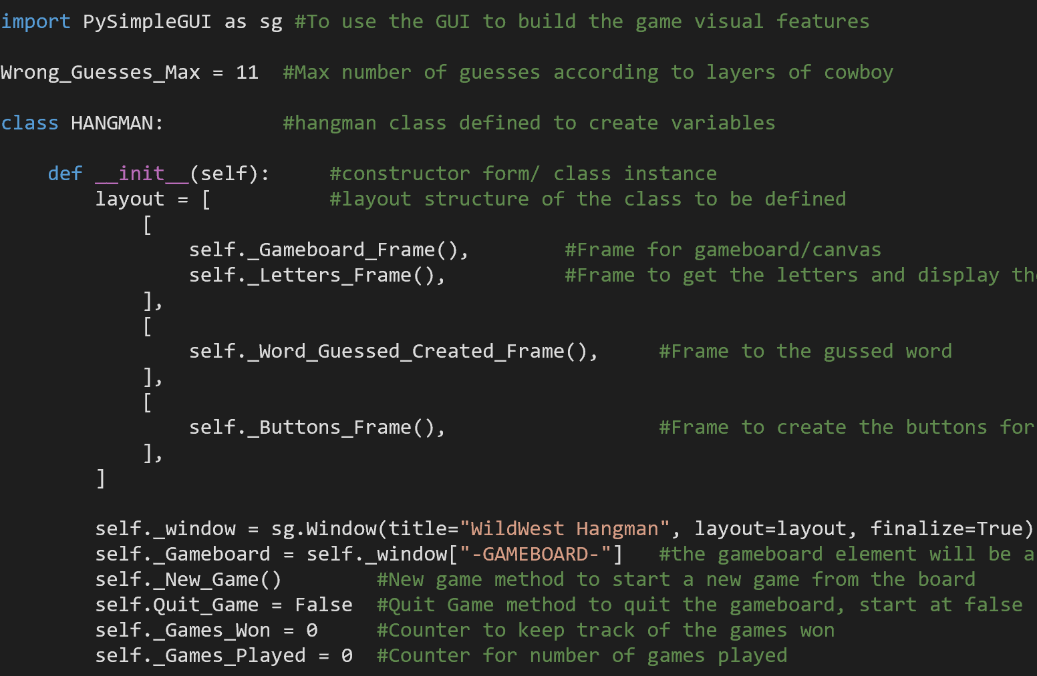
Methodology
Pseudo Code for Techniques Used
Len(), String, .txt read file.
Class, Constructor, Instance Method.
For and While Loops, Events creation and processing.
Setting Conditions for Instance Methods to Quit Game
Set, Lists, and Strings Used.
Gameboard instance created
Frame returned wih title, graph with key identifier,canvas size created, bottom left and top right bounds created
Letter group frame instance created
Letter groups are created with ascii to chunk letters in groups of 4
Buttons created with text as each letter, font and size set, border width set

Slide 5
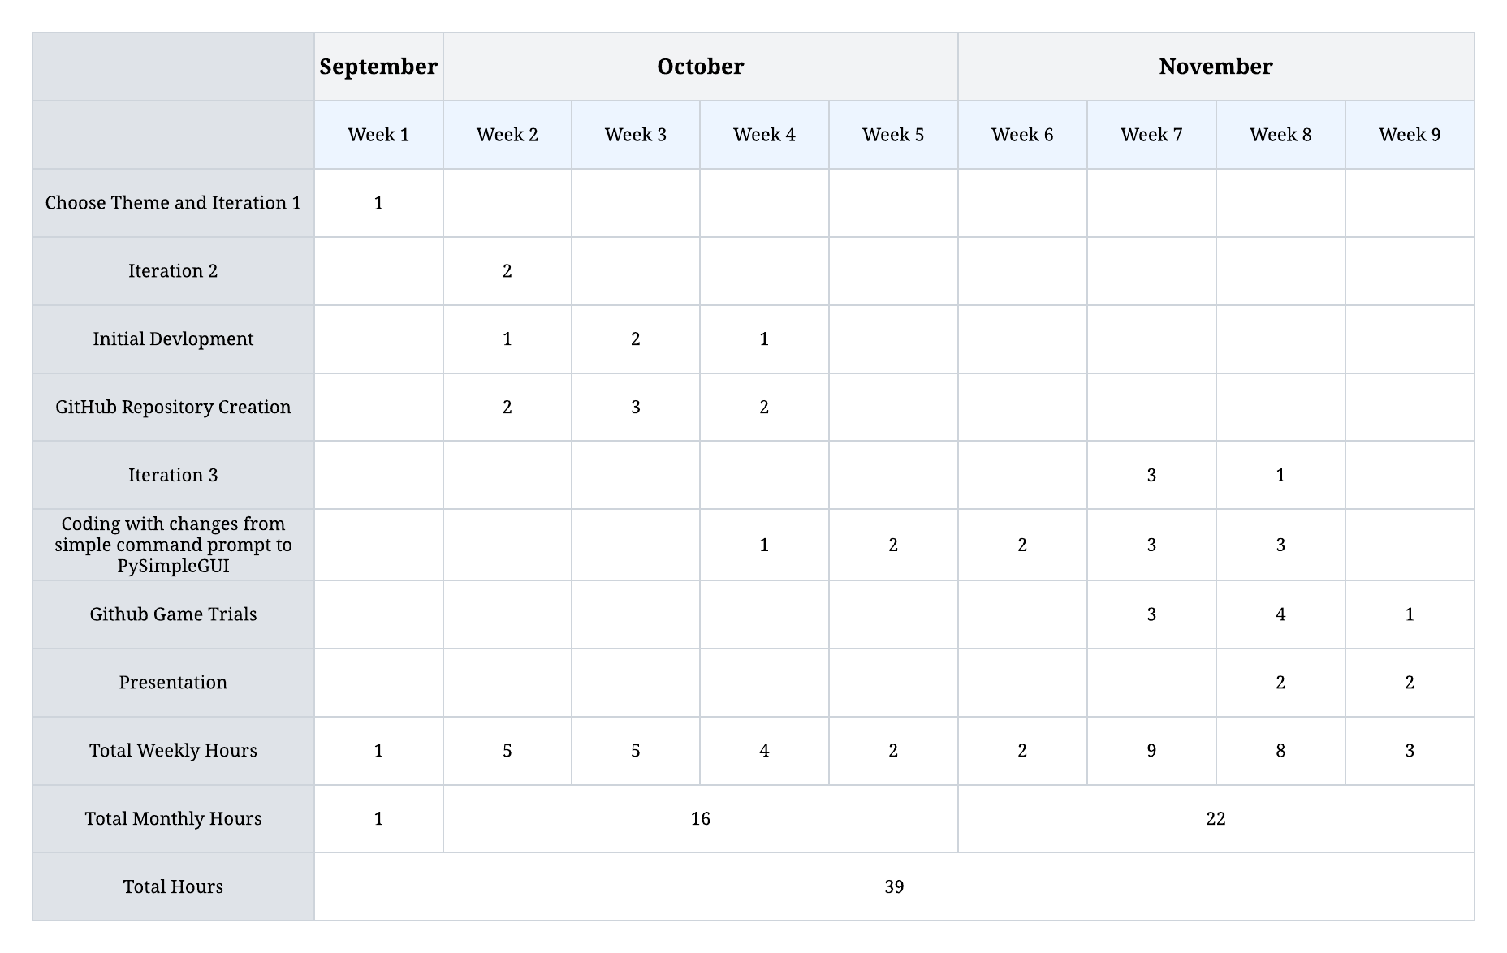
Project Hours Spent

Slide 6
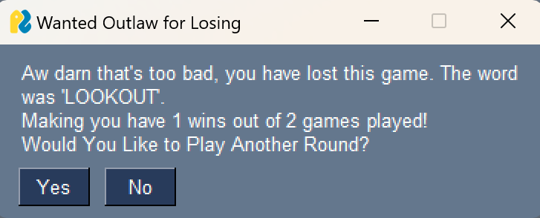
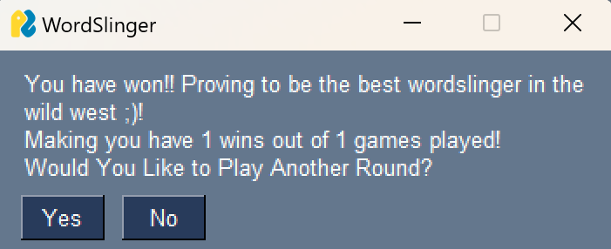
Analysis and Results
Key Findings:
The word bank was full of “wild west” words and there were more words with the vowel “o” or the letter “c”.
Data was not necessarily collected by the developer, but the game does collect the wins compared to games played data.
During the process, closing the game would give a statement “Game.close(), HANGMAN class has no attribute to close”
Higher chance to win when starting with a vowel, currently on my personal laptop with all the testing I did I have one 82 games out of 110.
Guessing words based of number of letters becomes easier as the words are learned more.

Slide 7
Discussion
Implications of Findings:
Limited list of specific type of words can lead to deviations with data since there are only a certain number of themed words available.
Game.close() still closed the game even when gitbash would claim there is no attribute.
Attribute was created so the statement was no longer an issue.
Python needs a file, list, or defined words for there to be a random word chosen for hangman.
Project Limitations:
Since I used the GUI instead of pygame, when creating the hangedman, I used line creations from drawing vector lines as opposed to uploading jpg files to be displayed in another window like pygame.
Using sg.Sizer() has many limitations with placement in a list, or a frame and syntax errors will produce a lot if not carefully coded in.
Used a code editing app for some of the process so syntax errors were only visible while trying to run the code with gitbash.

Slide 8
Conclusion
This project allowed me to learn more about OOP and classes with python, and the utilization of the instance method to create a functioning game with a GUI window. The entire class was the code for the hangman project as opposed to created numerous different functions as well as a main function, but the __name__ == “__main__” was utilized to run the code to allow for usage when file is just downloaded as a module or ran directly.
For future work, I would like to utilize an API or use pygame to create a better game environment and develop more with the code. Use up more of the windows space more, and make the game more interactive.

Slide 9
References (MLA 8)
Clough, David E, and Steven C Chapra. Introduction to Engineering and Scientific Computing with Python. CRC Press, 2022.
Deitel, Paul J., and Harvey M. Deitel. Intro to Python for Computer Science and Data Science: Learning to Program with AI, Big Data and the Cloud. Pearson Education Limited, 2020.
GeeksforGeeks. “Getting Started with Python Programming.” GeeksforGeeks, 5 Sept. 2024, www.geeksforgeeks.org/getting-started-with-python-programming/?ref=shm. Accessed 10 Oct. 2024.
Google, www.google.com/. Accessed 26 Nov. 2024.
Lutz, Mark. Learning Python. 5th ed., O’Reilly Media, Inc.
McKinney, Wes. Python for Data Analysis: Data Wrangling with Pandas, NumPy, and IPython. 3rd ed., O’Reilly Media, Inc.
“Wanted Poster Creator.” Wanted Poster Creator - Make a Wanted Poster | Create Funny Wanted Posters with Your Own Picture and Text, www.tuxpi.com/photo-effects/wanted-poster. Accessed 18 Nov. 2024.
“Web Colors.” Wikipedia, Wikimedia Foundation, 19 Oct. 2024, en.wikipedia.org/wiki/Web_colors. Accessed 10 Nov. 2024.

