Slide 1
Thinking Fast and Slow with Neural Networks and Unsupervised Clustering
Blake Elias, Kolya Malkin, Nebojsa Jojic

Slide 2
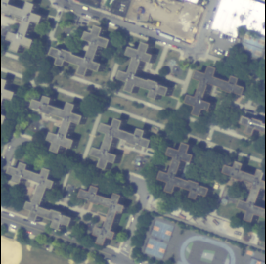
An example image:

Slide 3
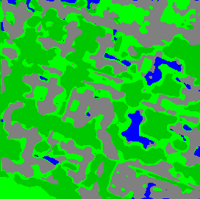
What the Neural Network sees:

Slide 4
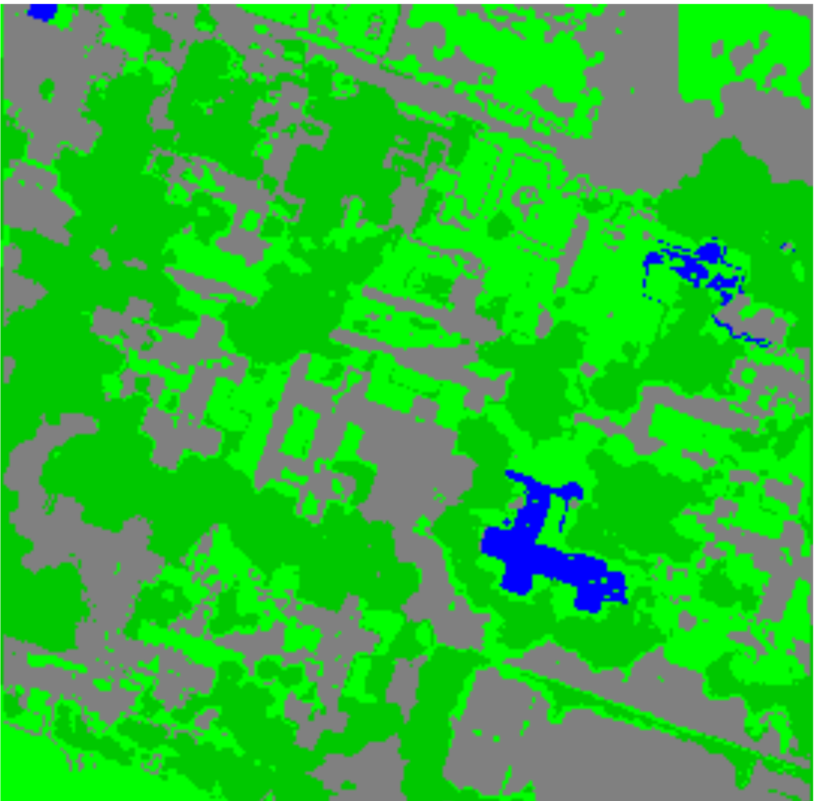
What Clustering Sees:

Slide 5
“Filling in details” (watch animation in presentation mode)

Slide 6
Behind the scenes: “overlap” clustering
Detects regions of similar, local color
Fills in the shapes of buildings, roads, and other logical entities, even when the coloring is not uniform – “tracks” continuous, local changes. As long as there’s no sharp jump in color, pixels will keep getting accumulated as part of the same “cluster” – while, at the boundaries, these colors may be quite different (such that ordinary, color-based clustering would not put them in the same cluster)

Slide 7
Behind the scenes: “overlap” clustering
Cluster itself does not get any classification a priori – was found via an unsupervised method, so cluster identities have no other semantics to them
All pixels within a cluster will get assigned the same class. To determine a cluster’s class:
look at all its pixels, and ask what class the neural network predicted there.
Take a “vote” among pixels, asking what class the neural network predicted most within the cluster
Provides a “paint by numbers” for the neural network to operate inside of
This gives semantics to the clusters where there was none, using the neural net’s fuzzy predictions
But, keeps the final predictions “hard” and sensible.
Reigns in the neural network’s continuous, free-form predictions. Leverages the NN’s “creativity”, while imposing some kind of structure – using geometric understanding that NNs otherwise struggle with

