Slide 1
GW

Slide 2
LZD Detection
NG
OK
STBY
TMSS LZD Color Sign

Slide 3
GW

Slide 4
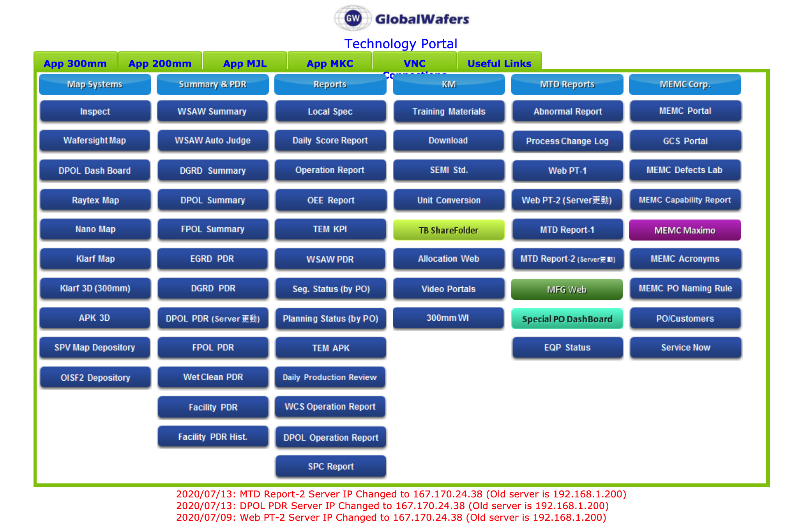
TMSS AI

Slide 5
TMSS_Web
index.html
styles
scripts
img
puller
wsaw
update.sh
website css script
website javascript
puller_img
Puller LZD HTML
Wiresaw Prediction HTMLs
apache_restart.sh
wsaw_img
log
WSAW_HPM
gw_image.pptx
wsaw_img_intro
cvx_log
WSAW_CM
wsaw_ncu
other images

Slide 6
Web
index.html
styles
scripts
img
A
B
update.sh
A.css
A.js
A_img
A.HTML
B.HTML
apache_restart.sh
B.css
B.js
B_img
A_1_log
B_1_log
Other bash scripts
..._css
..._js
..._img
A_2_log
B_2_log
other images
CSS
JavaScript
Images
A Results
B Results

