Slide 1
GW

Slide 2
LZD Detection
NG
OK
STBY
TMSS LZD Color Sign

Slide 3
GW

Slide 4
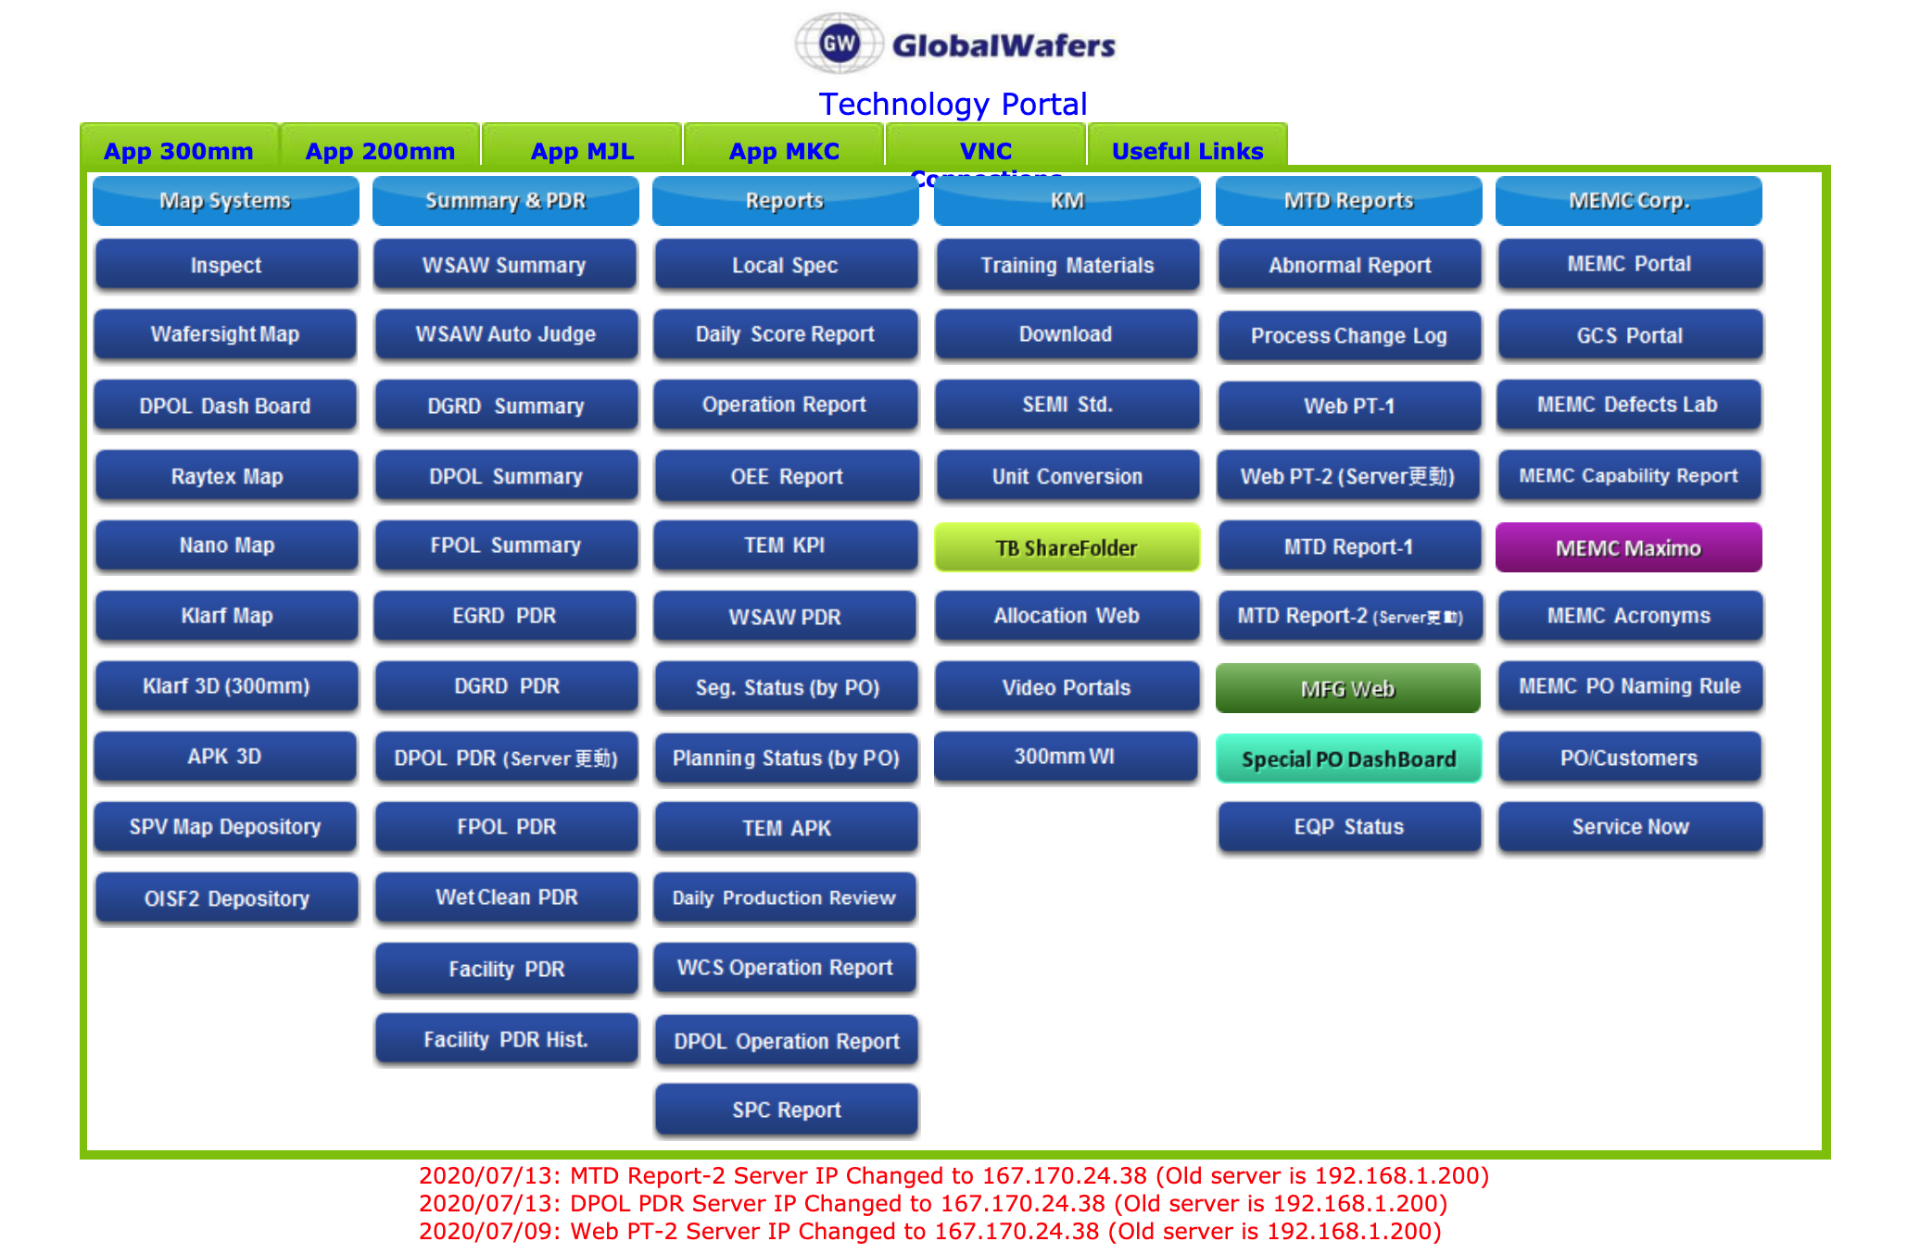
TMSS AI

