Slide 1
AI Agents in Science
From reading one paper to building a persistent research collaborator
https://bit.ly/ai-science-agents

Slide 2
Why this matters now
Agents have the capability to accelerate many tasks in science, if used correctly
Papers
Code & Data
Decisions & Judgment
Reading, extracting claims, and keeping up with a moving literature
Notebooks, plots, data cleaning, and analyses that should be reproducible
What to trust, what to test next, and when a human must stay in the loop

Slide 3
Why this matters now
Agents have the capability to accelerate many tasks in science, if used correctly
Papers
Code & Data
Decisions & Judgment
Reading, extracting claims, and keeping up with a moving literature
Notebooks, plots, data cleaning, and analyses that should be reproducible
What to trust, what to test next, and when a human must stay in the loop
Quick poll: who already uses AI in their research every week?

Slide 4
Goals of this workshop
Build a clear mental model for when AI/chat/copilots/agents/workflows are actually useful
Learn a practical framework for deciding what should be automated vs what should stay human
See concrete, realistic examples of these systems in scientific/research workflows
Understand the guardrails, validation checks, and failure modes needed to use them responsibly
Leave with portable takeaways you can apply immediately in your own work

Slide 5
State of agents in science today
Agents are useful when scientific work is variable but verifiable.
Pipelines
Handle repetition: fixed steps, predictable inputs, the same checks every run.
Agents
Handle bounded variation: choosing next steps around reliable, verifiable tools.

Slide 6
Basic terminology
LLM — the model that generates text based on a prediction of the next word
Context — the information currently available to the model (prompt, docs, history, retrieved material)
Tool — an external capability the model can call (search, code execution, database query, API)
Agent — an LLM + context + tools + a loop for taking and checking actions
Pipeline — a fixed sequence of steps that runs the same way each time

Slide 7
What is an agent?
An agent is an LLM running in a loop with access to tools (functions that DO something)
Environment
Agent Context/State
Agent Harness
System + User Prompt
Tool listing
LLM
Skills
Environment State
Tool functions

Slide 8
What is an agent?
An agent is an LLM running in a loop with access to tools (functions that DO something)
Environment
Agent Context/State
Agent Harness
System + User Prompt
Tool listing
sent to model
LLM
Skills
Environment State
Tool functions

Slide 9
What is an agent?
An agent is an LLM running in a loop with access to tools (functions that DO something)
Environment
Agent Context/State
Agent Harness
System + User Prompt
Tool listing
sent to model
LLM
Skills
Model emits tool calls
Environment State
Tool functions
ToolRequest(tool[‘params’])

Slide 10
What is an agent?
An agent is an LLM running in a loop with access to tools (functions that DO something)
Environment
Agent Context/State
Agent Harness
System + User Prompt
Tool listing
sent to model
LLM
Tool Result
New Obs.
Skills
Observation 1
Model emits tool calls
Environment State
Tool functions
Actions
ToolRequest(tool[‘params’])

Slide 11
What is an agent?
An agent is an LLM running in a loop with access to tools (functions that DO something)
Environment
Agent Context/State
Agent Harness
System + User Prompt
Tool listing
sent to model
LLM
Tool Result
New Obs.
Skills
Observation 1
Observation 2
Model emits tool calls
Environment State
Tool functions
Actions
ToolRequest(tool[‘params’])

Slide 12
What is an agent?
An agent is an LLM running in a loop with access to tools (functions that DO something)
Environment
Agent Context/State
Agent Harness
System + User Prompt
Tool listing
sent to model
LLM
Tool Result
New Obs.
Skills
Observation 1
Observation 2
Model emits tool calls
Environment State
Observation 3
Tool functions
Actions
ToolRequest(tool[‘params’])

Slide 13
A spectrum of agentic behavior
Chat
AI responds
Copilot
AI assists in the loop
Autonomous agent
AI acts by itself, towards a goal
Take action and initiative
Human involvement/control

Slide 14
A spectrum of agentic behavior
Chat
AI responds
Copilot
AI assists in the loop
Autonomous agent
AI acts by itself, towards a goal
Take action and initiative
Human involvement/control
Many tools can be used in various modes, these describe not only how a system is built,
but also how you use it

Slide 15

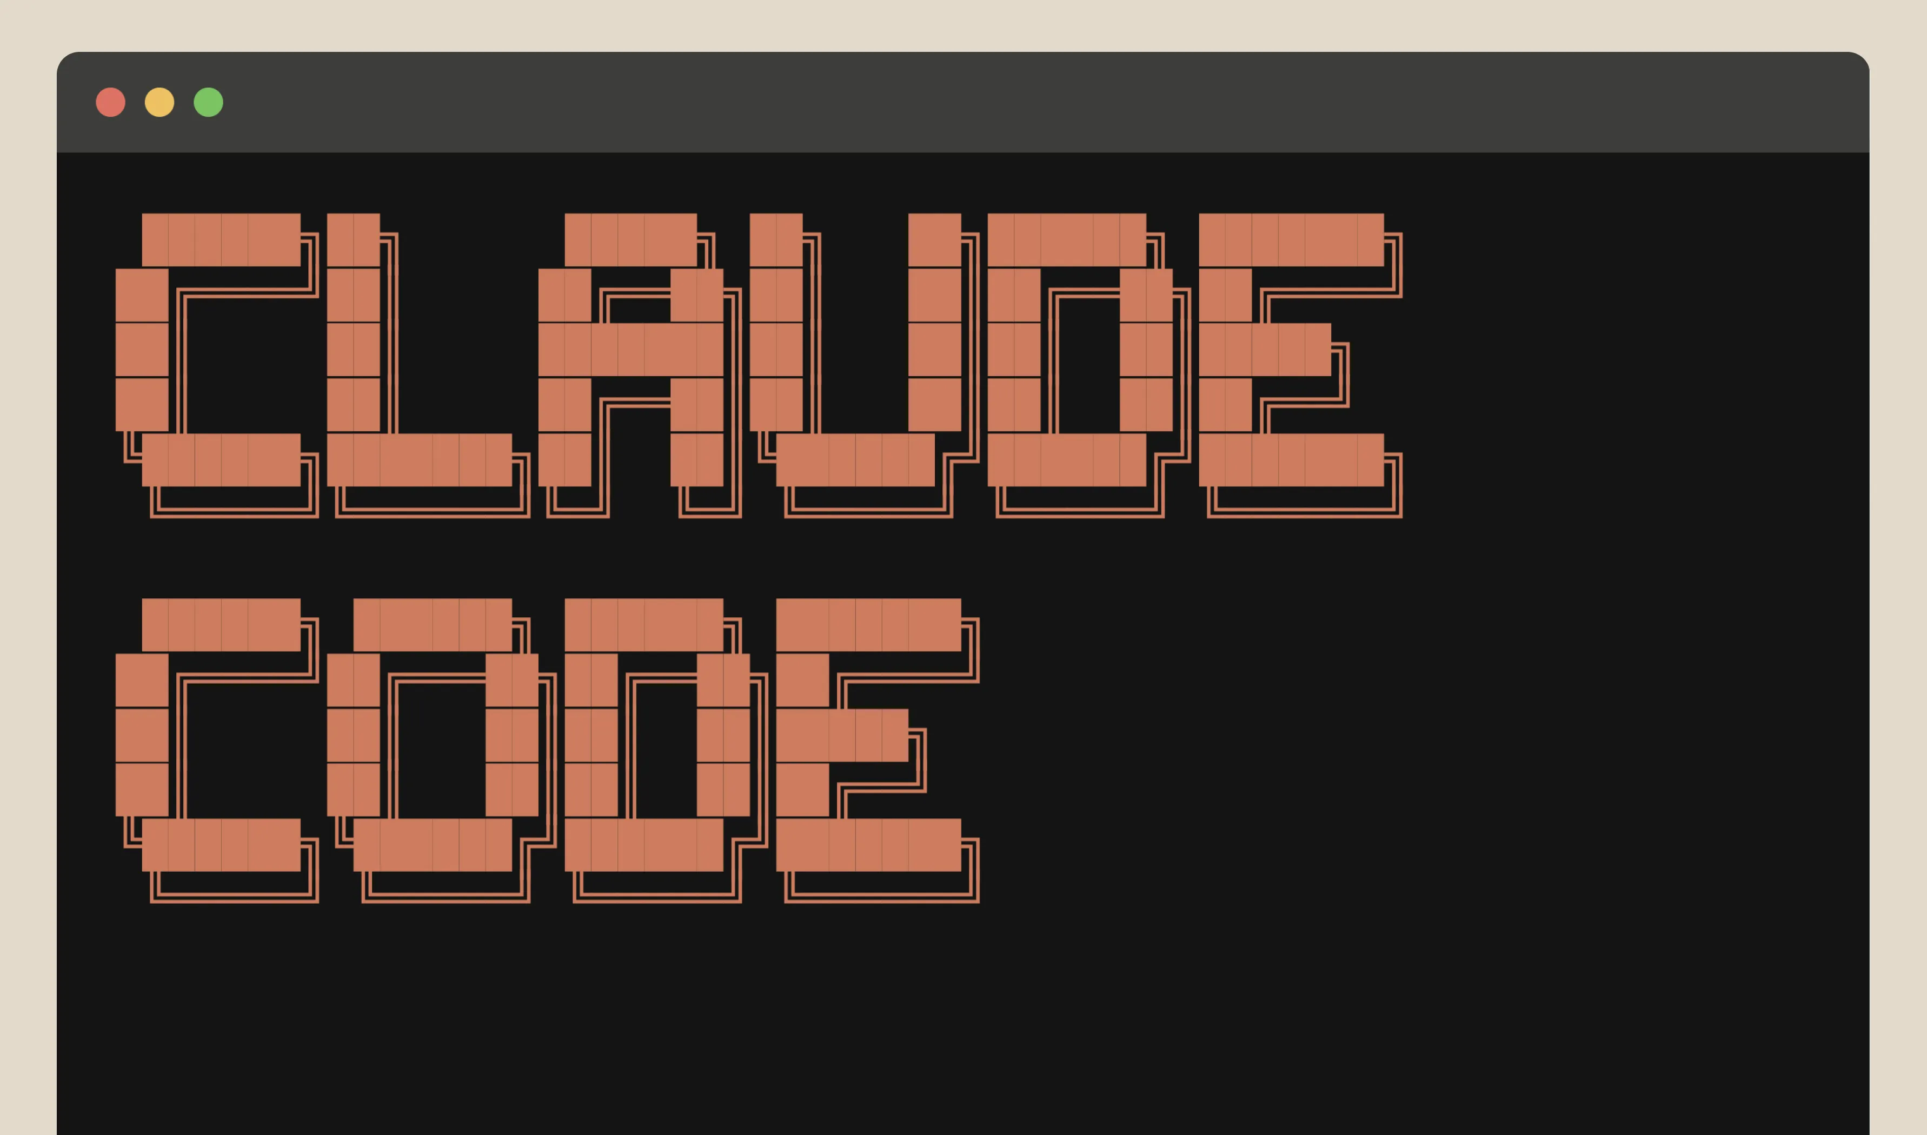
A spectrum of agentic behavior
Chat
AI responds
Copilot
AI assists in the loop
Autonomous agent
AI acts by itself, towards a goal
Take action and initiative
Human involvement/control
Many tools can be used in various modes, these describe not only how a system is built,
but also how you use it

Slide 16
A spectrum of agentic behavior
Chat
AI responds
Copilot
AI assists in the loop
Autonomous agent
AI acts by itself, towards a goal
Take action and initiative
Human involvement/control
Many tools can be used in various modes, these describe not only how a system is built,
but also how you use it

Slide 17
How do I decide what to use for my task?
Easy to verify
Input variation
Low variation
High variation
Hard to verify
Ease of verification

Slide 18
How do I decide what to use for my task?
Easy to verify
pipelines!
Input variation
Low variation
High variation
Hard to verify
Ease of verification

Slide 19
How do I decide what to use for my task?
Easy to verify
pipelines!
Input variation
Low variation
High variation
copilots
Hard to verify
Ease of verification

Slide 20
How do I decide what to use for my task?
Easy to verify
pipelines!
autonomous
agents
Input variation
Low variation
High variation
copilots
Hard to verify
Ease of verification

Slide 21
How do I decide what to use for my task?
Easy to verify
pipelines!
autonomous
agents
Input variation
Low variation
High variation
human judgement
+ templates
copilots
Hard to verify
Ease of verification

Slide 22
How do I decide what to use for my task?
Easy to verify
routine assay analysis
standard QC reports
pipelines!
autonomous
agents
Input variation
Low variation
High variation
human judgement
+ templates
copilots
Hard to verify
Ease of verification

Slide 23
How do I decide what to use for my task?
Easy to verify
routine assay analysis
standard QC reports
pipelines!
autonomous
agents
Summarizing papers
Input variation
Low variation
High variation
human judgement
+ templates
copilots
Hard to verify
Ease of verification

Slide 24
How do I decide what to use for my task?
Easy to verify
routine assay analysis
Reading and summarizing
emails in a text to you
standard QC reports
pipelines!
autonomous
agents
Summarizing papers
Input variation
Low variation
High variation
human judgement
+ templates
copilots
Reading and responding to emails
Hard to verify
Ease of verification

Slide 25
How do I decide what to use for my task?
Easy to verify
routine assay analysis
Reading and summarizing
emails in a text to you
standard QC reports
pipelines!
autonomous
agents
Summarizing papers
Input variation
Low variation
High variation
Design a new analysis strategy or pipeline
human judgement
+ templates
copilots
Interpreting surprising results
Reading and responding to emails
Hard to verify
Ease of verification

Slide 26
How do I decide what to use for my task?
Easy to verify
routine assay analysis
Reading and summarizing
emails in a text to you
standard QC reports
pipelines!
autonomous
agents
Summarizing papers
Input variation
Low variation
High variation
Design a new analysis strategy or pipeline
human judgement
+ templates
copilots
Interpreting surprising results
Reading and responding to emails
Reviewing a manuscript
Hard to verify
Ease of verification

Slide 27
Demo: How do I match the tool(s) to the task?
Ask these seven questions about every workflow, this is the mental model to take home.
Inputs
What goes in?
Agent needs
What must it be able to do?
Tools / access
What can it touch?
Artifact
What appears at the end?
Failure Modes
What does going wrong look like?
Check
How do we verify it?
Escalation
When does a human take over?

Slide 28
Demo framing
Stepping from reading a paper to having autonomous agents surface new work
Read
Contextualize
Decompose + Analyze
Monitor
Adapt
Task: Mine research, learn my preferences, extend published work
Task: Read and summarize a paper
Task: Read and summarize a paper in context to field
Task: Decompose paper claims and analyze validity
Task: Continually monitor for new research in an area
Chat
AI responds
Copilot
AI assists in the loop
Autonomous agent
AI acts by itself, towards a goal
Take action and initiative
Human involvement/control

Slide 29
Demo 1 — Read
Goal: Have an LLM read a new paper and summarize its findings
Inputs
What goes in?
Paper, instructions on output
Agent needs
What must it be able to do?
Read the paper, write text
Surface: Claude (chat)
Other options: ChatGPT,
Gemini, list goes on and on
Tools / access
What can it touch?
The paper
Artifact
What appears at the end?
Structured readout
Failure Modes
What does going wrong look like?
Overclaiming, misreading, fake-generic limitations.
Check
How do we verify it?
Citations to particular lines
Escalation
When does a human take over?
At the next turn

Slide 30
Demo 2 — Contextualize
New capability: tool use (content retrieval via MCP server)
Goal: Place the paper in its wider scientific context
Inputs
What goes in?
The paper + literature retrieval
Agent needs
What must it be able to do?
Search, compare, cite related work
Surface: Claude Cowork + Paperclip
Other options: NotebookLM, Elicit, PaperQA/Edison Lit, etc.
Tools / access
What can it touch?
Web + literature search
Artifact
What appears at the end?
Context memo with citations
Failure Modes
What does going wrong look like?
False novelty, invented context
Check
How do we verify it?
Citations resolve to real papers
Escalation
When does a human take over?
Before repeating novelty claims

Slide 31

Tool use: local tools & MCP servers
New concept: tools — local & via MCP
Goal: give the agent hands: actions through tools, with artifacts you can inspect
Agent (LLM + loop)
Local tools
MCP servers or APIs
Run where the model runs — your machine or a sandbox
Code execution, file read / write, local search
e.g. run Python on a CSV, grep a repo, edit files
One standard protocol to external systems
Databases, lab notebooks, literature APIs, Drive, Slack
The agent discovers each server's tools when it connects
Almost all AI tools have a marketplace of these, many run remotely!
https://paperclip.gxl.ai/

Slide 32
Demo 3 — Decompose + Traceable Analysis
New capability: code execution (traceable analysis), multi-agent for task specification
Goal: Break down claims, and analyze them with respect to public data, are there any discrepancies or agreements?
Inputs
What goes in?
The paper + its data and code
Agent needs
What must it be able to do?
Read paper, extract claims, analyze data,
audit results, write report
Tools / access
What can it touch?
Code running, public data
Artifact
What appears at the end?
Cited report, traceable analysis and code
Failure Modes
What does going wrong look like?
Convincing prose, no traceability
Check
How do we verify it?
Conclusions trace to cells, figures
Escalation
When does a human take over?
After the report is written

Slide 33
Demo 3 — Decompose + Traceable Analysis
New capability: code execution (traceable analysis), multi-agent for task specification
Goal: Break down claims, and analyze them with respect to public data, are there any discrepancies or agreements?
Inputs
The paper + its data and code
Well suited to subagents 1. Paper reader/claim extraction
2. Data analysis agents to verify
3. Auditor to check data analysis
4. Report writer to synthesize
Agent needs
Read paper, extract claims, analyze data,
audit results, write report
Tools / access
Code running, public data
Connectors/MCPs!!
Artifact
Cited report, traceable analysis and code
Use tool with this built in, or build into prompt
Failure Modes
Convincing prose, no traceability
Check
Conclusions trace to cells, figures
Surface: Claude Science
Other options: Claude Code, Codex, Cursor, Kosmos, Biomni, K-Dense, etc.
Escalation
After the report is written
Notes:
Claude Science thigns to point out 1. Open a project and define 2. Show connectors and customization 3. Show specialists – these are subagents, show them how to make them, but then we already have preconfigured ones. 4. Okay open session, paste prompt, let it rip, show them up to plan. Then move to done agent 5. Show initial plan 6. Show claim card 7. subagents, esp analysis 8. show auditor 9. show final synthesis 10. show cool thing is artifacts are traceable, show notebook and provenance. This can easily be extended to many other surfaces! What happens if a subagent doesn’t know how to do the type of analysis you want? Introduce skills…. And we will get into details in a sec

Slide 34
Demo 3 — Decompose + Traceable Analysis
New capability: code execution (traceable analysis), multi-agent for task specification
Goal: Break down claims, and analyze them with respect to public data, are there any discrepancies or agreements?
A subagent is a specialist the main agent delegates to — it runs in its own context window and returns only a summary.
analysis-auditor.md
Context isolation — noisy intermediate output stays inside the subagent, so the main thread keeps only the decisions.
---
name: analysis-auditor
description: verify conclusions trace to data
tools: [Read, Bash]
model: inherit
---
You are a skeptical reviewer.
For each conclusion, cite the
cell or dataset behind it.
Specialization — each subagent gets a narrow prompt, its own tool allowlist, and sometimes its own model.
Separation of duties — the agent that runs the analysis isn't the one that audits it — that independence makes the check meaningful.
Notes:
Claude Science thigns to point out 1. Open a project and define 2. Show connectors and customization 3. Show specialists – these are subagents, show them how to make them, but then we already have preconfigured ones. 4. Okay open session, paste prompt, let it rip, show them up to plan. Then move to done agent 5. Show initial plan 6. Show claim card 7. subagents, esp analysis 8. show auditor 9. show final synthesis 10. show cool thing is artifacts are traceable, show notebook and provenance. This can easily be extended to many other surfaces! What happens if a subagent doesn’t know how to do the type of analysis you want? Introduce skills…. And we will get into details in a sec

Slide 35
Demo 4 — Monitor with a Reusable Routine
New capability: routines (runs on its own), interacts with external DBs/surfaces, skills
Goal: We really liked this paper, lets get updated when similar things get published
Inputs
What goes in?
New papers from feeds, daily
Agent needs
What must it be able to do?
Filter, rank, dedupe, explain
Surface: Claude Code (routines)
Other options: Codex Automations, Cursor, many…
Tools / access
What can it touch?
Feeds + repo of skills, rubrics
Artifact
What appears at the end?
A digest: shortlist with reasons.
Ideally in a place I look at - Notion
Failure Modes
What does going wrong look like?
Noisy confidence, duplicates
Check
How do we verify it?
Deduped, selective, legible
Escalation
When does a human take over?
Human reads before acting on it
Notes:
1. Why agent and not pipeline, look at #2! We all know feeling of google scholar garbage 2. How do we ensure that the agent looks for what we want, and fitlers/presents them appropriately. We can write skills for any agent to use to tell it HOW to do this! 3.

Slide 36
Demo 4 — Monitor with a Reusable Routine
New capability: routines (runs on its own), interacts with external DBs/surfaces, skills
Goal: We really liked this paper, lets get updated when similar things get published
A skill is a reusable guide to a task, workflow, or tool.
SKILL.md
Frontmatter — the YAML block up top. Agent reads only the name and description to decide when to trigger this skill.
---
name: nmr-peak-annotator
description: assign peaks in a proton NMR spectrum
---
## Instructions
1. Match each shift to a group
2. Flag ambiguous peaks
→ references/shift-table.md
→ references/coupling-consts.md
Instructions — the markdown body below it — step-by-step guidance agent follows once the skill is loaded.
Reference docs — authoritative shift and coupling-constant tables the model reads instead of recalling from memory, keeping every assignment exact.
Notes:
1. Why agent and not pipeline, look at #2! We all know feeling of google scholar garbage 2. How do we ensure that the agent looks for what we want, and fitlers/presents them appropriately. We can write skills for any agent to use to tell it HOW to do this! 3.

Slide 37
Demo 5 — Adapt with Memory
New capability: memory (learns your preferences)
Goal: A routine repeats; a collaborator remembers and adapts
Inputs
What goes in?
Digests + my feedback over time
Agent needs
What must it be able to do?
Store, recall, apply preferences
Surface: Hermes
Other options: Claude Tag, Kosmos 2, OpenClaw
Tools / access
What can it touch?
Memory + the monitoring routine
Artifact
What appears at the end?
Before/after shortlist, reasons
Failure Modes
What does going wrong look like?
Decorative memory, no change
Check
How do we verify it?
Feedback visibly changes output
Escalation
When does a human take over?
When preferences conflict or drift
Notes:
Hermes is a top level orchestrator that is persistent and durable.
It has memory, skills, state, tool use, subagents, and more
It has ability to interact with you across many surfaces, and can pull in context from many places
It generates memory, skills and tasks on demand, and uses your feedback to improve skills to make later tasks easier.

Slide 38
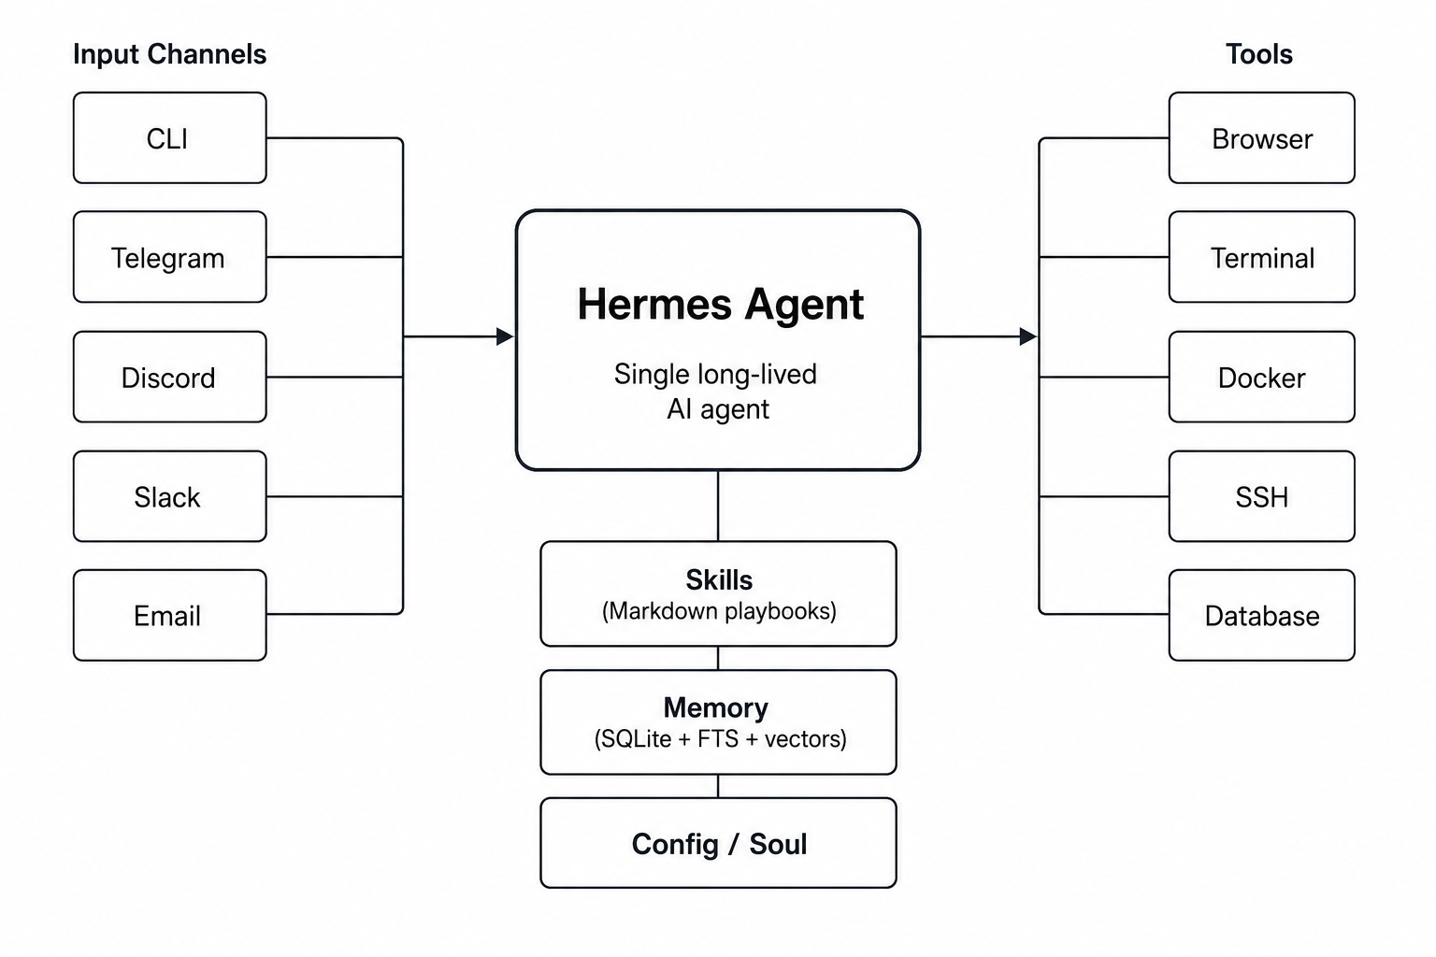
Demo 5 — Adapt with Memory
New capability: memory (learns your preferences)
Goal: A routine repeats; a collaborator remembers and adapts
https://medium.com/data-science-collective/what-is-hermes-agent-and-why-its-better-than-openclaw-for-personal-ai-workflows-d59d83436ad2
Notes:
Hermes is a top level orchestrator that is persistent and durable.
It has memory, skills, state, tool use, subagents, and more
It has ability to interact with you across many surfaces, and can pull in context from many places
It generates memory, skills and tasks on demand, and uses your feedback to improve skills to make later tasks easier.

Slide 39
Overview
Demo 1 — Read
Basics of AI chatbots
Demo 2 — Contextualize
Retrieval-grounded context: tool use, MCP servers, external access
Demo 3 — Decompose + Analyze
Specialization + traceable analysis: provenance from claim to evidence (subagents)
Demo 4 — Monitor
Reusable routines: a stable workflow becomes a packaged, versioned asset (via skills)
Demo 5 — Adapt
Memory + adaptation: feedback visibly changes future behavior (memory)

Slide 40
Your turn: design one agent workflow
Pick one recurring task in your scientific life that is variable but verifiable — then sketch it through the lens.
Inputs
Agent needs
Tools / access
Artifact
Failure Modes
Check
Escalation
Need inspiration? The room asked for these: data cleaning, plotting pipelines, repetitive analysis, reproducible analytics, literature triage, documentation.
Pair up or work alone: three minutes to sketch the seven boxes for your task.

Slide 41
Same capabilities, different tool surfaces
Capability you need | What we used | Equivalents you might also use
Reader | Claude (chat) | ChatGPT, Gemini, any strong chat model (open source!)
Retrieval workspace | Claude Cowork | NotebookLM, Elicit, PaperQA2/Edison Lit, etc.
Analysis workbench | Claude Science | Claude Code, Codex, Cursor, Kosmos, Biomni/Phylo, KDense
Routine execution | Claude Code routines | Scripts + scheduler, GitHub Actions, Cursor Cloud Agents, Codex Automations, Kosmos 2
Persistent agent | Hermes | OpenClaw, Kosmos 2, Claude Tag, Gemini Enterprise Agents, custom agent systems, etc.

Slide 42
AI agents are useful in science when they turn variable scientific work into inspectable workflows.
Thank you — questions?
Blake Lash
blakelash@gmail.com
Twitter: @blake_lash / LinkedIn

