Slide 1
Agents in Science
From reading one paper to building a persistent research collaborator

Slide 2
Why this matters now
Agents have the capability to accelerate many tasks in science, if used correctly
Papers
Code & Data
Decisions & Judgment
Reading, extracting claims, and keeping up with a moving literature
Notebooks, plots, data cleaning, and analyses that should be reproducible
What to trust, what to test next, and when a human must stay in the loop

Slide 3
Why this matters now
Agents have the capability to accelerate many tasks in science, if used correctly
Papers
Code & Data
Decisions & Judgment
Reading, extracting claims, and keeping up with a moving literature
Notebooks, plots, data cleaning, and analyses that should be reproducible
What to trust, what to test next, and when a human must stay in the loop
Quick poll: who already uses AI in their research every week?

Slide 4
Goals of this workshop
Build a clear mental model for when AI/chat/copilots/agents/workflows are actually useful
Learn a practical framework for deciding what should be automated vs what should stay human
See concrete, realistic examples of these systems in scientific/research workflows
Understand the guardrails, validation checks, and failure modes needed to use them responsibly
Leave with portable takeaways you can apply immediately in your own work
NOT GOALS: How do I prompt agents, what is the best AI tool (answer: depends!)

Slide 5
State of agents in science today
Agents are useful when scientific work is variable but verifiable.
Pipelines
Handle repetition: fixed steps, predictable inputs, the same checks every run.
Agents
Handle bounded variation: choosing next steps around reliable, verifiable tools.

Slide 6
Basic terminology
LLM — the model that generates text based on a prediction of the next word
Context — the information currently available to the model (prompt, docs, history, retrieved material)
Tool — an external capability the model can call (search, code execution, database query, API)
Agent — an LLM + context + tools + a loop for taking and checking actions
Pipeline — a fixed sequence of steps that runs the same way each time

Slide 7
What is an agent?
An agent is an LLM running in a loop with access to tools (functions that DO something)
Environment
Agent Context/State
Agent Harness
System + User Prompt
Tool listing
LLM
Skills
Environment State
Tool functions

Slide 8
What is an agent?
An agent is an LLM running in a loop with access to tools (functions that DO something)
Environment
Agent Context/State
Agent Harness
System + User Prompt
Tool listing
sent to model
LLM
Skills
Environment State
Tool functions

Slide 9
What is an agent?
An agent is an LLM running in a loop with access to tools (functions that DO something)
Environment
Agent Context/State
Agent Harness
System + User Prompt
Tool listing
sent to model
LLM
Skills
Model emits tool calls
Environment State
Tool functions
ToolRequest(tool[‘params’])

Slide 10
What is an agent?
An agent is an LLM running in a loop with access to tools (functions that DO something)
Environment
Agent Context/State
Agent Harness
System + User Prompt
Tool listing
sent to model
LLM
Tool Result
New Obs.
Skills
Observation 1
Model emits tool calls
Environment State
Tool functions
Actions
ToolRequest(tool[‘params’])

Slide 11
What is an agent?
An agent is an LLM running in a loop with access to tools (functions that DO something)
Environment
Agent Context/State
Agent Harness
System + User Prompt
Tool listing
sent to model
LLM
Tool Result
New Obs.
Skills
Observation 1
Observation 2
Model emits tool calls
Environment State
Tool functions
Actions
ToolRequest(tool[‘params’])

Slide 12
What is an agent?
An agent is an LLM running in a loop with access to tools (functions that DO something)
Environment
Agent Context/State
Agent Harness
System + User Prompt
Tool listing
sent to model
LLM
Tool Result
New Obs.
Skills
Observation 1
Observation 2
Model emits tool calls
Environment State
Observation 3
Tool functions
Actions
ToolRequest(tool[‘params’])

Slide 13
A spectrum of agentic behavior
Chat
AI responds
Copilot
AI assists in the loop
Autonomous agent
AI acts by itself, towards a goal
Take action and initiative
Human involvement/control

Slide 14
A spectrum of agentic behavior
Chat
AI responds
Copilot
AI assists in the loop
Autonomous agent
AI acts by itself, towards a goal
Take action and initiative
Human involvement/control
Many tools can be used in various modes, these describe not only how a system is built,
but also how you use it

Slide 15

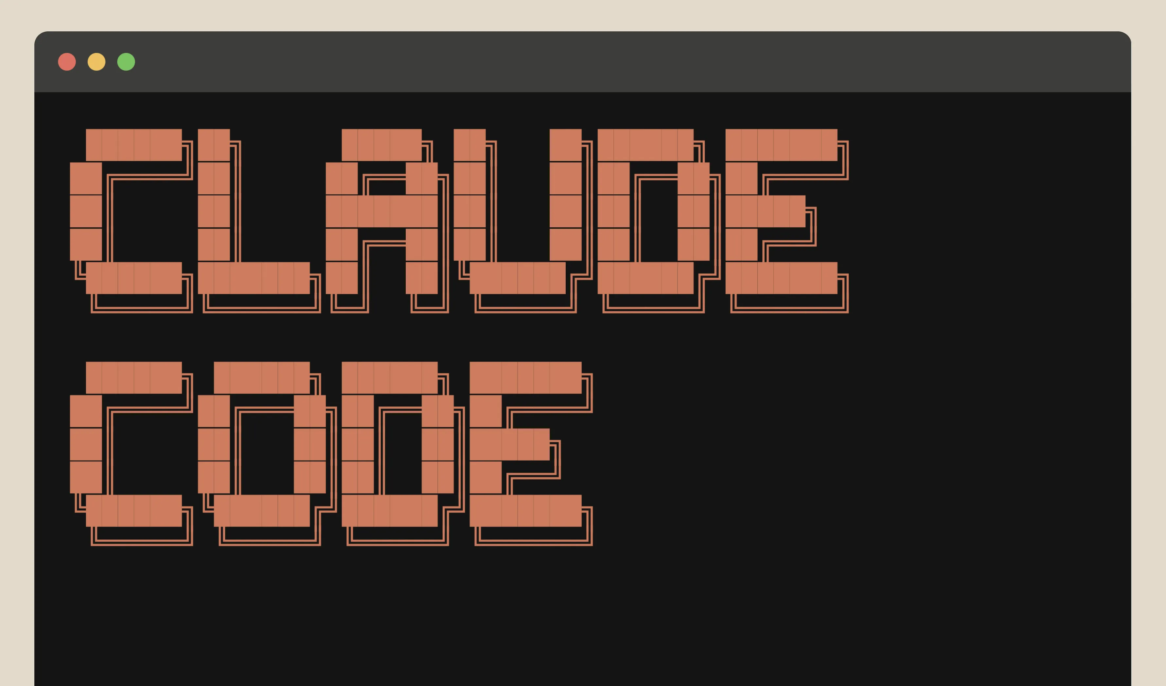
A spectrum of agentic behavior
Chat
AI responds
Copilot
AI assists in the loop
Autonomous agent
AI acts by itself, towards a goal
Take action and initiative
Human involvement/control
Many tools can be used in various modes, these describe not only how a system is built,
but also how you use it

Slide 16
A spectrum of agentic behavior
Chat
AI responds
Copilot
AI assists in the loop
Autonomous agent
AI acts by itself, towards a goal
Take action and initiative
Human involvement/control
Many tools can be used in various modes, these describe not only how a system is built,
but also how you use it

Slide 17
How do I decide what to use for my task?
Easy to verify
Input variation
Low variation
High variation
Hard to verify
Ease of verification

Slide 18
How do I decide what to use for my task?
Easy to verify
pipelines!
Input variation
Low variation
High variation
Hard to verify
Ease of verification

Slide 19
How do I decide what to use for my task?
Easy to verify
pipelines!
Input variation
Low variation
High variation
copilots
Hard to verify
Ease of verification

Slide 20
How do I decide what to use for my task?
Easy to verify
pipelines!
autonomous
agents
Input variation
Low variation
High variation
copilots
Hard to verify
Ease of verification

Slide 21
How do I decide what to use for my task?
Easy to verify
pipelines!
autonomous
agents
Input variation
Low variation
High variation
human judgement
+ templates
copilots
Hard to verify
Ease of verification

Slide 22
How do I decide what to use for my task?
Easy to verify
routine assay analysis
standard QC reports
pipelines!
autonomous
agents
Input variation
Low variation
High variation
human judgement
+ templates
copilots
Hard to verify
Ease of verification

Slide 23
How do I decide what to use for my task?
Easy to verify
routine assay analysis
standard QC reports
pipelines!
autonomous
agents
Summarizing papers
Input variation
Low variation
High variation
human judgement
+ templates
copilots
Hard to verify
Ease of verification

Slide 24
How do I decide what to use for my task?
Easy to verify
routine assay analysis
Reading and summarizing
emails in a text to you
standard QC reports
pipelines!
autonomous
agents
Summarizing papers
Input variation
Low variation
High variation
human judgement
+ templates
copilots
Reading and responding to emails
Hard to verify
Ease of verification

Slide 25
How do I decide what to use for my task?
Easy to verify
routine assay analysis
Reading and summarizing
emails in a text to you
standard QC reports
pipelines!
autonomous
agents
Summarizing papers
Input variation
Low variation
High variation
Design a new analysis strategy or pipeline
human judgement
+ templates
copilots
Interpreting surprising results
Reading and responding to emails
Hard to verify
Ease of verification

Slide 26
How do I decide what to use for my task?
Easy to verify
routine assay analysis
Reading and summarizing
emails in a text to you
standard QC reports
pipelines!
autonomous
agents
Summarizing papers
Input variation
Low variation
High variation
Design a new analysis strategy or pipeline
human judgement
+ templates
copilots
Interpreting surprising results
Reading and responding to emails
Reviewing a manuscript
Hard to verify
Ease of verification

Slide 27
Demo: How do I match the tool(s) to the task?
Ask these seven questions about every workflow, this is the mental model to take home.
Inputs
What goes in?
Agent needs
What must it be able to do?
Tools / access
What can it touch?
Artifact
What appears at the end?
Failure Modes
What does going wrong look like?
Check
How do we verify it?
Escalation
When does a human take over?

Slide 28
Demo framing
Stepping from reading a paper to having autonomous agents surface new work
Read
Contextualize
Decompose + Analyze
Monitor
Adapt
Task: Mine research, learn my preferences, extend published work
Task: Read and summarize a paper
Task: Read and summarize a paper in context to field
Task: Decompose paper claims and analyze validity
Task: Continually monitor for new research in an area
Chat
AI responds
Copilot
AI assists in the loop
Autonomous agent
AI acts by itself, towards a goal
Take action and initiative
Human involvement/control

Slide 29
Demo 1 — Read
Goal: Have an LLM read a new paper and summarize its findings
Inputs
What goes in?
Paper, instructions on output
Agent needs
What must it be able to do?
Read the paper, write text
Surface: Claude (chat)
Other options: ChatGPT,
Gemini, list goes on and on
Tools / access
What can it touch?
The paper
Artifact
What appears at the end?
Structured readout
Failure Modes
What does going wrong look like?
Overclaiming, misreading, fake-generic limitations.
Check
How do we verify it?
Citations to particular lines
Escalation
When does a human take over?
At the next turn

Slide 30
Demo 2 — Contextualize
New capability: tool use (content retrieval via MCP server)
Goal: Place the paper in its wider scientific context
Inputs
What goes in?
The paper + literature retrieval
Agent needs
What must it be able to do?
Search, compare, cite related work
Surface: Claude Cowork + Paperclip
Other options: NotebookLM, Elicit, PaperQA/Edison Lit, etc.
Tools / access
What can it touch?
Web + literature search
Artifact
What appears at the end?
Context memo with citations
Failure Modes
What does going wrong look like?
False novelty, invented context
Check
How do we verify it?
Citations resolve to real papers
Escalation
When does a human take over?
Before repeating novelty claims

Slide 31

Tool use: local tools & MCP servers
New concept: tools — local & via MCP
Goal: give the agent hands: actions through tools, with artifacts you can inspect
Agent (LLM + loop)
Local tools
MCP servers or APIs
Run where the model runs — your machine or a sandbox
Code execution, file read / write, local search
e.g. run Python on a CSV, grep a repo, edit files
One standard protocol to external systems
Databases, lab notebooks, literature APIs, Drive, Slack
The agent discovers each server's tools when it connects
Almost all AI tools have a marketplace of these, many run remotely!
https://paperclip.gxl.ai/

Slide 32
Demo 3 — Decompose + Traceable Analysis
New capability: code execution (traceable analysis), multi-agent for task specification
Goal: Break down claims, and analyze them with respect to public data, are there any discrepancies or agreements?
Inputs
What goes in?
The paper + its data and code
Agent needs
What must it be able to do?
Read paper, extract claims, analyze data,
audit results, write report
Tools / access
What can it touch?
Code running, public data
Artifact
What appears at the end?
Cited report, traceable analysis and code
Failure Modes
What does going wrong look like?
Convincing prose, no traceability
Check
How do we verify it?
Conclusions trace to cells, figures
Escalation
When does a human take over?
After the report is written

Slide 33
Demo 3 — Decompose + Traceable Analysis
New capability: code execution (traceable analysis), multi-agent for task specification
Goal: Break down claims, and analyze them with respect to public data, are there any discrepancies or agreements?
Inputs
The paper + its data and code
Well suited to subagents 1. Paper reader/claim extraction
2. Data analysis agents to verify
3. Auditor to check data analysis
4. Report writer to synthesize
Agent needs
Read paper, extract claims, analyze data,
audit results, write report
Tools / access
Code running, public data
Connectors/MCPs!!
Artifact
Cited report, traceable analysis and code
Use tool with this built in, or build into prompt
Failure Modes
Convincing prose, no traceability
Check
Conclusions trace to cells, figures
Surface: Claude Science
Other options: Claude Code, Codex, Cursor, Kosmos, Biomni, K-Dense, etc.
Escalation
After the report is written

Slide 34
Demo 4 — Monitor with a Reusable Routine
New capability: routines (runs on its own), interacts with external DBs/surfaces, skills
Goal: Package a stable workflow into a reusable monitoring routine
Inputs
What goes in?
New papers from feeds, daily
Agent needs
What must it be able to do?
Filter, rank, dedupe, explain
Surface: Claude Code (routines)
Other options: scripts + scheduler, CI jobs
Tools / access
What can it touch?
Feeds + repo of skills, rubrics
Artifact
What appears at the end?
A digest: shortlist with reasons
Failure Modes
What does going wrong look like?
Noisy confidence, duplicates
Check
How do we verify it?
Deduped, selective, legible
Escalation
When does a human take over?
Human reads before acting on it

Slide 35
Demo 5 — Adapt with Memory
New capability: memory (learns your preferences)
Goal: A routine repeats; a collaborator remembers and adapts
Inputs
What goes in?
Digests + my feedback over time
Agent needs
What must it be able to do?
Store, recall, apply preferences
Surface: Hermes
Other options: orchestration + memory
Tools / access
What can it touch?
Memory + the monitoring routine
Artifact
What appears at the end?
Before/after shortlist, reasons
Failure Modes
What does going wrong look like?
Decorative memory, no change
Check
How do we verify it?
Feedback visibly changes output
Escalation
When does a human take over?
When preferences conflict or drift
Notes:
Hermes is a top level orchestrator that is persistent and durable.
It has memory, skills, state, tool use, subagents, and more
It has ability to interact with you across many surfaces, and can pull in context from many places
It generates memory, skills and tasks on demand, and uses your feedback to improve skills to make later tasks easier.

Slide 36
What the five demos were really teaching
Demo 1 — Read
Comprehension: structured, checkable reading of a single paper
Demo 2 — Contextualize
Retrieval-grounded context: judgment needs the field, not just the paper
Demo 3 — Decompose + Analyze
Specialization + traceable analysis: provenance from claim to evidence
Demo 4 — Monitor
Reusable routines: a stable workflow becomes a packaged, versioned asset
Demo 5 — Adapt
Memory + adaptation: feedback visibly changes future behavior
Ask the room: which of these five capabilities feels immediately useful to your own work?

Slide 37
Your turn: design one agent workflow
Pick one recurring task in your scientific life that is variable but verifiable — then sketch it through the lens.
Inputs
Agent needs
Tools / access
Artifact
Failure Modes
Check
Escalation
Need inspiration? The room asked for these: data cleaning, plotting pipelines, repetitive analysis, reproducible analytics, literature triage, documentation.
Pair up: three minutes to sketch the seven boxes for your task.

Slide 38
What trustworthy agent demos had in common
Inspectable artifacts — every step leaves something you can open and read
External checks — verification against the paper, the data, or a second reviewer
Bounded scope — each agent had a job, not a mission
Visible failure modes — we named what going wrong looks like, out loud
Explicit escalation paths — a human knows exactly when to take over
The anti-hype point: these demos worked because they could be checked — not because the model was clever.

Slide 39
Same capabilities, different tool surfaces
Capability you need | What we used | Equivalents you might also use
Reader | Claude (chat) | ChatGPT, Gemini, any strong chat model (open source!)
Retrieval workspace | Claude Cowork | NotebookLM, Elicit, PaperQA2/Edison Lit, etc.
Analysis workbench | Claude Science | Claude Code, Codex, Cursor, Kosmos, Biomni/Phylo, KDense
Routine execution | Claude Code routines | Scripts + scheduler, GitHub Actions, Cursor Cloud Agents, Codex Automations, Kosmos 2
Persistent agent | Hermes | OpenClaw, Kosmos 2, Claude Managed Agents, Gemini Enterprise Agents, custom agent systems, etc.
Quick check: which equivalent surfaces do you already have access to?

Slide 40
AI agents are useful in science when they turn variable scientific work into inspectable workflows.
Thank you — questions?

