Slide 1


Jump List Forensics
:::::::::::::::::::::::::::::::::::::::::::::::::::::::::::::::
Computer Science Capstone
John Carlson, Hunter Blakely
carlsonj@sou.edu, blakelyh@sou.edu
@Version: 6-13-2013_9:20am
:::::::::::::::::::::::::::::::::::::::::::::::::::::::::::::::

Slide 2
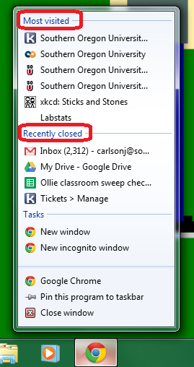

What is a Jumplist file?
Jumplist files are the Windows 7/8 equivalent to the Most Recently Used (MRU) list of applications, and files – used to map user activity.
Each jumplist file name begins with a unique identifier corresponding to a specific application – shown in the above picture, pinned on the windows bar.
Information stored inside of a jumplist file is specific to the corresponding application.
I.E. Internet explorer’s jumplist file would contain information about recently visited websites, uploaded and downloaded files. Microsoft Word’s jumplist would contain information about recently opened word documents.

Slide 3
Jump List File Structure
The file structures utilized in windows jumplists are the MS-CFB and MS-SHELLINK structures.
The MS-CFB is responsible for keeping track of MS-SHELLINK locations within the jumplist.
The MS-SHELLINK streams contain information pertaining to program functions and recent activity.
After parsing the MS-CFB structures it is then possible to parse the MS-SHELLINK data streams – which contain the pertinant data we are after.

Slide 4
Locating Jump Lists
* There are two file locations associated with jump lists in Windows 7. One directory for automatic destinations jump lists, and another directory for custom destinations jump lists.
* Automatic Destinations
- C:\Users\username\AppData\Roaming\Microsoft\Windows\Recent\AutomaticDestinations
* Custom Destinations
- C:\Users\username\AppData\Roaming\Microsoft\Windows\Recent\CustomDestinations

Slide 5
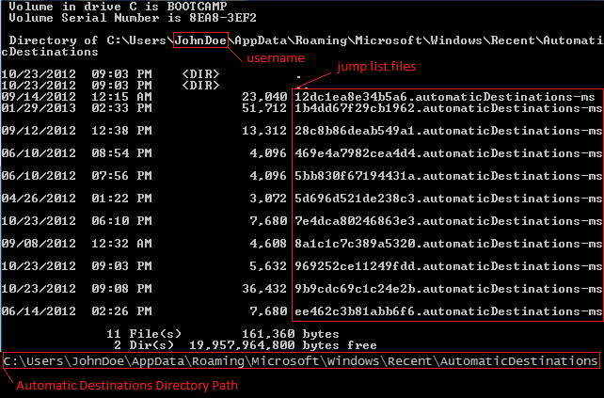
Locating Jump Lists
AutomaticDestinations

Slide 6
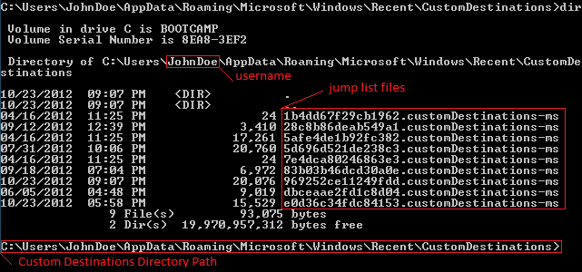
Locating Jump Lists
CustomDestinations

Slide 7
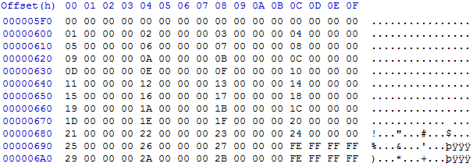


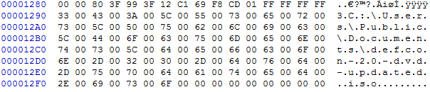
Sample Jump List
Header
etc...
Directory
etc...
Directory
etc...
File
* The above sample output has been snipped.

Slide 8
Useful Information
Data of interest includes – bu is not limited to:
Name of application used
Created Timestamp
Accessed Timestamp
Modified Timestamp
Timestamps are used to create a timeline of user activity.

Slide 9
Forensic Application
* Associate a program with the jump list – using known IDs to enumerate files.
* Parse the MS_SHLLINK files inside of the MS_CFB file to determine recent activity performed with the associated program.

Slide 10
Forensic Application
A forensic analyst can determine many actions of a user on a timeline.
* Is there evidence that the suspect committed a crime?
* Is there evidence that the suspect did not commit a crime?
Based on findings it is possible to supply crucial evidence in court – assisting in proving innocence or guilt to a specific crime.
EXAMPLE: User John Doe searched the Google using Internet Explorer 8 for the term “burning down your house for insurance fraud and getting away with it” three weeks before his house was mysteriously burned to the ground.

Slide 11
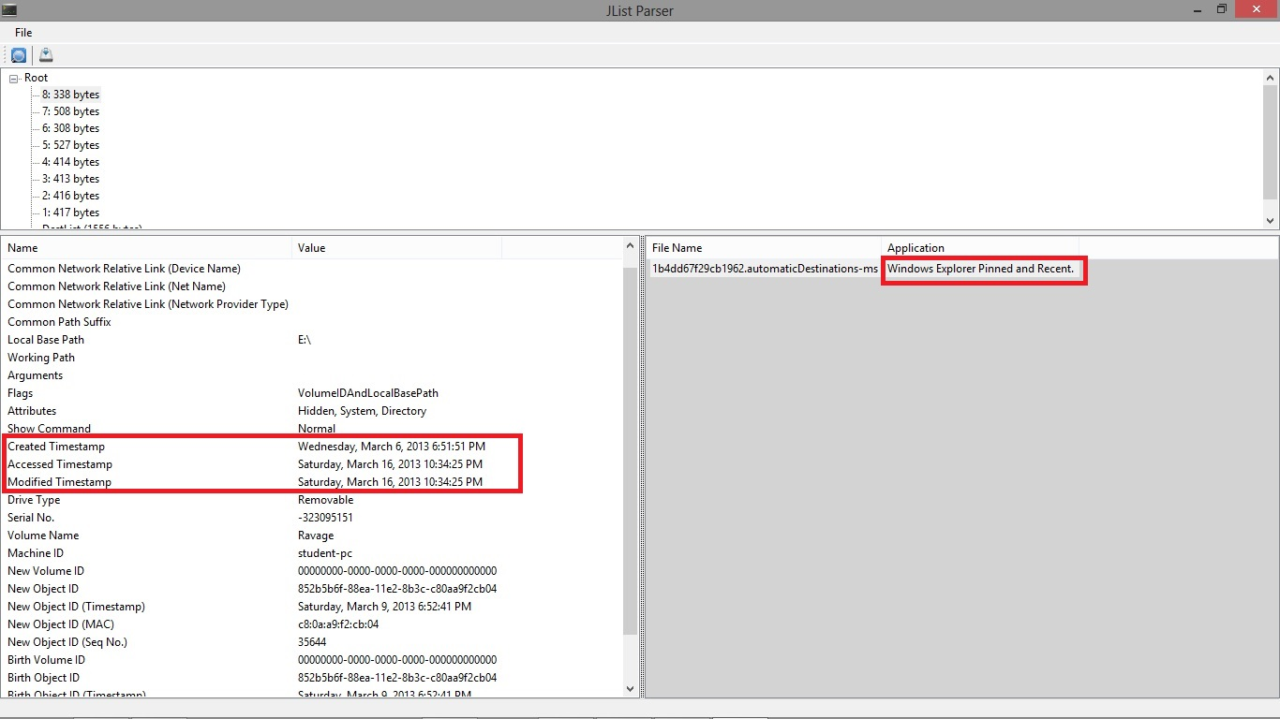
Example

