Slide 1
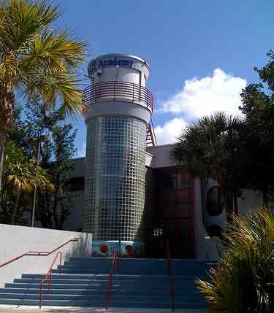

MAST IS NOT
FOR $ALE!

Slide 2
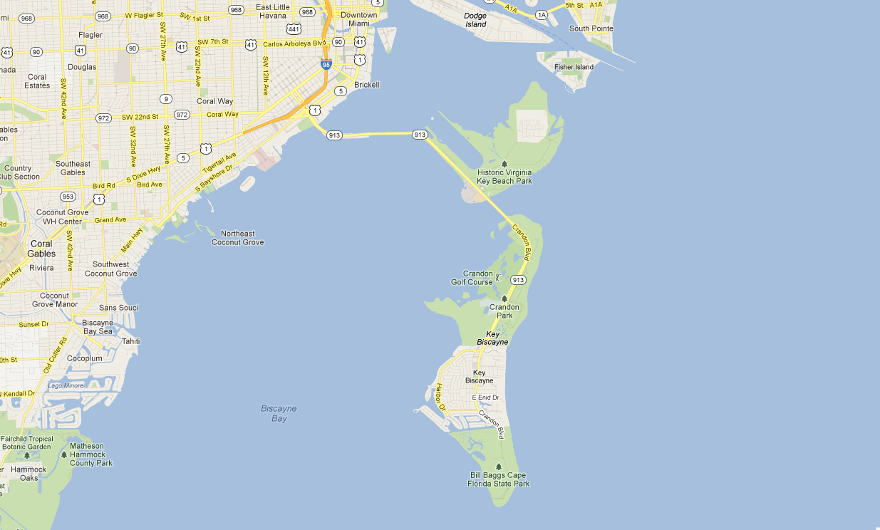
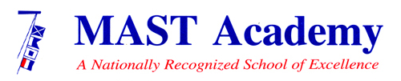

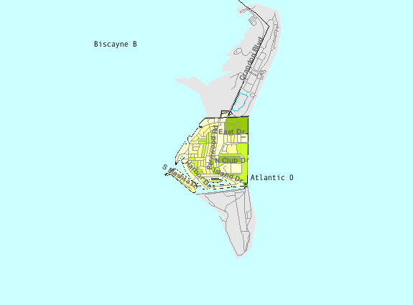

KEY BISCAYNE,
AN OLIGARCHY?

Slide 3
REPUTATIONS ARE EARNED, NOT BOUGHT!

Slide 4
ACADEMIC SEATS SHOULD BE EARNED, NOT BOUGHT!

Slide 5


NO QUEREMOS AMIGOS CON BOTES, QUEREMOS AMIGOS CON INTELIGENCIA.

